Slide 1
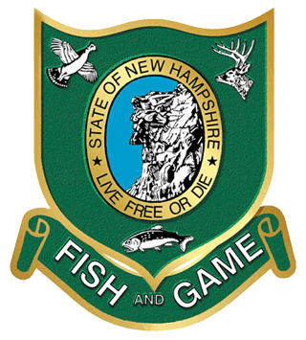
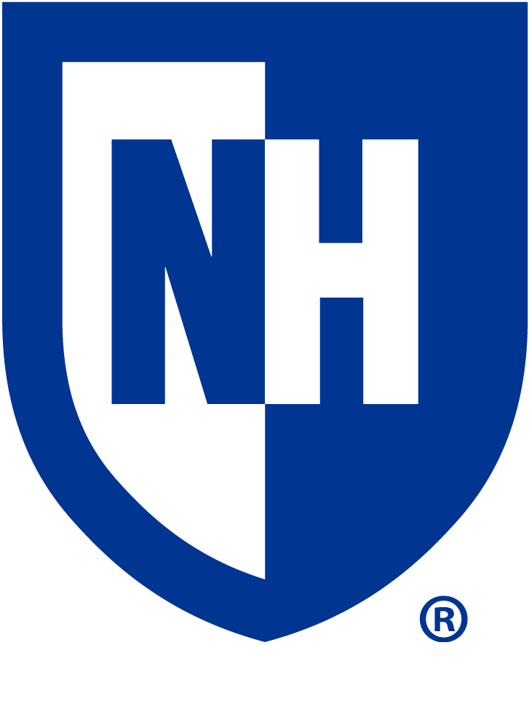
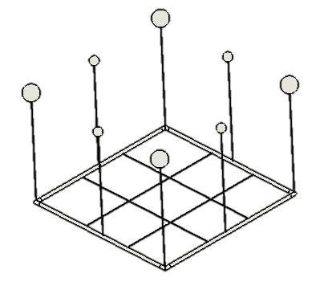
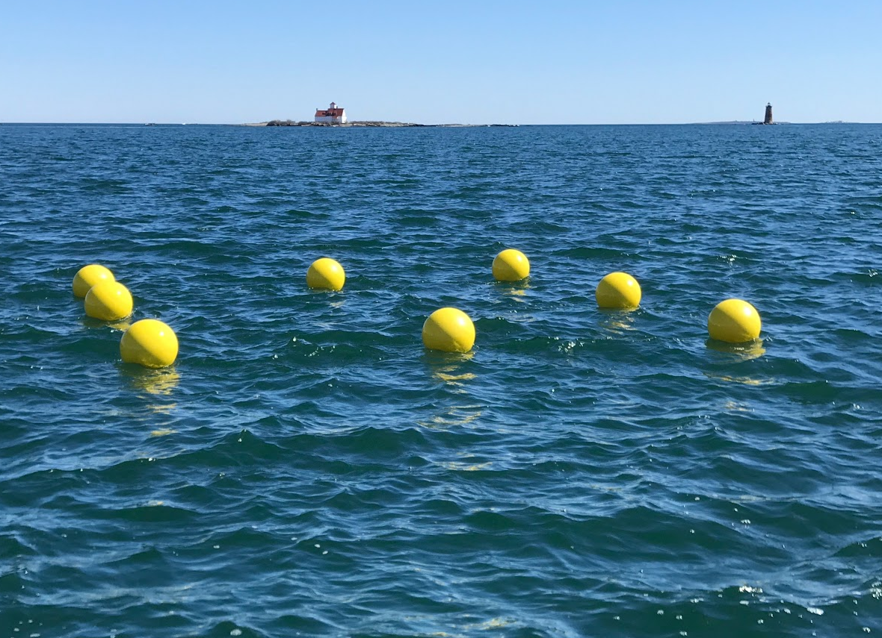
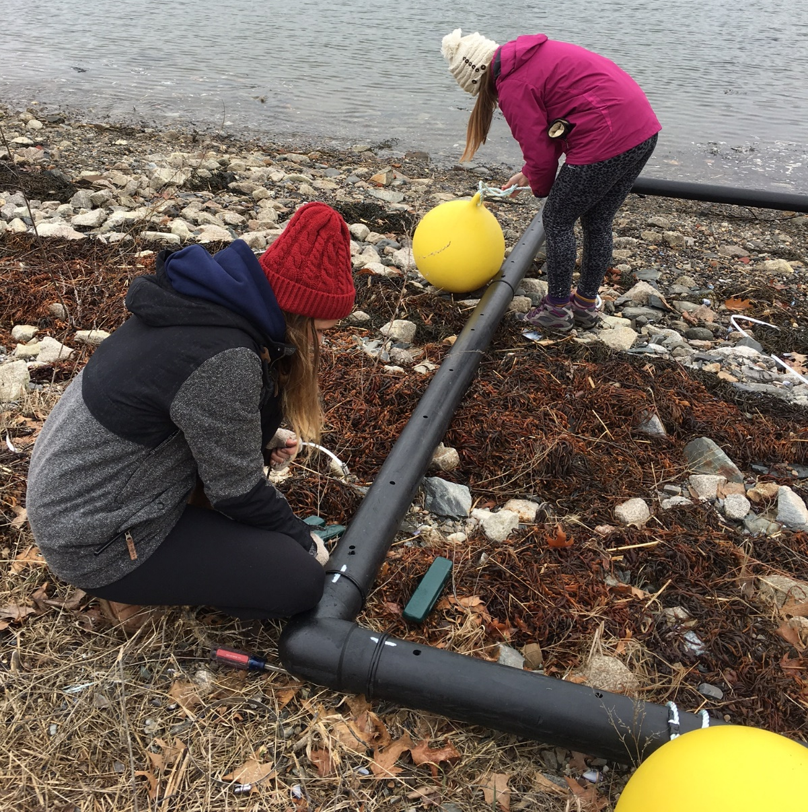
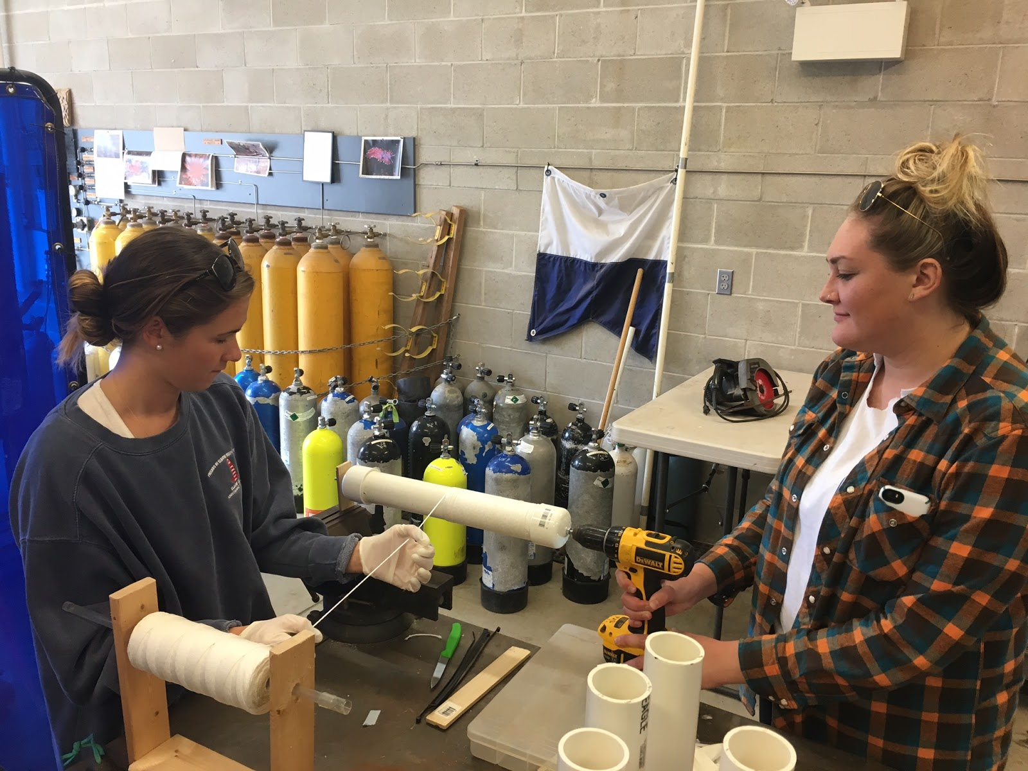
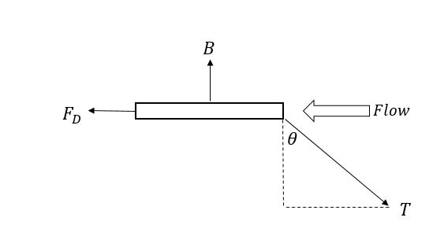
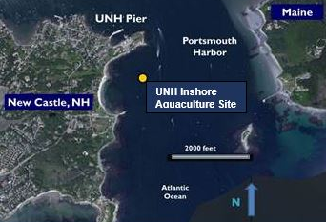
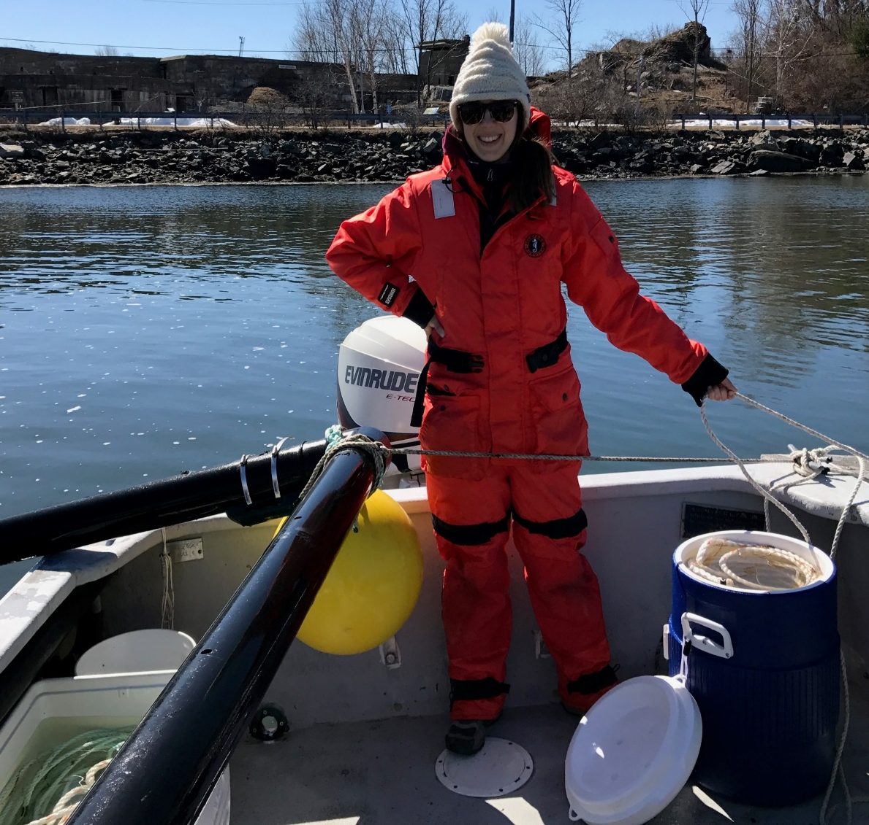
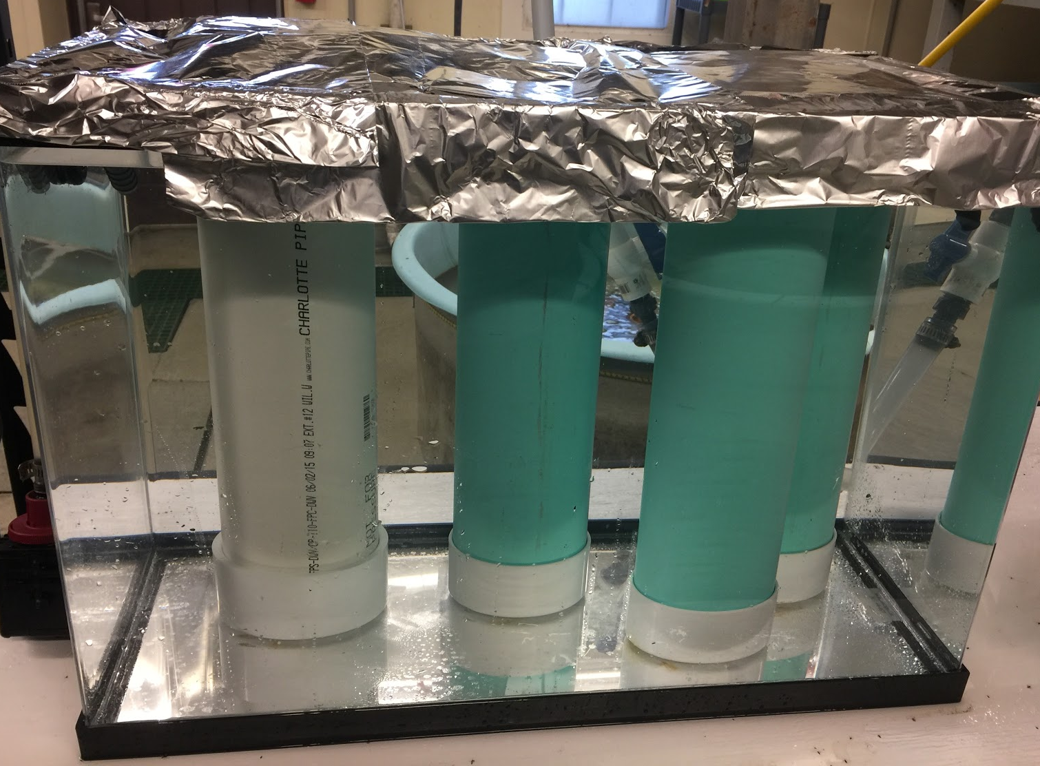
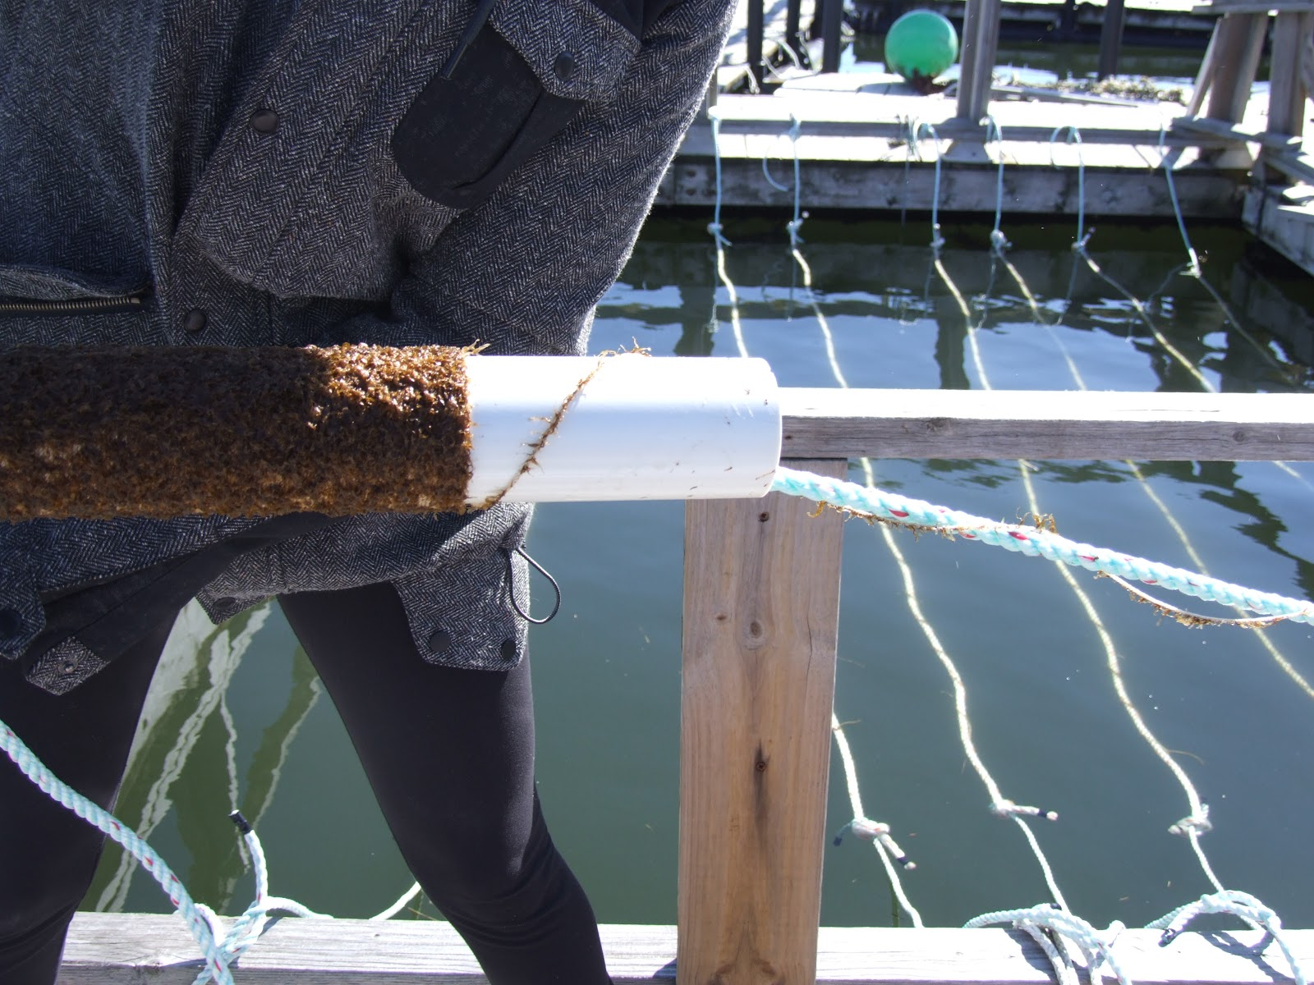
Project S.O.A.K. - Submersible Oceanic Aquaculture of Kelp
Angela Sarni, Megan Savoie, Jamie Barton, Hannah Root
Advisors: Michael Chambers & Rob Swift
Introduction
Biology & Engineering
SOAK is an interdisciplinary project
Goal: grow Sugar Kelp on frame system
Why Kelp?
Health Benefits
Environmental Benefits
Sustainable aquaculture
Fabrication
Cut & transport pipes to site
Fused pipes into frame
Drilled holes in pipes
Assembled mooring system
Deployment
Project Design
Design Considerations
Withstand forces during coastal storms
Convenience when submerging & raising
Efficiency growing kelp in a reduced area
Site Conditions
$u≈0.6 m/s$ Flood tide velocity
$u≈0.15 m/s$ Ebb tide velocity (back eddy)
$T_{avg}≈5 s$ January 2016 Storm ‘Jonas’
$H_{max}≈1.6 m$ January 2016 Storm ‘Jonas’
$u≈0.60 m/s$ Max velocity - river current
$u≈0.43 m/s$ Max particle velocity - waves
$u_{T}=1.03 m/s$ Total velocity
$F_{D}=6300N$ Resulting drag force
$T=6577N$ Tension in mooring lines
$B=1890N$ Buoyancy
Biology
Materials:
2 Nursery Tanks
PVC Pipe
Twine
LED lighting system
PES nutrients
3/24 - Snowstorm
Seeded lines
Deployed mooring system
3/28 - Cloudy
Attached weights & buoys on beach
Towed frame off beach
Tied frame to raft in bay temporarily
3/30 - Sunny
Towed frame to site
Attached pre-seeded lines
Attached frame to mooring
Seeded remaining lines
Methods
Collect mature sorus tissue
Spawn & transfer to PVC
12 hour light cycle
Weekly nutrients, 4 weeks
Continue growth in ocean
Transfer from spools to frame
$$F_{D}=ρC_{D}A_{p}u^{2}$$
$$u_{max}=\frac{HgT cosh⁡(k\left(h+z\right))}{2L cosh⁡(kh)}$$
Conclusion
Cohesive interdisciplinary team
End goal accomplished
Nature can dictate timeline
Kelp growth monitored
Future work prospects
Acknowledgements: This work is the result of research sponsored in part by the New Hampshire Sea Grant College Program through NOAA grant #NA10OAR4170082,and the UNH Marine Program.

