Slide 1
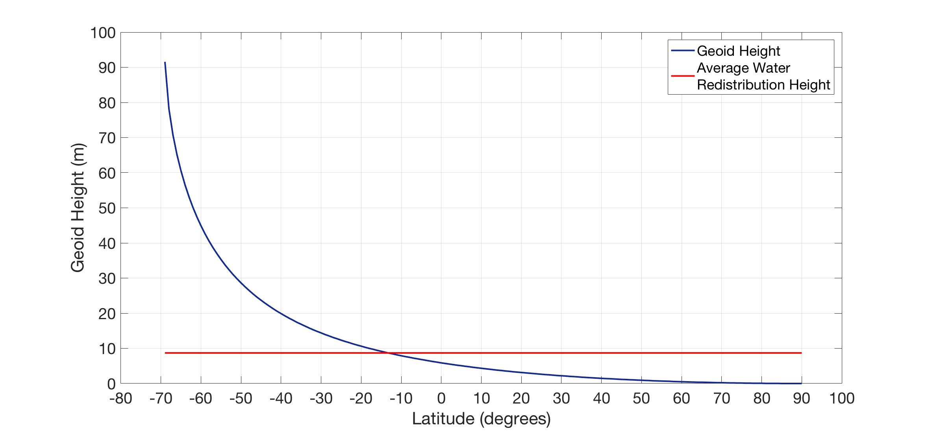
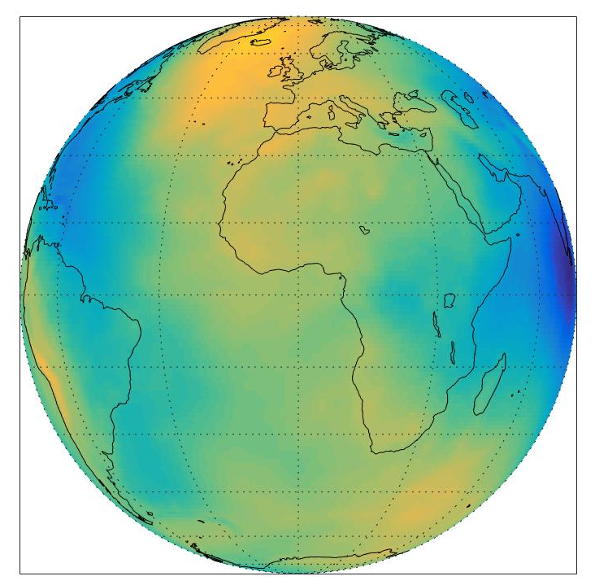
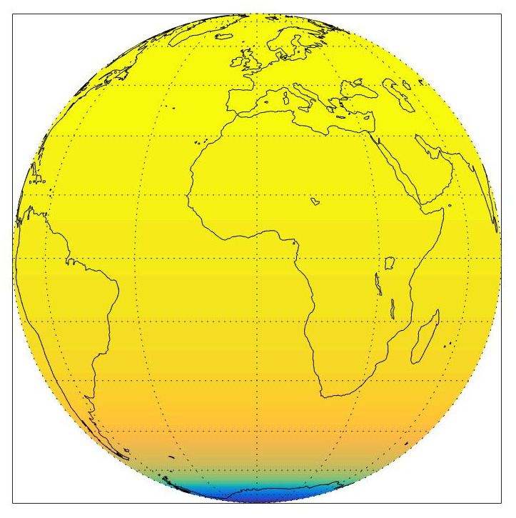
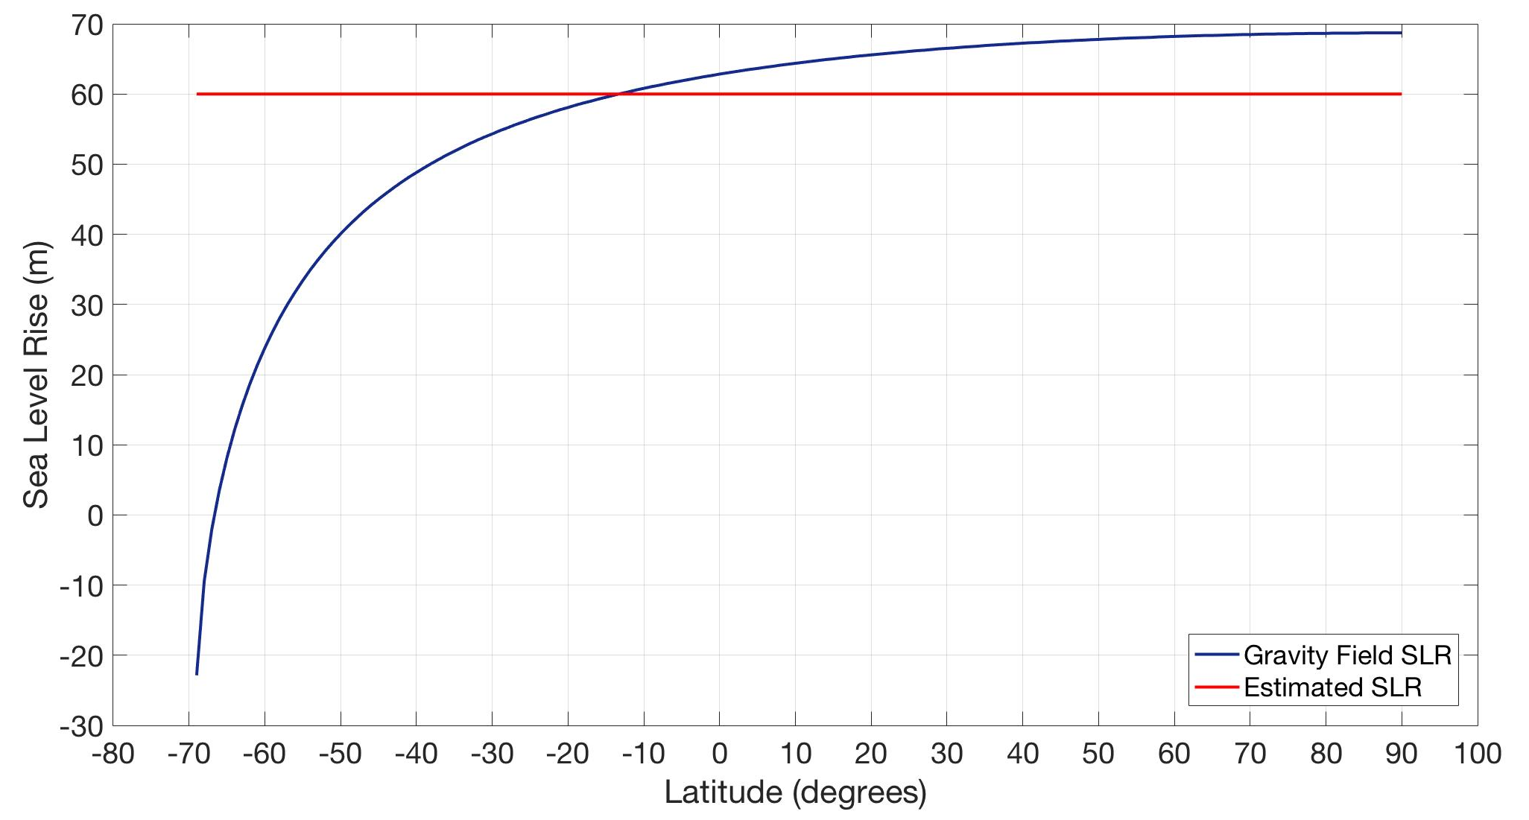
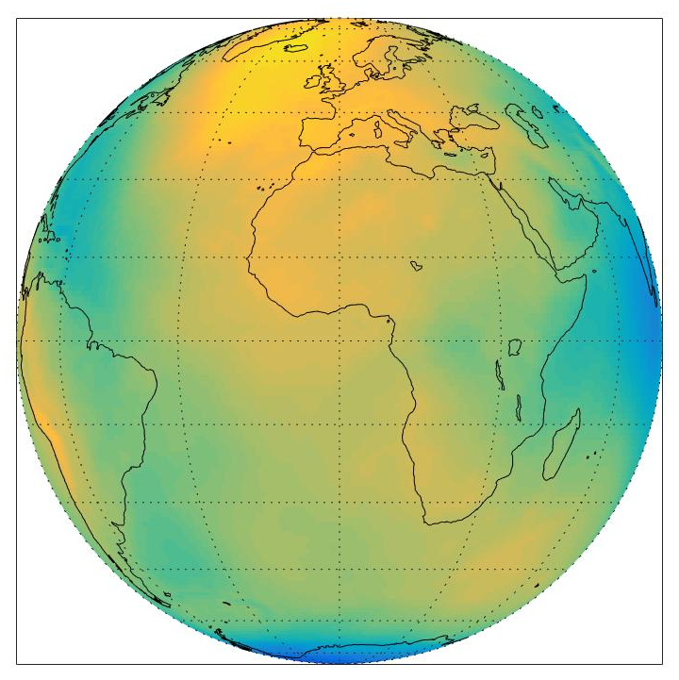
Analyzing Sea Level Rise Due to Melting of Antarctic Ice
and Dispersion of Sea Water from Mass Redistribution
Tessa Gorte
Department of Physics, University of New Hampshire
Introduction
Methods
Results and Analysis
Conclusions
Aspects of climate dynamics like sea level rise (SLR) will have profound impacts on coastlines worldwide. While the primary effect of SLR due to ice melt has been studied extensively, it is also important to study secondary factors such as change in Earth’s gravity field due to mass redistribution. Per Newtonian physics, massive objects experience gravitational attraction. Liquid water, which is mobile, will adjust to changes in the gravitational field caused by Antarctic ice melt.
The Antarctic ice mass accumulates a large bulge of water that, when the ice melts, will redistribute according to the new geoid. Because the water was mostly accumulated south of the equator, the redistribution will most adversely affect the northern hemisphere.
The data from the GRACE satellite is most easily represented in spherical harmonics. The gravity field can be recreated from the spherical harmonics using
where r_{E} is the radius of the Earth, 𝛿_{mn} is the Kronecker delta, P_{lm} is the associated Legendre polynomials, and C_{lm} and S_{lm} are the spherical harmonic coefficients.
I removed the l=2 harmonic as that overwhelms the higher harmonics of the geoid (l=2 is due to the earth being an oblate spheroid).
As a first simplification, Antarctica is approximated as a spherical cap centered around the South Pole with an angular width of 40 degrees. I subtracted the Antarctic ice cap from the gravity field by calculating the potential caused by a negative mass at 1 degree increments in latitude along a single line of longitude, then added the resulting potential to the existing potential, which is possible in this case due to the axial symmetry. I then rotated that single line of longitude around 360 degrees to get the total gravity field for the Earth caused by the ice melt.
Adding the two gravity fields together created a new gravity field that represented that of the entire planet sans the Antarctic ice cap, i.e. as though the ice cap had vanished entirely. By renormalizing the gravity fields to obtain the geoids, I was able to calculate the volume of water in the bulge around Antarctica. I then recalculated the potential gravity field to find the SLR relative to the average estimate of 60 m.
Using the negative mass geoid (Figure 2), I calculated the total volume of water that was bulging solely due to Antarctic ice – about 2.225e15 m³. That water evenly distributed over the oceans amounts to approximately 8.71 m in SLR which is about 14.51% of the total estimated SLR from complete melting of the Antarctic ice cap¹.
Because the bulge around Antarctica will redistribute around the Earth, latitudes below 13 degrees south would see less than the estimated 60 m SLR while latitudes north of 13 degrees south will see more.
It is also important to note, however, that latitudes south of 68 degrees south will see an overall drop in sea level. As this only accounts for 2 degrees in latitude because of the assumption of a spherically symmetric Antarctica, this drop in sea level is negligible.
Under the assumption of a spherically symmetric, uniform density idealized Antarctica, the redistribution of water due to geoidal changes from Antarctic ice melt will cause latitudes south of 13 degrees south to see less than the predicted 60 m of SLR and latitudes north of 13 degrees south to see more.
$$N\left(θ,φ\right)=r_{E}\sum_{l=0}^{n}{\sum_{m=0}^{l}{\left(\frac{\left(2−δ_{m0}\right)\left(2l+1\right)\left(l−m\right)!}{\left(l+m\right)!}\right)}}P_{lm}\left(\cos{θ}\right)\left(C_{lm}\cos\left(mθ\right)+S_{lm}\sin\left(mθ\right)\right)$$
Geoids
References
Figure 1 The current geoid according to data collected by the GRACE satellite.
Figure 4 The change in geoid height plotted versus the latitude along a single line of longitude (blue) shows the bulge of water created by the gravitational attraction to the ice mass. The red line indicates the average amount of SLR due to the redistribution of the water from the bulge.
1 Bamber J., and R. Riva. 2010. The sea level fingerprint of recent ice mass fluxes. The Cryosphere 4: 621-627.
Figure 2 The geoid created solely by a large negative mass centered on the South Pole with an angular width of 40 degrees which roughly corresponds to the average latitude of the Antarctic coast.
Future
Future additions and changes to the project would include making a more realistic Antarctica. This entails creating a code that more accurately matches Antarctica’s coastlines as well as creating a map that better corresponds to the locations of the Antarctic ice sheets for non-uniform melting. Additionally, future simulations should allow for more realistic levels of melting in different sections of Antarctica.
Figure 5 The SLR caused by Antarctic ice melt and the redistribution of the water in the bulge cause by gravitational attraction to Antarctic ice most adversely affects latitudes north of 13 degrees south. Latitudes south of 68 degrees south would see an overall drop in sea level.
Acknowledgements
Figure 3 The resultant geoid after subtracting the mass of Antarctica.
My thesis advisor, David Mattingly, and co-advisor, Cameron Wake, helped me to create a tractable problem with real-world impacts as well as assisted in writing the code and thesis. If you have any questions, please contact Tessa Gorte at tmi65@wildcats.unh.edu.

