Slide 1
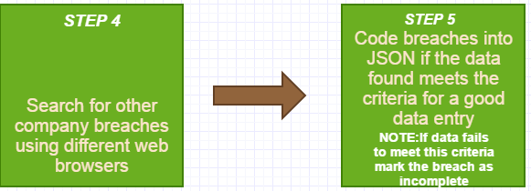
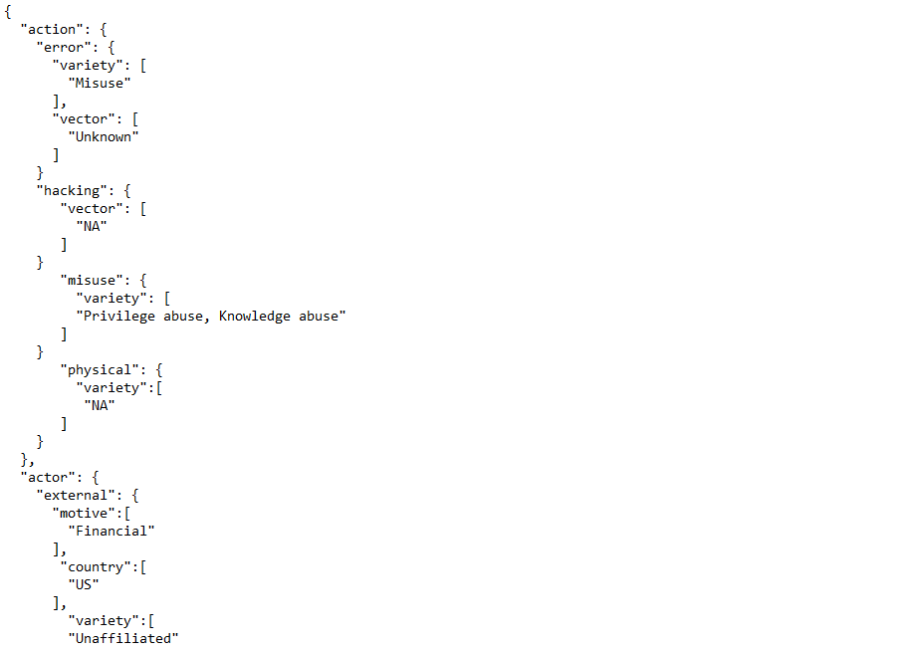
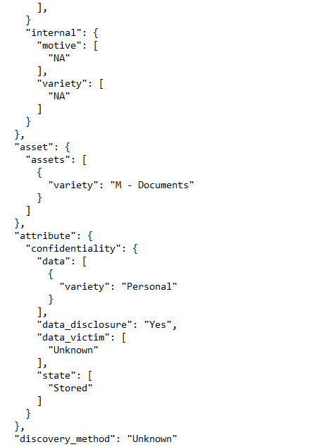
Public Data Breaches for the Fortune 1000 between 2005-2017 Andrew Ciesielski & Kristen Anderson CEPS, University of New Hampshire, Durham, NH 03824
Introduction
Public Data Breach Fortune 1000 Database Plan
Results
Data Breach: an incident where sensitive, protected, or confidential data has been viewed, stolen or used by an unauthorized individual; this concept is the core of our research into the Fortune 1000 (or F1000) companies. With technology being such an integral part of our society thanks to its usefulness in storing information and allowing communication worldwide, companies prioritize protection of their systems and the information they store; this is not always achieved though, since security is bypassed in multiple ways. No unrestricted raw dataset is currently available for download on security incidents that is able to support community research and decision-making. Reasons for focusing on the F1000 as the subject of our research:
Reasonably accurate representation of all other companies as a sample - the companies within represent various fields at varying degrees of overall income.
Helps to determine patterns found in industries susceptible to leaks in order to better combat data breaches .
Database Language Used
Future Data Analysis
Due to the vast amount of breaches that occur every year it would be impossible to complete all data entries this semester. This semester there will be around 400 entries in the database completed, all from the top 50 companies on the fortune 1000 list from 2016. Once the semester is over, Liberty Mutual will take over the process and procedures created by the project to fill in the entire database with relevant data breaches and ultimately develop knowledge of the different industries these businesses work in and the types of breaches these companies are susceptible to.
Methodology
Charts
Conclusions
Before performing research, steps had to be taken in order to ensure research was being performed in an efficient manner; these steps are as follows:
Defining a search procedure,
Select a framework to notate our research.
Veris selected due to ease of use and consistent organization of data.
Designed to support decision making.
Select a format to place research into
We simply asked ourselves what we wanted VERIS for, and prioritized the elements it has pre-defined. Here are some uses we had with VERIS:
An analysis of fields was included, displaying fields most often used by other organizations to decide what fields we would use.
Defining the Action (what was done to cause/contribute to the incident) of an event
Defining the Actor (who caused the incident), Asset (assets compromised), Attribute(security attributes compromised), source id, timeline, summary, and notes of an event.
Search Procedure Flowchart
The fortune 1000 data breach database will give Liberty Mutual a better understanding of the security they are trying to provide their members with, as well as a better form of trust and understanding of the forms of data breaches members should be aware of. Once the fortune 1000 data breach database provides the knowledge of breaches that are taking place in certain industries, these industries can take measures of protecting themselves from these data breaches. This database is different from others because it has a more specific focus on the top 1000 companies instead of including smaller inequivalent company’s breaches, giving a better snapshot of what the most common breaches are.
sTAMD Simulations
Acknowledgements
Figures
JSON format
Sponsor: Stephen Patton - Information Security at Liberty Mutual
VCDB Format
Search Procedure
Formatting the research was performed using JSON, or "Javascript Object Notation“. Aspects of JSON include:
Compact notation that is easy for people to read and write.
Easy for machines to parse and generate.
Less cumbersome than the column and row design of excel sheets.
The amount of research required for this project was deemed to be 10 breaches per team member on a weekly basis, with the overall goal of fully coding ~200 breaches by the end of the academic year.
References
VCDB database
ITRC
Databreaches.netiv
Privacy Rights Clearinghouse
The ID Theft Center
Breach Level Index
HHS Office of Civil Rights
An example of a coded breach
Example of coded breach continued

