Slide 1


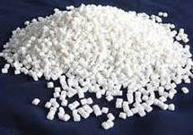
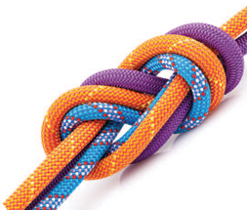
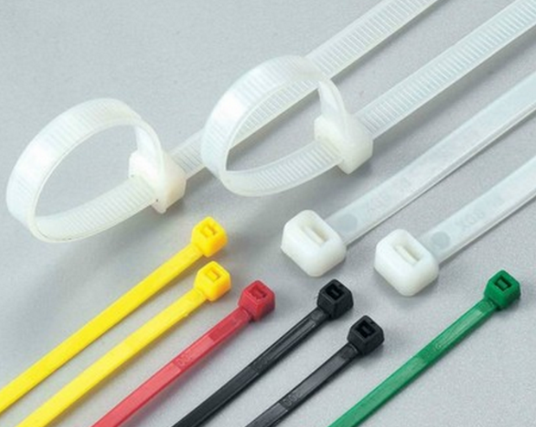
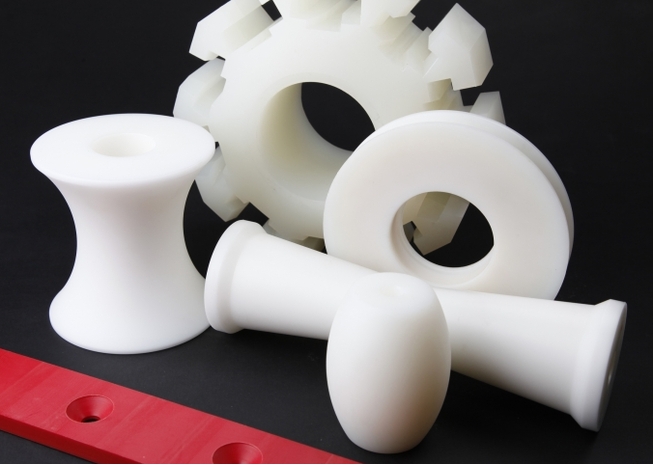
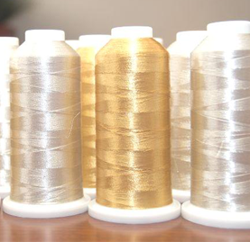


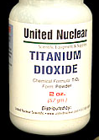
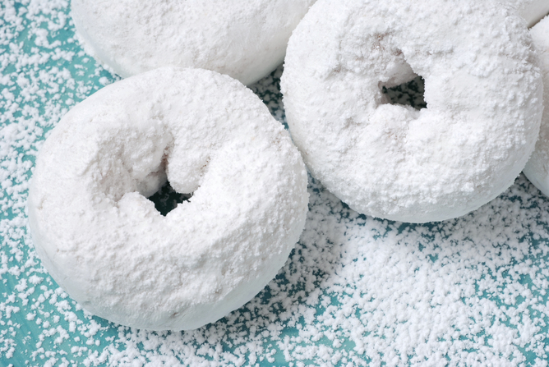

Semi-batch Processing of Nylon 66 Chips
Ryan Doherty, Meissy Fakhoury, Madeline Frattaroli, Abby Koczera
Chemical Engineering, University of New Hampshire, Durham, NH 03824
NYLONGING
for
GRADUATION
Introduction
Process Flow Diagram
Design an inherently safe and sustainable semi-batch process to produce 85 million pounds (38.5MM kg) of Nylon 66 chips per year
Goal:
Critical-to-Quality Variables
Chips: Granules sold to be melted and molded or spun into fibers
Purity: Use RODI water, pure reagents, & regular maintenance to mitigate contaminants
Color quality: Titanium dioxide
Mid-range MW ~ 17,000 Daltons
RO-DI
$≥$99% assay
Safety
Economic Analysis
Conclusions
Inherent Safe design
Minimize
Substitute
Moderate
Simplify
Productivity
One batch per 9.32 hours
33390 kg Nylon 66 per batch
1153 batches per year
2-week cleaning period
Capacity
Produce 85MM lbs chips/year
Operate at 100% and 67%
Profitability
Selling Price: $3.13/kg nylon
NPV: $8.2MM
NRR: 26%
DCFRR: 42%
Safety
Inherently Safe Design
Safety Controls in place
HAZOP: Reactors
NO_{x} Waste Treatment
Safety Controls
Recommendations
Based on safety and economic analyses, Nylonging for Graduation recommends a GO for this process to proceed to construction
Acknowledgements
Nylonging for Graduation would like to thank the Chemical Engineering Department at the University of New Hampshire for providing the tools and training necessary to complete this project.
R-210

