Slide 1
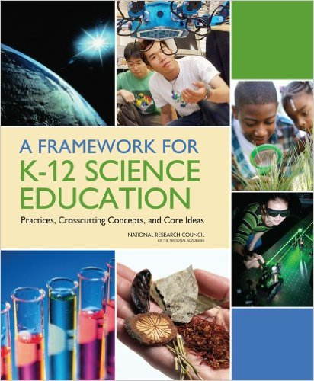
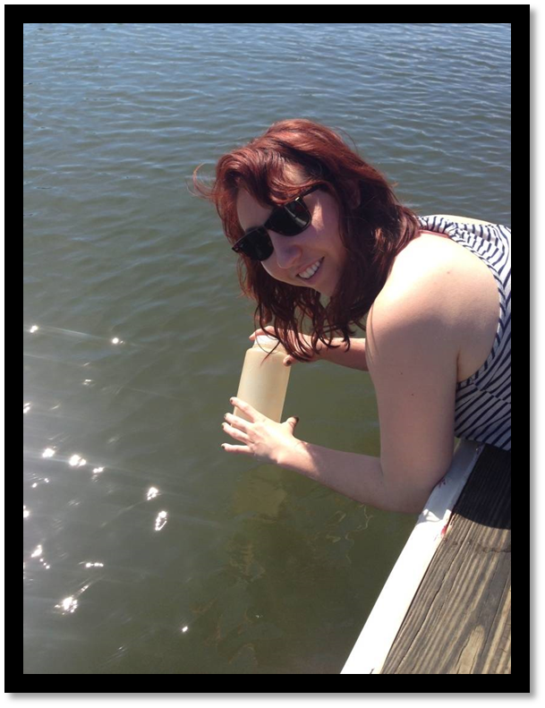
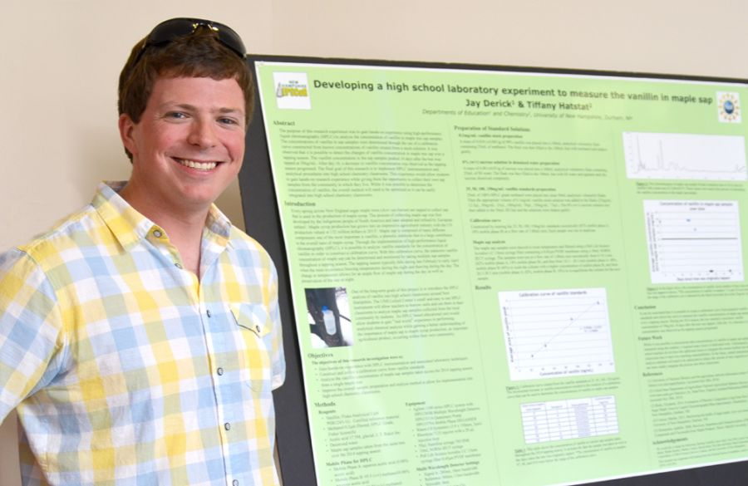
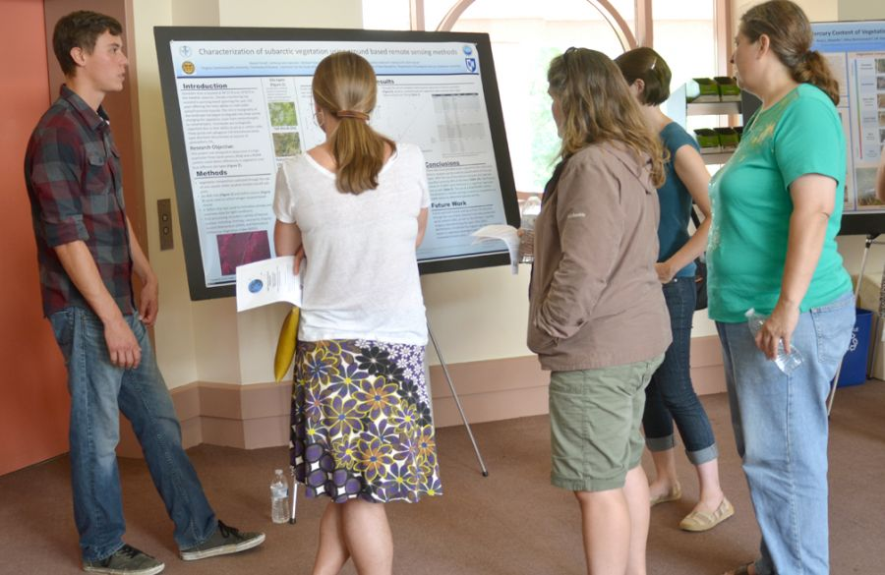
NH EPSCoR: Workforce Development through Research Training for Undergraduates and Teachers
Hale, Stephen, EOD NH EPSCoR and Research Associate, UNH Joan and James Leitzel Center for Mathematics, Science, and Engineering Education
Acknowledgements –The author thanks them any faculty staff and graduate students who have participated in mentoring the New Hampshire stem workforce of the future. Through contribution of their time, expertise, and laboratory space we have been able to develop a growing culture for research instruction for both the undergraduate students and secondary teachers in New Hampshire. The author also thanks to the many undergraduates and teachers who have spent their summers in research labs and in the field. These programs were supported through NSF grants to New Hampshire EPSCoR.
Abstract –During the recent NH EPSCoR Track 1 & 2 awards, key component s to the workforce development initiatives engaged undergraduates and teachers in project related research . During these awards , the research experience programs served 38 undergraduates and 22 G5-12 teachers. Research activities were hosted at both of NH’s research universities, four Primarily undergraduate 4-year colleges, and three community colleges. Of the 60 NH EPSCoR research experience projects, there were 37 different research mentors, 14 whom were not directly involved with the Track 1 or 2, but working on related research.
Models
Results
Undergraduates
Teachers
38 undergraduates received summer research training at 10 different institutions ranging from research universities two community colleges
Of 38 undergraduate participants:
5 community college students,
3 transfers from community college
30 4-year “native” undergraduates from 5 institutions
22 grade 5-12 teachers received summer research training at 4 different institutions
14 of 37 research mentors from 4-year colleges and community colleges were not directly involved in the Track 1 or 2.
10 week, full-time, paid research internship
$500 per week
Under mentorship of a faculty, staff, or a advanced graduate student
Weekly lunch meeting of all participants together with STEM education coach
Poster presentation at least one scientific symposium
7 week, full-time, paid research internship
$650 per week
Under mentorship of a faculty, staff, or a advanced graduate student
Introductory 3-day workshop on Next Generation Science Standards and research as pedagogical approach to STEM education
Weekly lunch meeting of all participantstogether with STEM education coach
Poster presentation at least one scientific symposium
Goals for Research Training Programs
Provide research training for undergraduate students across diverse institution types
Provide research training to teachers, so they can implement research as a pedagogical approach
Utilize research mentors from diverse institution types
Expand the EPSCoR tent with research mentors not already involved in NH EPSCoR community
Serve grade 5-12 teachers with underserved student populations
Mentorship experience for staff and advanced graduate students
Middle school teacher measuring trees in urban settings to estimate carbon storage in this land cover tight.
Undergraduate and community college transfer student collecting water samples for her Vibrio research
A group of teachers reviews A poster presentation with an undergraduate student.
- 1101245
- 1330641
Middle school teacher Presents his research poster at the summer symposium.

