Slide 1

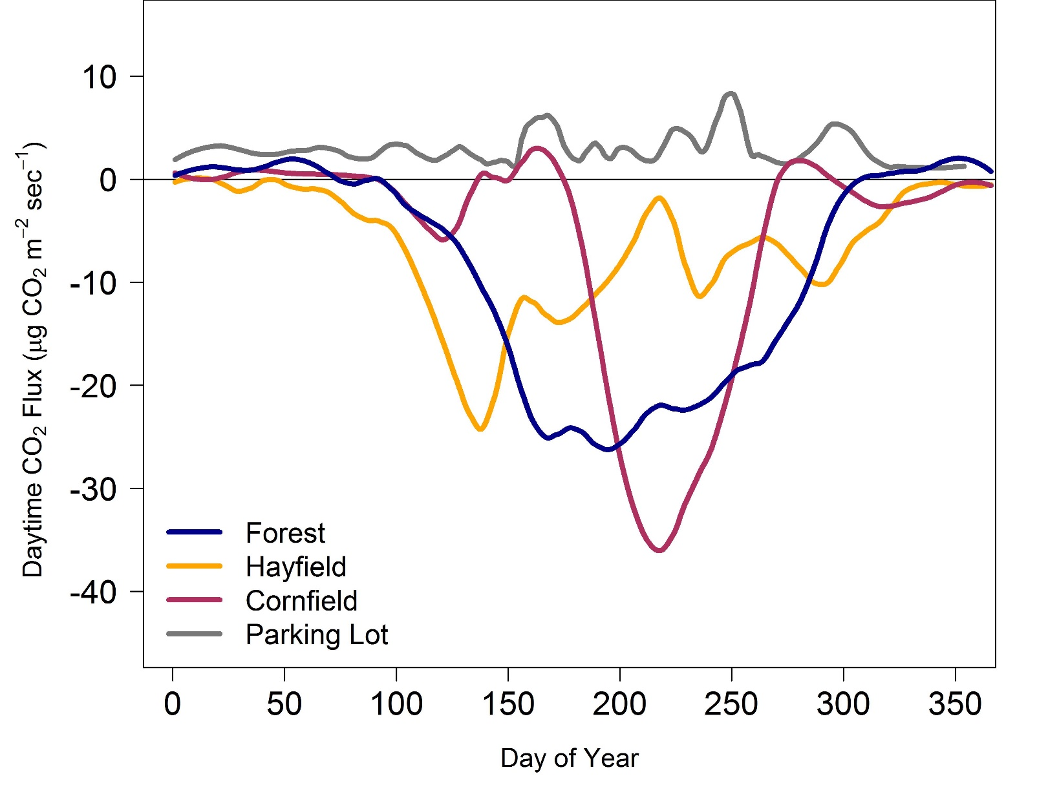
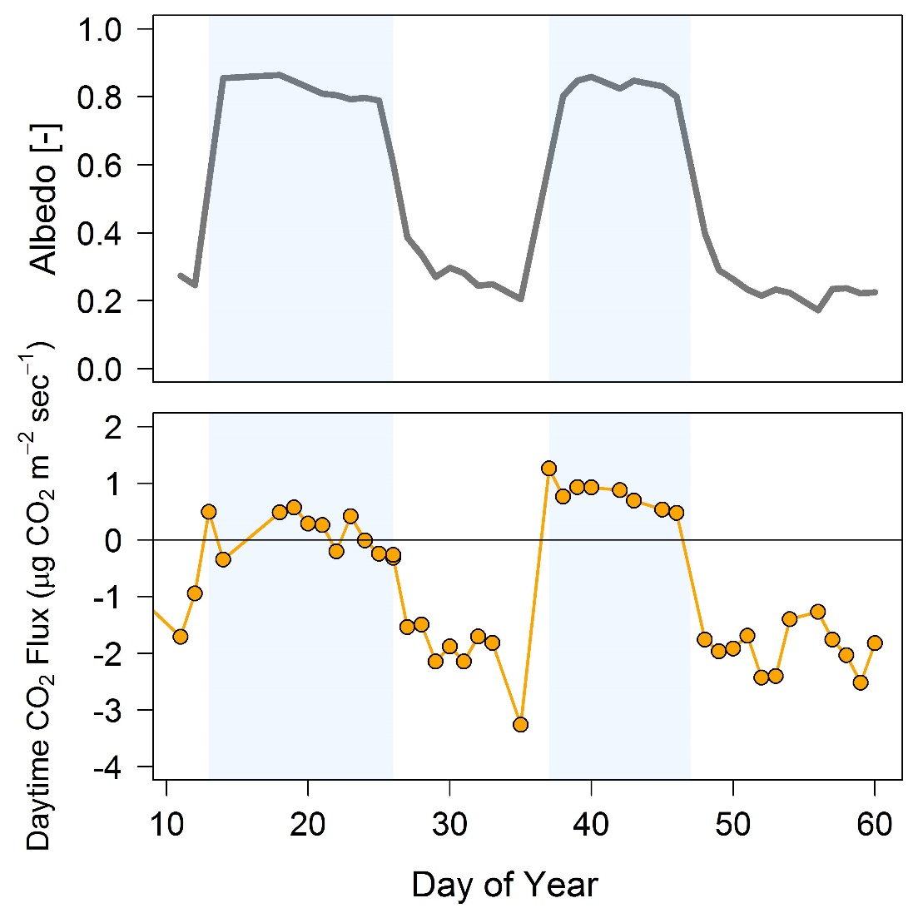
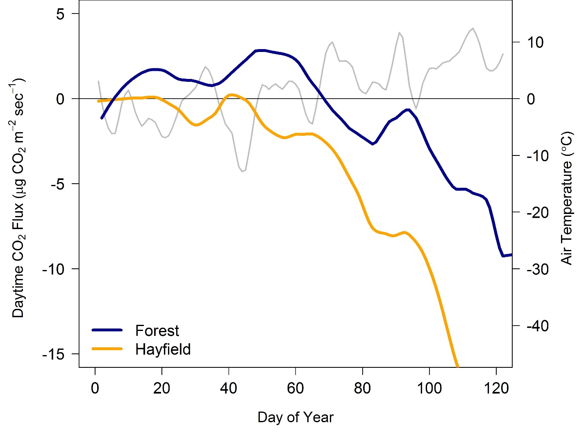


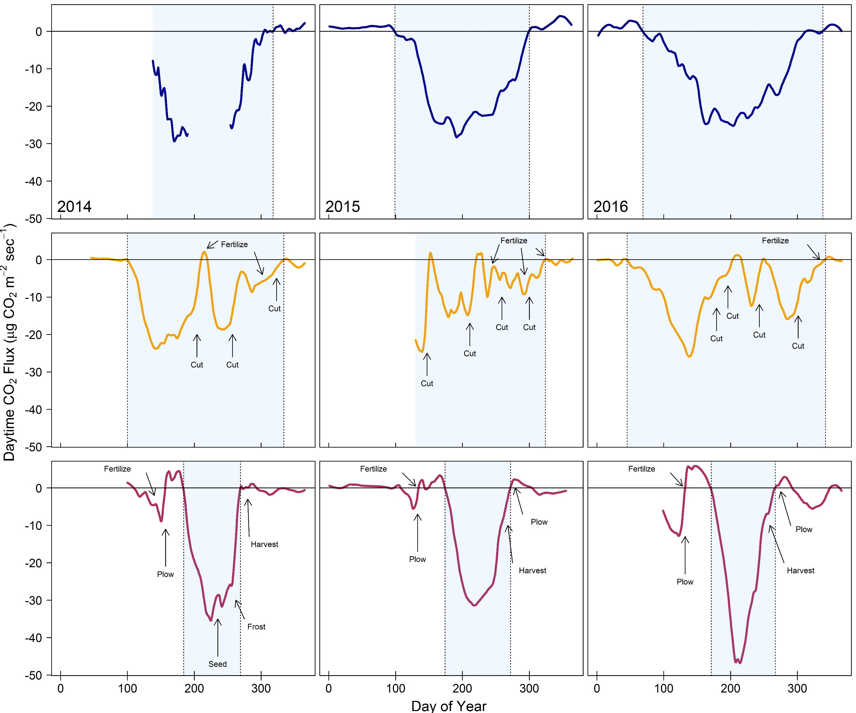
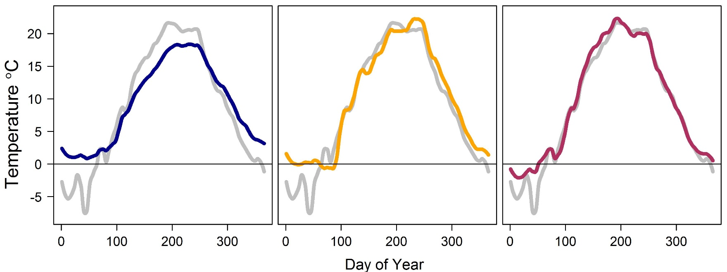
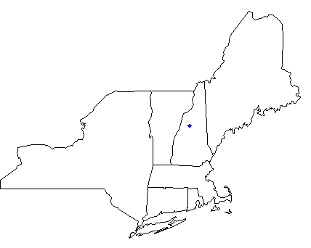
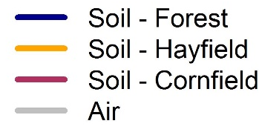
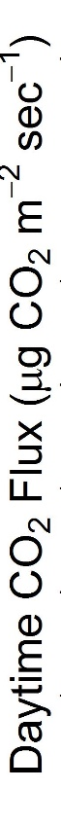
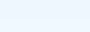
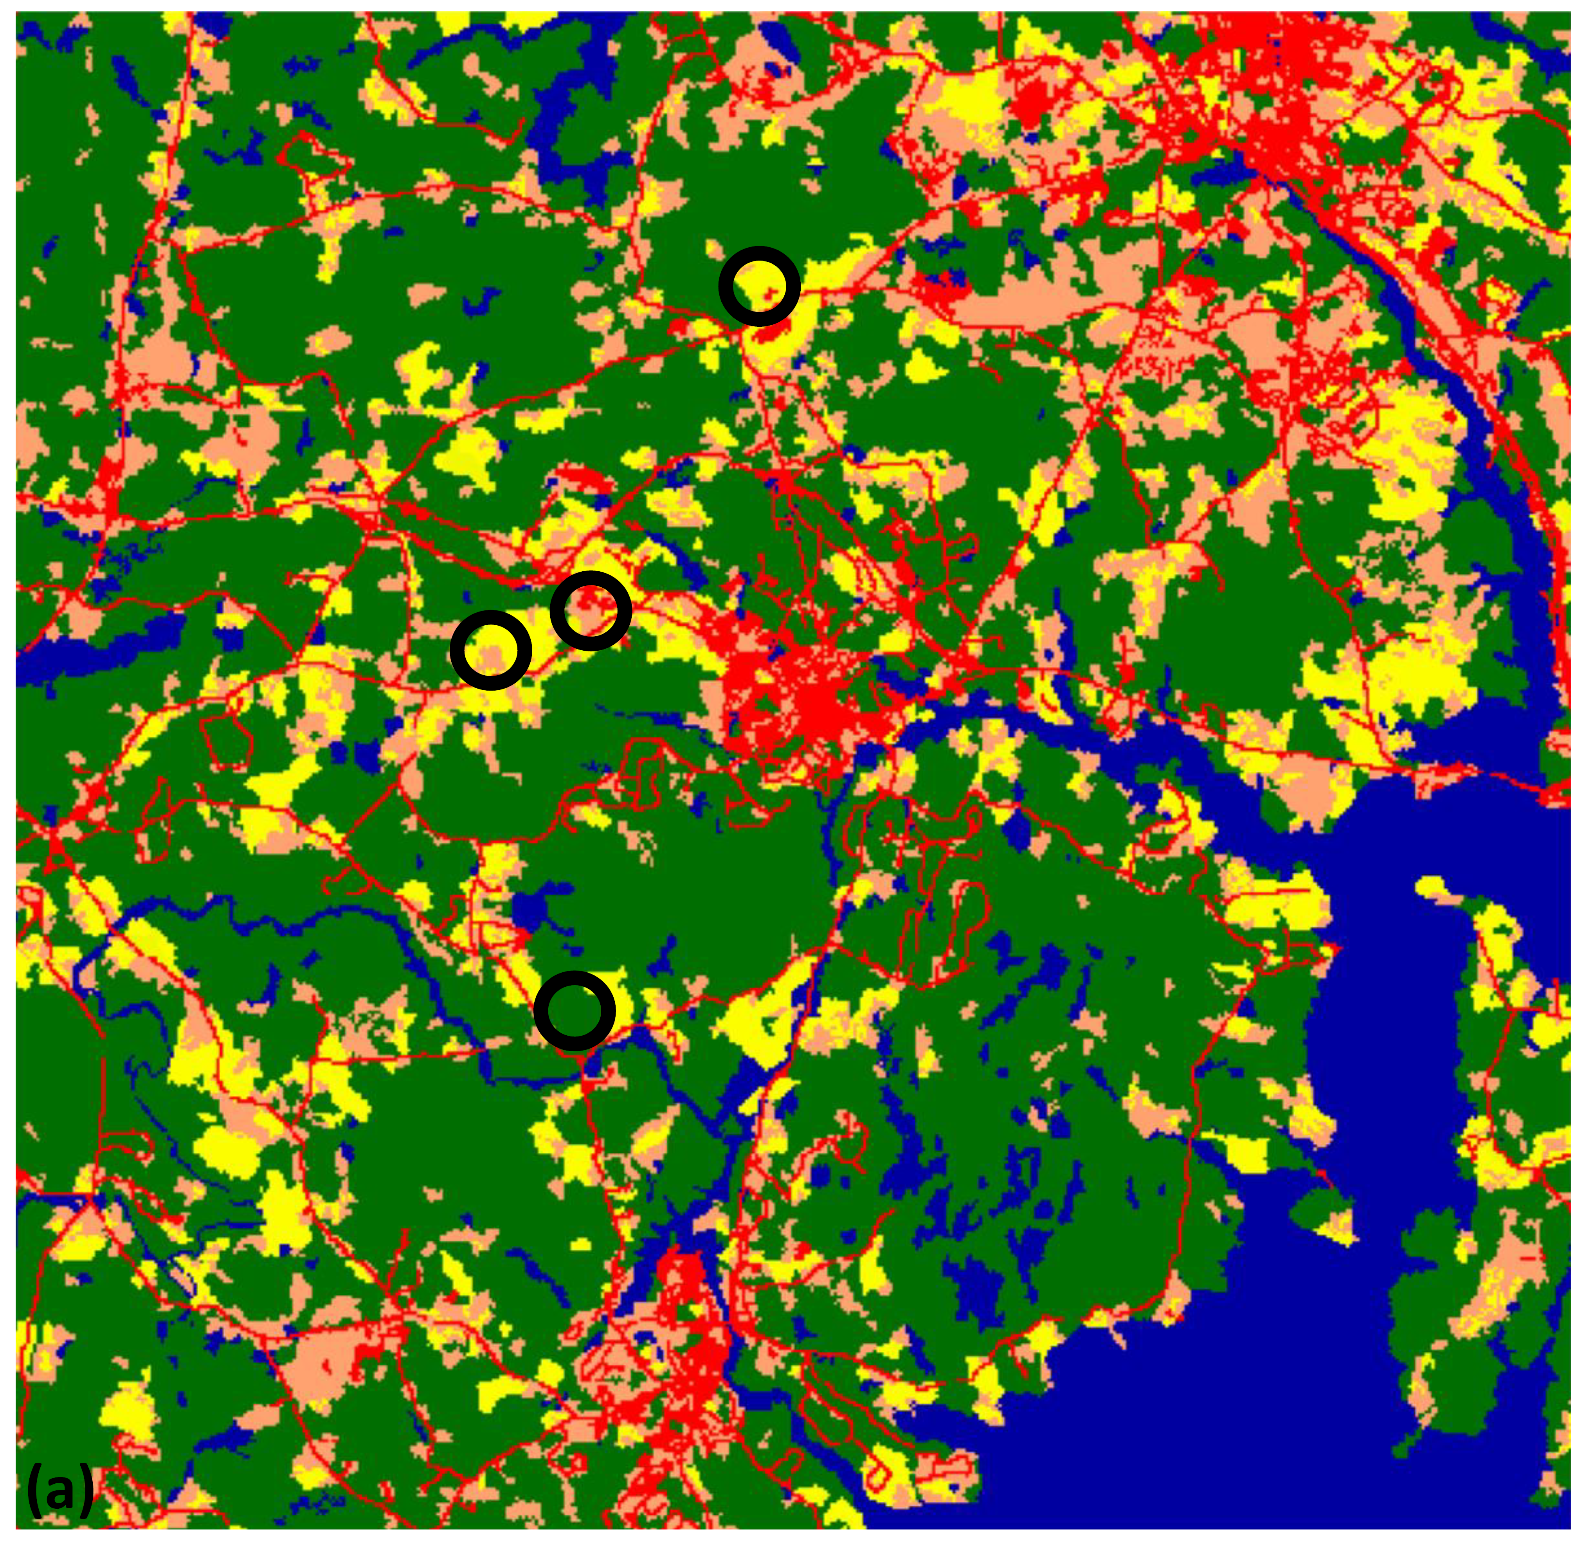
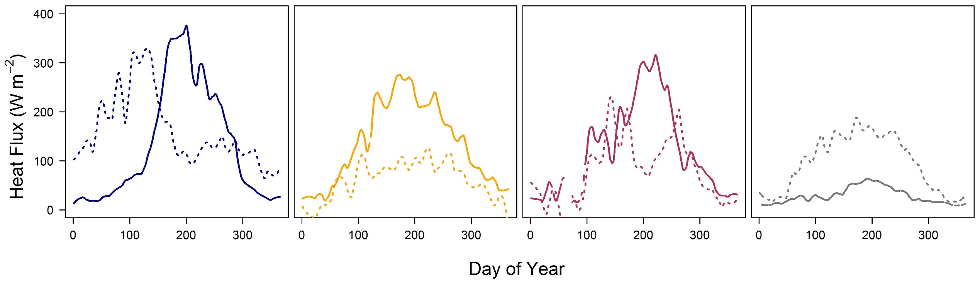
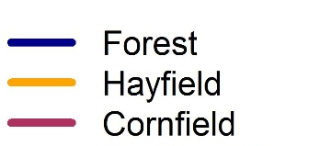
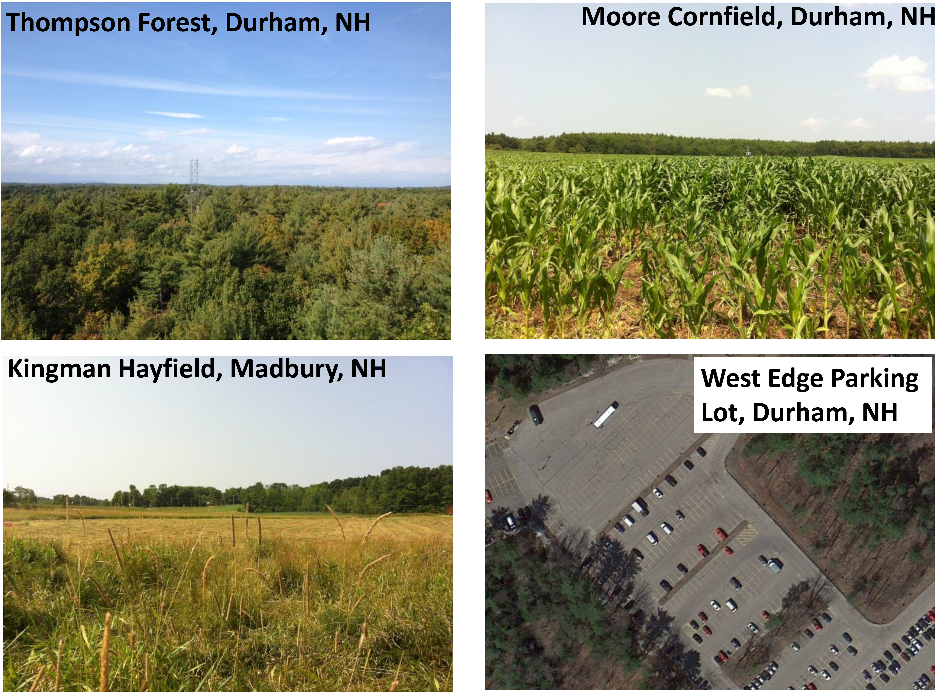
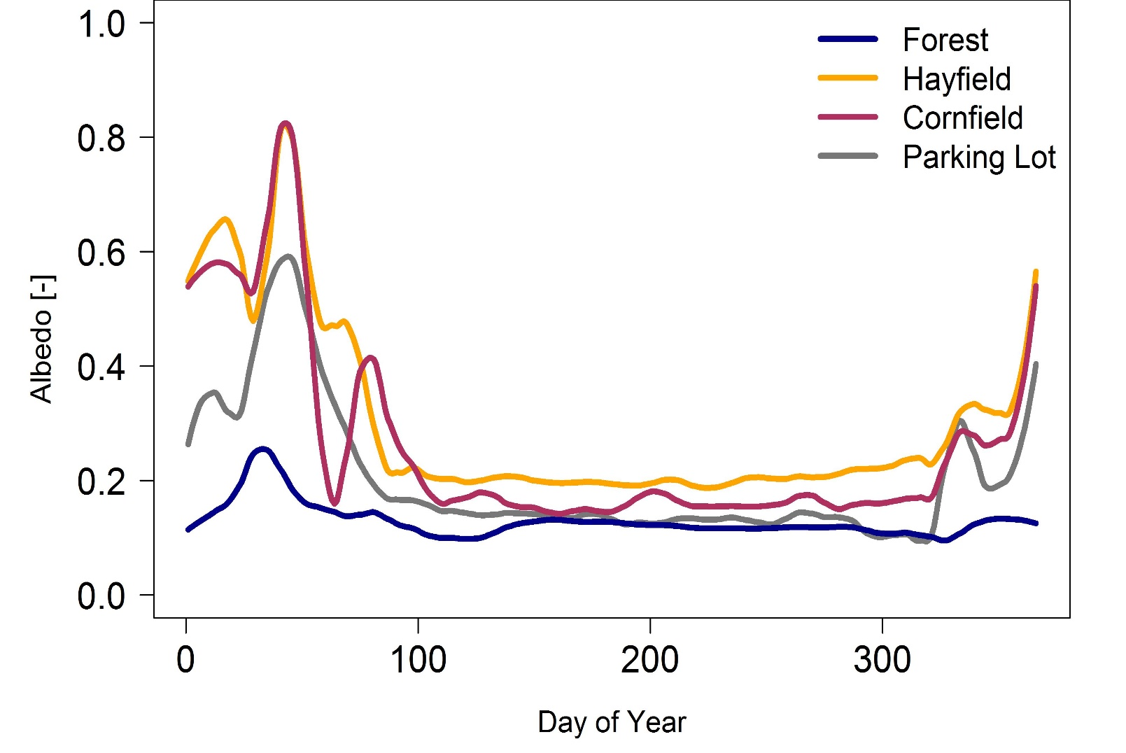




Investigating land-climate interactions across land cover types
using an eddy flux tower cluster in New Hampshire
Rebecca Sanders-DeMott, Andrew Ouimette, Lucie Lepine, Sean Fogarty, Scott Ollinger
Earth Systems Research Center & Department of Natural Resources and the Environment, University of New Hampshire
INTRODUCTION
CARBON FLUXES
SEASONAL TRANSITIONS
Land use, land management, and land cover change influence both local and global climate through impacts on net greenhouse gas exchange, albedo, evapotranspiration, and latent and sensible heat fluxes. In the context of changing climatic conditions, understanding how land-climate interactions vary over different land cover types will help us better assess the impacts of future climate and land-use scenarios.
We are using a cluster of eddy covariance flux towers located within 7.5 km of one another in southern New Hampshire across four land cover types—
Figure 2. Mean daytime (10:00 – 14:00) CO₂ fluxes averaged across 2014-2016 for each land cover type. Negative values represent net uptake of CO₂ from atmosphere by vegetation, whereas positive values represent a net source of CO₂ to atmosphere. Patterns of annual C fluxes in the hayfield and cornfield are influenced by land management.
mixed forest, cornfield, hayfield, and impervious surface (parking lot) —
to investigate the impacts of land cover type on land-climate interactions.
Here we present results from 2013-2016, highlighting the effects of each land cover type on carbon exchange, albedo, timing of seasonal transitions, soil temperatures, latent and sensible heat fluxes, and responses to interannual variability in climate and management.
Figure 5. Hayfield winter albedo (top) and mean daytime CO₂ fluxes (bottom) in Jan-Feb 2016. Shaded areas represent the likely presence of snowpack when albedo is high (> 0.5).
Figure 6. Early growing season response of daytime CO₂ fluxes for the forest and hayfield in warm spring of 2016. Gray line indicates mean daily air temperature among all flux tower sites.
Figure 7. Mean daily soil temperatures at 5 cm for each vegetated site from 2014-2016. Air temperature represents the site mean across all years.
Figure 1. (a) Location of flux tower cluster in southern NH relative to the northeast United States. (b) Land cover and (c) land surface temperature map of the flux tower cluster region near Durham, NH. Land surface temperature was derived from Landsat 8 thermal imagery from July 11, 2015. The developed areas, from north to south, are Dover, Durham, and Newmarket, NH.
(a)
Land Cover
Surface Temperature ⁰F
LATENT AND SENSIBLE HEAT FLUXES
Hayfield
Developed
Agriculture
Forest
Water/wetland
Non-vegetated
Hayfield
<= 75
79
81
82
84
86
88
90
>= 100
Cornfield
Parking Lot
Cornfield
Parking Lot
Forest
Forest
Figure 8. Mean daytime latent (solid line) and sensible (dashed line) heat fluxes averaged across 2014-2016 for each land cover type.
(b)
N
(c)
CONCLUSIONS AND FUTURE DIRECTIONS
FLUX TOWER SITES
Forest is a stronger daytime C sink than the hayfield or cornfield, but nighttime and management activities are not considered here.
Interannual variability in C fluxes in cornfield and hayfield tightly controlled by management, growing season of forest and hayfield likely influenced by interannual variation in climate more than the cornfield.
Forest has lowest albedo in both growing and non-growing season, suggesting a climate forcing trade-off between albedo and C uptake.
Hayfield C uptake was responsive to mid-winter warming in 2016 when snow not present and rapidly began taking up C during the early spring, whereas the forest was a source of C during much of the same period.
Forest soil temperature shows longest lagged response to air temperature in the spring and fall and is largely decoupled from air temperature in winter.
Sensible heat flux is high in forest and cornfield prior to peak vegetation, but hayfield and parking are consistent throughout growing season.
Future Directions: Calculate annual C fluxes, including management fluxes of fertilizer application and harvest. Investigate drivers of interannual variability in C uptake, especially related to winter and early growing season climate.
Figure 3. Interannual variation in daytime (10:00 – 14:00) CO₂ fluxes for the forest (top), hayfield (middle), and cornfield (bottom). Negative values represent net uptake of CO₂ by vegetation. Dotted vertical lines represent the start and end of the growing season (shaded area) for dominant vegetation in each land cover type as defined by timing of C uptake. Arrows indicate the timing of management interventions for the hayfield and cornfield. Data from parking lot not shown.
ALBEDO
Table 1. Mean mid-day albedo during the growing season (GS) defined as DOY 121 (May 1) – DOY 304 (Oct 31) when surfaces are influenced by vegetation (where applicable) and non-growing season (Non-GS) defined as DOY 305 (Nov 1) – DOY 120 (Apr 30) when surfaces are influenced by snow and ice.
Site | GS | Non-GS
Forest | 0.12 | 0.14
Hayfield | 0.20 | 0.40
Cornfield | 0.16 | 0.36
Parking Lot | 0.13 | 0.28
Figure 4. Mean mid-day albedo averaged across 2014-2016 for each land cover type.
This project is supported by NSF NH EPSCoR Program (EPS 11011245), USDA UNH Agricultural Experiment Station (Hatch NH00634), NASA Carbon Cycle Science (NNX14AJ18) and NSF Macrosystems (1638688).

