Slide 1
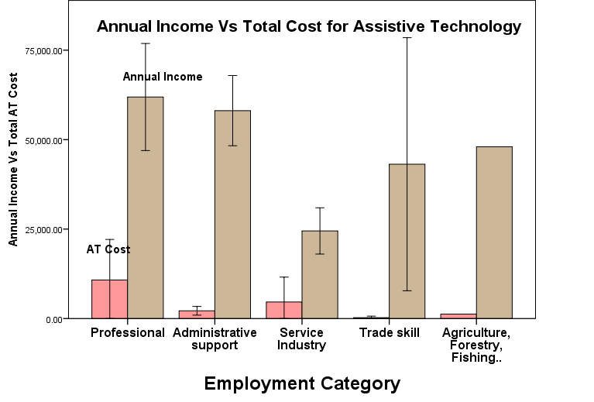
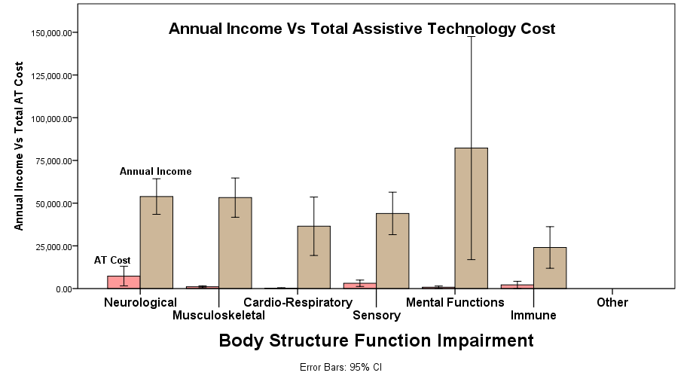
A Survey to Explore Usability and Cost Benefits of Assistive Technology in Workplace
Alyson Messina, OTS & Sajay Arthanat, Ph.D., OTR/L., ATP
Department of Occupational Therapy
BACKGROUND
RESULTS
DISCUSSION
Individuals with disabilities (IWDs) are mostly underrepresented in the workforce, partly because they require assistance and supports to be fully productive at work
Assistive technology supports work-related tasks and enables re-entry and sustained employment of IWDs (Cook & Polgar, 2015; Gray et al., 2014).
Preliminary research indicates barriers and strategies to successful AT implementation (Carlson, et al., 2001; Martins, 2015).
A larger study is needed to closely examine how AT usability relates to specific work roles and the cost-benefit value of AT in the workplace
The study is based on an employment-driven AT usability framework
The survey is ongoing, and these preliminary findings highlight the breadth and role of assistive technology in disability employment
Respondents were primarily working full time and experienced a wide range of neurological and musculoskeletal impairments
The vast majority of respondents stated their work as productive or very productive for specific roles
Most common types of AT used were worksite modifications, mobility devices, and computer access adaptations
Assistive technology usability
The productivity of employees was reported as high regardless of the primary type of AT
Nearly 75% to 80% of employees stated their AT devices to be effective and efficient for fulfilling their work roles
Efficiency found to be relatively lower for the first work role
A similar portion indication their skills and accommodations received for AT use to be adequate to very adequate
The high ratings may be attributed to an established employment experience (Mean=7.7 years)
There were modest to high significant correlations between work productivity and AT usability
Cost-benefit
The total cost for AT purchase, training, and maintenance was a small fraction in relation to respondent’s income regardless of diagnosis and employment category
The average cost was substantially higher for individuals with neurological and paralytic impairments who needed adaptive transportation (Eg; SCI quadriplegia- $47,543)
Limitations
Self-selected convenient sample may have introduced bias with responses, especially on perceived productivity
As of now, sample may not be an accurate representation of the disability workforce
Sampling error may have occurred due to limited sampling sources
Specific barriers and limitations with AT integration could not be examined within the scope of the survey
Correlations on work productivity and AT usability varied by sample size
Demographics
Age in Years
Min- 21 | Max- 67 | Avg- 41.9 | Std. Dev- 11.5
Income in Dollars
Min-1,600 | Max- 220,000 | Avg-51,939 | Std. Dev- 36,961
PURPOSE
The objective of this study is to examine the effectiveness and efficiency of AT devices in enabling employees with disabilities to fulfill work roles and to explore the relationship of AT usability with perceived skills, training, and employer accommodations.
Another objective is to analyze the cost-benefit ratio of integrating AT in the workplace.
Years of Employment
Min- .01 | Max- 31 | Avg- 7.7 | Std. Dev- 7.6
AT Usability
RESEARCH QUESTIONS
What types of AT devices are currently being used by individuals with disabilities at work?
How effectively and efficiently do the devices fulfill their work roles?
How adequate are the employee’s skills and accommodations received in regards to AT devices? And;
Is it worthwhile for stakeholders to invest in AT equipment and training in relation to an individual’s sustained employment and earning potential??
APPROACH
Design
An ongoing online survey based on an evaluation framework to measure usability of AT devices at workplace (Arthanat et al., 2016)
Sample
123 adults with physical disabilities
Currently employed and use AT devices to fulfill work roles
Recruited through Qualtrics© Health Panels, disability support networks and independent living agencies
Protocol and data collection
Approval of Institutional Review Board, University of New Hampshire
Data currently gathered through Qualtrics© database
Ratings for effectiveness, efficiency, skill, & accommodations
Productivity, Effectiveness, Efficiency, Skill, and Accommodations rated on a 5-point Likert Scale
Correlation between Productivity, Effectiveness, Efficiency, Skill and Accommodations
Role 1
Role 1 Productivity
AT 1
AT 2
AT 3
AT 4
AT 5
Ratings for effectiveness, efficiency, skill, & accommodations
PRODUCTIVITY | Effectiveness | Efficiency | Skill | Accommodation
Role 1 | 0.23 (p=0.01) | 0.25 (p-0.006) | 0.23 (p=0.01) | 0.29 (p=0.01)
Role 2 | 0.56 (0.00) | 0.53 (0.00) | 0.39 (0.00) | 0.28 (0.005)
Role 3 | 0.62 (0.00) | 0.79 (0.00) | 0.73 (0.00) | 0.60 (0.00)
Job Title
Role 2
Role 2 Productivity
AT 1
AT 2
AT 3
AT 4
AT 5
Role 3
Role 3 Productivity
AT 1
AT 2
AT 3
AT 4
AT 5
Ratings for effectiveness, efficiency, skill, & accommodations
AT Cost Benefit
CONCLUSION
By Employment Type
By Diagnostic Category
Assistive technology (by all types, cost, high-tech and low-tech) is highly valued by individuals with disabilities across all employment contexts
Considering the positive gap in cost and earning potential of the individual, AT must be viewed as a major empowerment tool from a public policy standpoint
An intervention study is underway to apply the AT usability framework in the context of vocational rehabilitation

