Slide 1
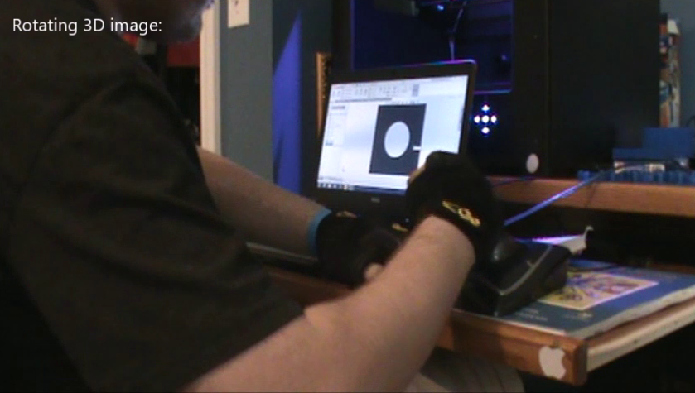
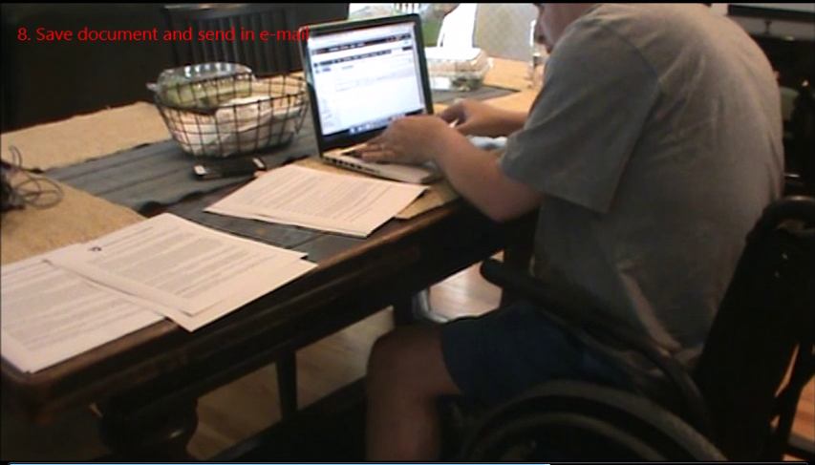
An Evaluation to Measure Usability of Computer Access Devices for
Individuals with Disabilities
Livia Gosselin, OTS & Sajay Arthanat, Ph.D., OTR/L., ATP
Department of Occupational Therapy, University of New Hampshire
BACKGROUND
Usability Scale of Assistive Technology- Computer Access
DISCUSSION
Assistive technology control interfaces are required by individuals with physical disabilities to access computers
Wide range of interfaces exist: standard and adapted keyboards, devices for mouse control, speech recognition systems, on-screen keyboards, one- or two-switch scanning input (Cook & Polgar, 2015)
Selection of an optimal interface is a complex process that needs to take into account client factors, motor and sensory skills and identification of an ideal body site for interface activation (Koester & Arthanat, in press)
Currently, computer access selection process is a trial & error approach with no recognized standardized protocol and very limited external evidence (Hoppestad, 2006; Hoppestad 2013; Davies et al., 2010)
Motor Skills | Posture | Seating stability
 |  | Proximal seating angles
 |  | Distal angles
 | Coordination | Forward reach
 |  | Text entry
 |  | Mouse pointing
 |  | Scrolling
 |  | Movement between mouse and keyboard
 | Mobility | Movement of distal extremities
 |  | Activate two keys simultaneously
 |  | Grasp
 | Manipulation | Turn on computer
 |  | Insert any hardware
 |  | Item or text selection with mouse
 |  | Drag and drop
 |  | Keyboard shortcuts
 |  | Hold mouse and scroll
 |  | Swipe touch pad
 | Endurance | Persistence with the task
Sensory Skills | Visual Skills | Can read text
 |  | Locate, identify and relocate icons
 |  | Locate, identify and relocate items in menu
 |  | Scanning-Left to right
 |  | Scanning-Top to bottom
 |  | Locate specific items or lines within text
 |  | Focus on moving targets
 |  | Switch focus on moving targets
 |  | Resolution
Computer Equipment | Monitor | Placement
 |  | Size
 | Keyboard | Letter Spacing
 |  | Visibility
 |  | Size
 |  | Button Location
 | Mouse | Cursor fluidity
Computer set up | Work Station | Seating equipment
 |  | Lighting
 |  | Noise
 |  | Space and approach
Pilot testing of USAT-CA by experienced computer access providers yielded very high inter-rater reliability for the overall tool and moderate values for each section
The content validity indices were “somewhat high” to “high” for the first phase
Revisions to the initial version of the tool were minimal: a shortened scale on motor and visual skills, changes to wordings on items and deletion of an item
Recommendation was made to provide information to potential AT providers on definitions of measures in the scales and interpretation of the scoring
The second phase of pilot testing by a random sample of AT providers yielded relatively higher inter-rater reliability scores for the overall tool and two sections [with one section showing a negative ICC value]
Noticeable increases in content validity for motor and posture skill domains
Both cohorts of AT providers (with the exception of one outlier review) “agreed” to “strongly agreed” on the utility and practical implementation of the USAT-CA
As an indication of the tool’s merit, both cohorts of AT providers were consistent in their recommendations for an alternate computer access interface for both clients
Limitations
The sample size for AT service providers in pilot (V2.0) was lower than anticipated
The responses of the AT providers may have been influenced by the quality and scope of the client videos
PURPOSE
To develop and test the Usability Scale for Assistive Technology for Computer Access (USAT-CA)
To evaluate the effectiveness and efficiency of a client's computer access through observation of specific motor, postural and sensory skills in conjunction with the characteristics and set up of the computer
METHODS
CONCLUSION
Methodological study to establish psychometric properties of the USAT-CA: content validity and inter-rater reliability.
Study protocol approved by the Institutional Review Board of University of New Hampshire
Phase I: Draft USAT-CA (V1.0) through literature review, and preliminary indicators (Arthanat et al., 2007) and observations
Phase II: A selected cohort of experienced computer access AT providers recruited through the Rehabilitation and Engineering Society of North America (RESNA) pilot tested USAT-CA (V1.0) through Qualtrics © database
The providers observed videos of two individuals with disabilities (having muscular dystrophy and SCI C4-C5) performing routine tasks on their computer. Videos were edited with captions for clarity and uploaded on a secure server
Following each video, the AT providers completed USAT-CA (V1.0)
Content validation data collected on the tool’s comprehensiveness, clarity, and ease of use
Edits to USAT-CA (V1.0) made after pilot testing
Phase III: A random sample of computer access AT providers recruited through RESNA observed the two videos and completed USAT-CA (V2.0) and content validation through Qualtrics © database
The USAT-CA addresses a need for structured and systematic methods for computer access AT selection and training
The tool is only meant to be a guide. Integration of the user’s needs, preferences and experience, along with knowledge base of the AT provider, is also critical
RESULTS
AT Provider Demographics
Phase | USAT Pilot (V1.0) | USAT Pilot (V2.0)
Years of Experience | Average: 17.6 Range: 8-27 | Average: 13.4 Range: 2-30
% Time on CA | Average: 51.2% Range:25%-90% | Average: 37.3% Range: 5%-90%
Profession: n | Occupational Therapist: 5 AT Specialist: 1 Total n=6 | Occupational Therapist: 3 AT Specialist: 7 Rehab Engineer: 2 SLP: 1 Total n=13
Client 1
Client 2
ANALYSIS
Intraclass Correlation Coefficient used to analyze inter-rater reliability
Pilot 1: ICC Two-way Random Model (2,6)
Pilot 2: ICC Two-way Random Model (2,13)
Qualitative feedback gathered to revise USAT-CA (V1.0)
Descriptive analysis used for content validity
Evaluation findings mapped to recommendations of AT service providers
Acknowledgements: Hamel Center for Undergraduate Research: Summer Undergraduate Research Fellowship. University of New Hampshire

