Slide 1
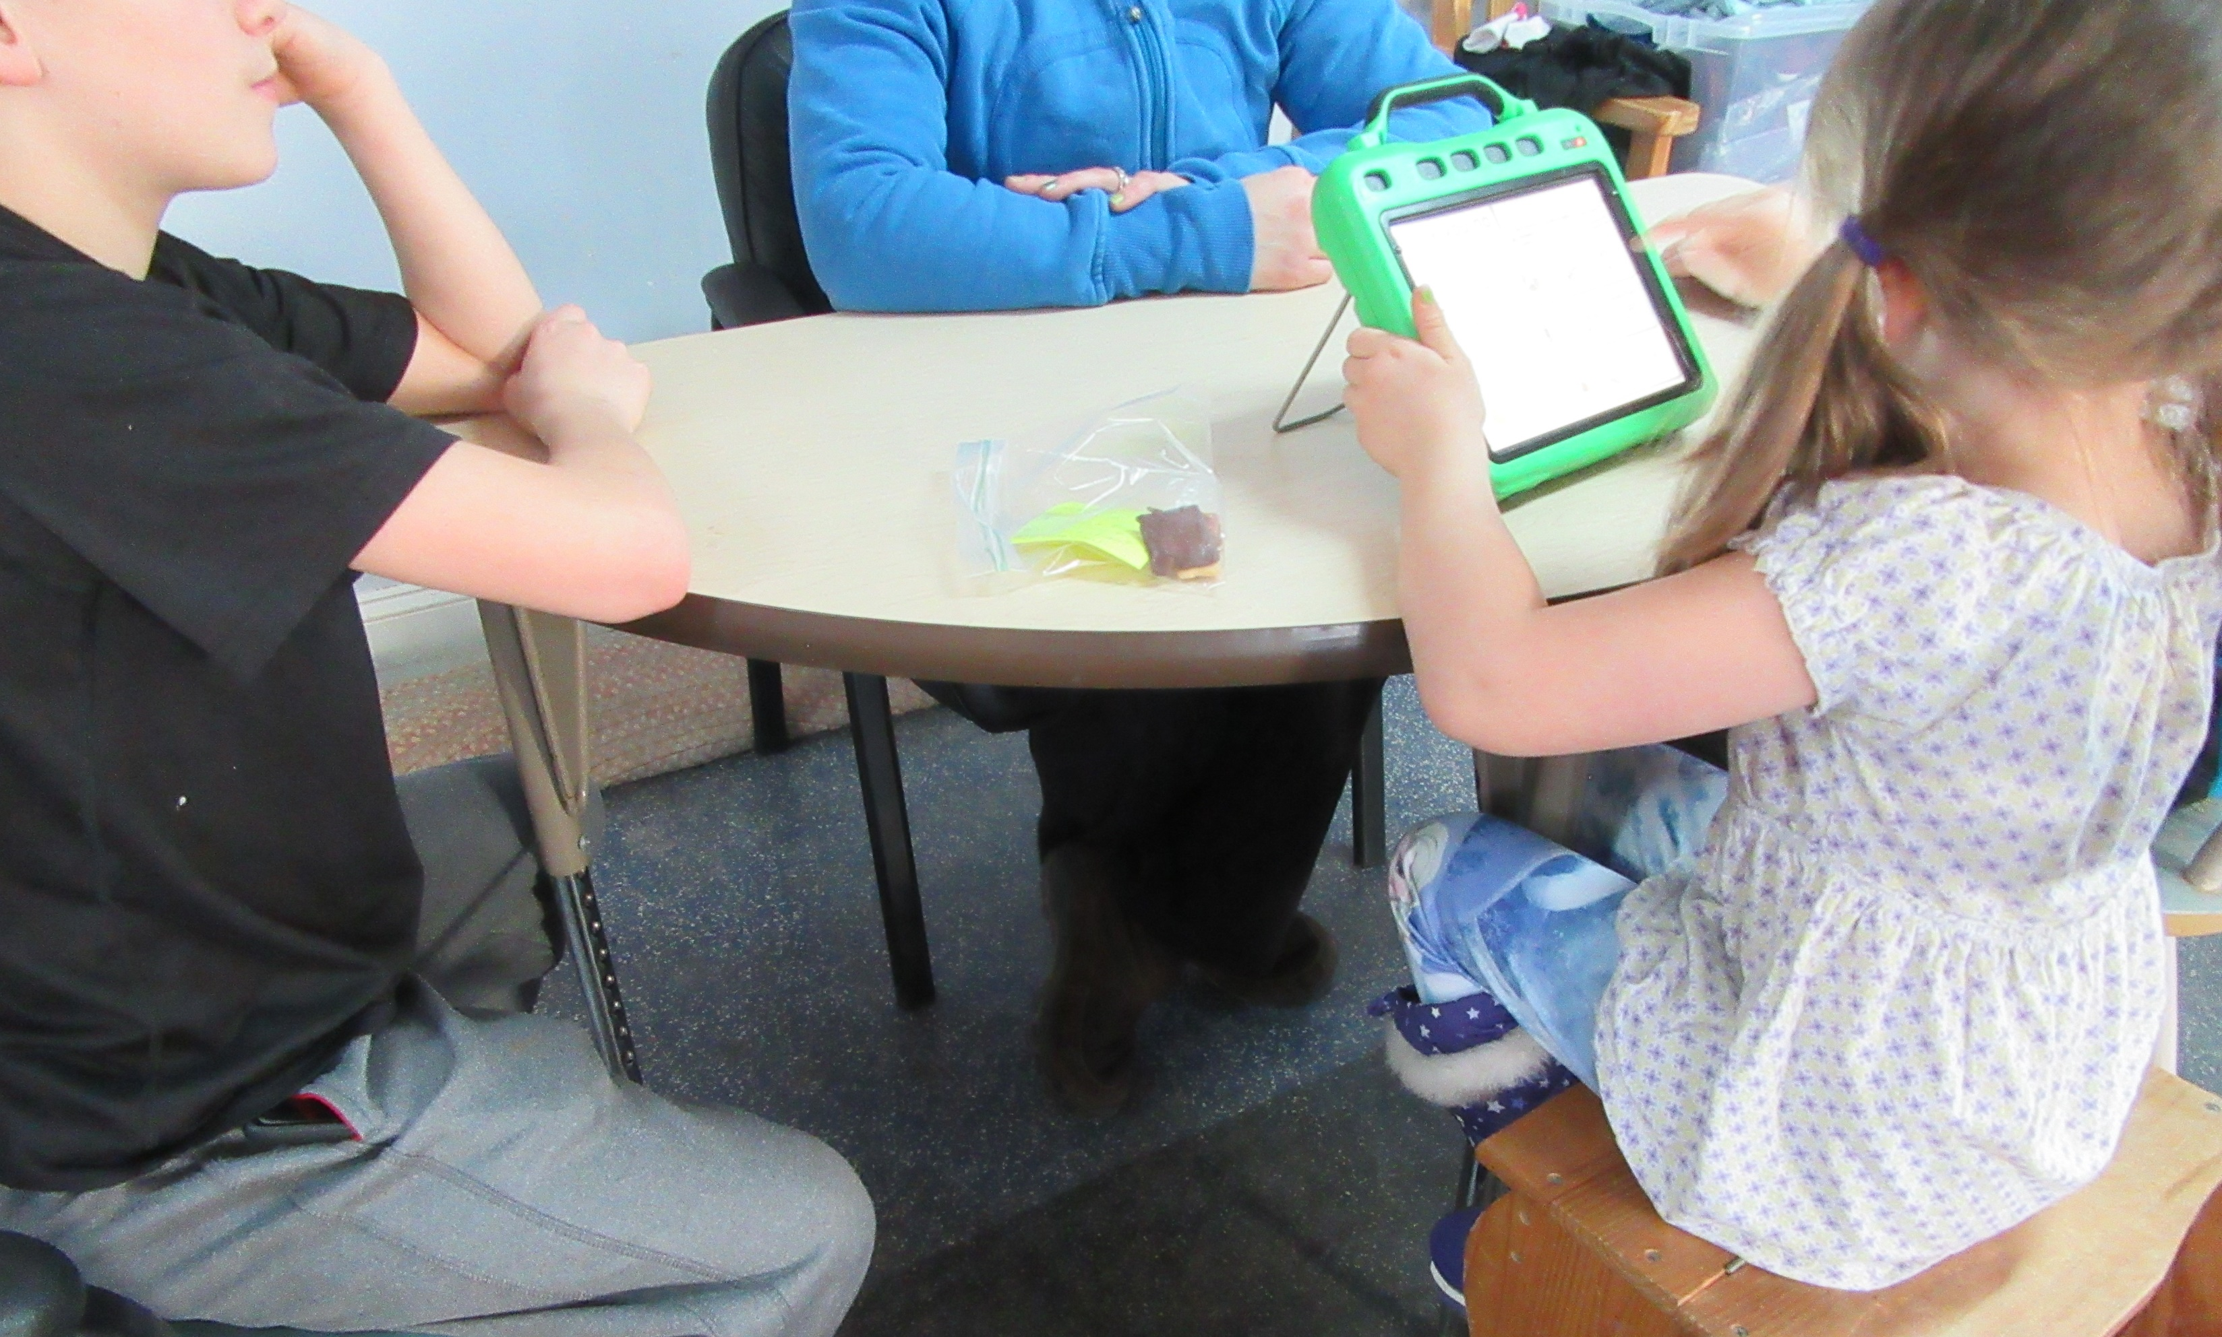
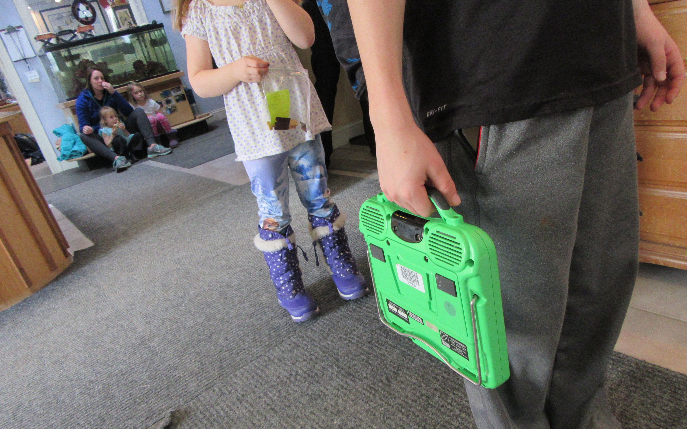
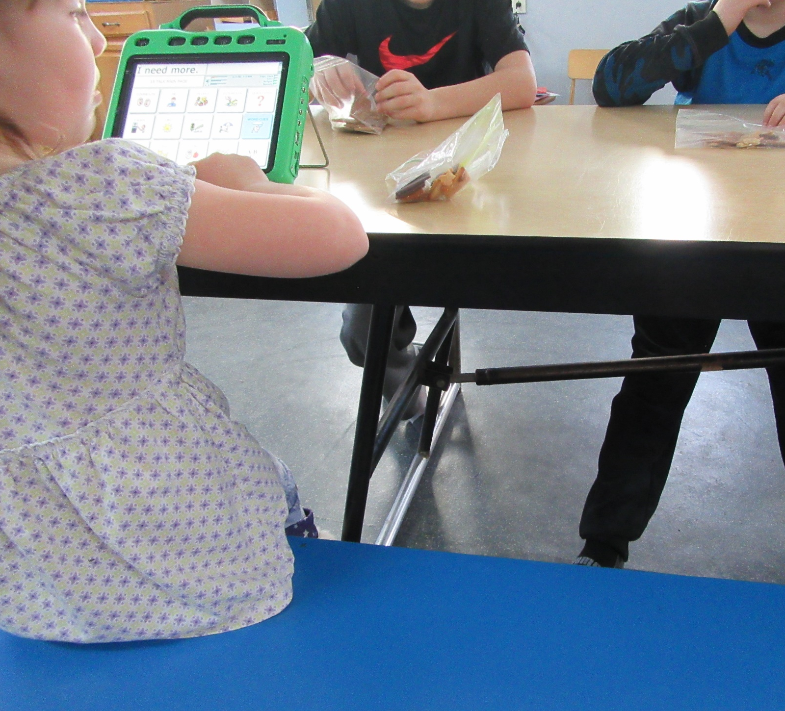
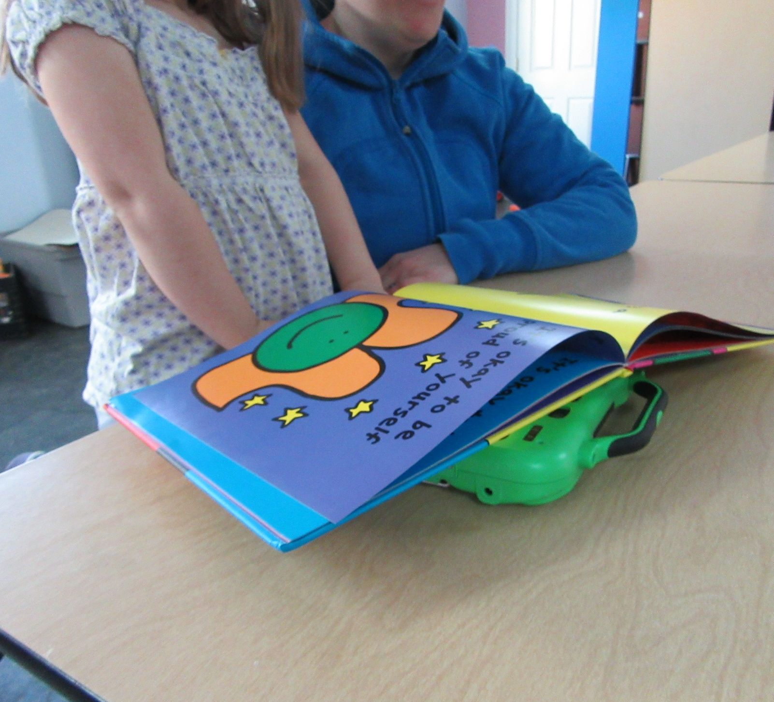
Social Interaction and Participation in School Activities of an Elementary School Student Using an Augmentative Alternative Communication Device
Samuel Lewis OTS
Background
Over 2 million AAC users in the United States today¹
Children who use AAC devices show that they have fewer over all communication events than their peers with the recorded events seldom self-initiated by the children^{2,3}
Children were, overall, less engaged in the school day due to their lack of peer-to-peer communication³
Results
Device used in 7 of 56 interactions
All 7 interactions using the device were with an adult, not peers
This student’s ESI measure indicates markedly inappropriate social interaction
This student’s SFA score indicates that she:
Participates in few activities in the classroom
Participates with full supervision in at recess and during transitions
Has modified full participation at lunch
Discussion
Very exploratory study, based on one student who did not use her AAC as intended
AAC use was not supported or deliberately encouraged
Student did not interact with peers, resulting in decreased participation
Constant supervision or modification was required for participation in activities
SFA indicates computer and equipment use may influence overall very low participation in all areas of school
Location | ESI Measure | SFA Participation Score
Recess | -0.7 | 3
Classroom | -0.3 | 2
Transitions | -1.0 | 3
Lunch | -0.4 | 5
Original Research Questions
To examine the level of participation in school activities for students who use AAC
To evaluate the quality of social interaction of students using AAC devices
To explore the relationship among students’ quality of social interaction and their participation in, and performance of, school activities
Methods
Single case design
Participant: (Heather)
9 year old female in a fully integrated 4th grade classroom
Introduced to an AAC device 4 years ago
Fully non-verbal
Assessments
School Function Assessment (SFA)⁴
Evaluation of Social Interaction (ESI)⁵
SFA Completion
Completed by teaching team
ESI Observations:
Observations in four typical school settings
Classroom, playground, hallway, cafeteria
Heather
Heather
Implications for Occupational Therapy
Work with team members to program the AAC to fit students’ individual needs, within specific school environments
Provide strategies for paraprofessionals on how to support students’ use of their AAC device
Provide strategies to school staff on how to promote opportunities for social interaction with peers, using AAC
Heather
References
¹American Speech Language Hearing Association (2016). Information on AAC users. Retrieved from http://www.asha.org/public/speech/disorders/InfoAACUsers/
²Chung, Y., Carter, E. W., & Sisco, L. G. (2012). Social interactions of students with disabilities who use augmentative and alternative communication in inclusive classrooms. American Journal On Intellectual And Developmental Disabilities, 117(5), 349-367. doi:10.1352/1944-7558-117.5.349
³Raghavendra, P., Olsson, O., Sampson, J., Mcinerney, R., & Connell, T. (2012). School Participation and Social Networks of Children with Complex Communication Needs, Physical Disabilities, and Typically Developing Peers. Augmentative and Alternative Communication. 28 (01). http://dx.doi.org.libproxy.unh.edu/10.3109/07434618.2011.653604.
⁴Coster, W. J., Mancini, M. C., & Ludlow, L. H. (1999). Factor structure of the School Function Assessment. Educational And Psychological Measurement, 59(4), 665-677. doi:10.1177/00131649921970099
⁵Fisher, A. G., & Griswold, L. A. (2015). Evaluation of Social Interaction (3rded. Revised). Fort Collins, CO: Three Star Press
Heather
Future Research Questions
What environment supports AAC use and participation?
How can AAC devices allow for effective social participation in multiple school-based locations?
Does the quality of social interaction have an impact on the ability to fully participate in different school activities?
Acknowledgements
Thank you to the Hamel Center for Undergraduate Research and to my faculty advisor Dr. Lou Ann Griswold

