Slide 1
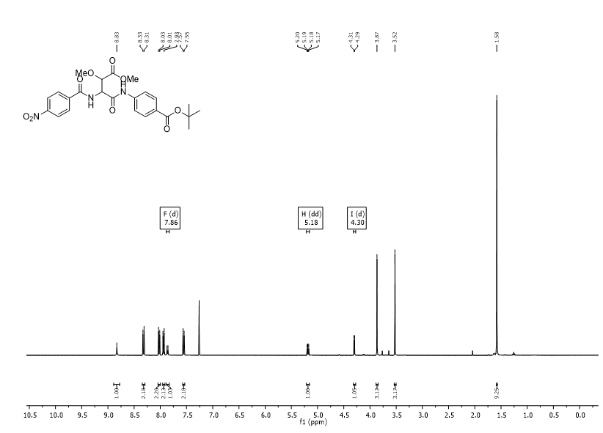
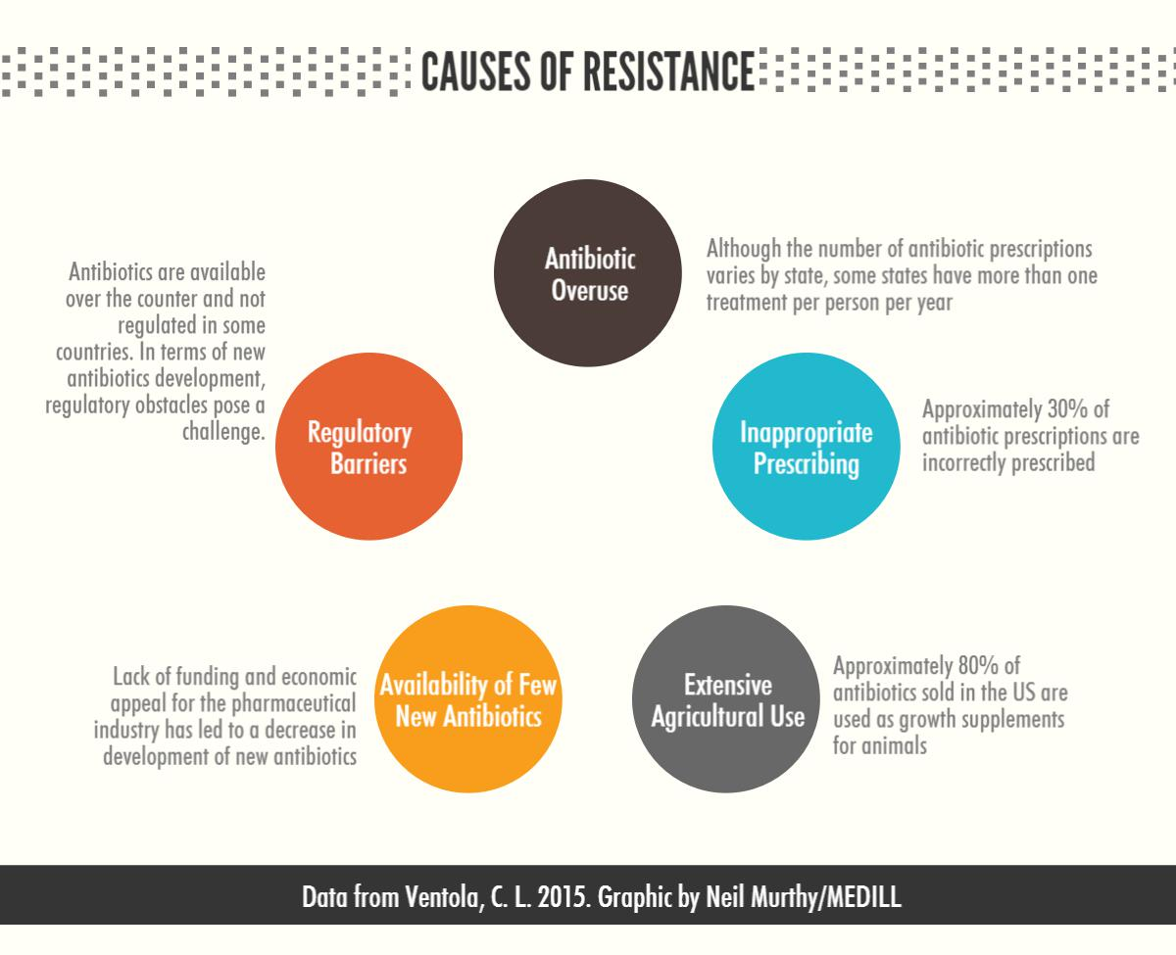
Synthesis of Super Potent Antibiotic Cystobactamide 861-2
Alison Deyett , Therese Planke, and Andreas Kirsching
Department of Organic Chemistry, Leibniz University , Hannover, Germany
Abstract
Synthesis
NMR
The need for new potent antibiotics to fight both gram negative and gram positive bacteria is overwhelmingly extant in today’s society. Cystobactamides may hold the key to filling this void in medical resources, but they cannot be isolated in any amount to even test their validity. In order to combat this issue the complete synthesis of cystobactamide 861-2 has been developed and optimized to make this special compound in high enough yields for testing.
Background
Bacterial infections have become more prominent because bacteria have gained resistances to antibiotics already on the market
2 million people are infected by antibiotic resistance each year in the United States
23,000 people are killed from these infections each year
The production of antibiotics can not keep up with the demand of resistant bacteria
Cystobactemides
Have shown promising results to get rid of many nosocomial infections that currently are very difficult to get rid of
Are potent bactericidal agents that inhibit several Gram-negative and Gram-positive bacteria
Are produced by Cystobacter sp. in very small amounts
Can not be isolated from the other similar compounds through the fermentation process
Must be organically synthesized
Summary
There is a need for new antibiotics that have the ability to fight new antibiotic resistant strains.
The optimization of the addition of the azide has increased the possible yield to provide less waste and increase the production time of the desired cystobactamide.
A large amount of the middle fragment of cystobactemide 861-2 was produced to be used for the completion of the rest of the compound.
Optimization
Future work
This is the original work up that severely hindered the ability to make large amounts of the compound.
Was first tried to change the work up of this product but it did not lead to a significant change in yield.
The compound will be fully synthesize and tested for usefulness in the field
Other cystobactamides will be synthesized and tested for usefulness
References
Objective
The product of this reaction was compound 4 but the alcohol group is protected by TMS and another side reaction in a 2:1 solution.
1. Moreno, M.; Elgaher, W.A; Herrmann, J.; Schlager, N.; Hamed, M.; Baumann, S.; Muller, R.; Hartman, R.W.; Kirschning, A. Synthesis and Biological Evaluation of Cystobactamid 507: A Bacterial Topoisomerase Inhibitor from Cystobacter sp. Synlett 2015, 26,1175-1178.
2. Baumann, S.; Hermann, J.; Raju, R.; Steinetz, H.; Mohr, K.; Huttel, S.; Harmrols, K; Stadler, M.; Muller, R. Cystobactamides: Myxobacterial Topoisomerase Inhibitiors Exhibiting Potent Antibacterial Activity. Angew. Chem. It Ed. 2014, 53, 14605-14609.
To generate 1 g of the middle fragment of Cystobactamide 861-2 in order to make a enough material for proper testing of the material
Was first done in THF, but this resulted in two inseparable compounds mixed 2:1.
DMF was used to promote the desired S_{N}2 product
Acknowledgement
Work for this project was supported by the American Chemical Society’s International Research Experience for Undergraduates (IREU) program which is funded by the U.S. National Science Foundation under IIA-1261104. I would also like to thank Professor Andreas Kirschning for the opportunity to work in his lab and the guidance he provided.

