Slide 1
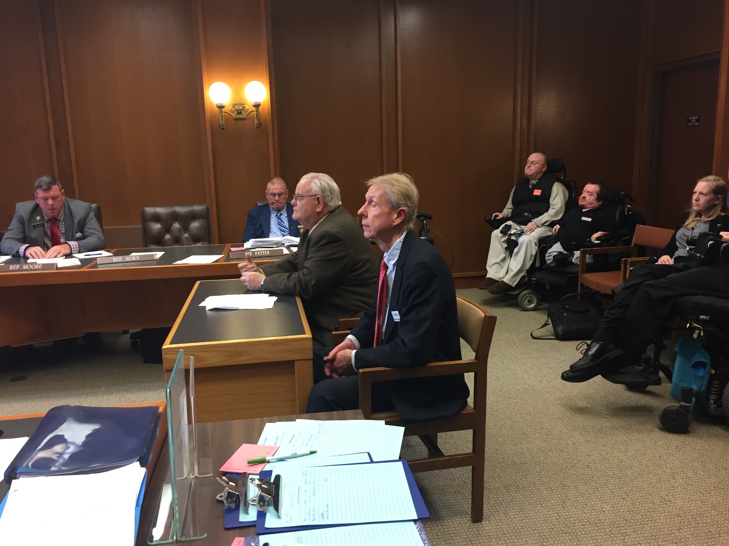
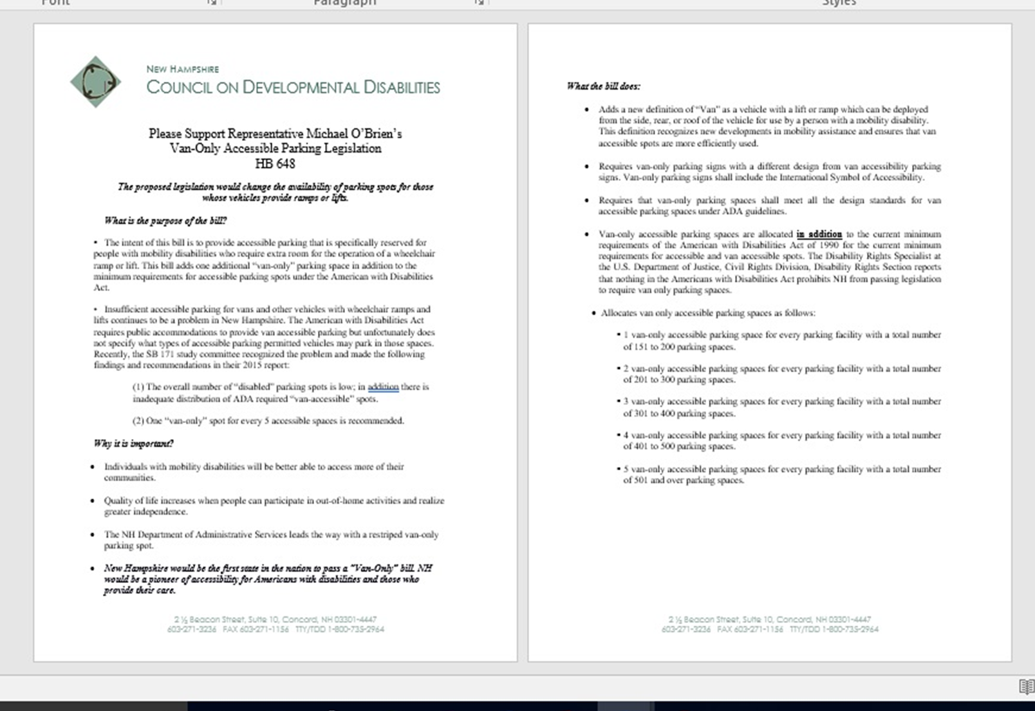
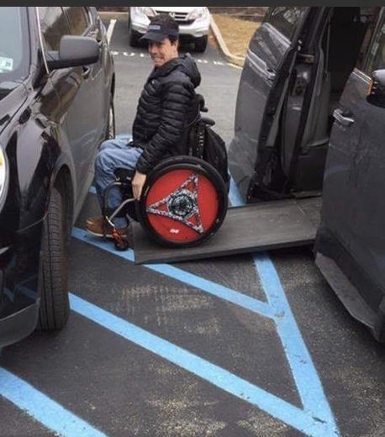
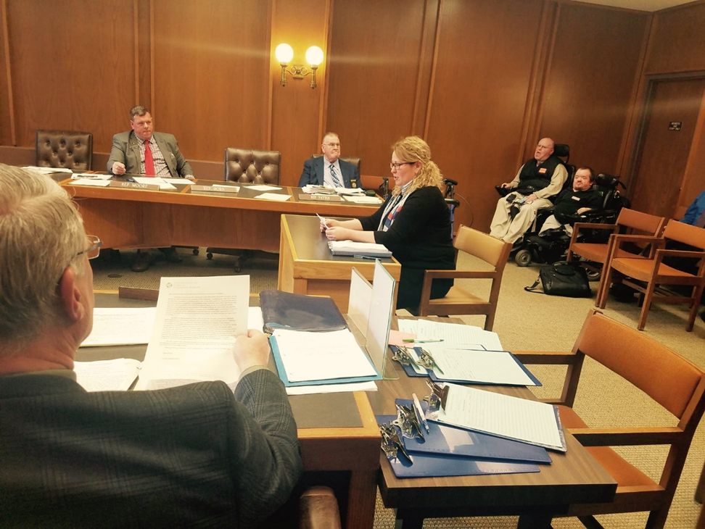
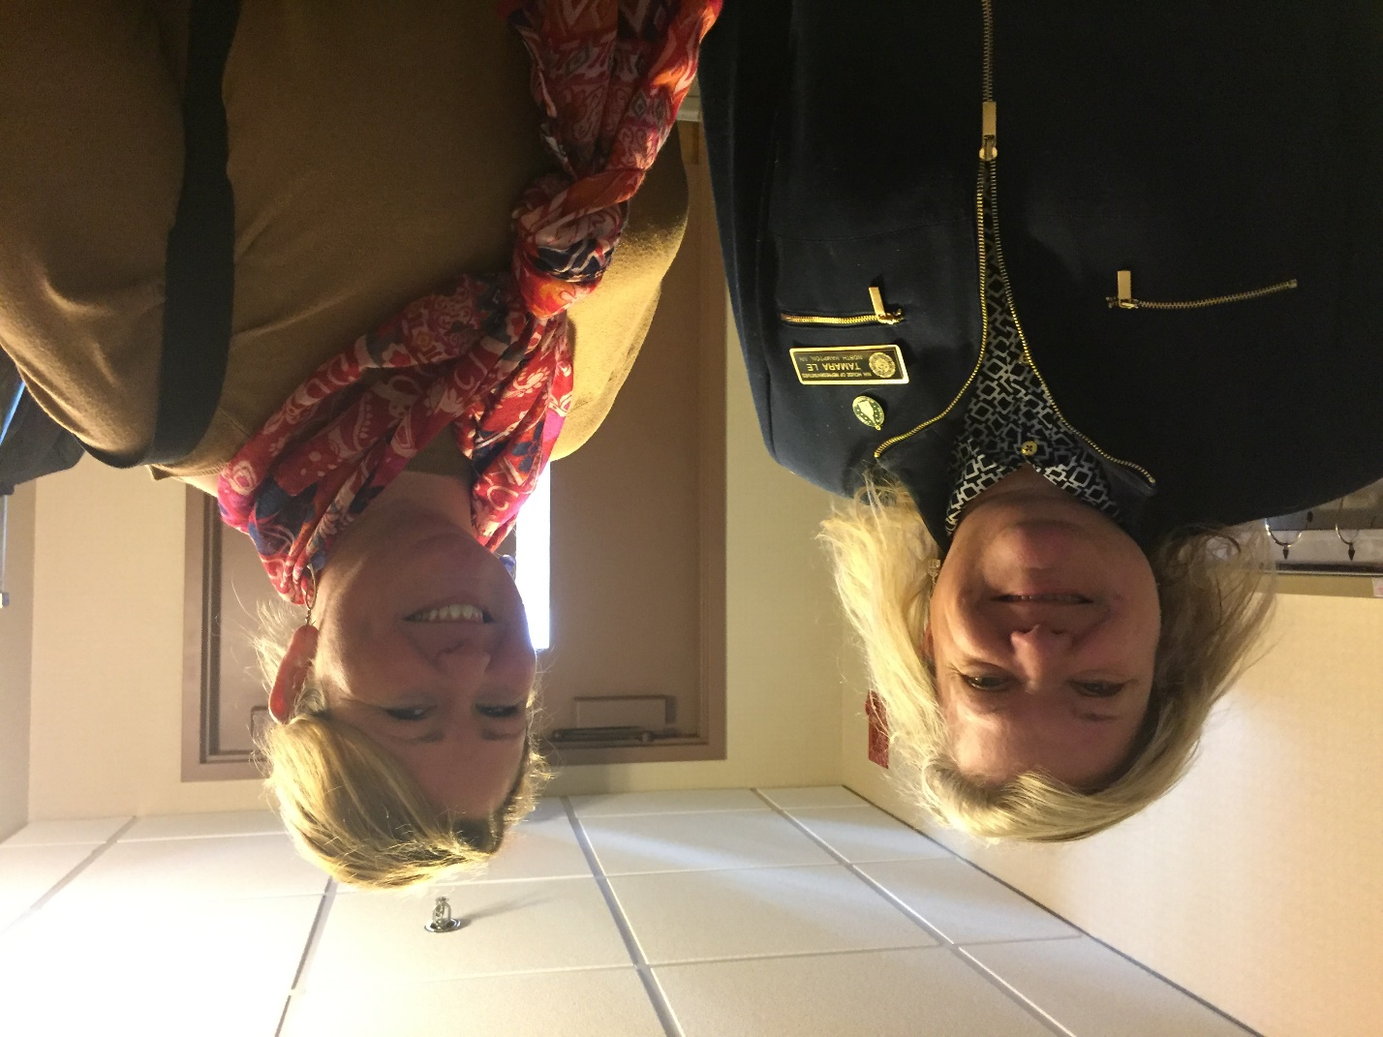
House Bill 648 Van-Only Parking
Jennifer Bishop-Saucier, MSW
University of New Hampshire, Durham
The NH Council on Developmental Disabilities Mission statement:
The New Hampshire Council on Developmental Disabilities is a federally funded agency that supports public policies and initiatives that remove barriers and promote opportunities in all areas of life. The Council is independent of the agencies that provide services to people with disabilities. The Council develops a State Plan every five years to establish specific goals, objectives and strategies to address the most important issues affecting people with developmental disabilities in New Hampshire. The Council carries out its mission through education, advocacy and the funding of innovative projects that make a difference in people's lives.
The Council has teamed with the NH-ME Leadership Education in Neurodevelopmental Disabilities program previously, mentoring trainees through the legislative process. Together, The NH Council and LEND have worked on many bills that enhance the dignity, full rights of citizenship, equal opportunities, and full participation of all NH citizens with developmental disabilities.
Representative O’Brien, Nashua and NH Council Director Chris Rueggeberg
Leadership Project: HB 648
Representative O’Brien’s House Bill 648 supported those with mobility disabilities who are further prohibited from opportunities due to the size of the equipment needed to allow for full inclusion. “This bill establishes requirements for van-only parking spaces for persons with disabilities.” This bill adds one parking spot to solely accommodate a vehicle with a ramp or lift that enables wheel chair users to exit their vehicle. This bill would add one space to a lot of 150 spots or more with additional spots as the lots become larger.
This years’ leadership activities followed this bill in specific steps:
1. Legislative research: what other states have a similar bill
2. Office of Legislative Services shores up the legalese in the bill’s wording
3. Creation of a fact sheet
4. Create a stakeholder list
5. Connect with stakeholders who will support the bill, testify, offer written testimony, and advocate.
6. Submitted to the committee
7. Gather Legislative sponsors
8. Hearing on the bill: testimony from stakeholders, supporters and opposition
9. Committee vote: The van-only bill was voted out of committee
10. House floor vote: if it passes, the bill goes to the Senate and the process occurs again.
11. If the Senate passes, the governor signs the bill into Law.
Bill Outcome
HB 648 was voted out of committee and onto the House Floor, where it was motioned and voted to be tabled. The Van-only parking bill had been shopped around a previous cycle and the concerns had been researched and fixed prior to unveiling to the transportation committee in the 2017 cycle. Despite being involved since Sept. 2016, another governor appointed group in the days leading up to the vote expressed concern that one spot was not enough and presented their own idea to make all accessible-spots van-accessible. With the advocacy groups appearing to be unaligned, the bill lost traction on the house floor by causing concerns to house members on what this divide meant. Because this was the second time this bill has been presented and voted out, it cannot be brought in front of committee for two years. It is the hope that parking for those with modified vehicles be improved and that this improvement occurs sooner rather than later.
Testimony Excerpt
“Dear Chairman Smith and the Members of the Transportation Committee,
The intent of Representative O’Brien’s bill is to provide accessible parking that is specifically reserved for people with mobility disabilities who require extra room for the operation of a wheelchair ramp or lift. This bill adds one additional “van-only” parking space in addition to the minimum requirements for accessible parking spots under the American with Disabilities Act. This bill was carefully drafted with accessibility experts including Granite State Independent Living, the Disability Rights Center, and the Institute for Human Centered Design in Boston. HB 648 will have minimal fiscal impact of business and state and local governments because the bill provisions only apply to parking lost with 150+ spaces. It will be necessary to add a van only parking space for these lots only when the lot is constructed, reconstructed or restriped; and the New Hampshire Department of Administration Services estimates that based on the cost of $50 to install a new sign per parking lot for the 75 lots the Department administers, the Department is making the following cost assumptions: $1,250 in FY 18, $1,000 in FY 19, $750 in FY 20 and $750 in FY 21
HB 648 is supporting community inclusion for persons with disabilities by adding new accessible parking spaces to the spaces the accessible spaces already required under the Americans with Disabilities Act. I am requesting that this bill ought to pass. “
Challenges experienced
Summary
The Kingdon Theoretical framework shows that policy becomes a bill when there is a “window.” Kingdon states when Problem Stream, Policy Stream, and Politics Stream meet, a window of opportunity allows for policy to become to law (Kingdon, 1995). Without these three, it is not likely for the policy to move forward. In this case the problem stream was the population who use modified vehicles noted difficulty in their accessibility due to the space needed for their vans. The Policy Stream being worked on and created by the New Hampshire Council presented many alternatives and proposed this current solution. However, the Political Stream, which is the larger political environment and in this case ideological differences, was not in line to create the window needed to pass this policy.
A problem and a solution are often co-occurring but the advocate must have the pulse of the political stream to know when to coordinate to catch the window. Creating policy shifts through law is an art in patience. In this case, the breakdown was in the solution with two groups proposing differing ideas, both good, but forcing lawmakers to choose one, when they were clear, that they would not. Even though the one solution in HB 648 had been vetted the addition of another idea, making all accessible spots van accessible, took the solution stream away from the window of opportunity.
HB 648 Testimony
Representative Tamara Le; North Hampton

