Slide 1
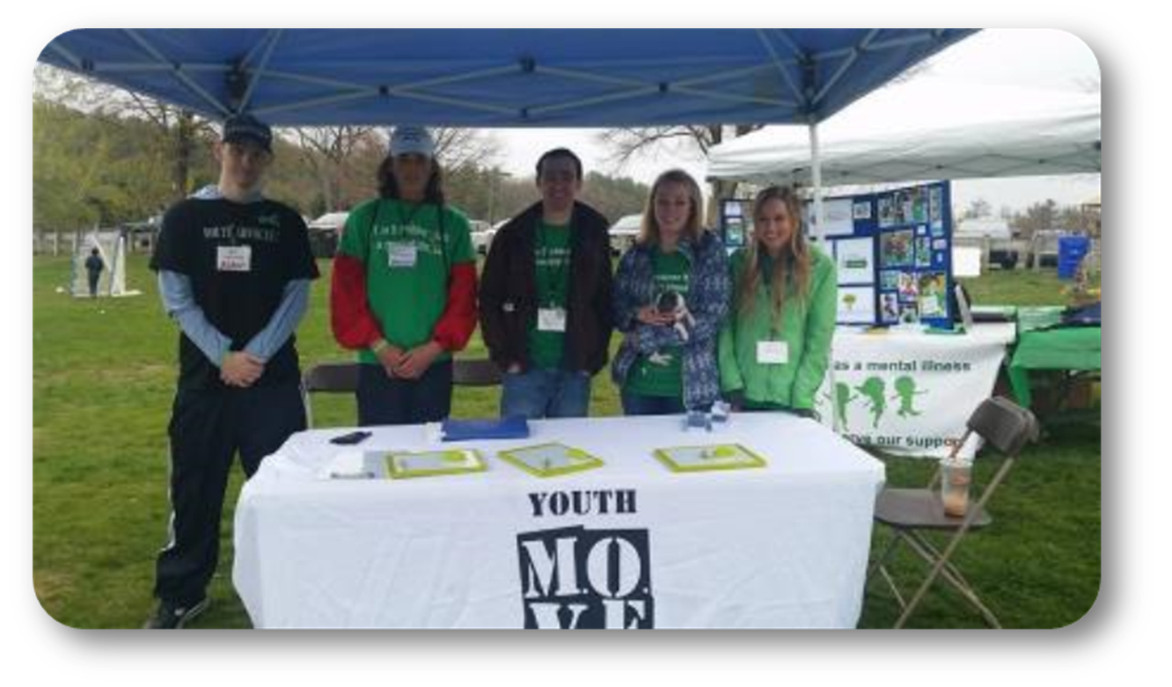
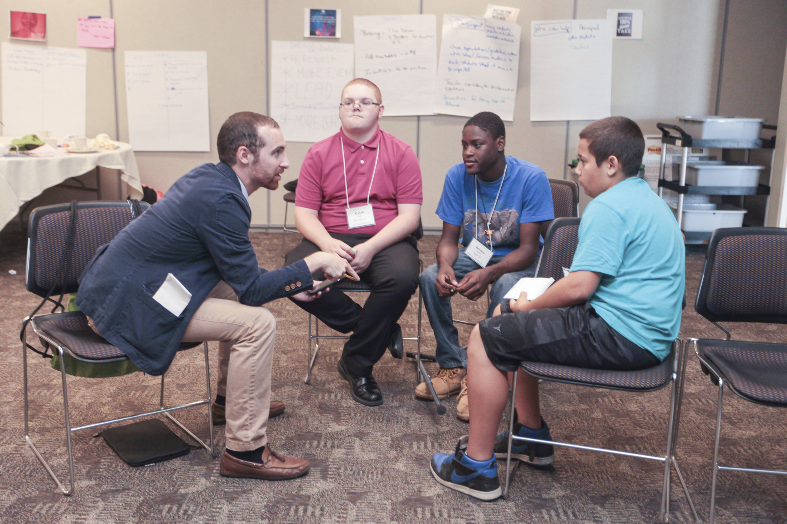
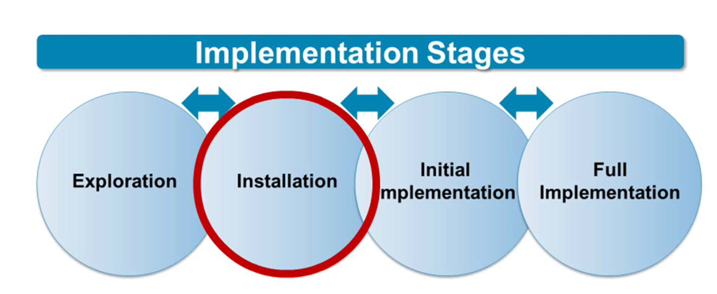
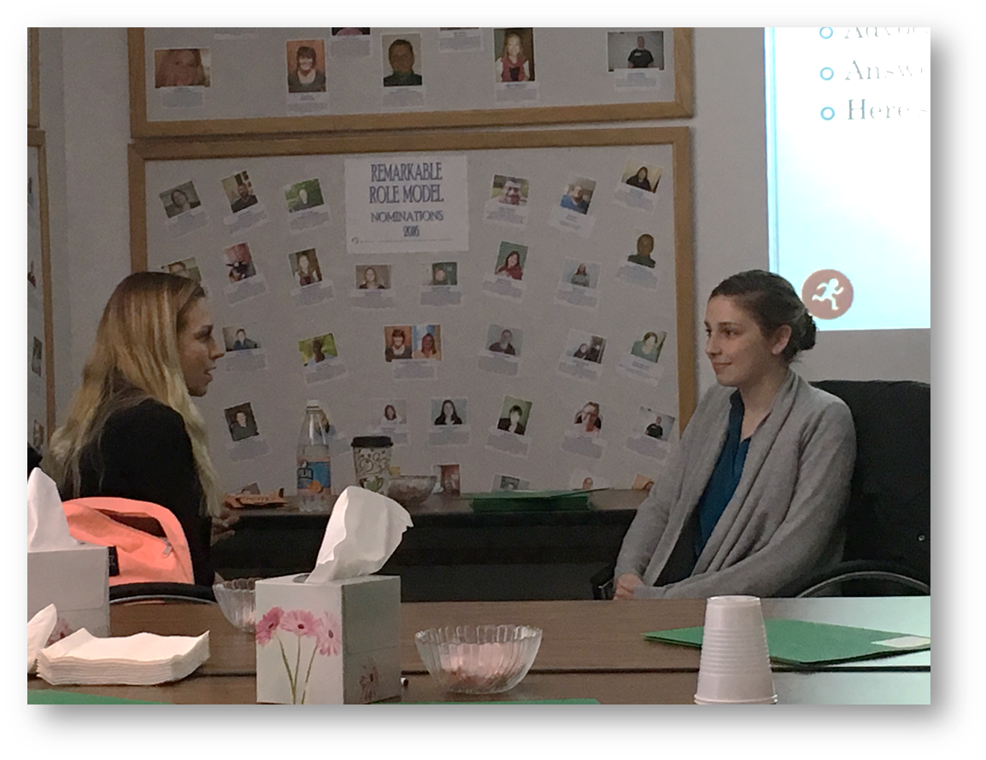
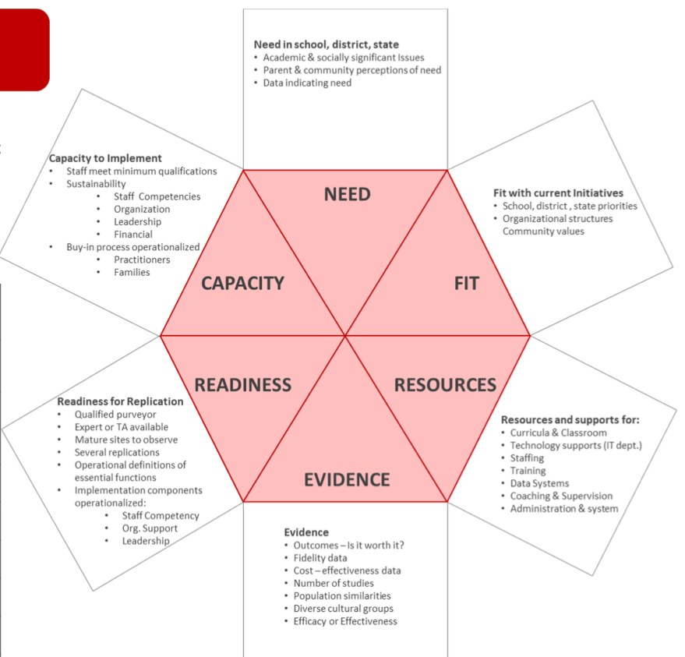
Developing Youth Peer Support Specialist Training Curriculum
Greta DeVolder Occupational Therapist
Leadership Placement
Leadership in Neurodevelopmental Disabilities
program (NH-ME LEND)
improves the health of youth and families who experience neurodevelopmental disabilities
Institute on Disability
improves knowledge, policies, and practices related to the lives of people with disabilities & their families
Youth M.O.V.E. (YM) NH
empowers youth to advocate for better services, enhanced youth rights, and stronger mental health systems
Youth Peer Support (YPS) Specialists
“provides support, education, skills training, and advocacy in ways that are both accessible and acceptable to families and youth” (2013 Joint CMCS and SAMHSA)
Placement Objectives
Develop and rollout a comprehensive training program for YM
Understand Implementation Science as it pertains to training and evaluation
Learn training strategies based on youth and adult learning theory
Train new YPS Specialists in
Purpose, Values, Principles, and Philosophies Context of Wraparound/System of Care
The Process
Researched program development through National Implementation Research Network (NIRN) framework
Reviewing YPS competencies, Practice Profile, Fidelity instruments
Qualitatively interviewed a current YPS Specialist to identify themes used in YM Evidence Based Practice (EBP), Profile and Competencies
Sharing Lived Experience/Wellness Strategies
Skills and Strategies for developing youth/YPS relationship
Understanding Trauma and Boundaries
I have:
Acquired an understanding of the NIRN program development framework
Developed skills in program development and implementation, as well as adult learning theory
Acquired leadership skills in communication, active listening, and team facilitation
Gained skills in developing program evaluations
Outline was developed based on qualitative themes and EBP
Curriculum was developed based on adult learning theory and NIRN
Piloted training was completed, along with experience survey

