Slide 1
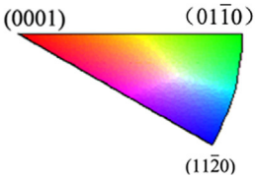
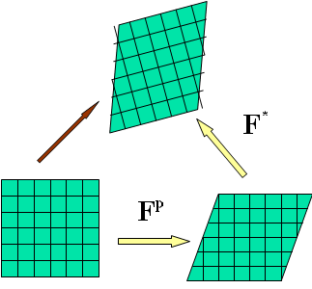
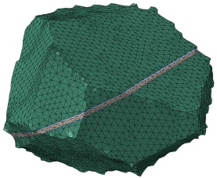
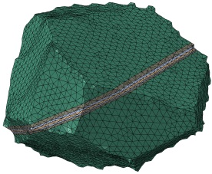
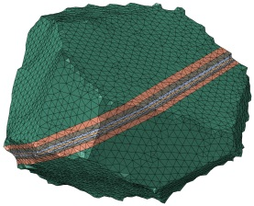
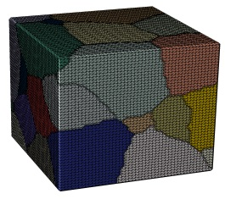
Explicit Modeling of Twin Lamellae in Magnesium Alloy AZ31 Using a Crystal Plasticity Finite Element Approach
Milan Ardeljan and Marko Knezevic Department of Mechanical Engineering, University of New Hampshire, Durham, NH 03824, USA
Introduction
Results
$$\left(0\overline{1}12\right)\left[01\overline{1}1\right]$$
$$\left(10\overline{1}2\right)\left[\overline{10}11\right]$$
$$\left(\overline{1}102\right)\left[1\overline{1}01\right]$$
Placement of the initial twin lamella
Deformation twins affect the material response in two ways:
- reorient the lattice,
- introduce a twin-matrix boundaries [1]
Application to magnesium alloy AZ31
- formation and propagation of extension twins - investigate the effect of twin dislocation density
Initially, we pre-strain the grain model
in simple compression. The grain in the
center has starting crystal orientation that is favorable for tension twinning ($\left(01\overline{1}2\right)\left[0\overline{1}11\right]$ extension twin variant
- Figure 1).
The twin is thickened from the initial 2% volume fraction in six different deformation steps to specific volume fractions (Figure 2).
Before twin formation
After twin formation
$$\overline{RSSTW}$$
$$\overline{VMises}$$
Xin (2014)
Modeling framework - CPFEM
Constitutive law
Flow rule
$$Finite element homogenization$$
DREAM.3D
3D meshing in MSC Patran
$$T^{e}=F^{e^{−1}}\left\{\left(detF^{e}\right)σ\right\}F^{e^{−T}}$$
$$F=F^{e}F^{p}$$
The black arrow indicates the location of the
highest stress concentration
$$T^{e}=CE^{e},$$
$$E^{e}=\frac{1}{2}\left\{F^{e^{T}}F^{e}−I\right\}$$
$${\dot{F}}^{p}=L^{p}F^{p}$$
Figure 1
$$\left(01\overline{1}2\right)\left[0\overline{1}11\right]$$
$$\left(\overline{1}012\right)\left[10\overline{1}1\right]$$
$$\left(1\overline{1}02\right)\left[\overline{1}101\right]$$
Slip resistance:
$$\frac{dF^{p}}{dt}=L^{p}F^{p}$$
Three extreme cases of twin
dislocation density are considered.
In the first case we adopt the stored DD at the time of twin inception.
Second involves fully recovering the dislocations within the twin region. The last case models the Basinski effect by doubling the stored dislocation densities.
$$Finite element and \\ integration point$$
$$Single crystal DD \\ hardening law$$
$$τ_{c}^{α}=τ_{0,f}^{α}+τ_{0,HP}^{α}+τ_{for}^{α}+τ_{sub}^{α}$$
$$Imposed deformation \\ F,∆t$$
$$\left\langle c\right\rangle$$
$$Prismatic$$
$$\left[\overline{1}\overline{1}23\right]$$
$$Pyramidal$$
$$II$$
$$\overline{VMises}$$
$$slip$$
$$Basal$$
$$\left(\int_{V}{B^{T}J}BdV\right)∆U= {}_{}^{τ}{R−\int_{V}{B^{T}σdV}}$$
$$n$$
$$b$$
$$\left\langle a\right\rangle$$
$$\left(0001\right)$$
$$\left\langle a\right\rangle$$
$$\left(01\overline{1}0\right)$$
$$\left(11\overline{2}2\right)$$
1
2
3
1
2
3
$$σ,J=\frac{∂∆σ}{∂∆E} \\ Crystal response$$
$$twin (pseudo slip)$$
Twin resistance:
$g_{1}^{tw},$ $f_{1}^{tw}$
$$τ_{c}^{β}=τ_{0}^{β}+μ^{β}\sum_{α}{C^{αβ}b^{β}b^{α}ρ_{for}^{α}}$$
$$Tension$$
$$twins$$
$$Compression \\ twins$$
Grain model contains 29 grains
(570000 C3D4 finite elements).
$g_{2}^{tw},$ $f_{2}^{tw}$
[2]
$$\left[0\overline{1}11\right]$$
$$\left[0\overline{1}12\right]$$
$$\left(01\overline{1}2\right)$$
$$\left(01\overline{1}1\right)$$
Figure 2
4
5
6
4
5
6
Procedure
[3]
Twin shear transfer
The increase in dislocation density content within the twinned region is found to slow down the twin propagation process. Thus, if the twinned region is harder due to increased DD, the twin will not grow as much as if it were softer.
1
2
3
4
5
6
Create voxel-based polycrystalline microstructures
Define finite element mesh of grain structure
Perform deformation (simple compression)
Extract surface
mesh of individual grain
Twin volume fraction [x10⁻²] | $$2.08$$ | $$4.91$$ | $$10.07$$ | $$19.76$$ | $$35.77$$ | $$44.94$$
Applied effective strain | $$0.0021$$ | $$0.006$$ | $$0.0127$$ | $$0.0259$$ | $$0.0489$$ | $$0.0671$$
$$same DD$$
$$removed DD$$
strain
Grain structures
with two different
twin configurations
with 45% twin
lamellae (Figure 3).
Table presents
calculations of the
system energy
when the 45% twin
volume fraction is
embodied in one
lamella or two
separate lamellae.
$$\overline{VMises}$$
$$45\%$$
$$2xDD (Basinski effect)$$
(2)
$$Twin volume fraction$$
$$36\%$$
Select grains developing $f^{tw,pts}$
Twin formation
strain
(1)
$$20\%$$
Define twin planes corresponding to β=tw,pts
Intersect grain surface mesh with twin planes
Generate surface mesh over parent grain and twin
$$2\%$$
$$10\%$$
$$5\%$$
$$True strain$$
$$True strain$$
Twin lamella (1)
$$\overline{RSSTW}$$
Work integral | same DD | Removed DD | 2xDD
$$∆W=\frac{1}{V}\sum_{1}^{n}{\int_{V}{σ_{ij}ε_{ij}^{P}}}$$ | $$∆W\left[\frac{MJ}{m^{3}}\right]x{10}^{4}$$ | $$∆W\left[\frac{MJ}{m^{3}}\right]x{10}^{4}$$ | $$∆W\left[\frac{MJ}{m^{3}}\right]x{10}^{4}$$
Grain cluster | 0.24 | -2.06 | 2.4
Parent grain + twin | 0.29 | -0.17 | 0.4
Parent grain | 0.13 | -0.125 | 0.03
Twin lamella | 0.16 | -0.05 | 0.37
$$F^{p^{−1}}\left(τ\right)=\left\{I−S^{tw,pts}m_{0}^{tw,pts}\right\}$$
Twin thickening
Parent grain (2)
Select grains with growing $f^{tw,pts}$
Define twin planes corresponding to β=tw,pts
Intersect grain surface mesh with twin planes
Generate surface mesh over parent grain and twin
$$F^{p^{−1}}\left(τ\right)=F^{p^{−1}}\left(t\right)\left\{I+f^{tw,pts}S^{tw,pts}m_{0}^{tw,pts}\right\}$$
Figure 3
Conclusions
References
A novel approach to modeling twin transformation in AZ31 was successfully implemented by explicit incorporation of twin lamellae in 3D CPFE. Characteristic twin shear and grain reorientation were explicitly incorporated in the model. Stress-strain fields and normalized twin driving force are analyzed as a function of strain/twin volume.
We show that Basinski effect slows down the twin propagation process as oppose to when the dislocation density is retained or removed by the twin.
[1] J.W. Christian, S. Mahajan, Progress in Material Science, 39 (1995) 1-157
[2] M. Ardeljan, I.J. Beyerlein, B.A. McWilliams, M. Knezevic, International Journal of Plasticity, 83 (2016) 90-109
[3] M. Ardeljan, J.R. McCabe, I.J. Beyerlein, M. Knezevic, Computer Methods in Applied Mechanics and Engineering, 295 (2015) 396-413
Insert grains neighboring twin lamella
Assemble mesh and perform mesh repair
Meshing and mapping state variables

