Slide 1
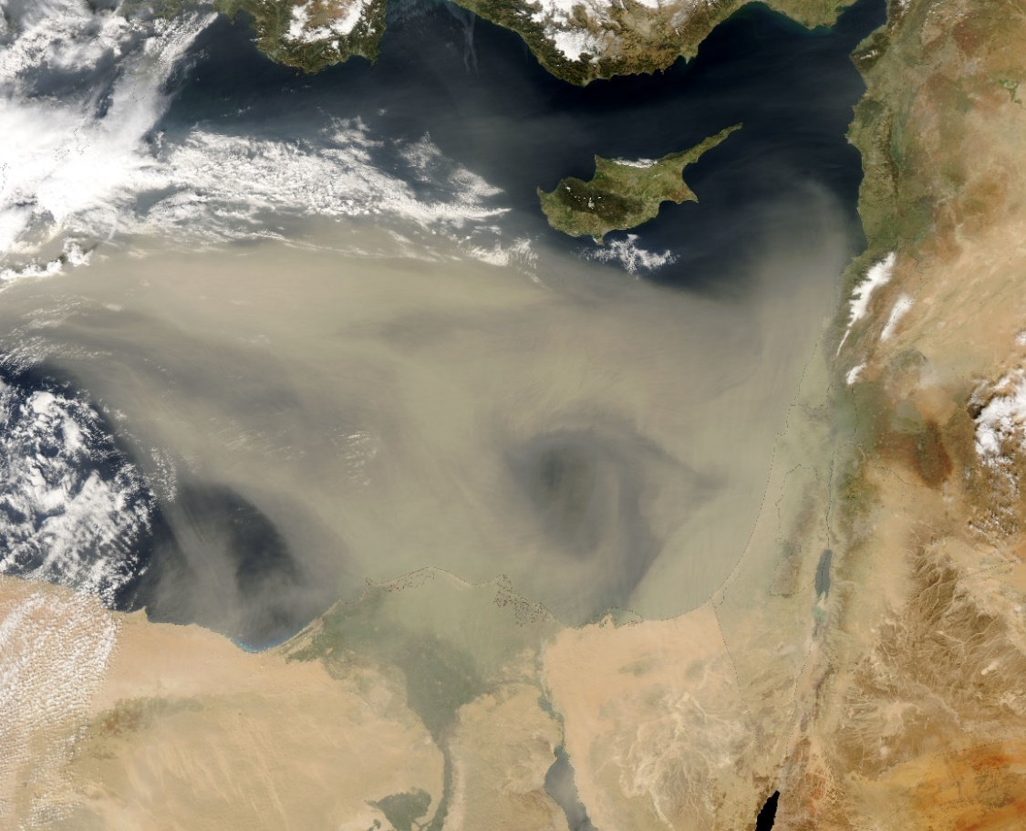
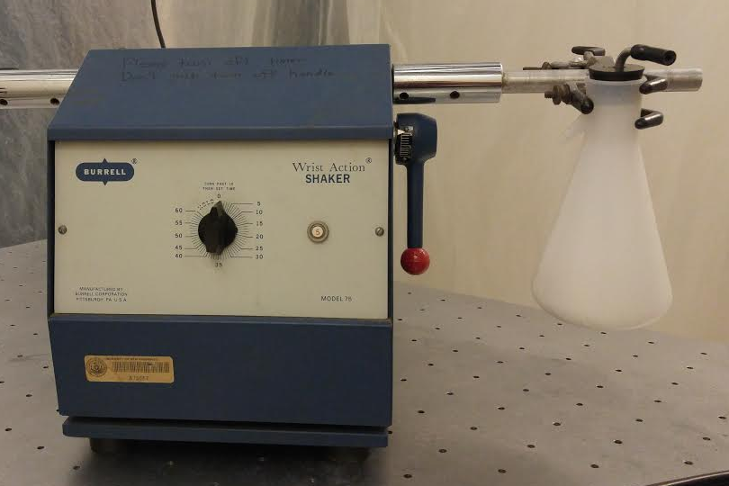
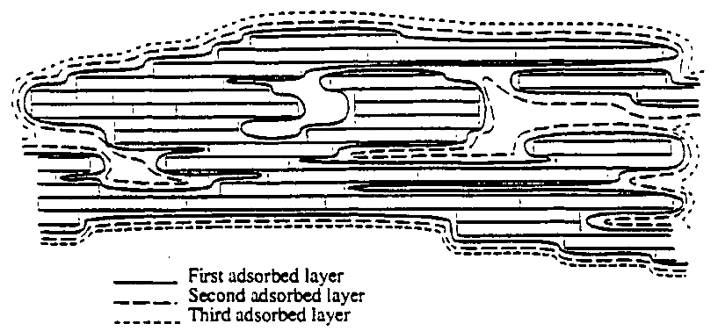
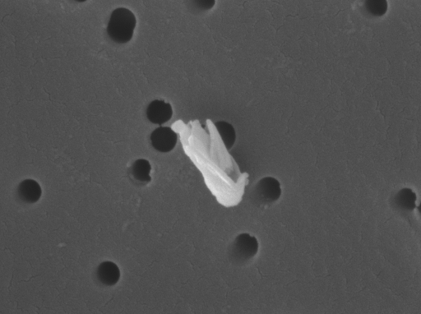
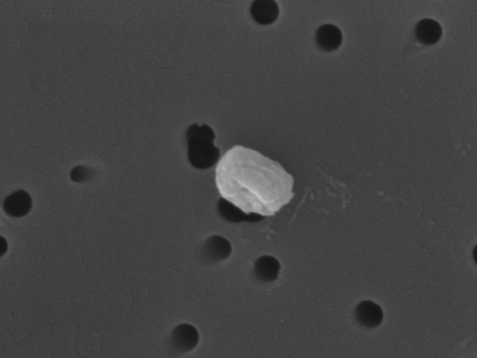
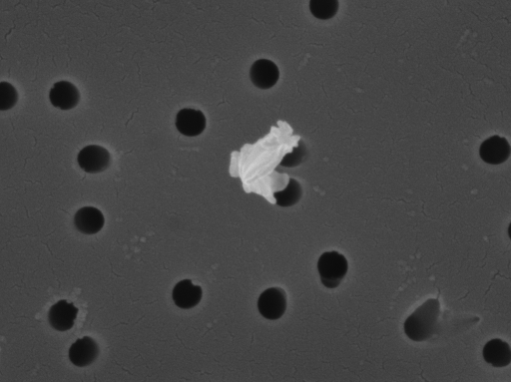
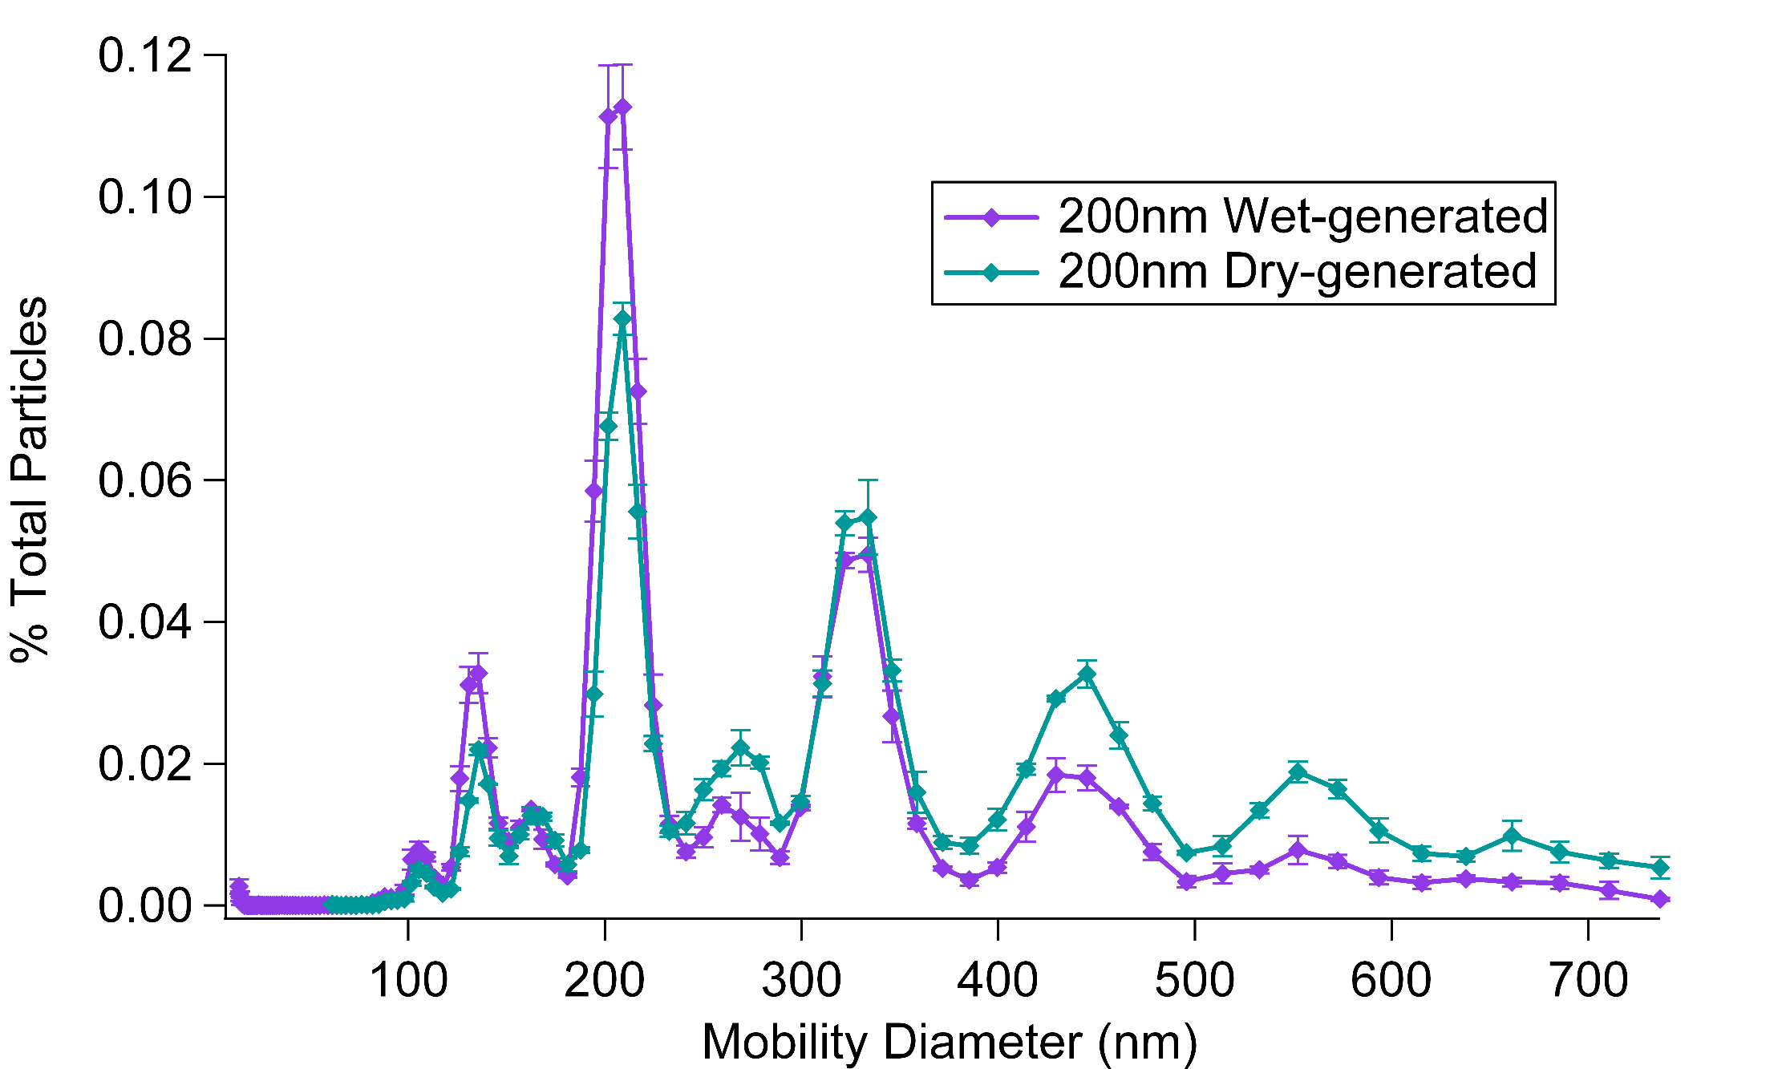
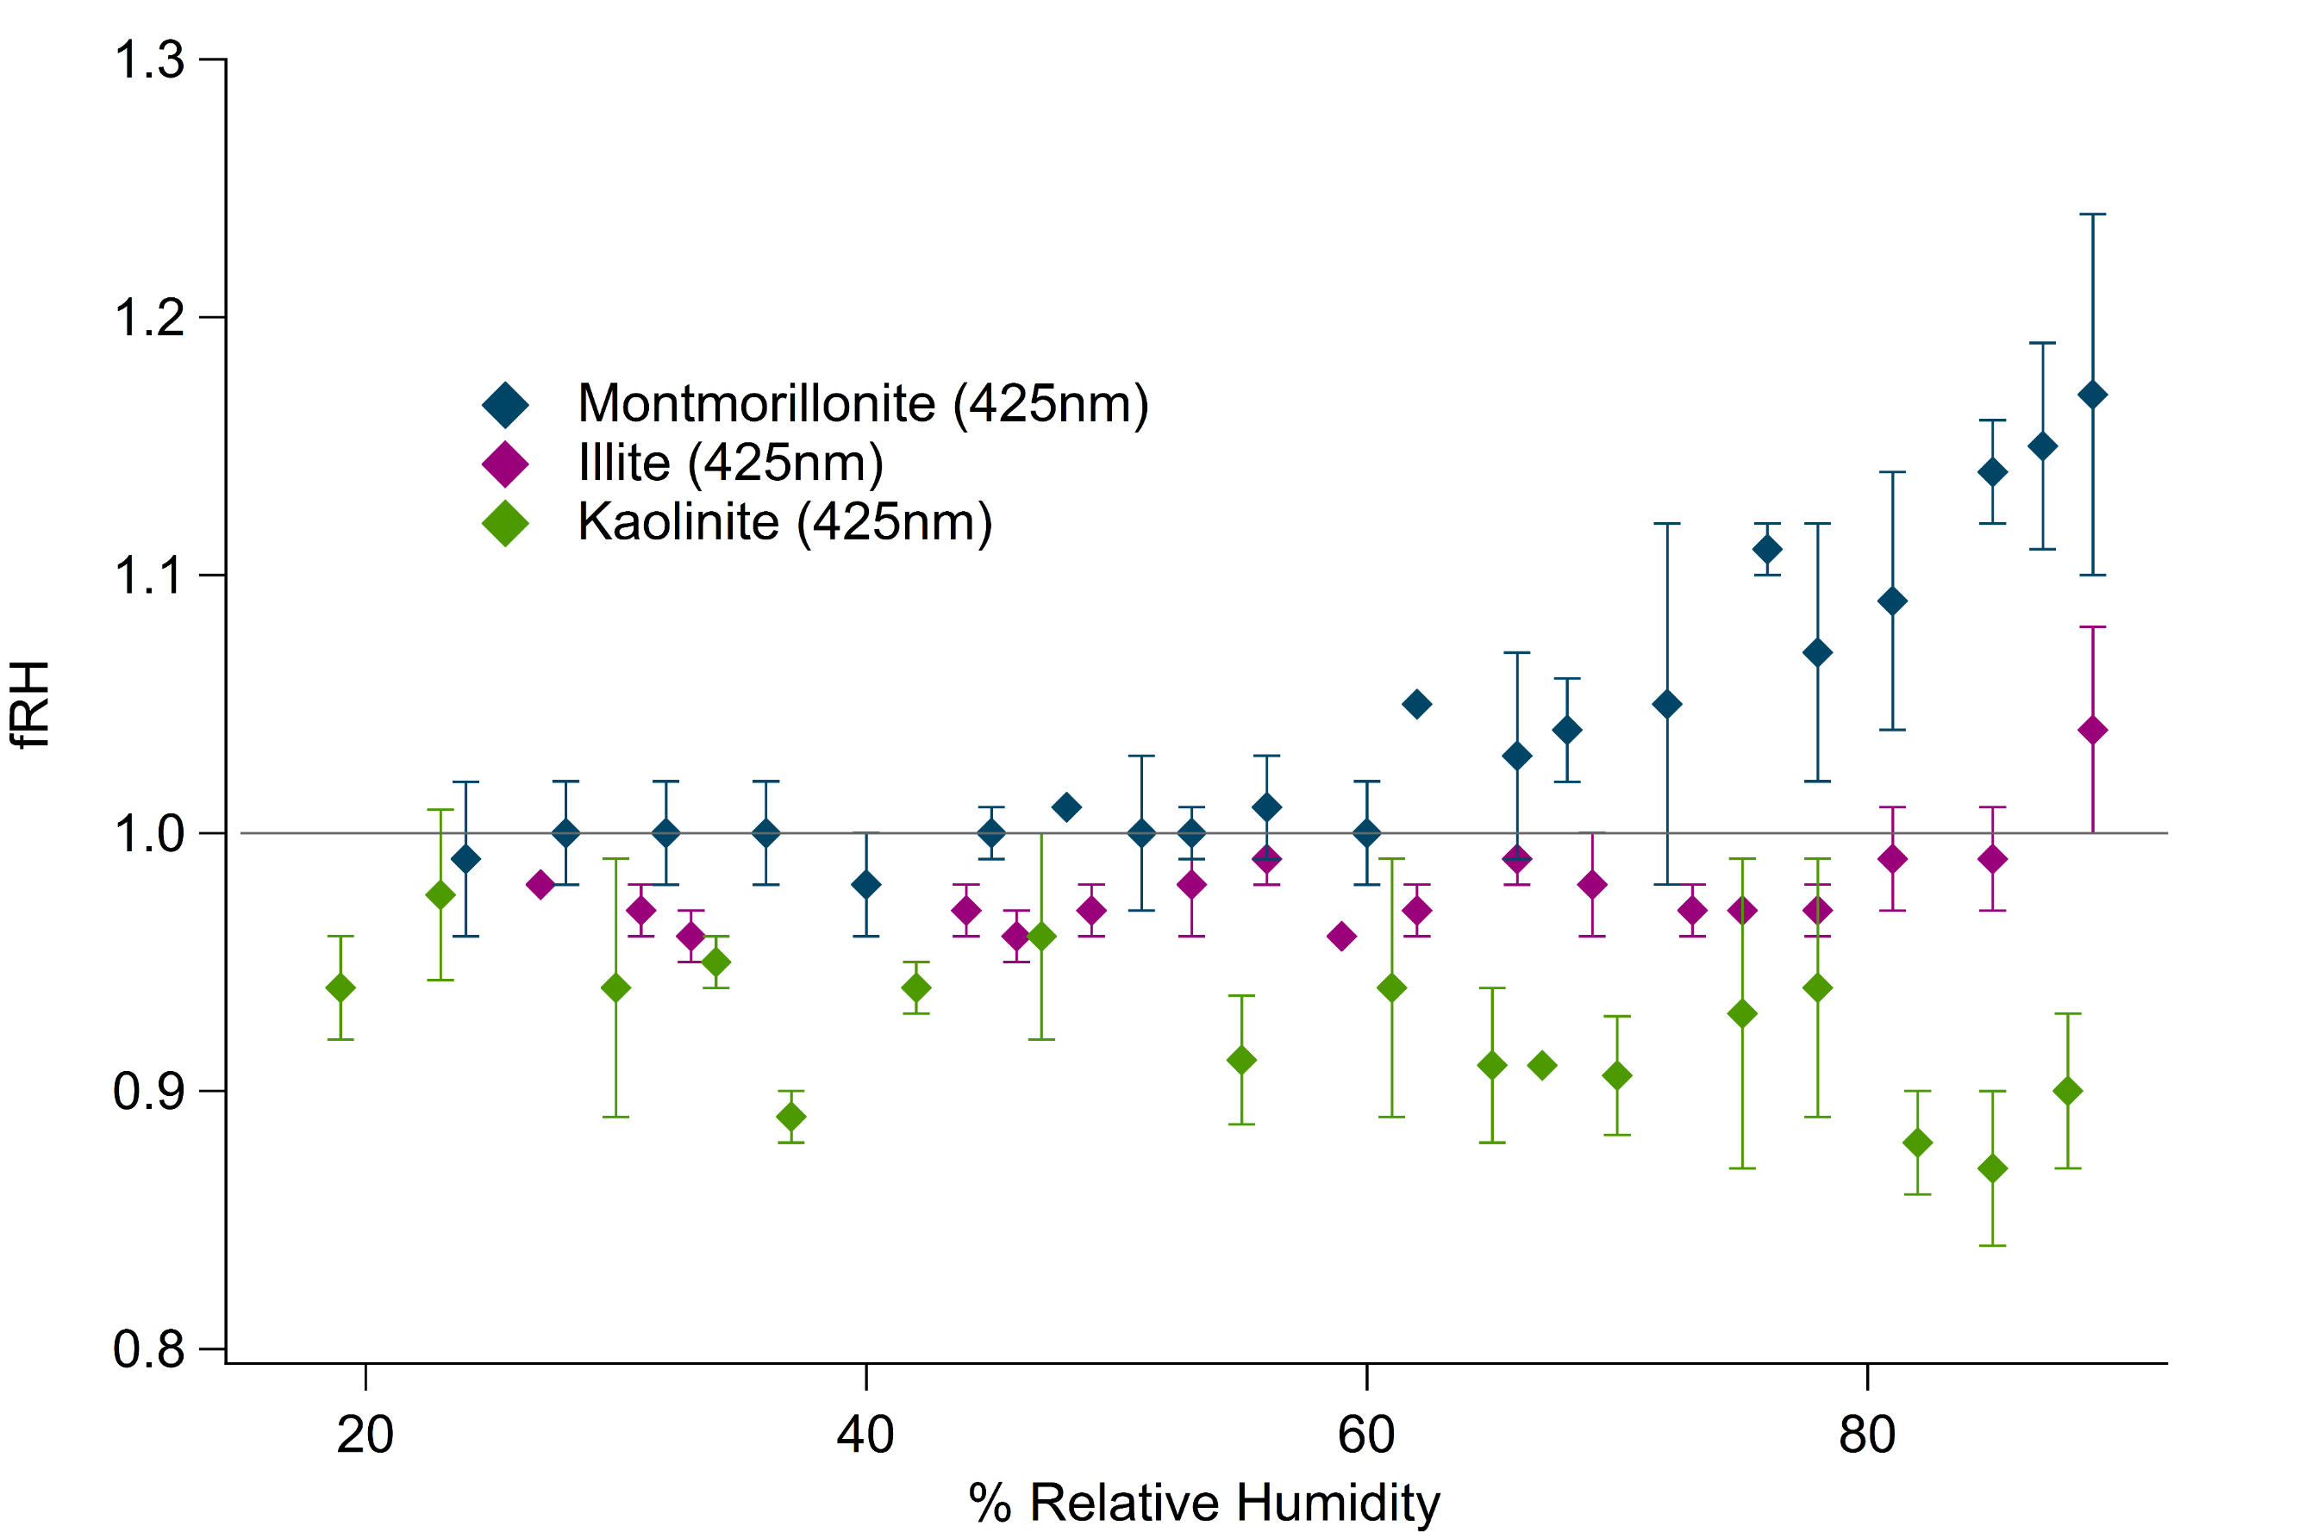
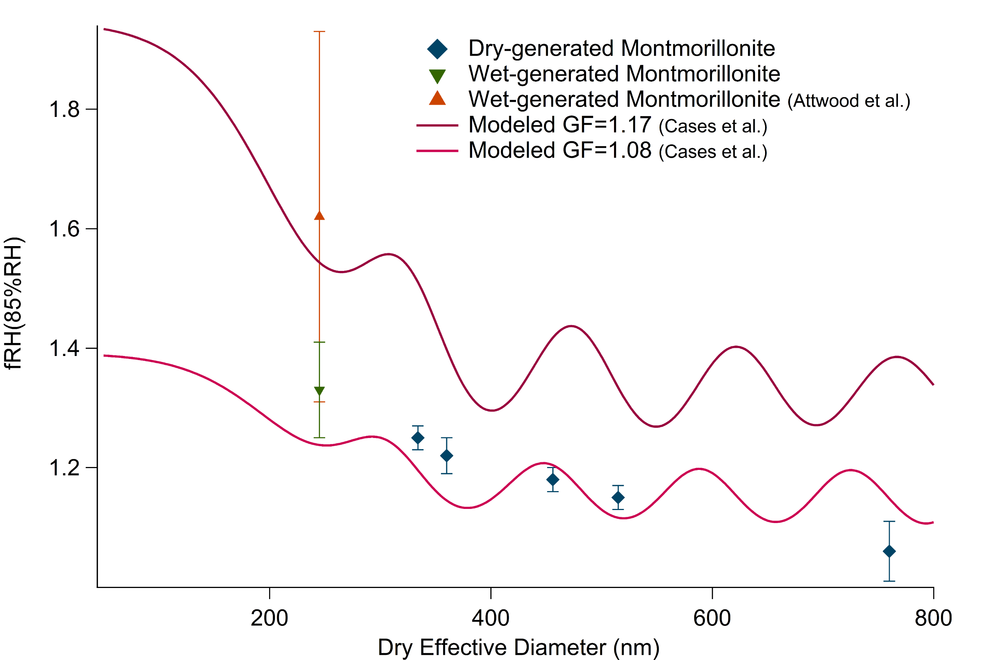
The Optically Observed Water Uptake of Dry-generated Clay Aerosol
and the Influence of Experimental Variables
Jillian Morang, Tyler Galpin, and Margaret E. Greenslade
University of New Hampshire, Chemistry Department, Durham, NH 03824
Introduction
Dry Aerosol Generation
Discussion
Mineral dust aerosol mostly enter the atmosphere via large dust storms.¹
Composed of a variety of types of clays that can be used to trace their source.²
Smaller particles will have longer life times than larger particles and can be transported more than 20,000 km.²
Structure allows water uptake on the surface and between the layered sheets.³
Aerosols were dry-generated with a Burrell wrist action shaker and side-arm flask.
Dry, ground clay is placed in the bottom of a side-arm flask with four agitators.
A stream of nitrogen flowed down a center tube and out the side arm.
Shaking motion, agitators, and nitrogen flow work together to suspend clay particles.
Settling volume and PIXE impactor remove particles >1μm.
A dry-generation technique was successfully developed to study water uptake on clay aerosol and compare with other generation methods.
Most previous literature has utilized wet-generation. The early introduction of water to the clay may not replicate ambient conditions.
Dry-generation creates a higher percentage of larger particles than wet-generation.
Non-spherical shape of particles may cause Mie theory to underestimate optical properties. This and the size dependent nature of fRH makes doublet corrections difficult.
Different types of clays exhibit different behavior upon humidification between 30% and 90%RH:
σ_{ext} of montmorillonite increases with increasing humidity
σ_{ext} of illite has little to no change upon humidification
σ_{ext} of kaolinite deceases with increasing humidity.
https://earthobservatory.nasa.gov/NaturalHazards/view.php?id=18049
Mineral dust aerosols contribute large uncertainties to climate models because of non-spherical shape, high atmospheric concentrations, and interactions with water/relative humidity (RH) and other compounds.⁴
In order to better understand differences cause by various generation methods:
Dry-generation technique was
developed
Extinction of dry and humidified
clay aerosol was measured; fRH
was found
Comparisons were made with
literature and wet-generation fRH
and GF values
Results
Dry-generated 350nm Na-montmorillonite particles, imaged with SEM.
$$fRH\left(\%RH\right)=\frac{σ_{ext,\%RH}}{σ_{ext,dry}}$$
First adsorbed layer
Second adsorbed layer
Third adsorbed layer
$$GF=\frac{D_{\%RH}}{D_{dry}}$$
Cases, et al. Langmuir, Vol. 8, No. 11, 1992
500nm
500nm
500nm
Goal: Develop a dry aerosol generation technique and compare optical properties between wet and dry-generated clay aerosol.
Experimental Methods
Cavity Ring-Down Spectroscopy (CRD)⁵
532 nm Nd:YAG laser (near solar maxima) used to determine the extinction of light by the clay particles.
The extinction cross-section (σ_{ext}) for a single particle can be determined with size control and concentration measurements.
Tandem CRD cells allow comparison of optical properties with a change, such as increased RH.
The effect of clay type
Different types of clay will undergo different optical changes when humidified. This dry-generated water uptake data is comparable to that seen in previous literature.
Future Work
Doublet corrections for fRH data to improve comparison between wet and dry-generation techniques at selected sizes.
Retrieve effective RI for rough clay particles to allow climate models to account for multiple scattering events.
Investigate the effect that other experimental variables have on water uptake.
Compare fRH(85%) as a function of particle size for the two generation techniques of the same clay.
Experimental Diagram
PIXE Impactor
Cavity Ring-Down Spectrometer
Humidifier
Dry-generation
Acknowledgments
Condensation Particle Counter
The UNH College of Engineering and Physical Sciences (CEPS), and in particular the Department of Chemistry.
Nancy Cherim and the University Instrumentation Center (UIC) for help with and use of the SEM.
All of the Greenslade research group members.
Differential Mobility Analyzer
Size effects
Modeled lines represent the range of literature growth factors. Optical properties are size dependent, giving shape to fRH model. Points are plotted as optical effective diameter. Purple arrows indicate points with the same mobility diameter.
Mie Theory
A solution to Maxwell’s equations used to calculate extinction cross-section of a particle of known size and refractive index (RI).
Assumes particles are homogenous and spherical.
Can be employed to model optical relative humidity factors (fRH) from measured physical growth factors (GF).
Other techniques and information
Studied clays include montmorillonite, illite, and kaolinite.
Size selected aerosols imaged with scanning electron microscopy (SEM).
Tandem differential mobility analyzer technique was used to determine differences in size distribution for different generation methods.
Settling Volume
200nm Mobility Diameter
References
1.Boucher, O.; Randall, D.; Artaxo, P.; Bretherton, C.; Feingold, G.; Forster, P.; Kerminen, V.-M.; Kondo, Y.; Liao, H.; Lohmann, U.; Rasch, P.; Satheesh, S. K.; S.; Sherwood; Stevens, B.; Zhang, X. Y., Clouds and Aerosols. In Climate Change 2013: The Physical Science Basis. Contribution of Working Group I to the Fifth Assessment Report of the Intergovernmental Panel on Climate Change, Stocker, T. F.; Qin, D.; Plattner, G.-K.; Tignor, M.; Allen, S. K.; Boschung, J.; Nauels, A.; Xia, Y.; Bex, V.; Midgley, P. M., Eds. Cambridge University Press: Cambridge, United Kingdom and New York, NY, USA, 2013; pp 571-658.
2.Grousset, F. E.; Ginoux, P.; Bory, A.; Biscaye, P. E., Case study of a Chinese dust plume reaching the French Alps. Geophysical Research Letters 2003, 30 (6), 4.
3.Cases, J. M.; Berend, I.; Besson, G.; Francois, M.; Uriot, J. P.; Thomas, F.; Poirier, J. E., Mechanism of Adsorption and Desorption of Water-Vapor by Homoionic Montmorillonite: The Sodium-Exchanged Form. Langmuir 1992, 8 (11), 2730-2739.
4.Usher, C. R.; Michel, A. E.; Grassian, V. H., Reactions on mineral dust. Chemical Reviews 2003, 103 (12), 4883-4939.
5.Attwood, A. R.; Greenslade, M. E., Optical Properties and Associated Hygroscopicity of Clay Aerosols. Aerosol Science and Technology 2011, 45 (11), 1350-1359.
Notes:
Abstract: Mineral dust aerosol makes up a large portion of the aerosols present in the atmosphere and can affect climate, air quality, and human health. Having a laboratory method to replicate the aerosol created during a dust storm to study the components of mineral dust aerosol under controlled and varied conditions is important to constrain climate models. Previous aerosol-generation techniques are not representative of the natural dust storm process, having involved creating a slurry of the desired clay in water. This study has developed an environmentally representative dry-generation technique and begun to quantify the optical changes that occur with water uptake by certain clay particles. The chosen clays are montmorillonite, kaolinite, and illite as these are commonly found in the atmosphere and exhibit differing behavior when humidified. The light extinction by these aerosols is measured with a cavity ring down spectrometer consisting of two parallel measurement cells with a humidification step in between, so that water uptake can be observed. Comparisons will be made between wet and dry aerosol-generation techniques with consideration of how particle sizes and humidification process impact experimental results. Early results show some experimental influence in the optically obtained fRH values of clay aerosol.

