Slide 1
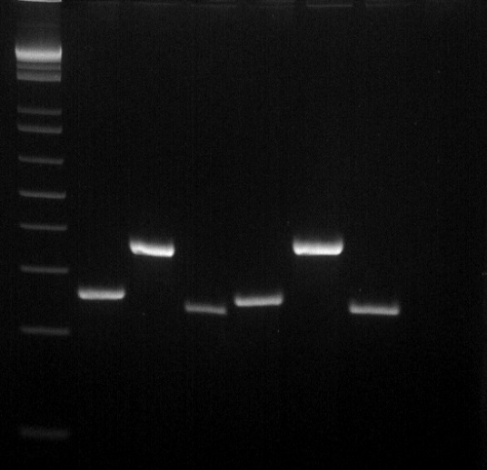
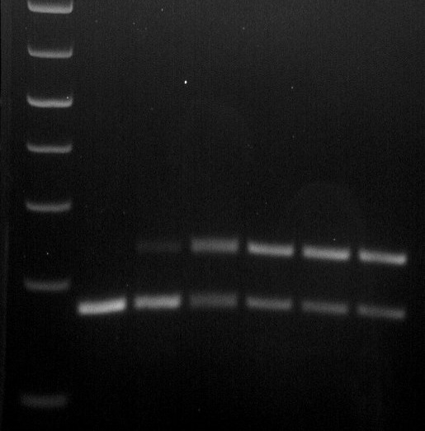
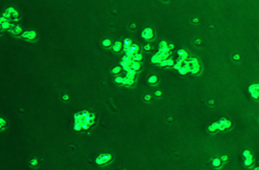
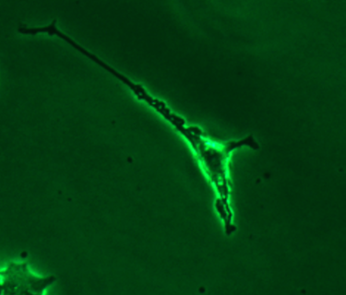
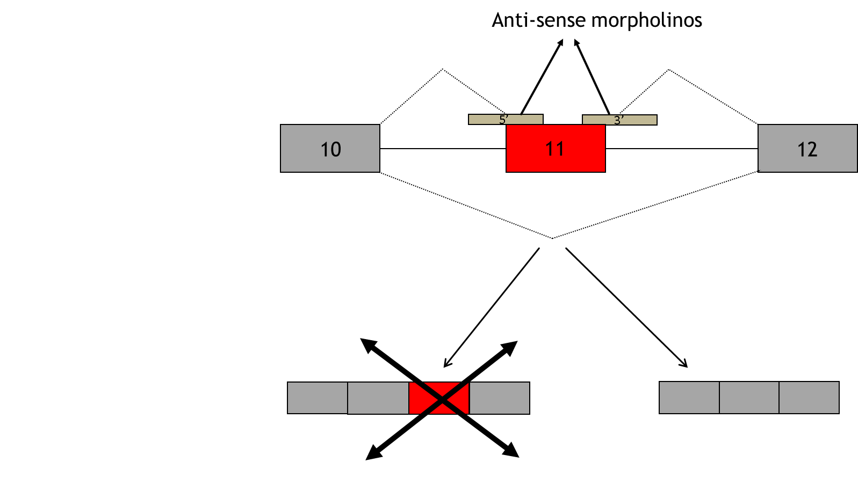
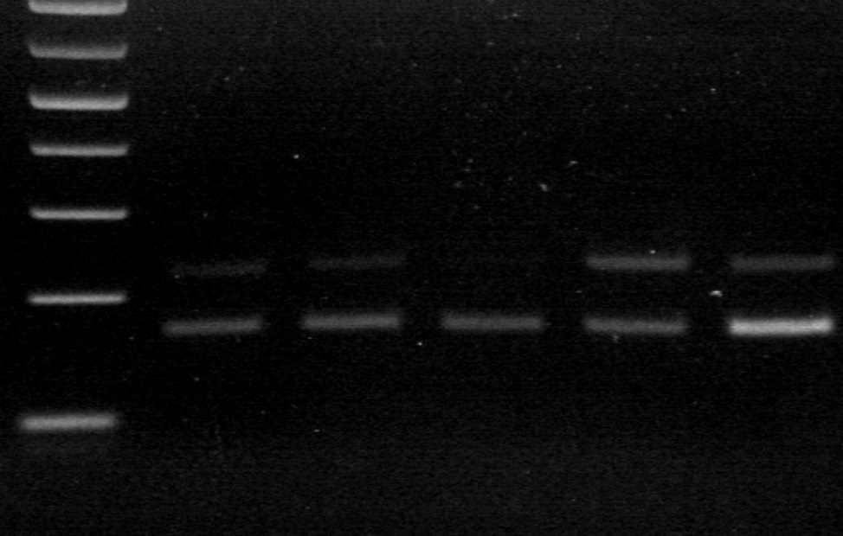
Assessing the role of Cacna1d pre-mRNA splicing on gene expression LaCarubba B, Savage K, Bunda A, Foxall T, Andrade A Department Of Biological Sciences, University of New Hampshire, Durham, NH 03824
Introduction
Expression e11 in the human nervous system
Immunodetection of Ca_{V}1.3 in PC12 cells
Splicing factors in PC12 cells
Ca_{V}1.3, an L-type voltage-gated calcium channel, is highly expressed in the postsynaptic membrane of neurons, and in neuroendocrine cells. Depolarization of the postsynaptic membrane opens these calcium channels and allows calcium entry. This calcium entry couples to secondary messengers and induces activity-dependent gene expression¹. Alternative splicing of the Cacna1d (Ca_{V}1.3) pre-mRNA is critical in generating molecular and functional diversity of Ca_{V}1.3 through the generation of tissue-specific isoforms. Here we investigate the tissue and developmental expression of exon 11 (e11), a cassette exon that is either included or excluded in the final mRNA transcript (Figure 1a). E11’s sequence is also conserved amongst species (Figure 1b,c) highlighting it’s potential importance. Calcium coupled gene expression is most notable in the immediate expression of c-Fos, a transcription factor whose expression levels increase 60 fold within 1 hour of calcium entry². If e11 contributes to tissue and developmentally regulated gene expression, expression levels of c-Fos are likely to change. To test this, we utilize the rat pheochromocytoma PC12 cells, a cell line which can be differentiated to a neuron-like phenotype using nerve growth factor (NGF). Using morpholinos targeted to e11, we successfully inhibited inclusion of e11. Next we will measure c-Fos mRNA with RT-qPCR in cell cultures lacking the e11 isoform. We also aim to elucidate how e11 splicing is regulated. Initial evidence suggests that the splicing factors Mbnl1, 2 and Rbfox1 regulate e11 splicing. Mbnl1 and Mbnl2 knock out decreases inclusion of exon 11 in mouse brains³. Similar results were observed in Rbfox1 knock out mice⁴. These results suggest a complex regulation of exon 11. We expect our results to provide mechanistic insights on the nuances of calcium-dependent gene expression throughout different regions of the nervous system and during development.
FB HB CB CC HC SC DRG SN NC
D4
Figure 5. Ca_{V}1.3 protein is detected in PC12 cells Confocal image of a differentiated PC12 cell stained with a Cav1.3 specific antibody. Day 7 differentiated PC12 cells were fixed with paraformaldehyde then incubated in Ca_{V}1.3 antibody (alomone ACC-005) overnight. They were then incubated with the secondary antibody donkey anti-rabbit IgG H&L 488 (ab150073) before being plated on glass slides and imaged. Green indicates robust expression of Ca_{V}1.3 in PC12 cells.
ND
1 2 3 4 5 6
200 bp
100 bp
300 bp
Figure 2. e11 inclusion changes across different areas of the nervous system. Several areas of the nervous system were analyzed using RT-PCR to detect the levels of e11 inclusion. Primers were located in exons 9 and 12 flanking exon 11 (Figure 1a). Left panel) Representative RT-PCR of several areas of the nervous system. Right panel) Multiple independent RT-PCRs (3) from pooled mRNA derived from several subjects were run. Data are mean ± S.E. (%). Fetal brain (FB, 100), adult human brain (HB, 89 ± 1.3 ), cerebral cortex (CC, 88 ± 1.2), cerebellum (CB, 87 ± 0.4), hippocampus (HC, 82 ± 1.3), spinal cord (SC, 45 ± 2.6), dorsal root ganglia, (DRG, 65 ± 2.4), substantia nigra (SN, 70 ± 2.8) p<0.0001.
200 bp
100 bp
Figure 8. mRNAs for splicing factors Mbnl1, Mbnl2 and Rbfox1 are present in PC12 cells. Representative RT-PCR of splicing factors Mbnl1 (lane 1, ND and lane 4, D4), Mbnl2 (lane 2, ND and lane 5, D4), and Rbfox1 (lane 3, ND and lane 6, D4). All three splicing factors were present in both undifferentiated and differentiated cells.
Developmental expression of e11
e11 Inclusion in PC12 cells
a.
Ca_{V}1.3 pre-mRNA
9
10
11
12
P0 P9 P18 P30 P60 P180
a.
b.
Ca_{V}1.3 mRNA
9
10
11
12
9
10
12
Conclusions
b.
+11 isoform
Δ11 isoform
c.
ND D4
Splicing of exon 11 is both tissue specific and developmentally regulated.
e11 inclusion is quantitatively different in human relative to mouse or rat.
P12 cells express Ca_{V}1.3 protein.
Differentiation induces e11 inclusion in PC12 cells
Morpholinos effectively knockdown e11 inclusion in PC12 cells.
200 bp
d.
100 bp
200bp
100bp
Future Directions
Figure 3. e11 increases over development in whole brain. Mouse specific primers were located in exons 9 and 12 flanking exon 11 (Figure 1a). Left panel) Representative RT-PCR of whole mouse brains at different post-natal ages. Right panel) Multiple independent RT-PCRs (3) from RNA extracted from male C57BL6/J mouse brains .Data are mean ± S.E. (%). E11 levels P0 (2.5 ± 2.5), P9 (18.4 ±5.8), P18 (51 ±5.4), P30 (56.1 ±1.5), P60 (64.6 ± 1.4), P180 (57 ± 2.3), p<0.0001.
Figure 6. Differentiation of PC12 into a neuron-like phenotype induces e11 inclusion in PC12 cells a) Bright field image of undifferentiated (ND) PC12 cells plated on collagen I. b) Bright field image of PC12 cells differentiated for 4 days (D4) with 100 ng/mL NGF. c) Example RT-PCR ND vs D4 cells. d) Multiple independent RT-PCRs from RNA extracted from ND and D4 PC12 cells. Data are mean ± S.E. (%). ND (24.5 ± 0.5), D4 (46.6 ±1.5) p<0.0001.
Human WCWWRRRGAAKAGPSGCRRWG
Rat WCWWKRRGAAKTGPSGCRRWG
Mouse WCWWKRRGAAKTGPSGCRRWG
We will use the knockdown of exon 11 to investigate changes in gene expression. Specifically we will use qRT-PCR to study the induction of c-Fos expression after cell depolarization and calcium influx.
We will use whole transcriptome analysis to determine if there are any other genes which may be differentially regulated by e11 expression.
We will elucidate how the splicing of exon 11 is regulated by Mbnl1, Mbnl2 and Rbfox1.
c.
E10 E11 E12
Species comparison of e11 splicing
Suppression of e11 in PC12 cells
HB RB MB NC
a.
b.
Figure 1. a) Ca_{V}1.3 pre-mRNA is spliced to either include or exclude exon 11 in the final transcript. This produces two distinct splice isoforms. Boxes represent exons. Lines indicate intronic regions. Arrows represent the location of primers used. b) Unfolded diagram of a calcium channel. Red circle shows the putative location of exon 11 in the I-II linker of the Ca_{V}1.3 protein. This region is not present in the Δ11 isoform c) Sequence alignment of genomic region in chromosome 3 containing e10, e11, and e12 (blue boxes). E11 is highly conserved amongst vertebrates (green peaks). Source: UCSC genome browser GRCh38/hg38
Acknowledgements
Funding for this research comes from the National Institute of Health R00-MH099405 . Thank you to Maxwell Blazon for conducting the antibody staining. Special thanks to my undergraduates, Hannah Sargent, Zach Tepper, and Sumeet Panesar for your help in this project.
200 bp
d.
Morpholinos
Methodology
c.
5’ 3’ Both D4 ND
References
RNA: Human (3-21 individuals were used depending on sample region) and rat RNA (200 individuals were used). PC12 and mouse brain RNA was extracted using Qiagen RNAeasy kits.
RT-PCRs: RNA was transcribed into cDNA using Superscript IV reverse transcriptase. Species specific primers located on exons 9 and 12 were used for PCRs.
Cell Culture: PC12 cells were cultured in RPMI-1640 media 10% heat inactivated horse serum and 5% FBS in suspension. To induce differentiation, cells were plated on collagen I coated plates in serum free media containing 100 ng/mL nerve growth factor.
Morpholino: Morpholinos were transfected using endoporter and entry was assessed based on fluorescence. Cells were incubated in morpholinos 4 days, new morpholinos were added every 48 hrs.
100 bp
200 bp
Wheeler, D. G., Groth, R. D., Ma, H., Barrett, C. F., Owen, S. F., Safa, P., & Tsien, R. W. (2012). Ca V 1 and Ca V 2 channels engage distinct modes of Ca 2+ signaling to control CREB-dependent gene expression. Cell, 149(5), 1112-1124.
Sheng, M., & Greenberg, M. E. (1990). The regulation and function of c-fos and other immediate early genes in the nervous system. Neuron, 4(4), 477-485.
Goodwin, M., Mohan, A., Batra, R., Lee, K. Y., Charizanis, K., Gómez, F. J. F., ... & Clark, H. B. (2015). MBNL sequestration by toxic RNAs and RNA misprocessing in the myotonic dystrophy brain. Cell reports, 12(7), 1159-1168.
Gehman, L. T., Stoilov, P., Maguire, J., Damianov, A., Lin, C. H., Shiue, L., ... & Black, D. L. (2011). The splicing regulator Rbfox1 (A2BP1) controls neuronal excitation in the mammalian brain. Nature genetics, 43(7), 706-711.
100 bp
Figure 4. Inclusion of e11 is more robust in human adult whole brain than in rat or mouse adult whole brain. Species specific primers were used (Figure 1a). Left panel) Representative RT-PCR of adult whole brain from human (HB), rat (RB) and mouse (MB). Right panel) Multiple independent RT-PCRs (3) from pooled RNA (HB and RB) or RNA extracted from 3 mice (MB). Data are mean ± S.E. (%). Human (89 ± 1.3), mouse (51 ±2.27), rat (57 ± 2.27), p<0.0001.
Figure 7. Morpholinos prevent inclusion of e11 a) Representative bright field image of D4 PC12 cells transfected with fluorescein-labeled morpholinos. b) Representative epifluorescence image of transfected PC12 cells. Green fluorescence indicates PC12 cells transfected with morpholinos. c) Anti-sense morpholinos were designed to target the 5’ and 3’ intron-exon junctions to prevent inclusion of e11. d) Representative RT-PCR of PC12 cells transfected with 5’, 3’, and both morpholinos compared to D4 and ND PC12 cells.

