Slide 1

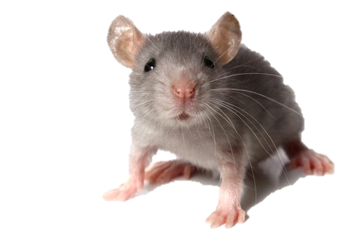
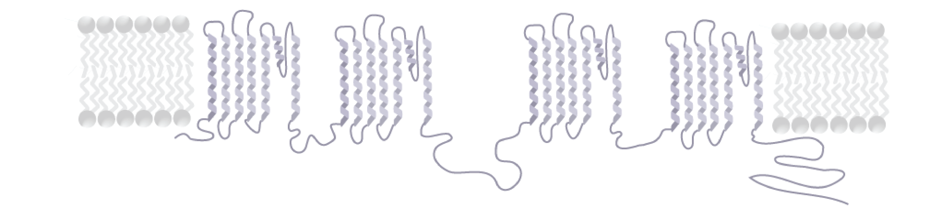
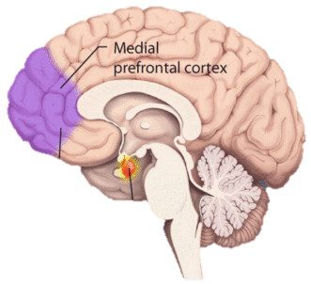
Alternative splicing of Ca_{V}2.2 pre-mRNA influences fear conditioning in females
University of New Hampshire
Alexandra Bunda, Brianna LaCarubba and Arturo Andrade PhD | Department of Biological Sciences
Introduction
Mouse Model
Results
Presynaptic N-type (Ca_{V}2.2) voltage-gated calcium channels control transmitter release in various areas of the nervous system. Alternative splicing of the cassette exon 18a (e18a) on the cytoplasmic II-III linker of Ca_{V}2.2 generates two splice isoforms (18a and Δ18a) with unique biophysical properties. 18a splice isoforms are more resistant to closed-state inactivation following repetitive stimulation, and produce larger calcium currents than Δ18a isoforms. This suggests that 18a isoforms allow more calcium influx than Δ18a isoforms. Expression of Δ18a is dominant over 18a in cortex and hippocampus (~87% vs ~13%). To assess the role of Δ18a in these brain areas, we generated a mouse that globally expresses only the 18a isoform of Ca_{V}2.2 (18a-only), but not Δ18a. We applied several protocols to both the 18a-only and WT mouse lines for both sexes, including contextual and cued fear conditioning to assess the hippocampus and amygdala respectively, and cued fear extinction and cued fear retention for cortical areas. For completeness, we also compared exploration behavior between WT and 18a-only mice for both sexes in the open field (OF) and elevated plus maze (EPM) tests. These preliminary studies are some of the very few assessing the effects of alternative splicing on behavior, and will enhance our understanding on how e18a is involved in cued fear conditioning.
Homologous Recombination
Exon 18a influences female fear extinction
A
B
Figure 2. A novel mouse line was generated to globally express only the +18a isoform of Ca_{V}2.2 using homologous recombination. The junction indicated between introns 18 and 19 was replaced with exons 18 and 18a, resulting in e18 and e18a fused to e19, thus eliminating the splice choice by the system.
Experimental Mice
Figure 5. Fear extinction training. Female (A) and male (B) freezing behavior observed during repeat exposure to the conditioned stimulus. Average time spent freezing during habituation and tones 1-15 shown in scatter plot. Average time spent freezing during the first 3 tones shown in bar graph (Females; +18a: 58.6 ± 6s, WT: 41.4 ± 8s. Males; +18a: 57.6 ± 8s, WT: 55.5 ± 8s).
A
B
+18a isoform
Δ18a isoform
Exon 18a influences female fear extinction recall
Figure 3. Two genotypes were used for testing, wildtype (WT) and +18a. (A) Shows the structure of pre-mRNA for each mouse line. The WT line has normal splicing patterns whereas +18a line expresses pre-mRNA in which exons 18 and 18a are fused to exon 19, therefore not allowing for a splice choice by the system. (B) Shows the RT-PCR result for WT and +18a mice, indicating the presence of solely the +18a isoform in the transgenic mouse line.
A
B
A
Calcium ion
outside
H₂N
Methods
|
18a
I
II
|
18a
III
IV
inside
Fear Acquisition
Contextual Fear Conditioning
Fear Extinction Training
Fear Extinction Recall
B
17
18
18a
19
COO⁻
Ca_{V}2.2 pre-mRNA N-type
Figure 6. Fear extinction recall. Female (A) and male (B) freezing behavior observed during repeat exposure to the conditioned stimulus. Average time spent freezing during habituation and tones 1-15 shown in scatter plot. Average time spent freezing during the first 5 tones shown in bar graph (Females; +18a: 45.4 ± 8s, WT: 23.2 ± 6s. Males; +18a: 31.6 ± 6s, WT: 29.9 ± 11s). A significant difference was observed for females during the first 5 tones (p = 0.037).
Ca_{V}2.2 mRNA N-type
+18a isoform
Δ18a isoform
Day 1
Day 2
Day 3
Day 4
Figure 1. (A) Drawing of Ca_{V}2.2 pore-forming subunit both folded (left) and unfolded (right) with the putative location of e18a within the primary sequence of the channel relative to the cell membrane. (B) The alternative splicing of cassette exon 18a results in two unique isoforms of Ca_{V}2.2 (+18a and Δ18a).
Results
Conclusion
Future Aims
Exon 18a influences female contextual fear extinction
Exon 18a plays a role in extinction to context as well as cued fear extinction and recall in a sex-dependent manner. These results indicate an influence of e18a in the amygdala, hippocampus and prefrontal cortex of females.
Determine the source for the sex-dependent differences during the conditioned fear response. For this, we will look at 18a expression in cell populations to pinpoint the influence of this exon.
Fear Pathway
A
Female Extinction to Context
B
Male Extinction to Context
The amygdala is responsible for learning of fear to the cue and stimulates fear-related responses i.e. fight or flight and freezing behaviors. This brain region is targeted during fear acquisition and extinction.
Fear response in mice is measured by time spent freezing. Freezing is defined as any lack of movement for longer than 1s other than what is required for respiration.
References
Acknowledgements
Ventromedial Prefrontal Cortex
Ghasemzadeh, M. B., Pierce, R. C., & Kalivas, P. W. (1999). The monoamine neurons of the rat brain preferentially express a splice variant of a1B subunit of the N-type calcium channel. J. Neurochem., 73, 1718–1723.
Thaler, C., Gray, A. C., & Lipscombe, D. (2004). Cumulative inactivation of N-type Ca V 2 . 2 calcium channels modified by alternative splicing, 101(15), 5675–5679.
From the neurobiology of extinction to improved clinical treatments - Scientific Figure on ResearchGate. Available from: https://www.researchgate.net/258768260_fig1_Figure-2-Basic-procedure-for-fear-conditioning-in-rodent-models-Classic-Pavlovian-fear [accessed 7 Apr, 2017]
Main Page. (n.d.). Retrieved April 07, 2017, from https://upload.wikimedia.org/
Yourgenome.org. (2015, July 01). Retrieved April 07, 2017, from http://yourgenome.org/.
Mouse line generation: Dianne Lipscombe, Sylvia Doname and Summer Allen
University of New Hampshire
Funding: R00-MH099405
Project Approval: IACUC
Amygdala
Figure 4. Contextual fear extinction. Female (A) and male (B) extinction of freezing behavior to context. Scatter plot graphs represent percent of time spent freezing for each 30s over a 5 minute exposure. Bar graphs represent the average time spent freezing during the first (T1) and last (T2) 30s for each genotype (Females T1; +18a: 64.9 ± 10%, WT: 73.8 ± 8%. T2; +18a: 54.7 ± 12%, WT: 36.0 ± 12%)(Males T1; +18a: 64.2 ± 10%, WT: 67.5 ± 9%. T2; +18a: 44.2 ± 10%, WT: 32.3 ± 14%).

