Slide 1
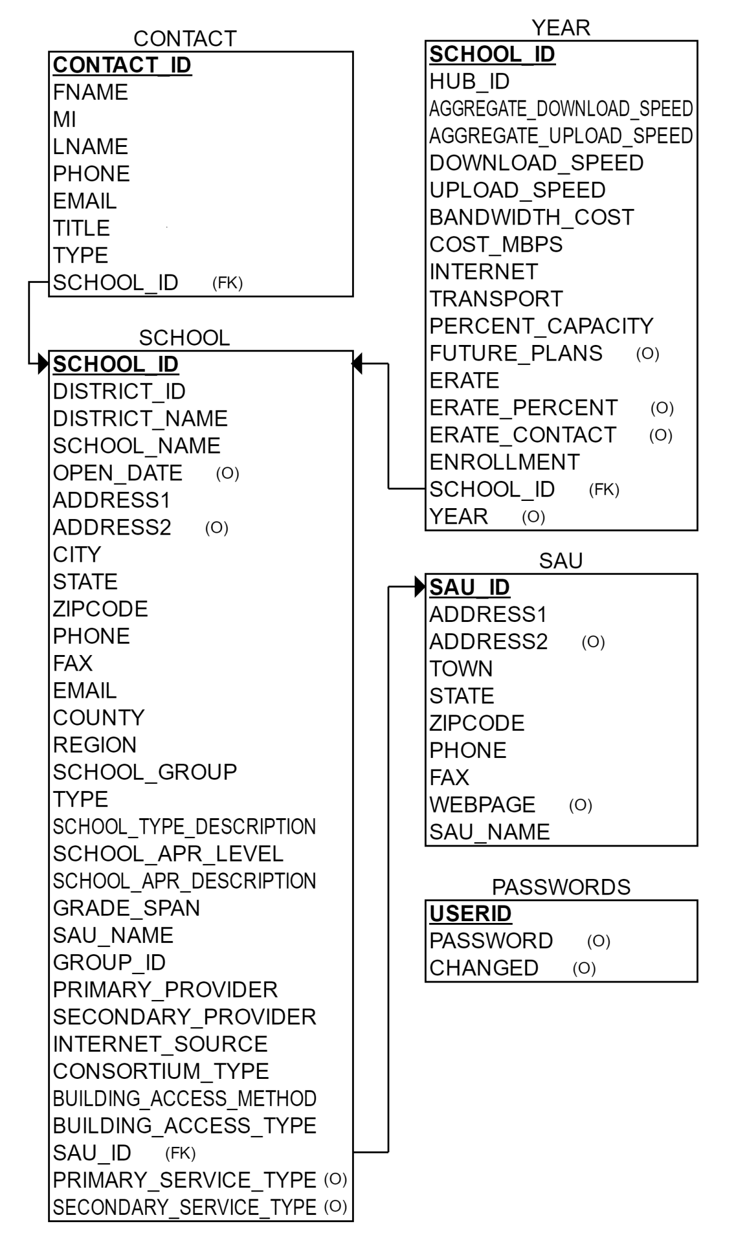
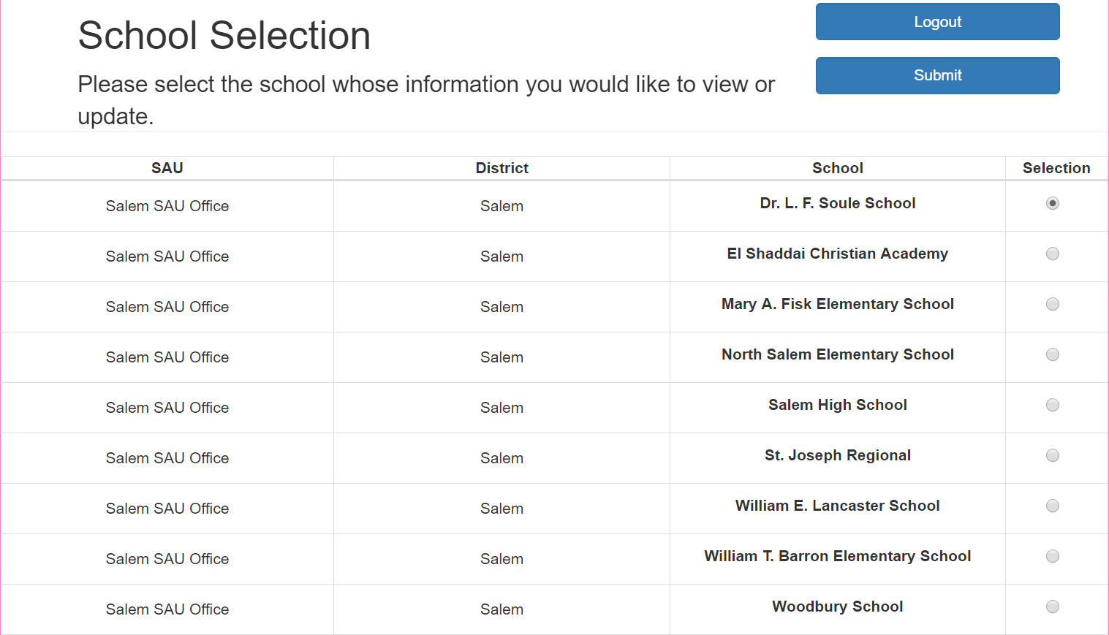
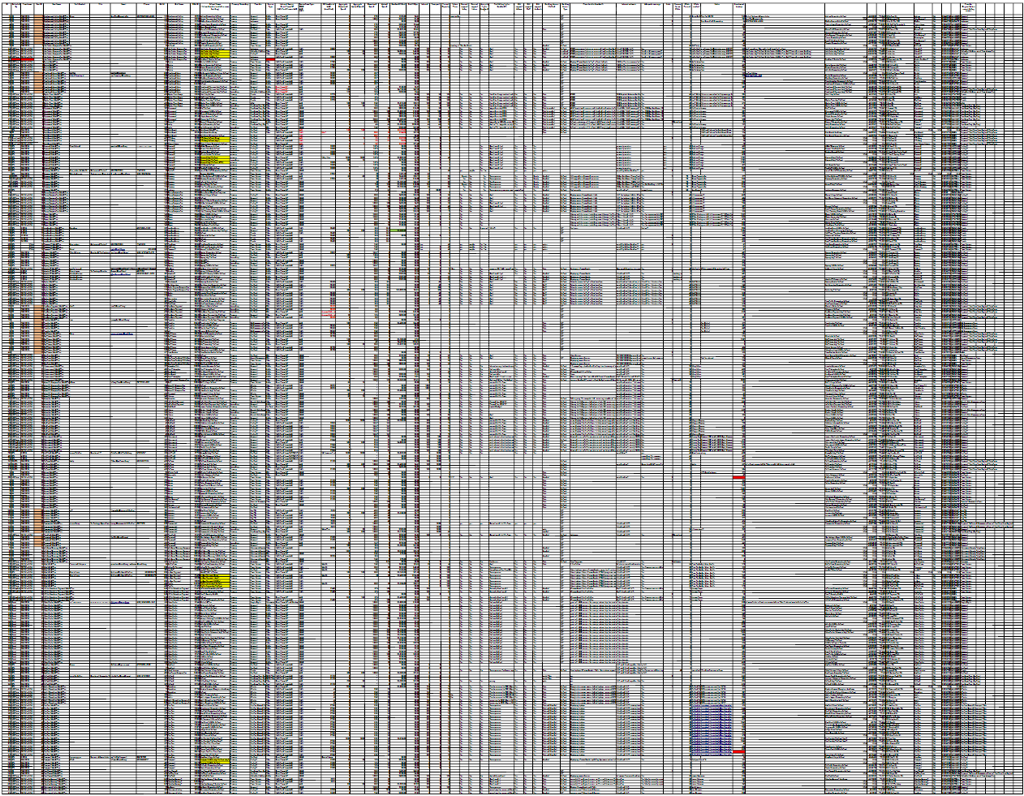
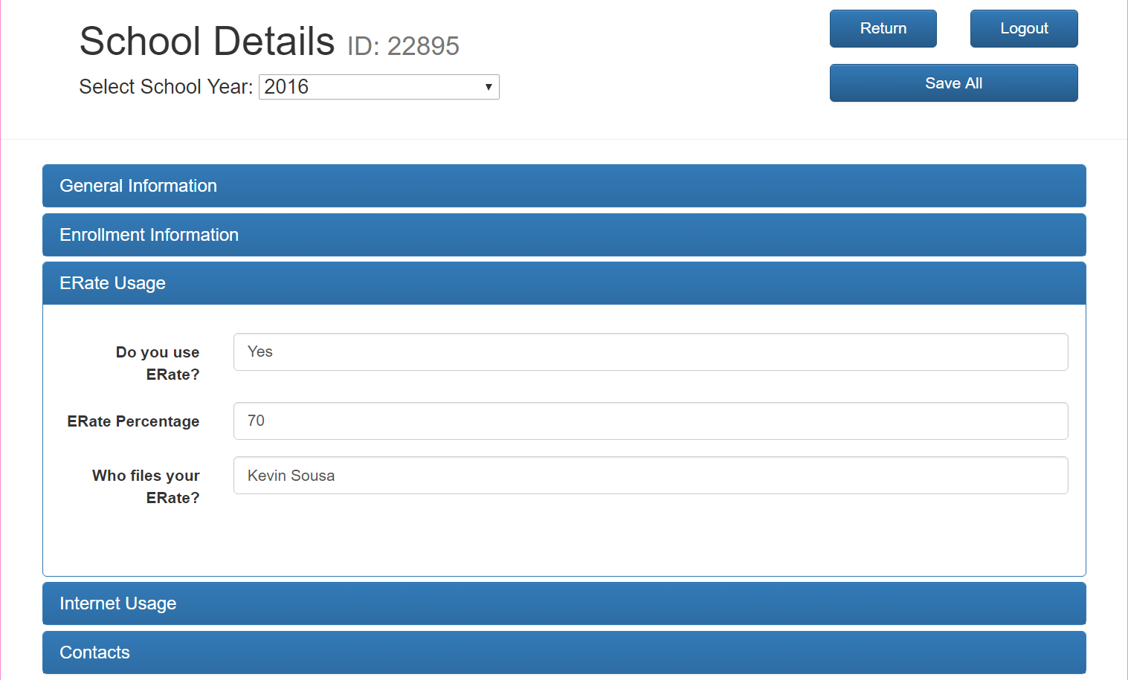
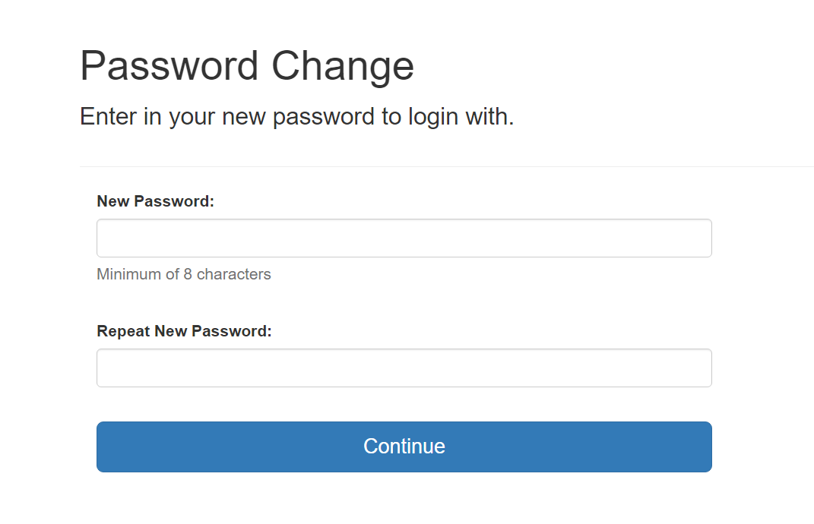
K-12 Data Collection Portal
Matthew Arroyo, Sebastian Coraccio, Charles McNaughton, Auderien Monareh, David San Antonio, Tiffany Winn
--
Sponsored by Scott Valcourt and Brian Shepperd
Advised by Collette Powers
Department of Computer Science | University of New Hampshire | Durham, NH
Background and Motivation
Portal Components
Database Schema
Operational Database
Normalized
Optimizes speed of query
Day-to-day input
What we initially designed
Analytical Database
Not normalized
Might have redundancy
“Data warehouse”
What we needed
We are not frequently updating the database (i.e., we are storing static data). Therefore, there is no need for an operational database.
New Hampshire School Connectivity Initiative (NHSCI)
Aims to provide fiber optic internet connectivity to all K-12 schools in NH
Goal: 100 Mbps per student by 2020
Utilize E-Rate funding and alleviate price disparity between school districts
This K-12 Data Collection Portal will be utilized to help the NHSCI administrators make decisions concerning broadband for K-12 schools.
Login Page
Users log in with school, district, or SAU ID and their password.
School Selection
ID type determines which schools are displayed. User selects school to edit.
Initial data consisted of 10 worksheets, the largest having 47 columns and 513 rows. This data was collected via phone calls to all individual school technical directors, proving to be too time-consuming and inefficient.
School Details
Data from database is displayed per school year. Users are able to update and save new data. Database can be exported as a CSV file.
Future
Beta testing to begin during 2018 E-Rate filing season.
Future Uses
Scope may be able to be extended to a nationwide data collection system for E-Rate Funding
Portal could be adapted to collect data from other community anchor institutions
Future Features
Exported data can be filtered based on needs for analysis
Data visualization available through web portal
Design Considerations
End Users
SAU/District/School Technical Directors
NHSCI Leaders
State Legislators
Needs a user-friendly interface to:
Collect data from end users
Visualize data in an aesthetically pleasing and informative way
Be as intuitive as possible as users have varying levels of technical knowledge
Mobile friendly
Technical directors may not have the time to sit down at a computer to fill in the form
Tablets and mobile devices are commonly issued to technical directors, so they are readily available to access the portal
Technologies Utilized
Contact Us
Users are able to contact the website administrator through this e-mail form to retrieve passwords, submit bugs, or ask general questions.
Password Change
Initial login using predetermined credentials will prompt password change.

