Slide 1
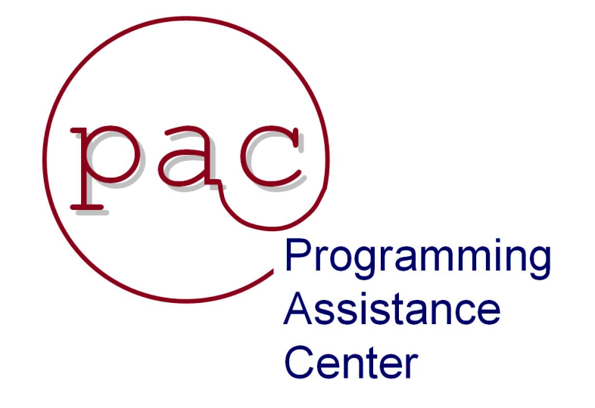
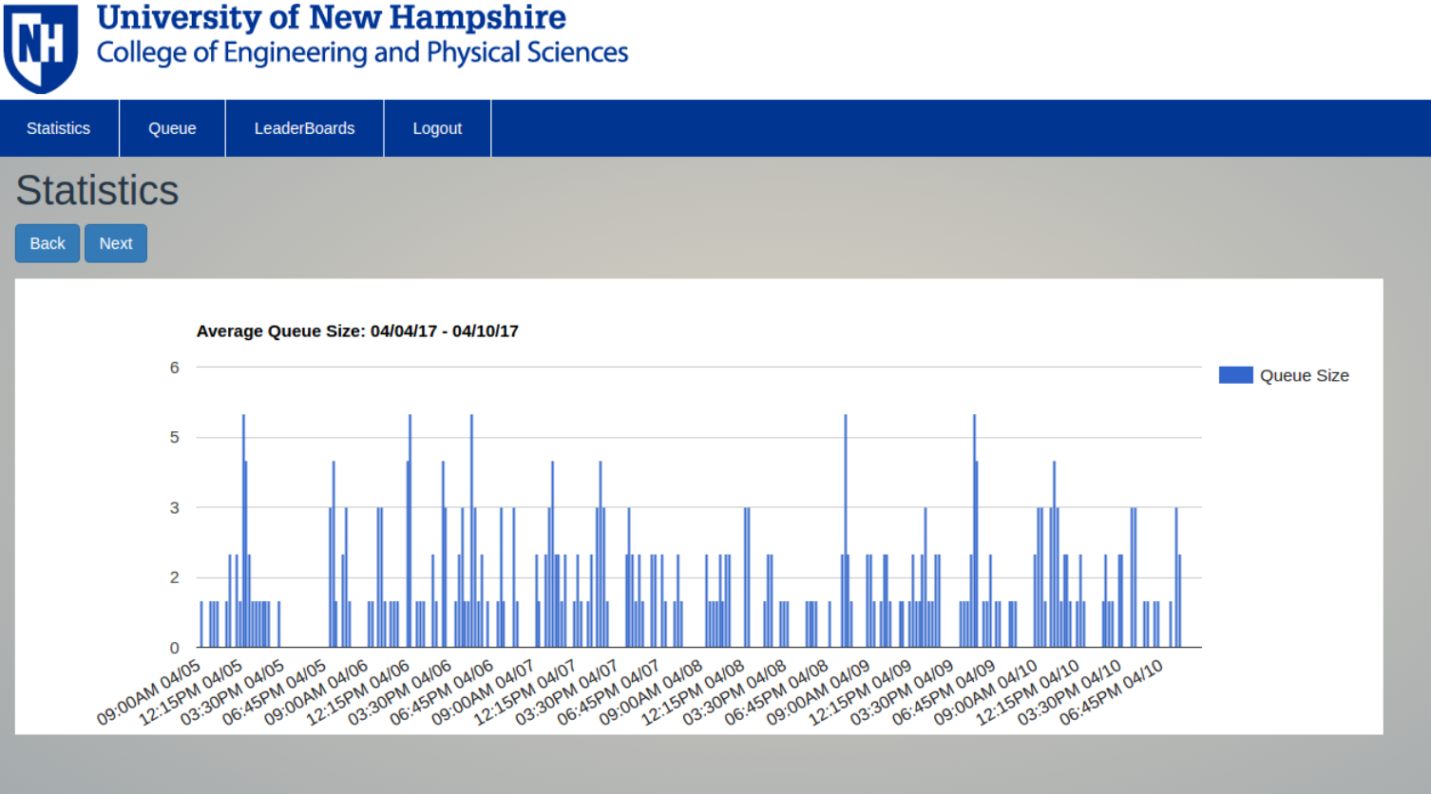
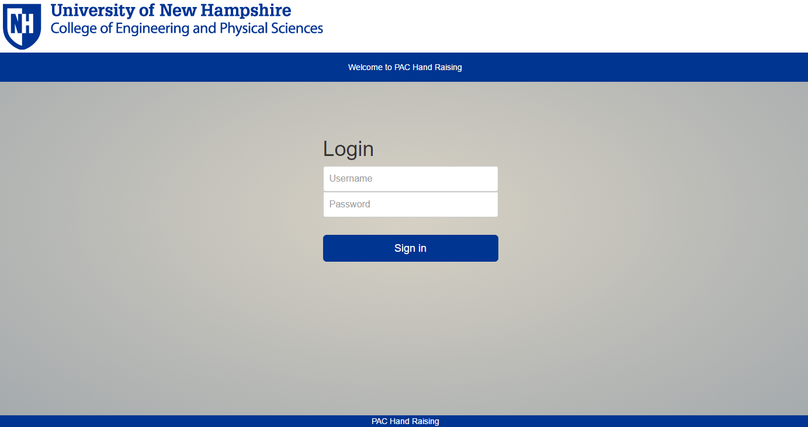
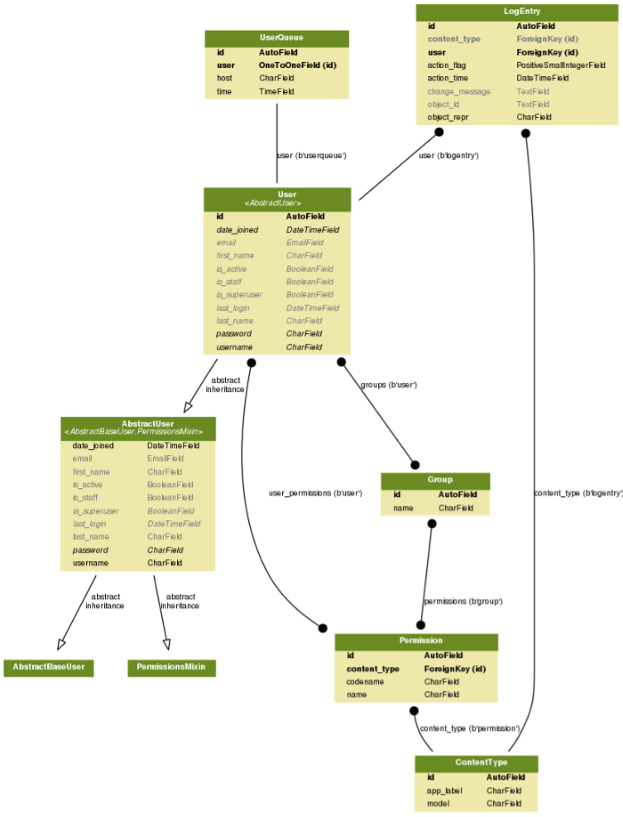
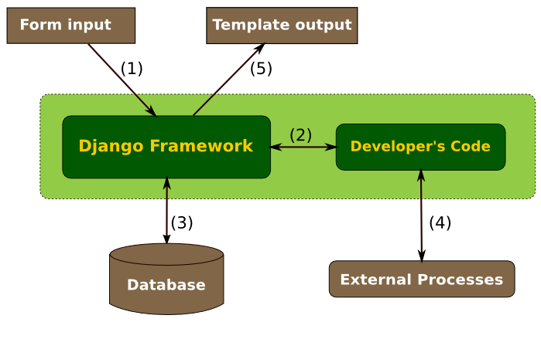
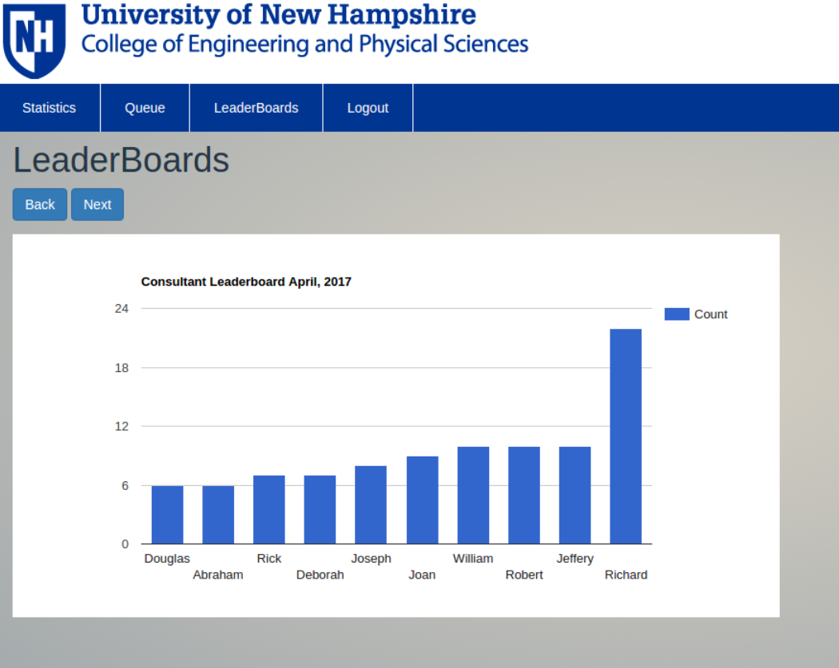
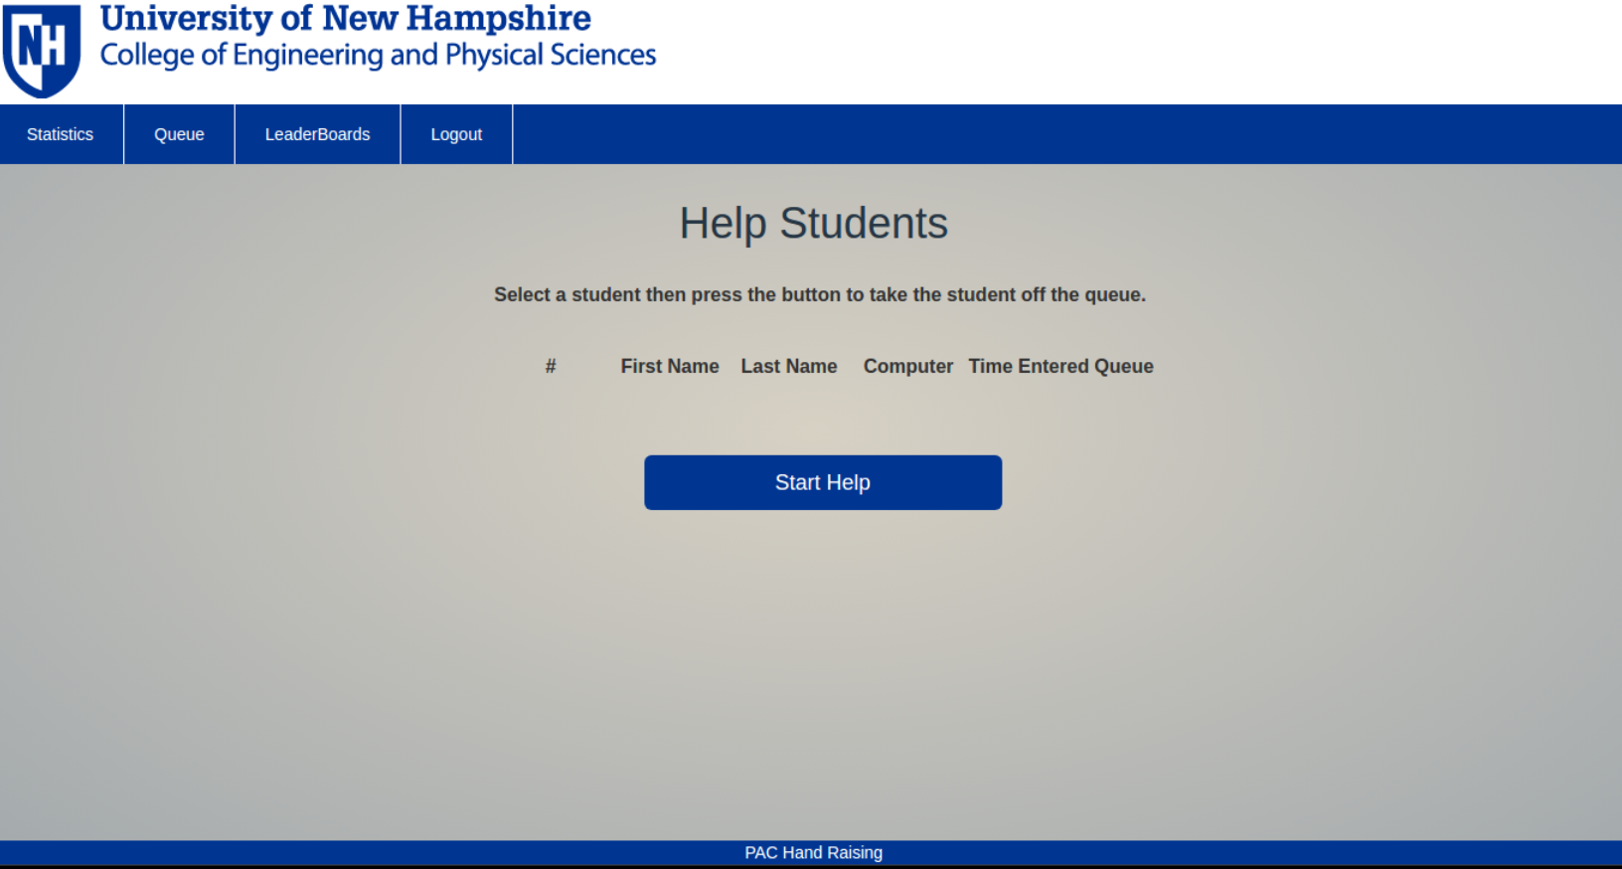
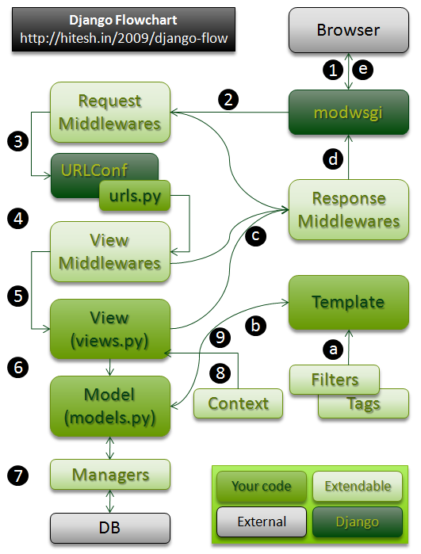
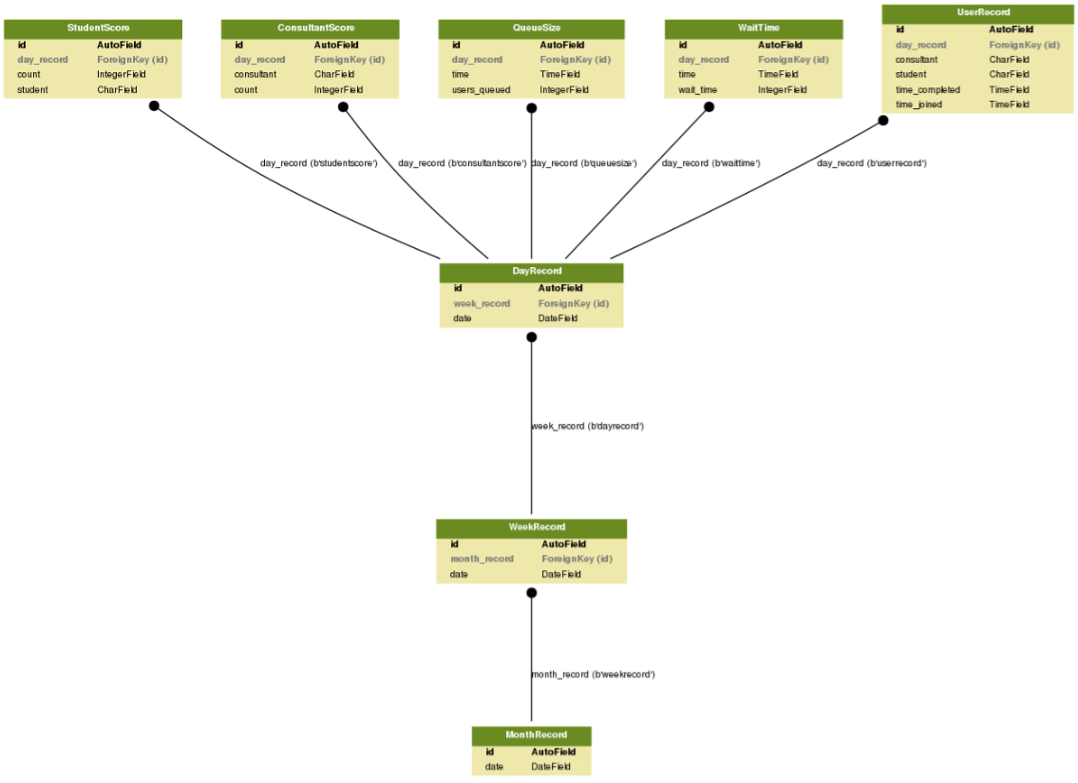
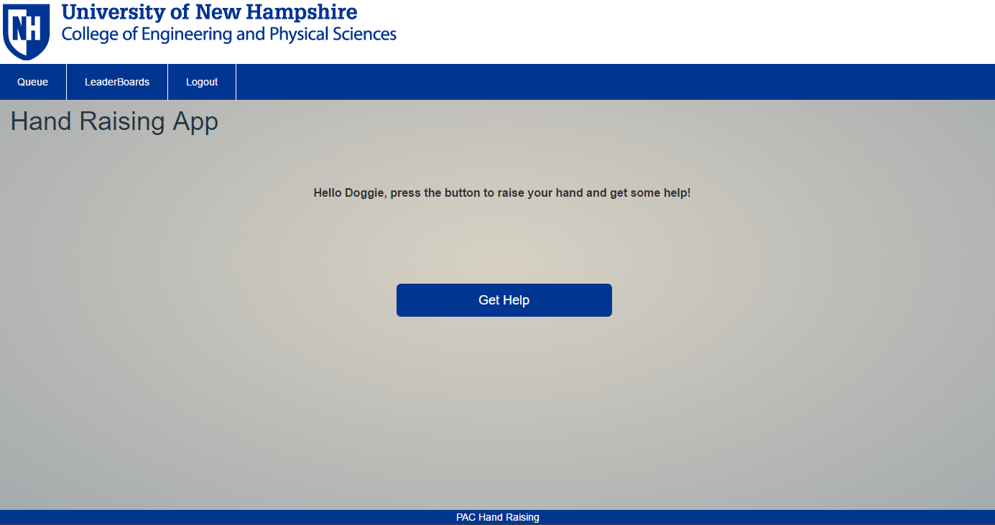
UNH Programming Assistance Center Automation
PAC Help Application – Technical Design Specifications
Abstract
Detailed Design
Statistics:
This view is only visible by superusers. This view displays the average queue size and wait time over a week.
Queue Database Models
The Programming Assistance Center (PAC) helps students with their programming assignments. Students raise their hand to request for help. With a hand raised, the students are unable to continue debugging and developing their assignments. Additionally, there is no way to track the number of students in the PAC requesting help. The goal is to make the PAC more organized and efficient by implementing a web-based queue system to create a better work-flow for consultants. The help application is designed using the Django framework, including Python, JavaScript, HTML, and CSS. This help app will facilitate record keeping on student traffic in the PAC and allow administrators to make better predictions on PAC utilization based on statistical data. This system creates a virtual queue and allows students to continue to learn on their own with the knowledge that help is on the way.
User Interface
Log in/log out:
Users enter their UNH ID and password to login and clicks the logout button in the navigation bar to logout.
This figure shows the models that are used to create the user queue. Most of the models in this figure are “under the hood” meaning Django creates and manages these models in the database.
Architecture
Leaderboards:
This view is visible to everyone. This view displays a leaderboard of the top ten consultants who helped the most students and top ten students who required the most help.
Consultant Queue:
This view is only visible by consultants. It displays the students in the queue including their queue position, first name. last name, computer they’re using, and the time they entered the queue.
Django Framework
A Django-based application consists of models, templates and views with additional data processing components.
Programming Languages
Django is built using Python, which is an interpreted high level programming language that supports object-oriented programming. Templates consist of HTML code with tags.
Models, Templates, and Views
Models describe the logical grouping of data and functionality, like classes in the model-view-controller pattern. Templates define the look of the user interfaces of a Django application . Views define the structure of a Django application.
Request Processing
The way a user interacts with a web application can be described as a sequence of requests from the user to the application, each followed by a response of the application.
Celery: Distributed Task Queue
Celery is an asynchronous task queue/job queue based on distributed message passing.
Server Information
The project is running on an apache webserver running on a linux(Fedora 23) server.
Development
Development is done through a subversion repository on the server.
Statistics Database Models
This figure shows the models that are used to populate the leaderboard and statistics views. All of these models are created by the developer and automatically stored in the database by Django. “AutoField” means that Django creates it. “ForeignKey” is used to represent a Many-to-One relationship. So, a model with a “ForeignKey” field signifies that the model is or will be part of a set in a different model.
Student Queue:
This view is only visible by non-consultants. The user (student) clicks the “Get Help” button to enter the queue to get help from a consultant. It then displays their position in the queue.
Project Flow

