Slide 1
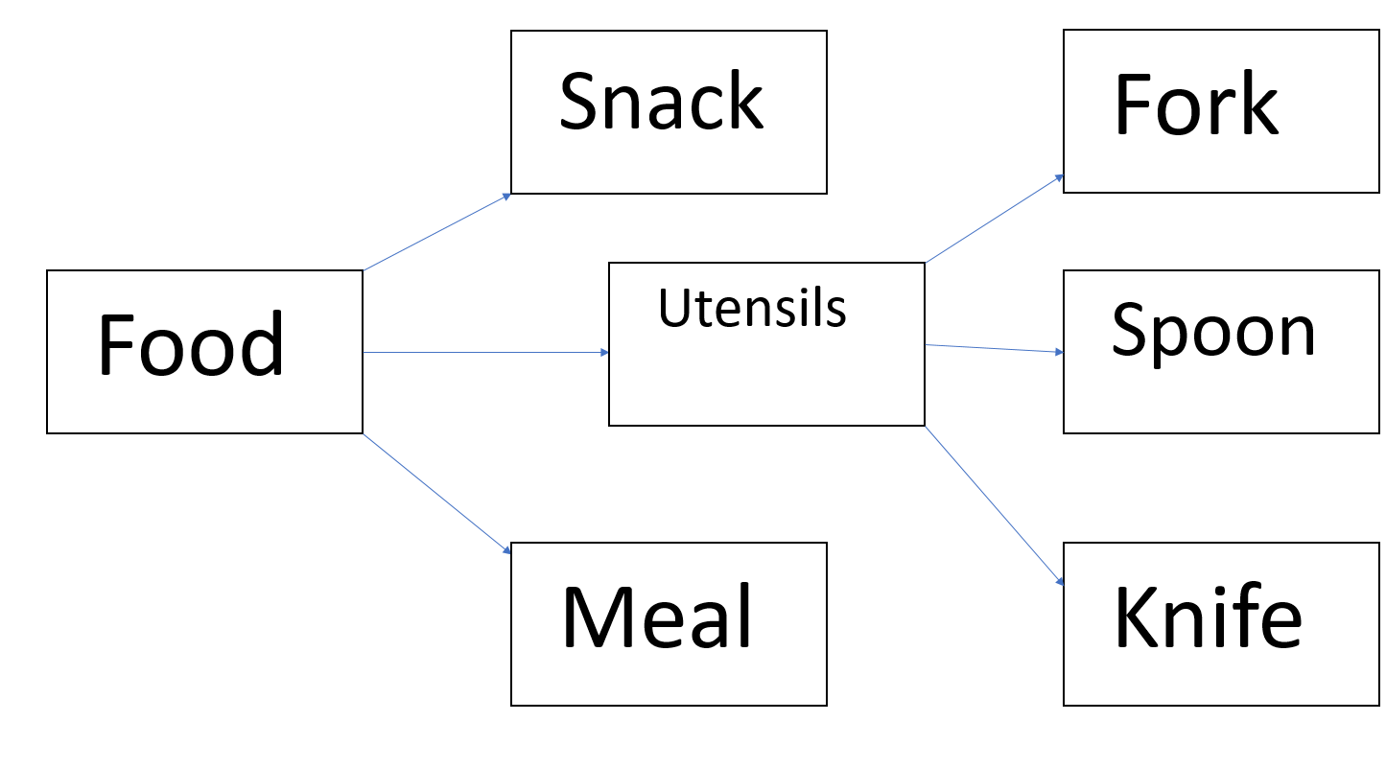
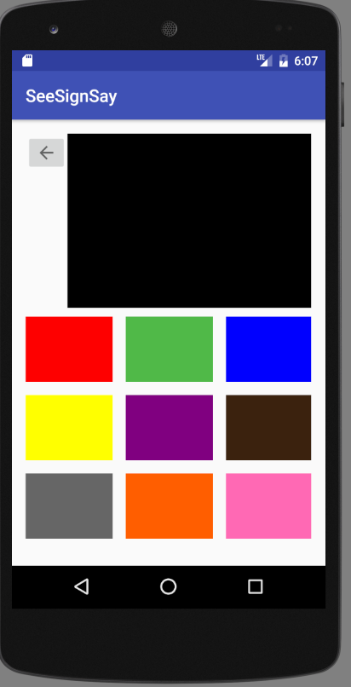
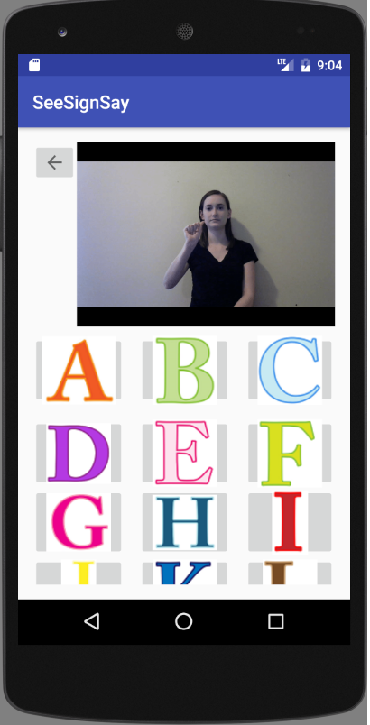
Joe Janiak Department of Computer Science Project Advisor: Deb Hamiln, MS CCC-SLP
See, Sign, Say
Introduction
Identification
Organization
See, Sign, Say will help students who are illiterate learn sign language.
The main problems being addressed is that these students cannot expressively communicate to other people.
Each sign is associated with an appropriate symbol for the user to select.
Symbols range from basic pictures to blocks of colors.
The symbols and signs are grouped into commonly used groups.
Expressive Communication
The ability to effectively transfer thoughts, feelings, wants, or needs to another person.
Lack of expressive communication can cause isolation and make communication very difficult.
55% body language, 38% tone, and 7% words used.
Existing apps talk for the user, but only allows 7% of the idea to be said.
Through ASL, the user can communicate with 100% efficiency.
Next Steps
Matching games to help teaching.
Additional signs.

