Slide 1
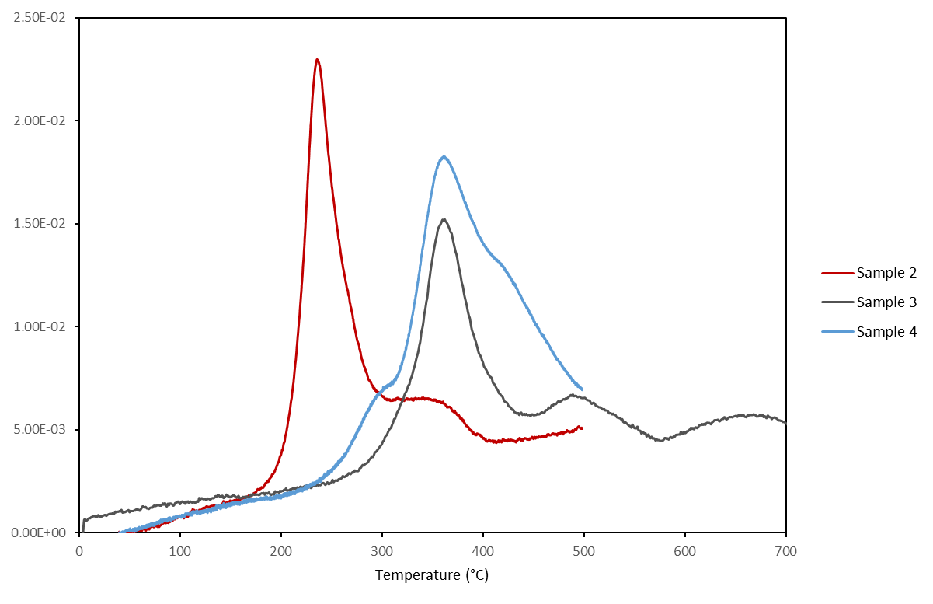
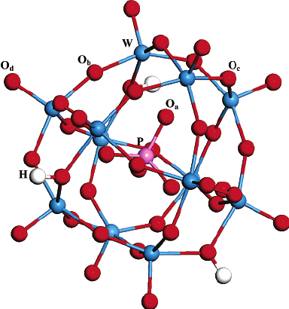
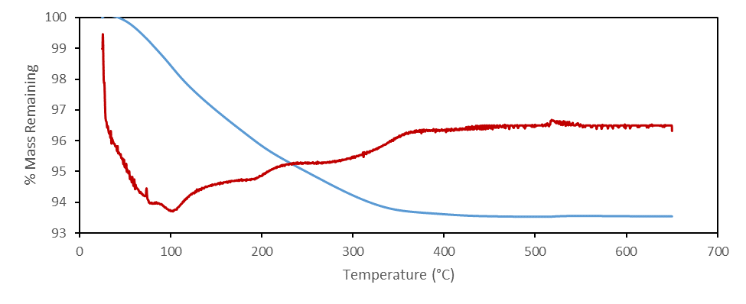
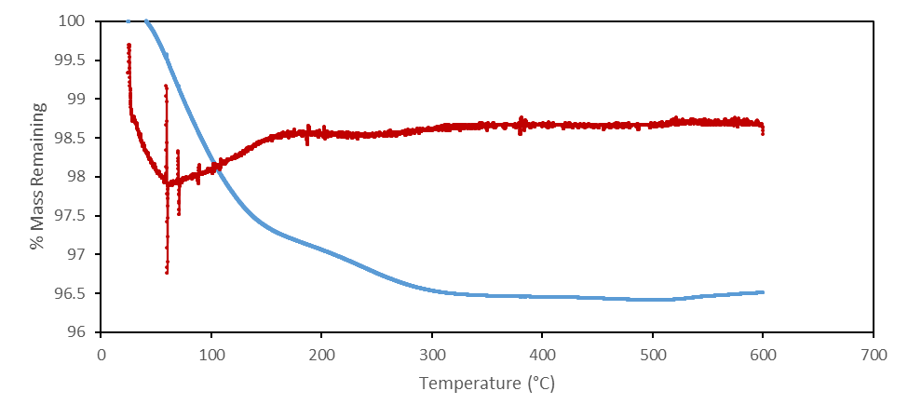
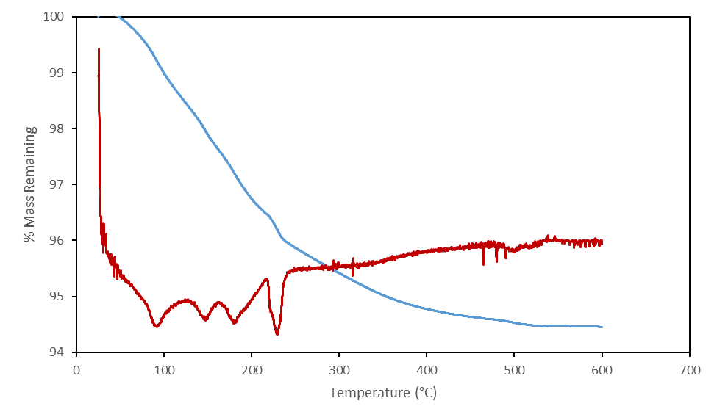
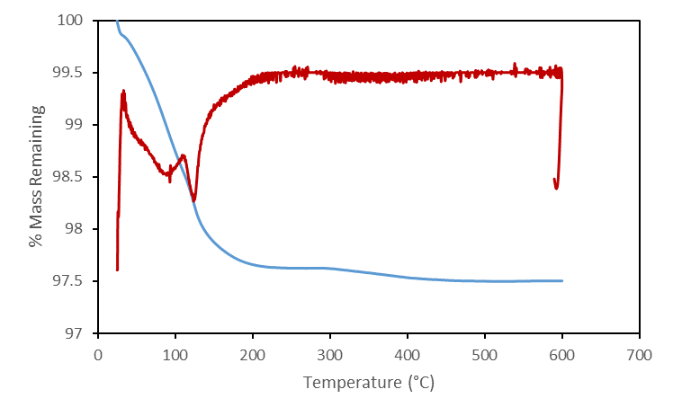
Synthesis and Characterization of Copper and Cesium Modified Heteropoly Acids
Madison M. Wood
Dr. Nan Yi, Faculty Advisor
Department of Chemical Engineering, University of New Hampshire
Abstract
Objectives
Hydrogen Temperature-Programmed Reduction
Heteropoly acids (HPAs) are a class of acid catalysts composed of acidic hydrogen atoms and oxygen with certain metals and non-metals. The two most common structural forms of HPA are known as the Keggin structures (H_{n}XM₁₂O₄₀) and the Dawson structures (H_{n}X₂M₁₈O₆₂). Modifying the Keggin structure of HPA with a variety of transition metals has proven to boost the catalytic performance in a variety of applications. This project focused on modifying the Keggin structure of phosphotungstic heteropoly acid (H₃PW₁₂O₄₀) with different ratios of copper and cesium cations. Characterizations including Thermogravimetric Analysis (TGA) and Hydrogen Temperature-Programmed Reduction (H₂-TPR) were used to optimize the calcination temperature and determine the surface oxygen species.
Increase the insolubility of heteropoly acid catalysts with the aid of cesium (Cs⁺) and copper (Cu²⁺).
Optimize the ratio of copper to cesium.
Characterize modified HPA catalysts to optimize calcination temperature and determine surface oxygen species.
Synthesis of Cs_{x}Cu_{2.5-x}H_{0.5}PW₁₂O₄₀
Catalysts were synthesized by precipitating aqueous solutions of Cu(NO₃)₂ and Cs₂CO₃ with a solution of H₃PW₁₂O₄₀ in stoichiometric amounts:
Aqueous solutions of Cu(NO₃)₂ and Cs₂CO₃ were simultaneously added dropwise to a solution of H₃PW₁₂O₄₀ under constant stirring.
The solution was stirred at room temperature for 24 hours.
Solvent was evaporated at 70°C in a vacuum furnace.
 | Cs⁺/Cu²⁺ ratio | x (Cs_{x}Cu_{2.5-x}H_{0.5}PW₁₂O₄₀)
Sample 1 | 1:1 | 1.25
Sample 2 | 4:1 | 2.00
Sample 3 | 1:4 | 0.50
Sample 4 | 10:0 | 2.50
Figure 6. Hydrogen Temperature-Programmed Reduction (H₂-TPR) profile of samples.
Introduction
Conclusions:
Reduction peaks indicate the presences of different oxygen species.
Lower temperature peaks (below 300°C) can be attributed to surface oxygen species.
High temperature peaks (above 300°C) can be related to oxygen species in bulk.
Keggin Structure Heteropoly Acid (HPA)
Heteropoly acids are a class of acid catalysts
containing a central heteroanion surrounded by
transition metal oxides. Of the many HPA
structures, the Keggin structures (H_{n}XM₁₂O₄₀)
and the Dawson structures (H_{n}X₂M₁₈O₆₂)
are of particular interest as catalysts.
Previous studies have shown that the HPA maintains its Keggin structure when modified with transition metals.^{[2]}
HPA as Heterogeneous Catalysts
Heterogeneous catalysts have several advantages over homogeneous soluble catalysts:
Simplified separation of the catalyst from the products
Minimized production of waste
Environmentally benign
Heterogeneous HPA salts have been developed by modifying the Keggin structure with certain metal cations, including cesium (Cs⁺) and potassium (K⁺).^{[3]}
Modifying HPA to Control Acidic Properties
This project aims to develop an insoluble catalyst with improved selectivity and activity.
Cesium has been shown to produce an insoluble HPA salt with increased activity.^{[4]}
Copper has been shown improve the catalytic activity of HPA and improve redox properties.^{[5]}
Next Steps
Thermogravimetric Analysis
Determine the effect of Cs⁺
How is the presence of cesium shifting the peaks seen in the H₂-TPR curves?
Compare to H₄SiW₁₂O₄₀
Does the difference in protons lead to different properties?
Conversion of methane to methanol
Will this HPA catalyst achieve the same conversion as strong liquid acid?
Figure 1. Keggin structure of H₃PW₁₂O₄₀ ^{[1]}
Figure 2. Thermogravimetric and Differential Thermal Analysis curves for Sample 1, Cs⁺/Cu²⁺ (1:1).
Figure 3. Thermogravimetric and Differential Thermal Analysis curves for Sample 2, Cs⁺/Cu²⁺ (4:1).
References
Figure 4. Thermogravimetric and Differential Thermal Analysis curves for Sample 3, Cs⁺/Cu²⁺ (1:4).
Figure 5. Thermogravimetric and Differential Thermal Analysis curves for Sample 4, Cs⁺.
Yang, J.; Janik, M. J.; Ma, D.; Zheng, A.; Zhang, M.; Neurock, M.; Davis, R. J.; Ye, C.; Deng, F. ChemInform 2006, 37 (15).
Zheng, Y.; Zhang, H.; Wang, L.; Zhang, S.; Wang, S. Frontiers of Chemical Science and Engineering 2015, 10 (1), 139–146.
3. Rafiee, E.; Eavani, S. RSC Advances 2016, 6 (52), 46433–46466.
4. Mizuno, N.; Misono, M. Chemical Reviews 1998, 98 (1), 199–218.
5. Min, J.-S.; Mizuno, N. Catalysis Today 2001, 71 (1-2), 89–96.
Conclusions: Optimized calcination temperature 450°C
Samples 1, 2, 3, and 4 lost 6.54%, 3.57%, 5.35%, and 2.50% of mass, respectively.
100% of mass loss occurred at temperatures below 450°C.

