Slide 1
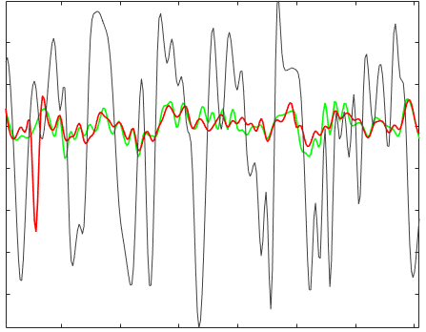
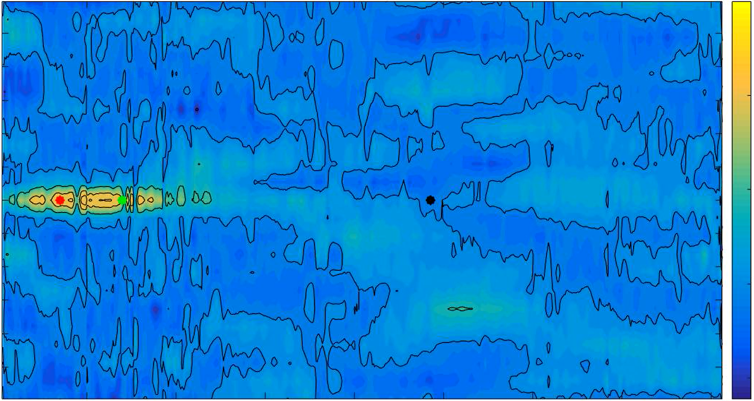
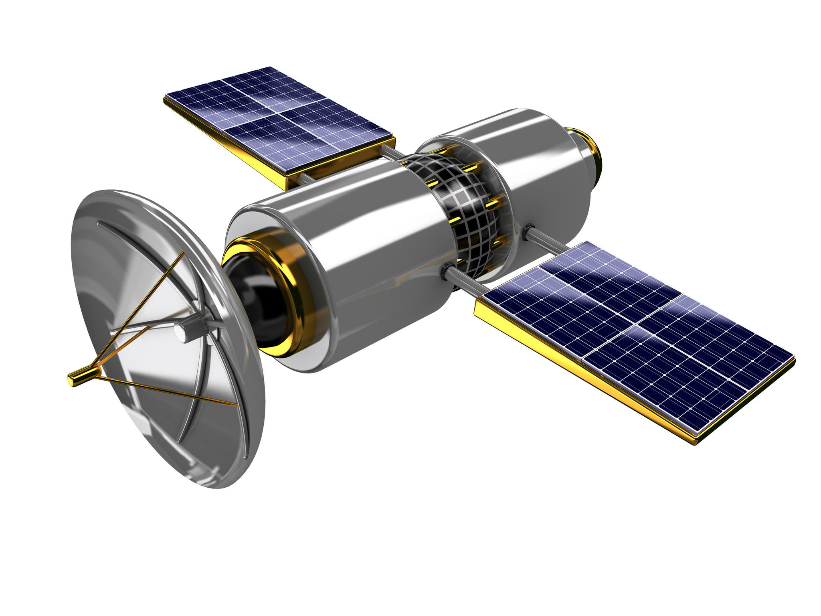
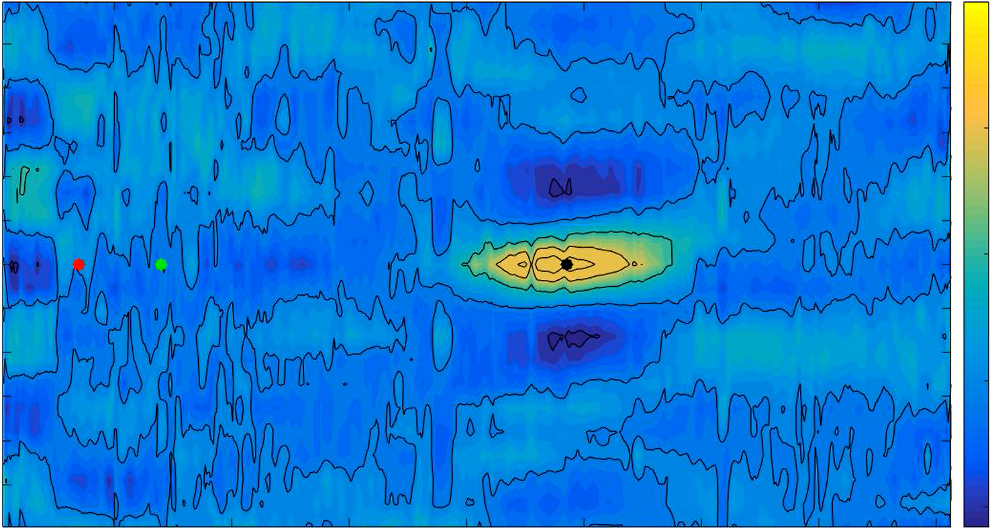
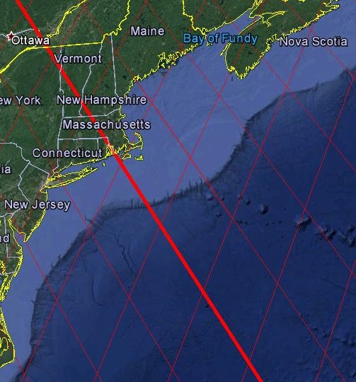
Examining the connection between the dynamics of western boundary shelves and the deep sea using satellite altimetry data
Nicholas Trefonides and James Pringle, Ph.D.
Background
Results
The exchange of water between the western boundary shelves and the deep sea is an important transport pathway between land and sea for carbon and other chemical constituents that have significant impacts on marine life and global climate.
Sea-Surface Height Anomaly
Correlation Lagged in Time and Space
Shelf
0.25
0.75
Satellite altimetry is an indirect technique for measuring sea-surface height by measuring the time taken by a radar pulse to travel from the satellite antenna to the sea surface and back to the satellite receiver.
0.4
0.2
0.2
0.15
0.5
0
0.1
Sea-Surface Height Anomaly (meters)
0.05
-0.2
Time Lag (year)
0.25
0
-0.4
-0.05
Pressure Gradient
Sea Level
-0.6
-0.1
0
Current is perpendicular to the pressure gradient because of Earth’s rotation.
-0.8
-0.15
Shelf
-0.2
2003
2004
2005
2006
2007
2008
2009
-0.25
-0.25
Exchange of water near the bottom is driven by the alongshore current.
100
200
300
400
500
600
700
800
Slope
Figure 2 (above) is the sea-surface height anomaly for two shelf locations (red and green) and one deep sea location (grey). Note that the two shelf locations are correlated but the deep sea location is not correlated to the shelf locations.
Distance from the coast (kilometers)
0.75
0.25
Objective
0.2
0.5
Understand how sea level variation is correlated from the shore to the deep sea.
0.15
0.1
Satellite track used for the following plots
0.05
0.25
Time Lag (year)
Figures 3 and 4 are plots of correlations lagged in time and space for one location on the shelf (top) and one location in the deep sea (bottom). In the top plot, note that the shelf location is spatially correlated across the entire shelf. In the bottom plot, note that the deep sea location is spatially correlated for about 200 kilometers, but it is not correlated to the slope or the shelf.
0
-0.05
-0.1
0
-0.15
-0.2
-0.25
-0.25
100
200
300
400
500
600
700
800
Distance from the coast (kilometers)
Methods
Conclusions
Read the AVISO satellite altimetry data for sea-surface height anomaly into MATLAB.
Interpolate the sea-surface height anomaly data to become a function of distance from the coast instead of latitude/longitude position.
Produce an animation of sea-surface height anomaly correlations lagged in time and space for all locations along all cross-shelf tracks of interest.
Sea-surface height anomaly at locations across the shelf are spatially correlated, but the correlation does not extend down the full length of the slope or into the deep sea.
Sea-surface height anomaly at locations across the deep sea are correlated over a distance of about 200 kilometers.
Since sea-surface height on the shelf is uncorrelated to that in the deep sea, the difference between the two are governed by different processes. To understand the exchange between shelf and deep sea, we must understand two independent actors – the shelf and the deep sea – separately.
Figure 1 (above) is a map showing the tracks along which the satellite measures sea-surface height.

