Slide 1

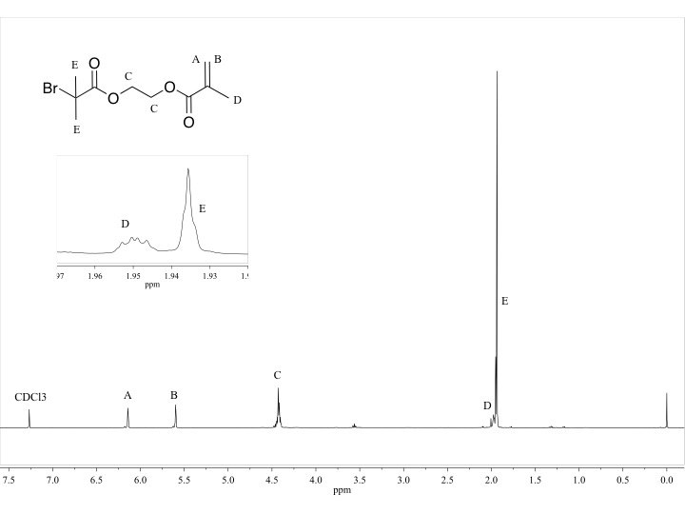
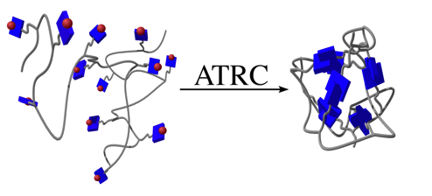
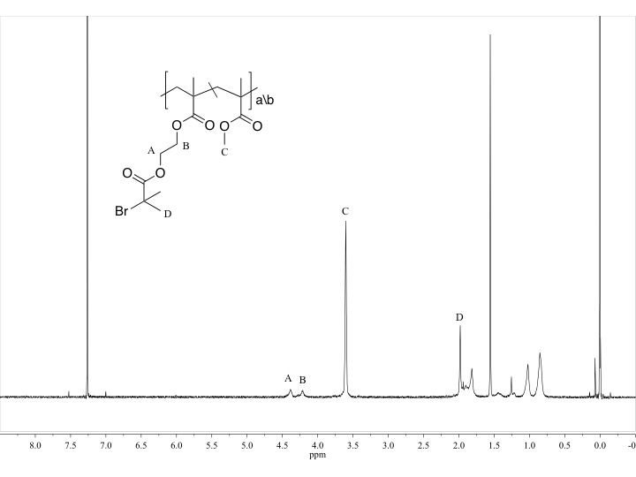
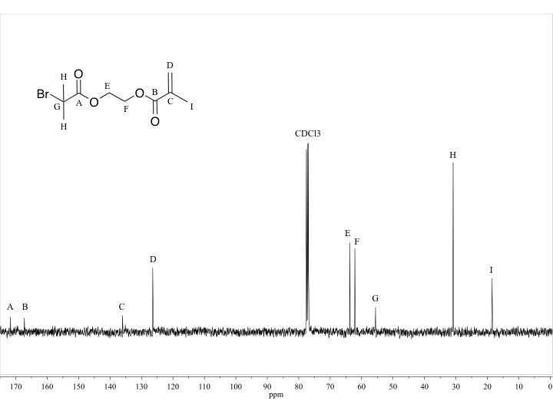
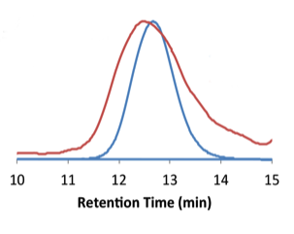
Synthesis of Single-Chain Nanoparticles via Atom-Transfer Radical Coupling
Claudia Willis, Prof. Erik Berda
csw2002@wildcats.unh.edu, Department of Chemistry, University of New Hampshire, Durham, NH
April 19, 2017
Introduction:
The goal of synthesizing single-chain nanoparticles (SCNPs) via atom-transfer radical coupling (ATRC) was to produce SCNPs under relatively mild conditions¹. First, a cross-linkable monomer, dimethyl bromoethylmethacrylate (Me₂Brema), was polymerized with methyl methacrylate (MMA) at 10%, 20% and 50% incorporations through reversible addition fragmentation chain-transfer (RAFT) polymerization². The Me₂Brema pendant functionality can then do an irreversible crosslink via ATRC to produce the SCNPs. The resultant collapse from polymer to SCNP was monitored by gel permeation chromatography (GPC). The parent polymers elute faster due to their larger hydrodynamic radius, leading to a shift to longer retention times upon formation of SCNPs.
Figure 1. General ATRC collapse from polymer to SCNP³
Experimental Design:
Scheme 1. Synthesis of the Me₂Brema monomer
The Me₂Brema monomer was synthesized first by a simple base-catalyzed substitution reaction. By-product was a triethylamine salt that was removed by liquid-liquid extraction. Peaks A and B on Figure 3 are important, because they are where polymerization will occur. Copolymers of Me₂Brema and MMA were then synthesized through RAFT.
Scheme 2. RAFT polymerization of
Me₂Brema and MMA
Conversion of monomer was monitored by ¹H NMR. Upon polymer formation the reaction was diluted with tetrahydrofuran and precipitated into cold methanol.
Figure 2. ¹³C NMR of Me₂Brema
Figure 3. ¹H NMR of Me₂Brema
Copolymers were then collapsed via ATRC. Me₂Brema acted as a radical reactive pendant functionality that participated in coupling in order to collapse polymers into SCNPs.
Scheme 3. Collapse of Me₂Brema copolymer to SCNP via ATRC
Results:
Figure 4. ¹H NMR of 10% Me₂Brema 90% MMA copolymer
Figure 5. GPC trace of 10% Me₂Brema
copolymer (blue) and collapsed polymer
into SCNP (red)³
Discussion:
The synthesis of the Me₂Brema monomer was successful based on ¹³C NMR and ¹H NMR (Figures 2-3), and had a yield of 84%. Peaks A and B on Figure 4 show the formation of polymer. Percent incorporations of monomers in the copolymer were verified by ¹H NMR, and exact monomer incorporations (Figure 4) were found to be 12.5% Me₂Brema and 87.5% MMA. Coupling of pendant Me₂Brema on the parent polymer via ATRC is a copper mediated process. A shift in retention time on the gel permeation chromatography (GPC) trace (Figure 5) shows some formation of SCNPs. However the peak is not ideal, displaying a broadening due to disproportionation events.
Figure 6. Disproportionation event, where a hydrogen abstraction occurs instead of coupling of pendant functionality
Disproportionation has a high probability of occurrence on the pendant Me₂Brema, because it has six available hydrogen atoms that could participate in an abstraction. Several fellow Berda Group researches have used a similar synthetic route to SCNP formation with monomers that have a lesser propensity to disproportionate, observing greater degrees of collapse. The resulting GPC traces show narrower peaks with a cleaner shift in retention time from the parent polymer to SCNP.
Future Work:
This promising synthetic route could be optimized by tuning the chemical properties of the ligand or the reaction conditions, including solvent and temperature. I wide variety of ligands have been developed for the related atom-transfer radical polymerization (ATRP) process, but these remain untested for ATRC. Testing ATRC with continuous addition is also a promising way to improve viability by using higher concentrations.
Conclusion:
Monomer and parent polymer synthesis was successful. SCNPs were formed, however broadening of GPC trace (Figure 5) from parent polymer to SCNP was not ideal. Broadening of the GPC trace was likely due to disproportionation. The radical reactive pendant on the parent polymer used in this synthetic route has a high probability of participating in a disproportionation event.
Acknowledgements:
I would like to thank Ashley, Liz, Jen and the rest of the Berda Research Group. I would also like to thank the University of New Hampshire Department of Chemistry for their funding.
References:
(1)Hanlon, A. M.; Lyon, C. K.; Berda, E. B.: What Is Next in Single-Chain Nanoparticles? Macromolecules 2016, 49, 2-14.
(2)Moad, G.; Chong, Y. K.; Postma, A.; Rizzardo, E.; Thang, S. H.: Advances in RAFT polymerization: the synthesis of polymers with defined end-groups. Polymer 2005, 46, 8458-8468
(3)Hanlon, A.M.; Chen, R.; Rodriquez, K. J.; Willis, C.; Dickinson, J.G.; Cashman, M.; Berda, E.B. Scalable synthesis of single-chain nanoparticles under mild condititons. Macromolecules 2017, 50(7), 2996-3003.

