Slide 1
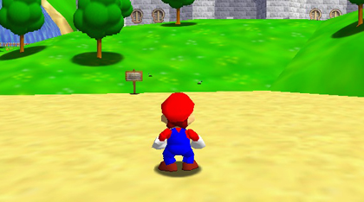
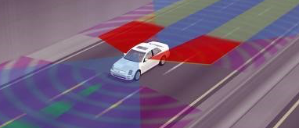
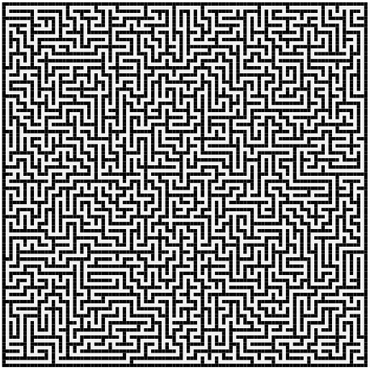
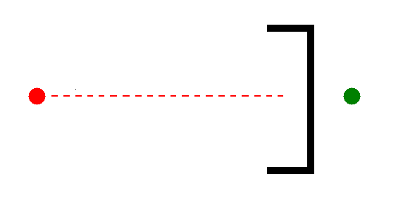
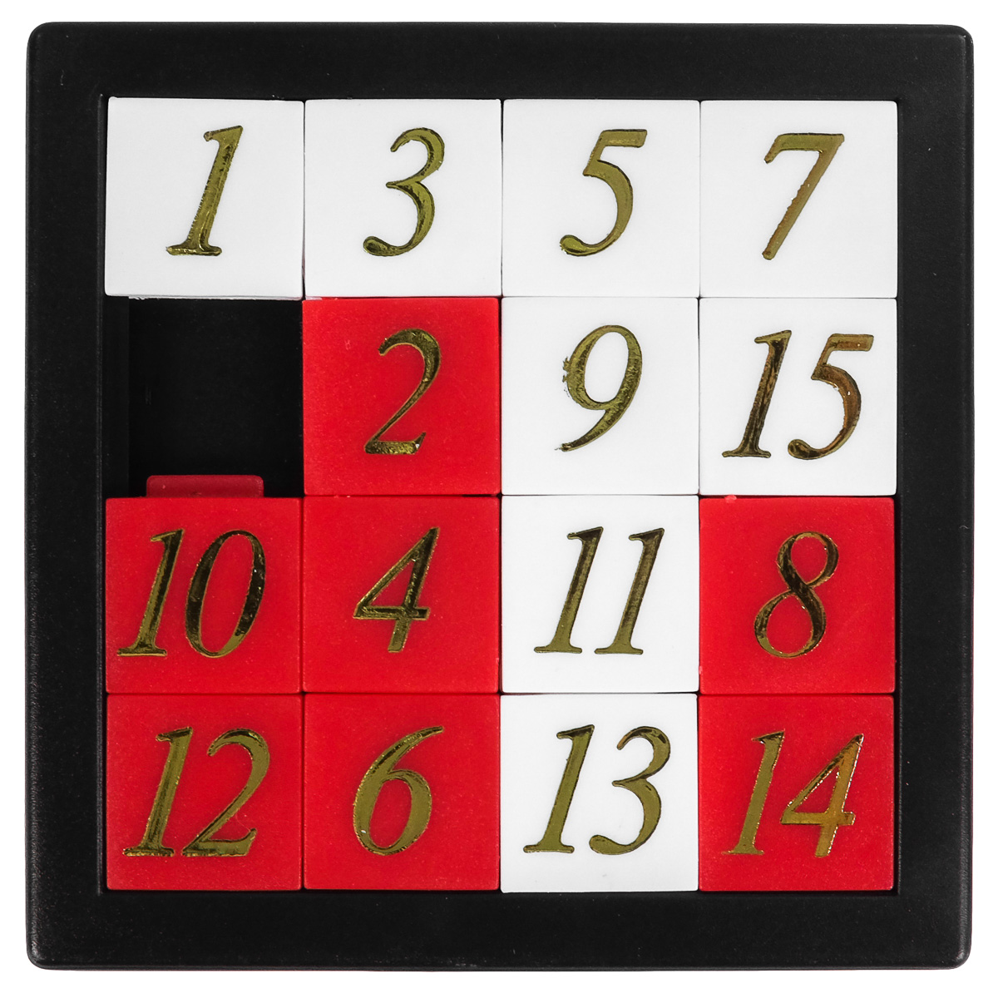
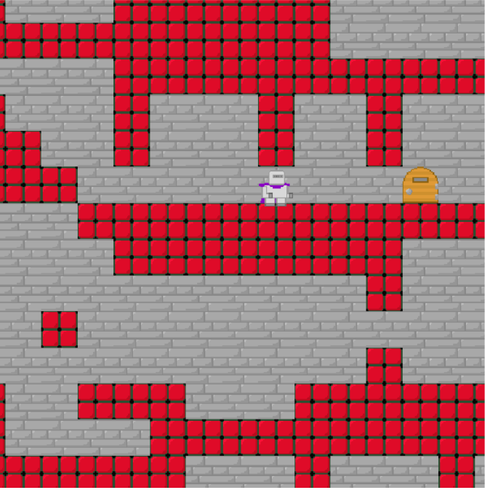
Real-Time Planning: Does Fast Beat Thorough?
Shane Kochvi
Advisor: Wheeler Ruml
Problem
Method
Preliminary Results
Implement LSS-LRTA* and RTAA*
Test over maze domain and other domains. Example domains:
Our implementations of LSS-LRTA and RTAA* run using a maze domain were in accord, but many measures do not accord with the RTAA* paper. Our implementation uses known terrain, while the paper uses unknown terrain.
Source: neogaf.com
Source: Irish Times
In applications like self-driving cars and video games, we don’t want to wait for an entire plan: want to select the next action within a fixed deadline (in “real time”)
Real-time planners must learn in order to avoid making the same mistake twice.
RTAA* takes less time to learn than LSS-LRTA*, but is less thorough.
Previous work showed RTAA* outperforms LSS-LRTA* in mazes, but mazes are not representative of many real-world domains.
Maze
Source: Koenig and Likachev, 2006
Sliding Tile Puzzle
Future Investigations
Run experiments where searches are executed concurrently with action executions
Run algorithms on more domains
Source: Retroplanet.com
Platformer
Source: Burns, Kiesel, and Ruml

