Slide 1

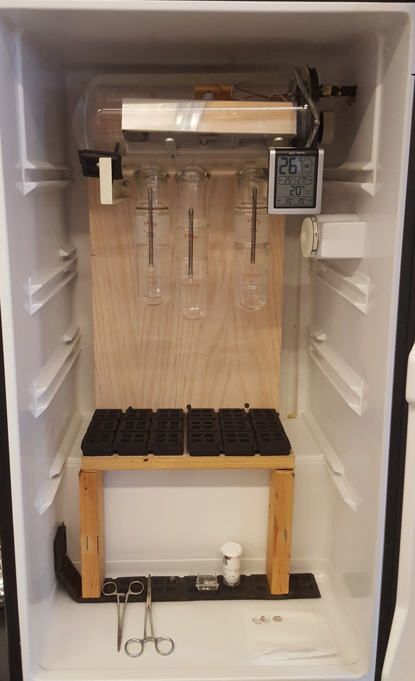
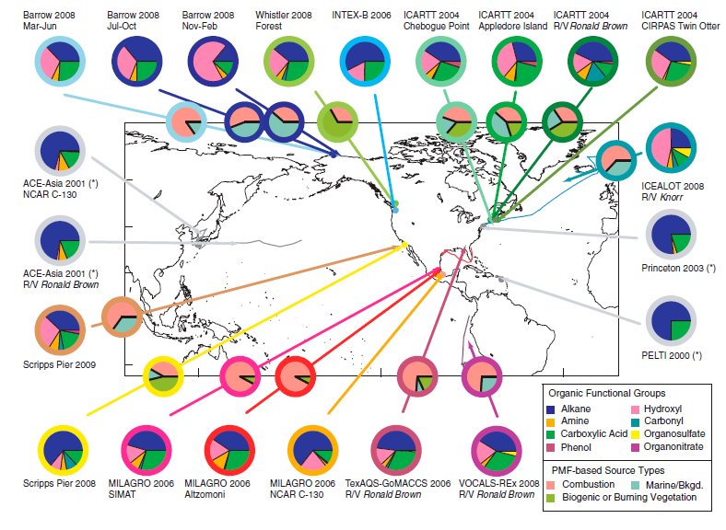
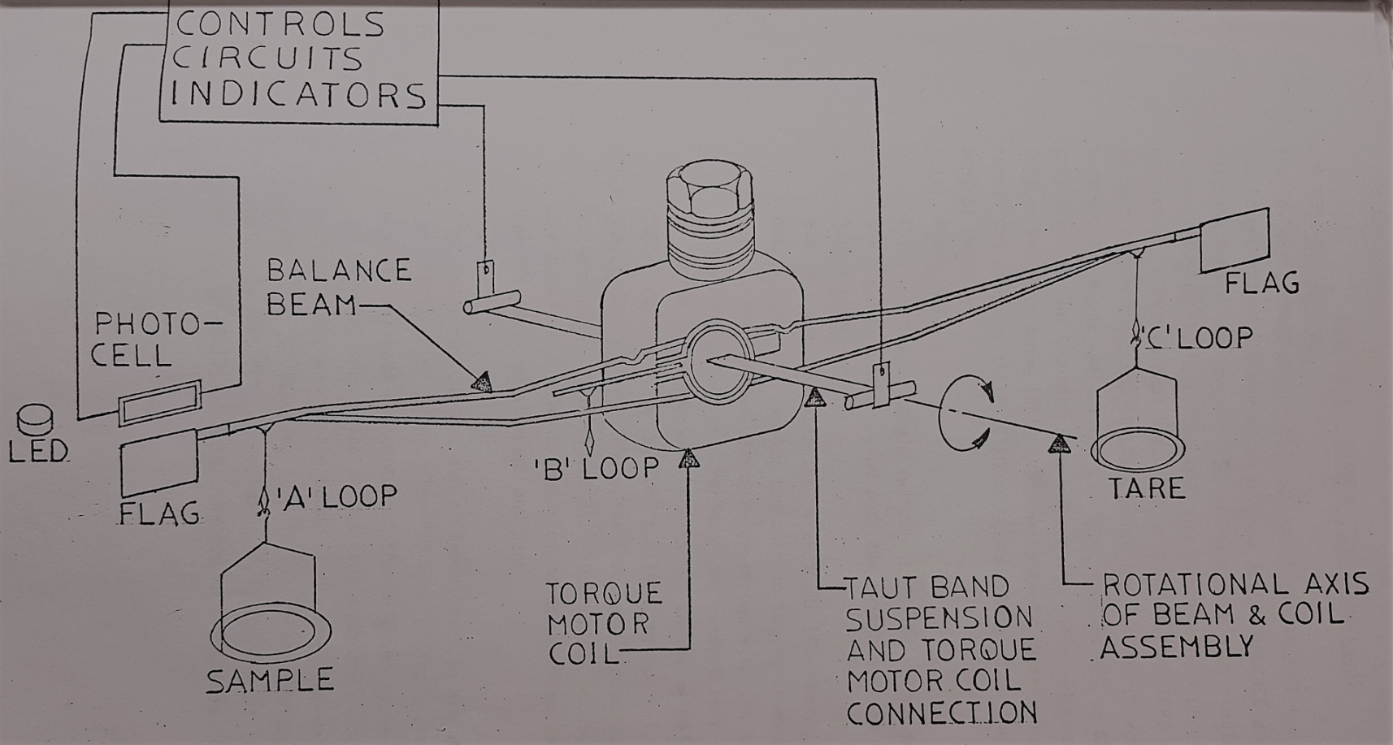
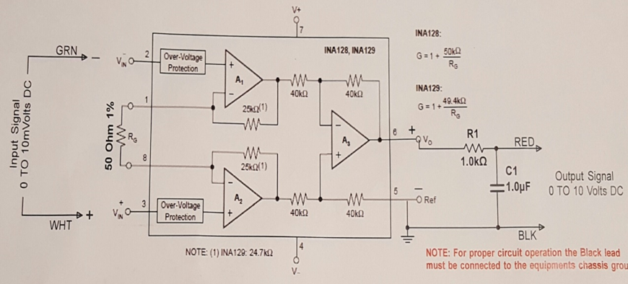
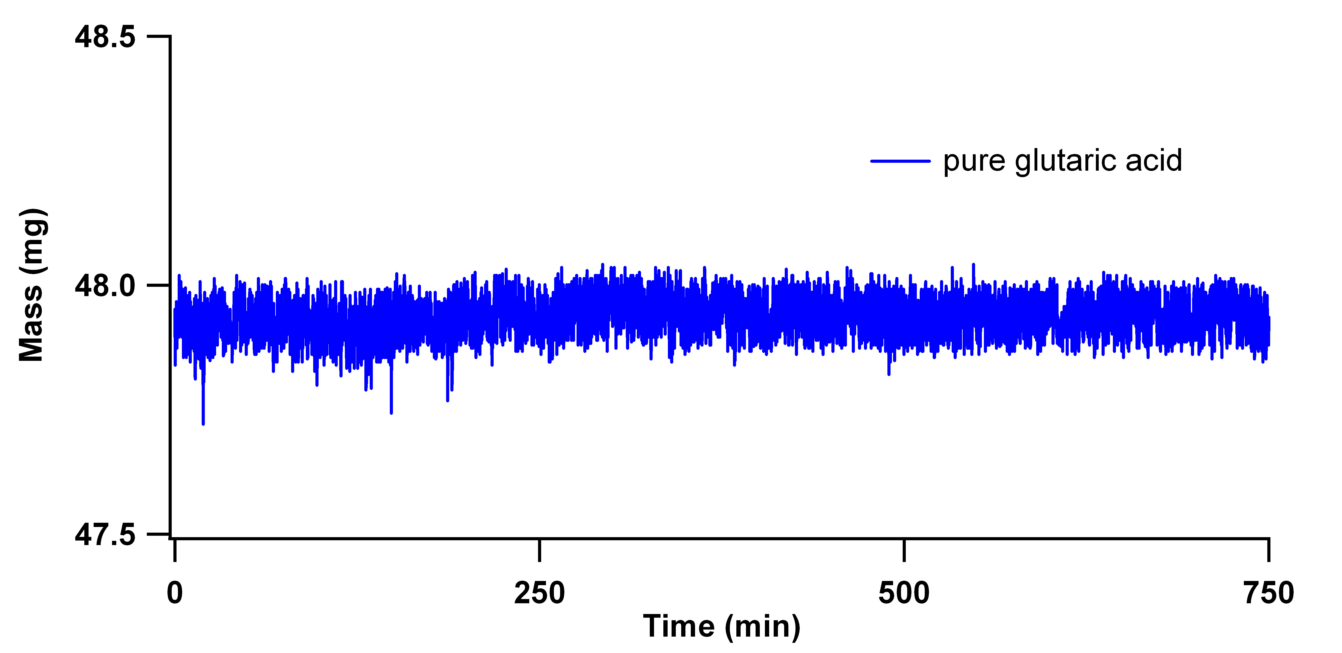
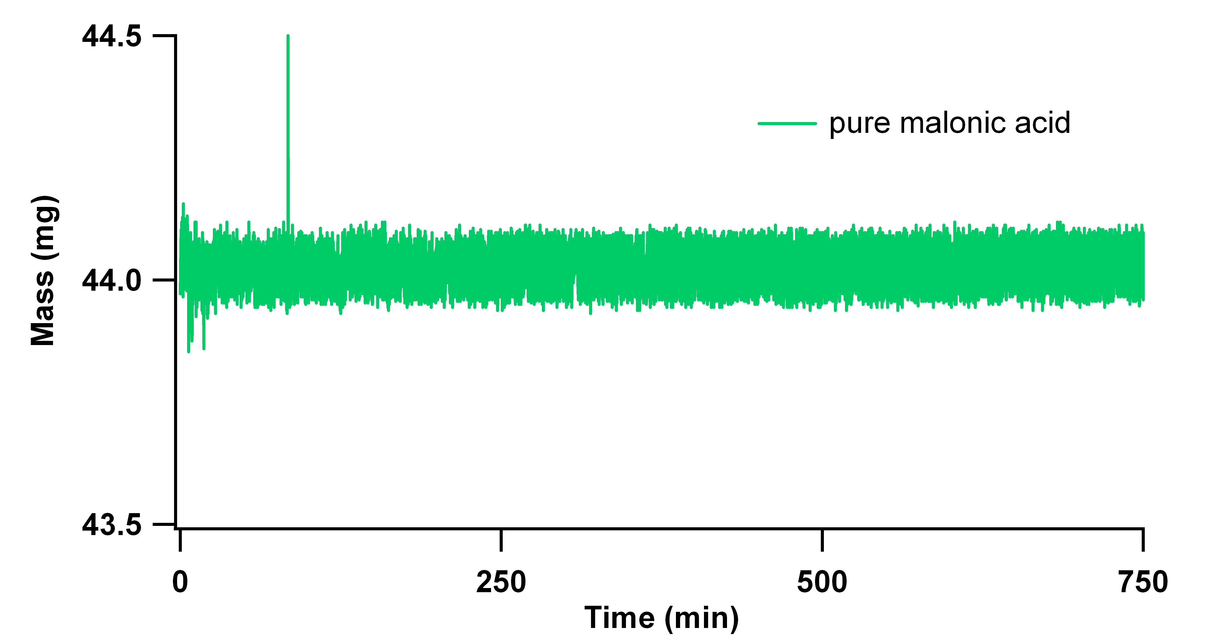
The Effect of Evaporating Dicarboxylic Acids
on Aerosol Size
Jackson Kaspari and Margaret E. Greenslade
University of New Hampshire, Chemistry Department, Durham, NH 03824
Introduction
Controlled Environment
Discussion
Aerosol are a fundamental component of Earth’s climate system.
The energy balance of the atmosphere is impacted directly by how aerosols scatter and absorb incoming solar radiation and indirectly by how they modify cloud formation.¹
Influences on the direct and indirect aerosol radiative effect, include, but are not limited to, particle size, shape and complex refractive index.²
      The organic fraction of aerosols has been reported to be 30-50% depending on location, but can be up to as much as 90% of a sample.³
      Dicarboxylic acids are a type of polycarboxylic acids that make up a significant fraction of the water soluble organic portion of atmospheric aerosols.¹
A refrigerator was converted into a chamber capable of housing the CAHN 2000 Electrobalance.
The chamber was outfitted with an Accurite humidity monitor to quantify humidity and temperature.
Humidity remains constant with preliminary trials showing a max fluctuation of 5%. Temperature deviates at most by 2°C.
A sealed environment allows for trials to be run under increased humidity.
Pure desiccated glutaric and malonic acid trials showed no evaporation.
The 50 and 70wt% trials for glutaric and malonic acid clearly drop into the negative range for water ratio, indicating that a significant amount of the dicarboxylic acid is evaporating for both of these solutions.
Higher weight percentages of glutaric and malonic acid correlate to faster initial evaporation rates.
The rates of evaporation are dependent on RH, highlighting the importance of running trials under constant conditions. Evaporation rate and relative humidity maintain an inversely proportional relationship.
All trials exhibit the same duel rate trend. The shift from initial to secondary rate may be caused by the crystallization within the remaining solution as the dicarboxylic acid concentration increases. Under this hypothesis the secondary rate could be attributed to the diffusion of any remaining water through the crystalline structure.
Dicarboxylic Acid Solutions
Malonic and glutaric acid are desiccated to remove any water contamination.
1mL of solutions in water are made using varied weight percentages of dicarboxylic acid (1wt%, 10wt%, 50wt%, and 70wt%). Each trial uses 50µL of solution and each solution is single use.
      Most studies, when measuring the affect of RH on aerosol size, fail to report or consider the potential for aerosol evaporation as a source of uncertainty.
Future Work
Goal: Understand evaporation from pure and mixed organic aerosols starting from the bulk to explain discrepancies in the literature. This will lead to more accurate future data collection and potential refinements in climate models.⁴
Results
Perform TGA on post trial crystalline samples to determine if any residual water remains.
Expand evaporation studies to succinic and oxalic acid.
Implement RH/Temperature controller and relay system to keep conditions constant under increased humidity.
Record a time lapse of crystallization to confirm the cause of the dual rate trend.
Collect data regarding the vapor pressures of glutaric, malonic, oxalic and succinic acid.
RH (%) | T (°C)
26-27 | 20-21
45-51 | 21-22
25-27 | 20-21
25-26 | 20-20
25-27 | 20-20
44-66 | 20-21
Instrument: CAHN 2000 Electrobalance
      An electric current-to-torque transducer. Forces from masses acting on both sides of the beam produce torque around the axis of rotation. An equivalent and opposite torque is provided by a current flowing in the torque motor coil. The current is quantified and is directly related to the masses.
      Millivolt signal is amplified with an operational amplifier.
      The signal is recorded digitally using a Vernier voltage probe.
      Op amp implementation is a large advance over previous capabilities.
Acknowledgments
Dr. Greenslade and the Greenslade group.
Dr. Tillinghast and Mark Townley for the CAHN 2000 Electrobalance.
Jim Abare from UNH TSC who constructed the operational amplifier.
Funding from the UNH Hamel Center (INCO 590) and CEPS.
RH (%) | T (°C)
25-26 | 20-20
25-30 | 20-20
22-26 | 20-21
26-30 | 20-20
References
1. Xue, H.; Khalizov, F. A.; Wang, L.; Zheng, J.; Zhang, R.; Effects of dicarboxylic acid coating on the optical properties of soot. Phys. Chem. 2009, 11, 7869-7875.
2. Pope, F. D.; Dennis B. J.; Griffiths, P. T.; Clegg, S. L.; & Cox, R. A. Studies of Single Aerosol Particles Containing Malonic Acid, Glutaric Acid, and Their Mixtures with Sodium Chloride. I. Hygroscopic Growth. Phys. Chem. A. 2010, 114, 5335-5341.
3. Kanakidou, M.; Seinfeld, J. H.; Pandis, S. N.; Barnes, I.; Dentener, F. J.; Facchini, M. C.; Van Dingenen, R.; Ervens, B.; Nenes, A.; Nielsen, C. J.; Swietlicki, E.; Putaud, J. P.; Balkanski, Y.; Fuzzi, S.; Horth, H.; Moortgat, G. K.; Winterhalter, T.; Myhre, C. E. L.; Tsigaridis, K.; Vignati, E.; Stephanou, E. G.; Wilson, G. Organic aerosol and global climate change modelling: a review. Phys. Chem. A. 2005, 5, 1053-1123.
4. Bilde, M.; Barsanti, K.; Booth, Murray.; Cappa, D. C.; Donahue, M. N.; Emanuelsson, U. E.; McFiggans, G.; Krieger, K. U.; Marcolli, C.; Topping, D.; Ziemann, P.; Barley, M.; Clegg, S.; Dennis-Smither, B.; Hallquist, M.; Hallquist, M. A.; Khlystov, A.; Kulmala, M.; Mogensen, D.; Pervical, J. C.; Pope, F.; Reid, P. J.; Riberio da Silva, M. A. V.; Rosenoern, T.; Salo, K.; Soonsin, P. V.; Yli-Juuti T.; Prisle L. N.; Pagels, J.; Rarey J.; Zardini, A. A.; Riipinen, I. Saturation Vapor Pressures and Transition Enthalpies of Low-Volitivity Organic Molecules of Atmospheric Relevance: From Dicarbocylic Acids to Complex Mixtures. Chem. Rev. 2015, 10, 4115-4156.

