Slide 1
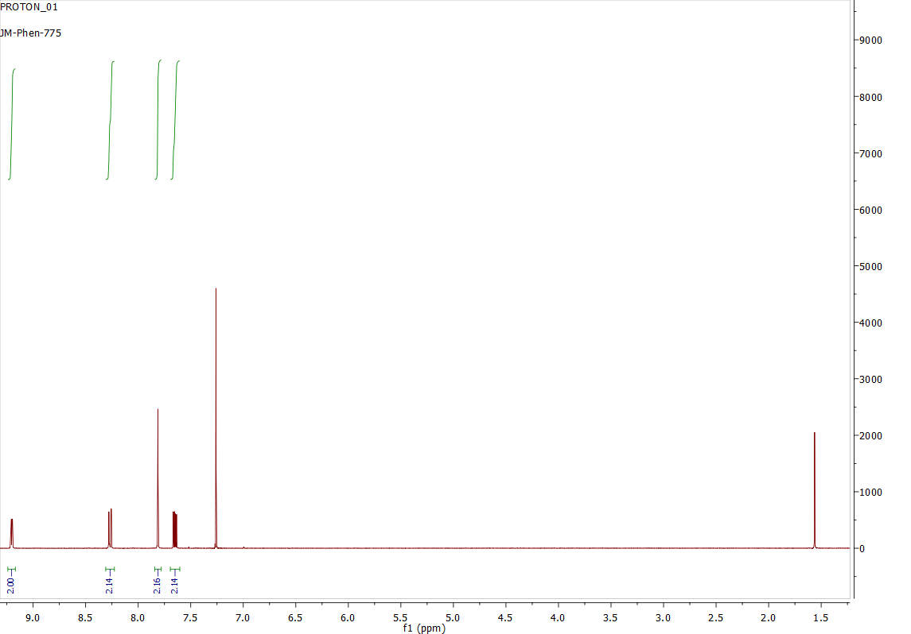
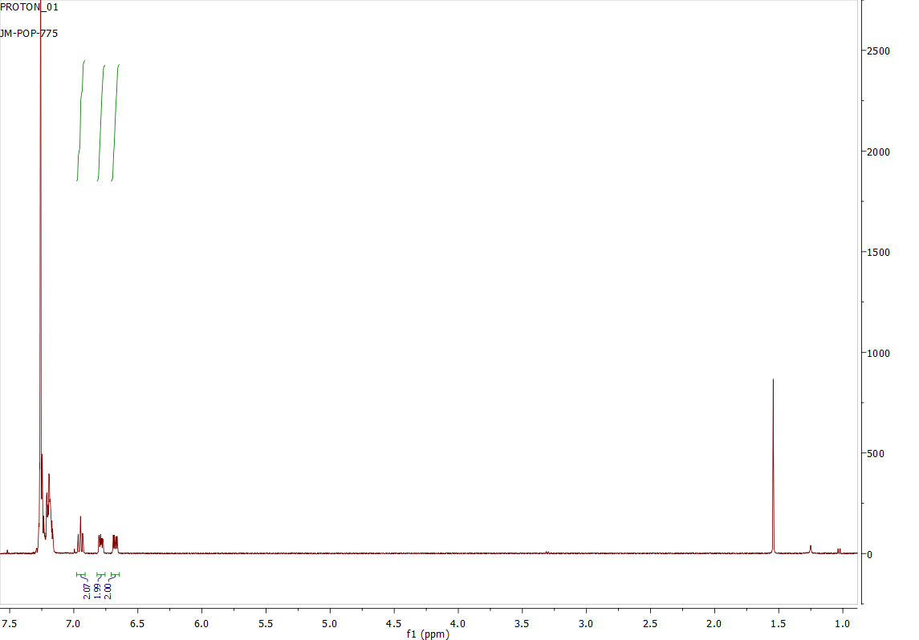
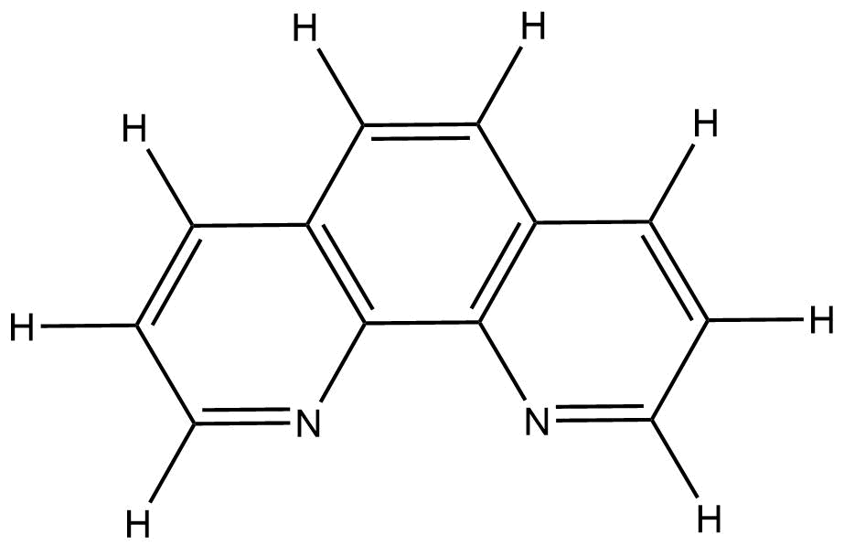
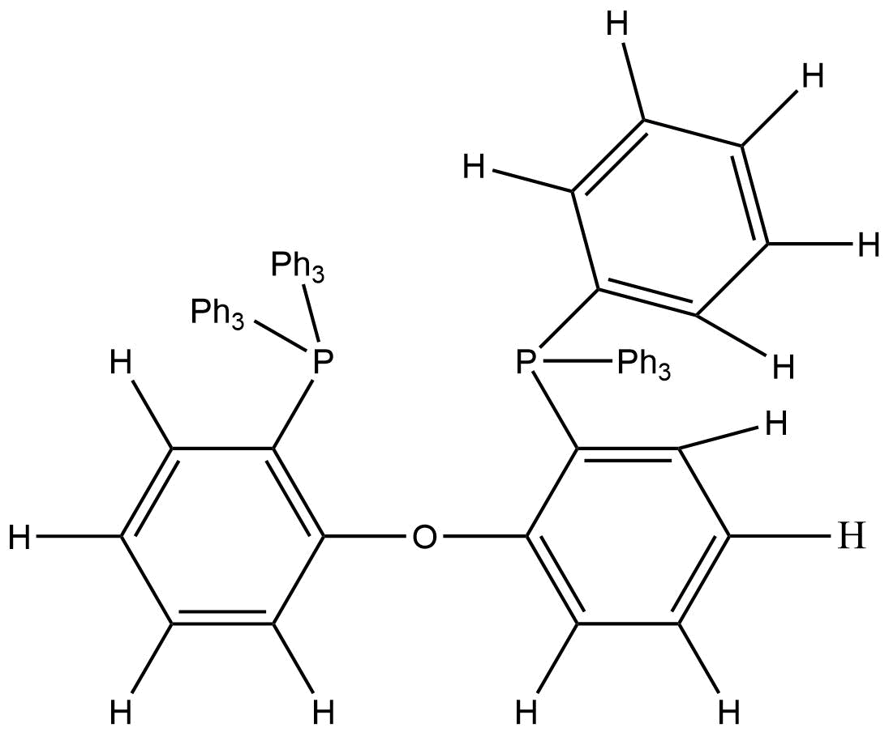
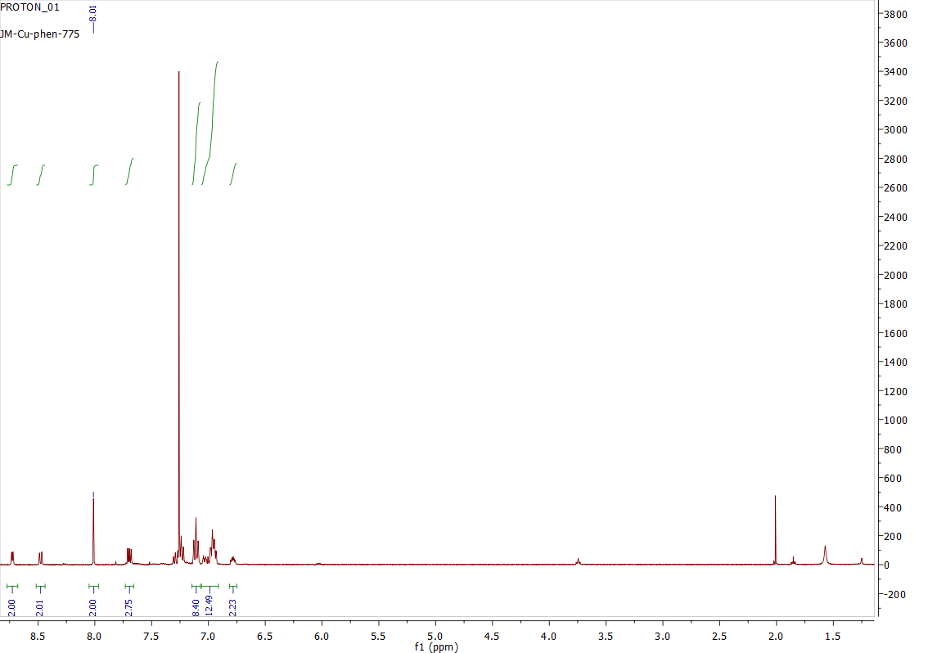
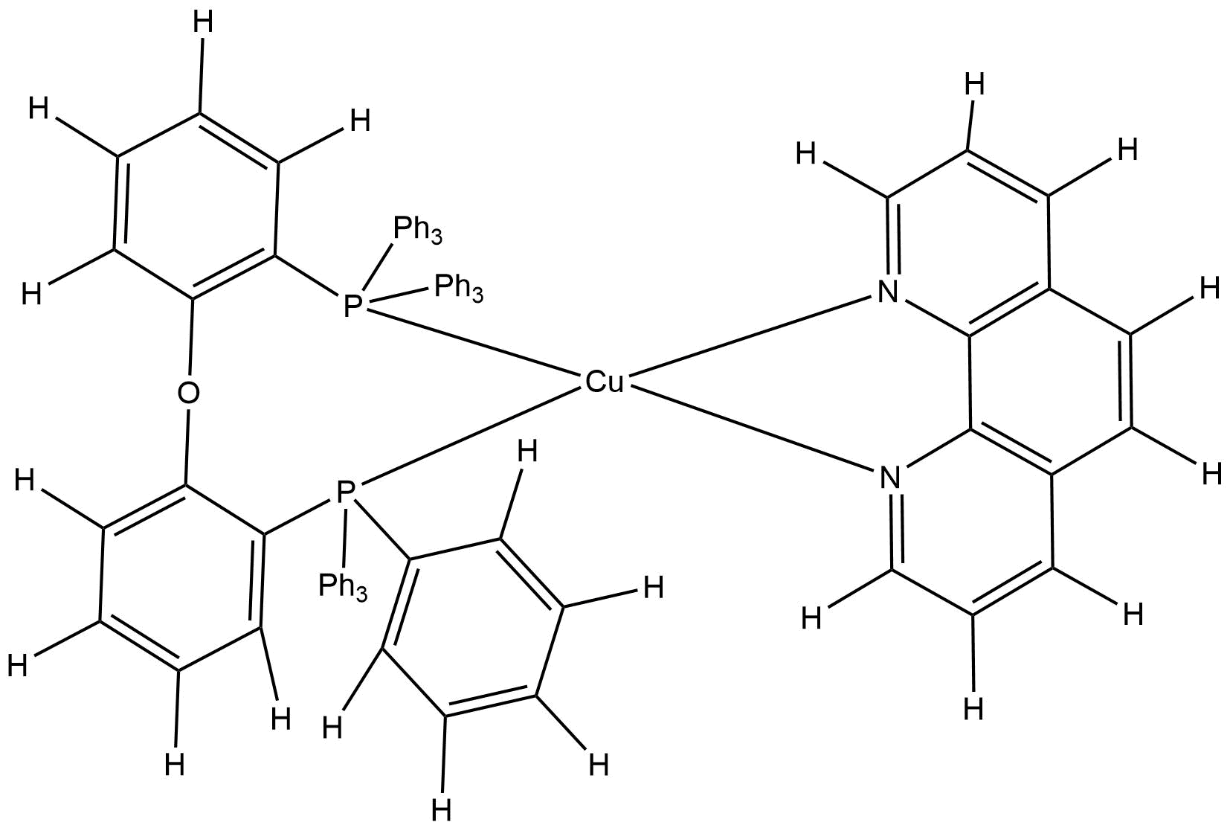
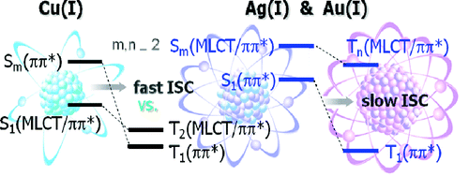
Investigation of the Effect of Ligands on Metal-to-Ligand Charge Transfer Transitions using d¹⁰-complexes of Group 11 Elements
Evangelos Rossis, Roy Planalp, Zane Relethford
er1@wildcats.unh.edu, Department of Chemistry, University of New Hampshire, Durham, NH
05/04/2017
There have been several attempts for the synthesis of d¹⁰-complex OLEDs. The purpose of this experiment is to synthesize and characterize the complex (Cu(POP)(phen)]BF₄) based on its ability to emit color at the visible spectra, using the Hsu et al^{[1]}. as a comparison. The ligand that was used in this experiment other than POP was 1,10-Phenanthroline. A possible factor that could affect the complex is steric repulsion, which weakens the coordinative bonding of the metal complex. That could affect the energy gap between the single excited state and the sequence of triplet state manifold. The desired complex is the one that exhibits a larger rate of intersystem crossing (ISC) so that complexes can process π → π* in the lowest transition single excited state. The major factors to this low transition are the d-orbital contribution (MLCT) and the atomic number of the metal, enhancing the spin-orbit coupling.
Scheme 1. Inverted Order of the Lower Lying singlet-to-Triplet Levels for the Cu(I), Ag(I) and Au(I)
The synthesis was performed starting with [Cu(CH₃CN)₄]BF₄ in acetonitrile and POP in THF. After stirring at RT for 1 hour, a solution of 1,10-Phenanthroline THF was added. The mixture continued stirring for 3 days and the solvent then was evaporated. Light green crystals are obtained by diffusion of hexanes into CH₂Cl₂ solution of product at RT with 109 % yield. To analyze the compound created, several different tests were used. IR, ¹H NMR, UV-Vis, cyclic voltammetry and fluorimetry.
Scheme 2. Proposed Synthetic Route to [Cu(POP)(phen)]BF_{4.}
The synthesis of the desired complex was successful based on the H NMR results in chloroform. The H NMR of the metal-complex was characterized and compared to H NMR of the pure ligands. The H NMR of the metal complex showed a right shift on the ligand peaks, indicating bonding between the metal and ligands.
The UV-Vis spectroscopy peaked at the absorption wavelength λ_{max}=394 nm. Using the fluorimetry technique, with the given absorption wavelength at λ_{max}=394 nm provided intensity and wavelength of the complex at 0.46 and 538 nm respectively
Further work should consider the use of EL spectra, current density-voltage-luminance characteristics^{[2]}, external quantum efficiency/luminance efficiency vs luminance for the OLEDs and phosphorescence lifetime measurements^{[3]} in order to validate that the synthesized complex can be used in the manufacturing of OLEDs.
The synthesis of the [Cu(POP)(phen)]BF₄ was completed successfully. However, the CV shape of the graph indicates that oxidation could occurs on both metal and the ligand at the same time, which could result in irreversible bond breaking between the metal and ligand, while is at the excited state. The would make the complex a bad choice for use in the manufacturing of OLEDs.
I would like to thank Dr. Planalp and the T.As Zane Relethford and Luke A. Fulton as well as the UNH Department of Chemistry.
[1] W. Hsu, C. C. Lin, M. W. Chung, Y. Chi, G. H. Lee, P.T. Chou, C. H. Chang, P. Y. Chen, J. Am. Chem. Soc. 2011, in press. Systematic Investigation of the Metal-Structure–Photophysics Relationship of Emissive d10-Complexes of Group 11 Elements: The Prospect of Application in Organic Light Emitting Devices
[2]Lin, C.-C.; Chen, C.-L.; Chung, M.-W.; Chen, Y.-J.; Chou, P.-T. J. Phys. Chem. A 2010, 114, 10412
[3] De Mello, J. C.; Wittmann, H.F.; Friend, R. H. Adv. Mater. 1997, 9, 230
Introduction:
Results and Discussion:
C
D
D
C
B
A
A
B
C
D
B
A
A
B
C
A
B
C
C
B
A
Figure 6: Fluorimetry of the metal-complex at 394nm.
Figure 1: H NMR Spectra of 1-10 phenantholine
Figure 2: H NMR Spectra of POP
Future Work:
Figure 3: H NMR Spectra of [Cu(POP)(phen)]BF₄
Conclusions:
The data collected from cyclic voltammetry using ferrocene as the internal standard was used to find the reversible peak potential, indicating the barrier that forms the flattened geometry (square-planar) while the compound is at the excited state. During the anodic scan in CH₂Cl₂ the Cu(I) exhibited reversible peak potential at 0.36V. The shape of the CV graph also indicates the likelihood of the oxidation of both metal and ligand, which may result in irreversible metal-ligand bond breaking. The initial expectation was oxidation only on the metal forming the d⁹ square planar geometry. The observed result could be caused from unideal angle between the Cu-N-C₁-C₂.
Experimental Design:
Acknowledgements:
References:
.
Figure 4: Cyclic voltammetry of the meta-complex
Figure 5: Cyclic voltammetry of the internal standard ferrocene.

