Slide 1
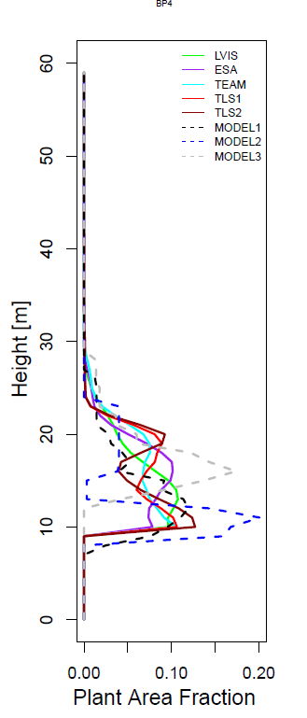
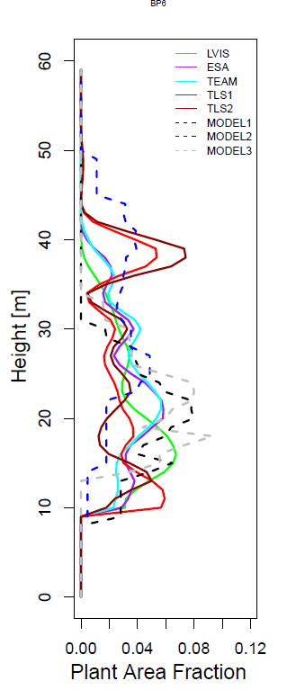
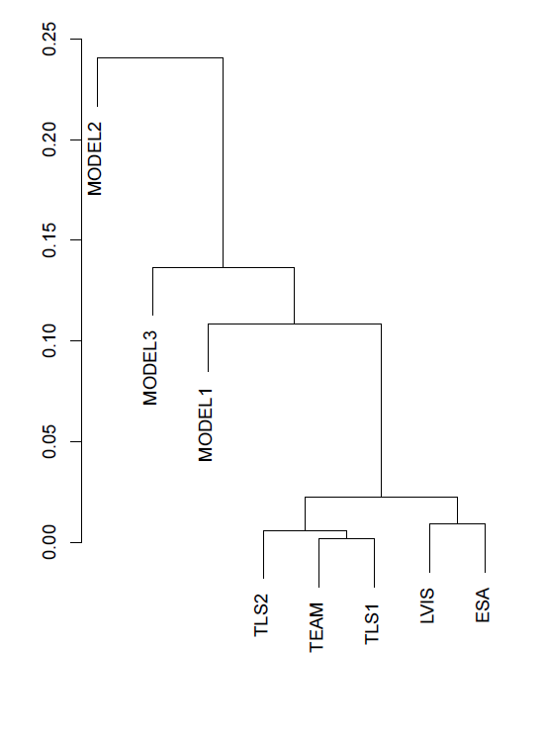
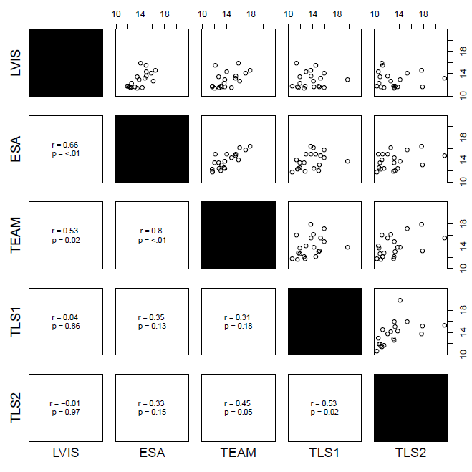
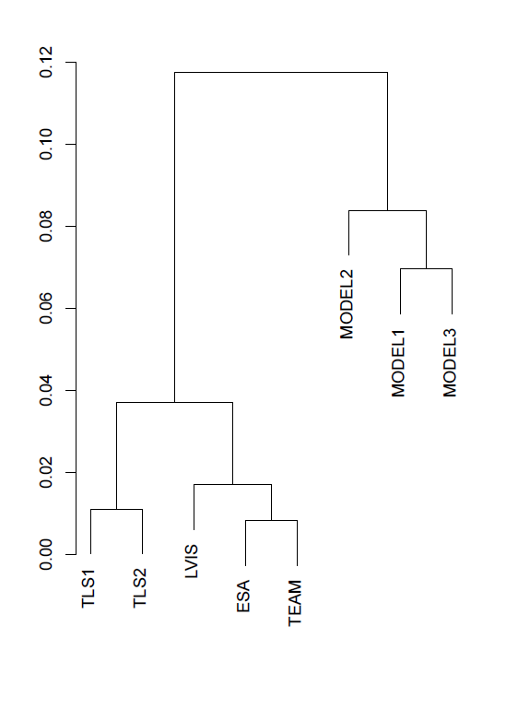


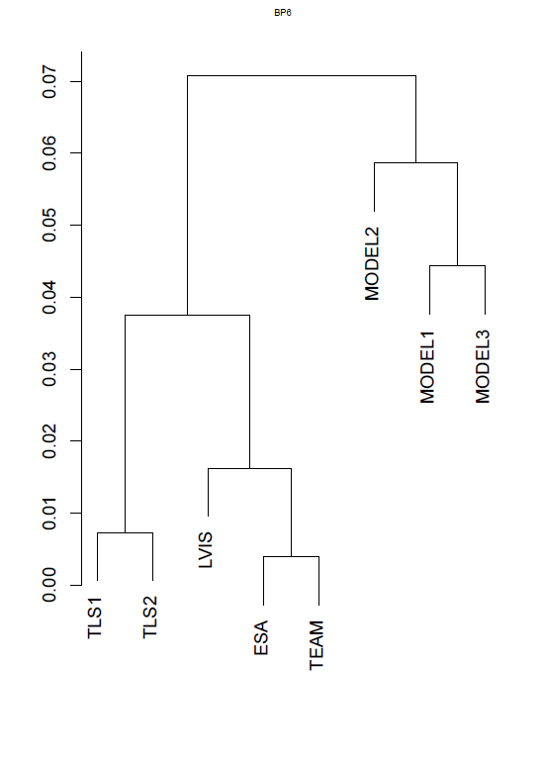
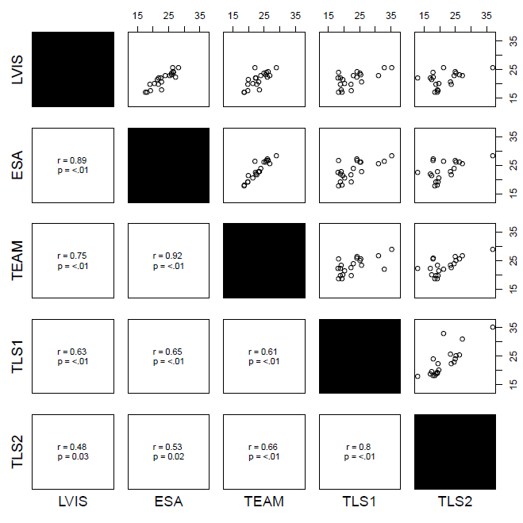
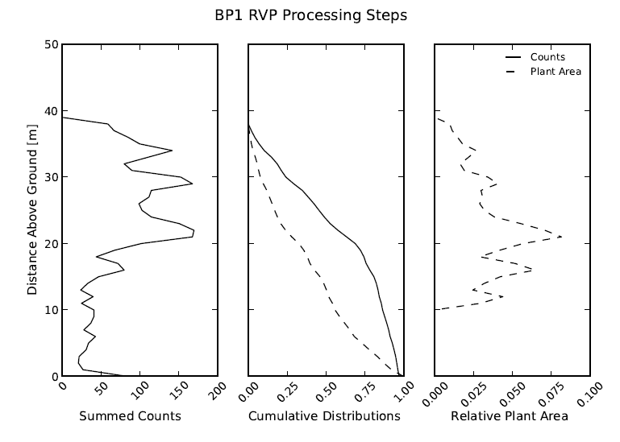
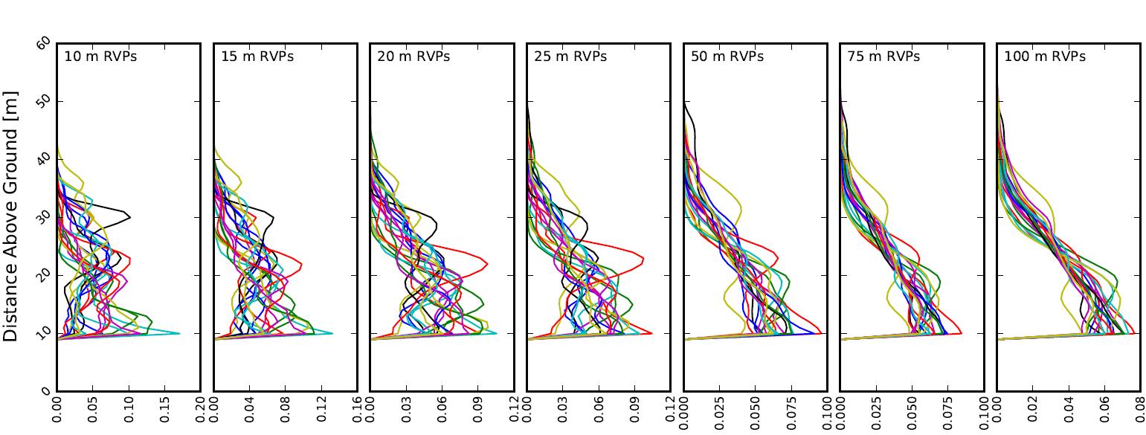
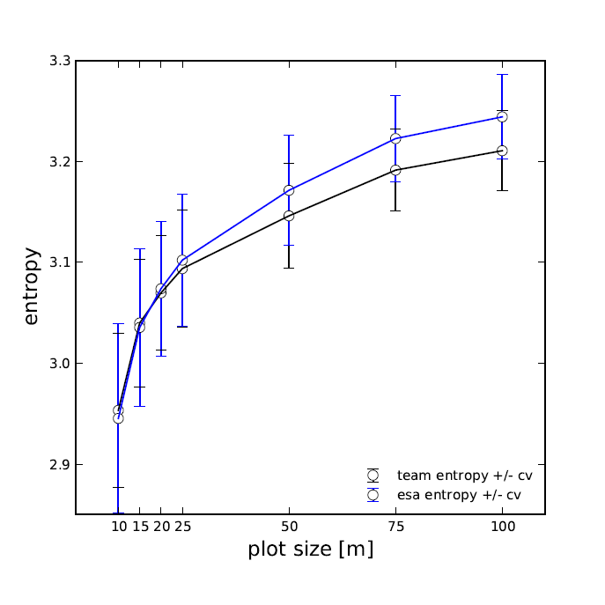
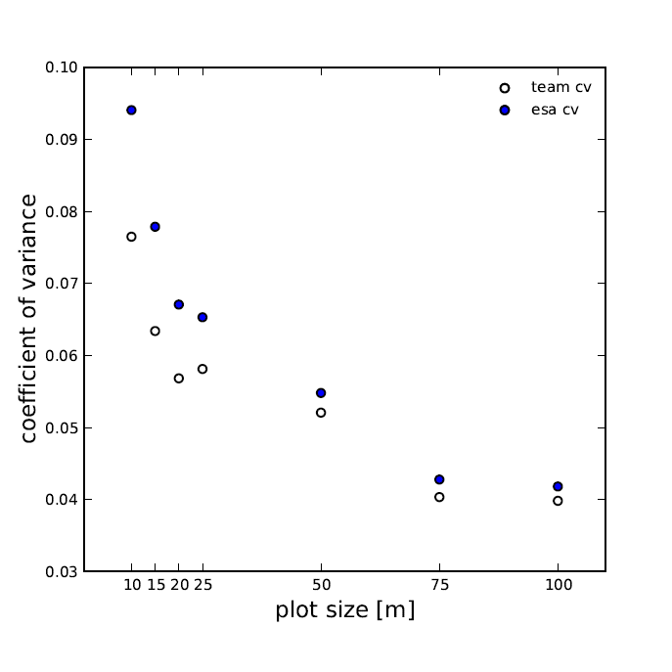
Relative vegetation profiles in a Neotropical forest: comparison of lidar instrumentation and field-based measurements
Results
B41E-0352
A
B
A
Franklin Sullivan, Earth Systems Research Center, University of New Hampshire, fsulliva@gmail.com
Michael Palace, Earth Systems Research Center, University of New Hampshire, michael.palace@unh.edu
Mark J Ducey, Department of Natural Resources, University of New Hampshire
Christina Czarnecki, Earth Systems Research Center, University of New Hampshire
Julia Zanin Shimbo, Departamento de Ecologia, Universidade de Brasília
Jonas Mota e Silva , Instituto de Geociências, Universidade de Brasília
Introduction
B
Remote estimates of forest structure are a key advancement in forest management and carbon accounting. These data have aided in quantifying standing biomass and biomass change across large spatial scales in regions where collecting data is difficult and time consuming or otherwise not possible (e.g. Kellner et al. 2009, Dubayah et al. 2010). Light detection and ranging (lidar) instruments flown aboard satellites and aircraft have been used to characterize the relative distribution of plant area. Vertical complexity measures are thought to be an indicator of forest structure and heterogeneity, as evidenced by the use of metrics from power return distributions and relative vegetation profiles (RVPs) to estimate many structural characteristics, most notably biomass, based on empirical relationships (Drake et al. 2002, Dubayah et al. 2010).
Because of high costs and high demand of sensors like LVIS, there have been few repeat flights of moderate- to high-spatial-resolution airborne lidar sensors over the same location. Establishing the ability of different sensors and different sensor platforms to consistently measure vertical structure would aid in monitoring and characterizing tropical forest change over shorter timescales. In this study, we aimed to evaluate correspondence between two different forms of airborne lidar, a terrestrial lidar, and models based on allometric equations in dense tropical forest stands.
Figure 3 On average, we found agreement between RVPs generated from lidar instruments and between modeled profiles, but the greatest differences were found between modeled profiles and lidar profiles. Terrestrial RVPs (TLS) deviated further from airborne platforms, both discrete (TEAM, ESA), and full waveform (LVIS).
Figure 2 RVPs shown for two plots at La Selva generated from four lidar instruments and three models (left), and their respective cluster dendrograms showing correspondence between lidar instruments, and divergence between lidar instruments and models (middle). In addition, lidar metrics (25th percentile, top right; 75th percentile, bottom right) calculated from these profiles exhibit general agreement. In general, higher regions of the canopy and similar types of instruments (i.e. discrete and airborne compared to terrestrial instruments) exhibited strongest correspondence.
Summary and Future Work
Methods
In this study, we showed that different types of sensors measure RVPs similar to each other, but that our models were not ideal for this region. In future work, we hope to modify our models to improve correspondence between lidar and model profiles.
In addition, we hope to contribute to discussions regarding lidar sensor development. In particular, identifying the spatial scale at which canopy profile variation is minimized may prove beneficial for determining appropriate footprint sizes for estimating relevant forest characteristics (Figure 4). Target footprint sizes should be smaller than the scale of variation. Although the scale of variation may prove a regional problem, determining a global threshold may be useful for planning future missions.
Spatial Data Processing
Shapefiles were created from retrieved lidar returns within 20 m of each field plot. To do this, we used the open-source geospatial package, OGR, in Python 2.7 (Python Software Foundation, v. 2.7.2) to isolate lidar returns. Lidar height and waveform data were output as comma-separated values files for further processing.
Relative Vegetation Profiles Processing (Fig 1)
Statistical Analysis
Statistical analysis was performed using R (R Foundation for Statistical Computing, version 2.14.1, 2011). For each field plot, we calculated a similarity matrix using sum of squares to compare differences between all RVPs. We conducted a cluster analysis for each plot, as well as a cluster analysis of the average differences. Cluster analysis results were presented in the form dendrograms (Figure 3).
Figure 1 Data processing steps are shown from left to right, following Harding et al. (2001): lidar observations are binned into 1 m height intervals (left panel), followed by cumulative summation and normalization (middle panel, solid line). Data were transformed and normalized (middle panel, dashed line), and then relative plant areas were calculated and normalized for the profile above 10 m (right panel).
Figure 4 RVPs generated for twenty field plots with increasing plot radii. As plot size increases, profiles tend towards similarity (left), as is demonstrated by corresponding changes in entropy (middle) and associated coefficient of variance (right) for two discrete lidar instruments.
Dubayah, R.O., Sheldon, S.L., Clark, D.B., Hofton, M.A., Blair, J.B., Hurtt, G.C., and Chazdon, R.L., 2010, Estimation of tropical forest height and biomass dynamics using lidar remote sensing at La
Selva, Costa Rica. Journal of Geophysical Research, 115, doi: 10.1029/2009JG000933.
Drake JB, Dubayah RO, Clark DB, Knox RG, Blair JB, Hofton MA, Chazdon RL, Weishampel JF, and Prince S. 2002a. Estimation of Tropical Forest Structural Characteristics Using Large-footprint Lidar.
Remote Sensing of Environment 79: 305– 319.
Harding D.J., M.A. Lefsky, G.G. Parker and J.B. Blair. 2001. Laser altimeter canopy height profiles: Methods and validation for closed-canopy, broadleaf forests. Remote Sens. Environ. 76: 283-297.
Kellner J.R., D.B. Clark and M.A. Hofton. 2009. Canopy height and ground elevation in a mixed-land-use lowland Neotropical rain forest landscape. Ecology 90:3274. Ecological Archives E090-233-D1.
Acknowledgements: Funding from NASA Terrestrial Ecology, NASA New Investigator Program in Earth Science; ESA data from Kellner et al. (2009) , TEAM data from Tropical Ecology Assessment and Monitoring Network (teamnetwork.org), LVIS data from NASA (lvis.gsfc.nasa.gov)

