Slide 1
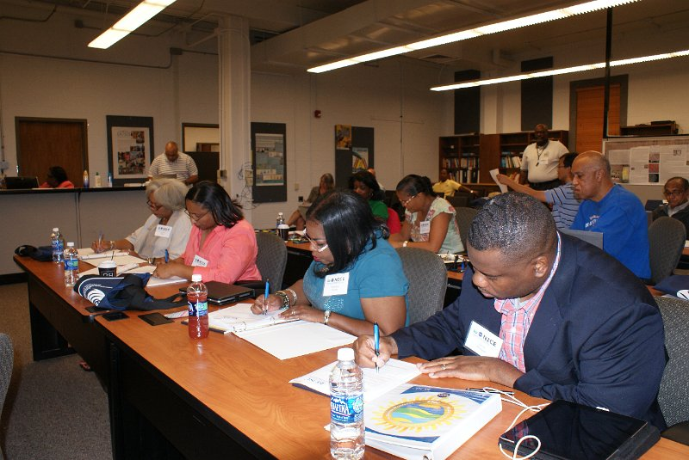
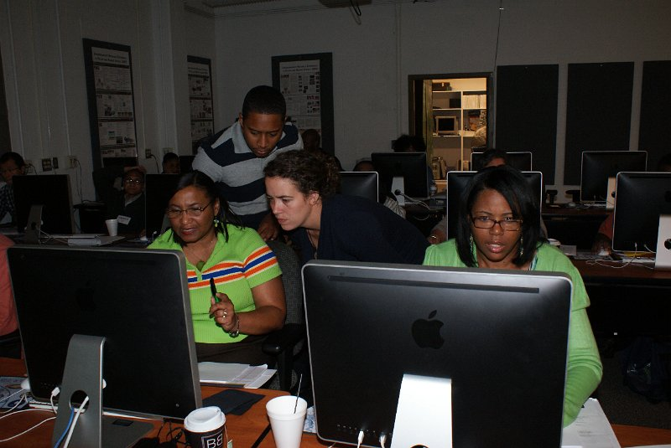
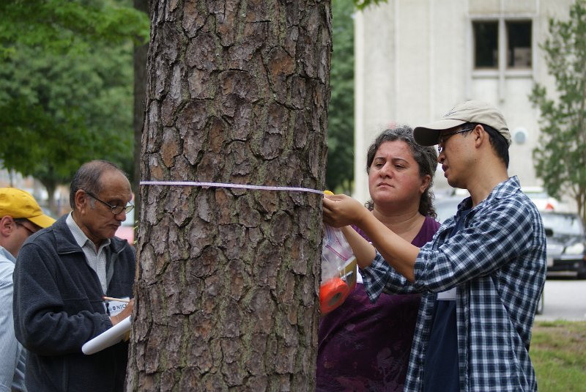
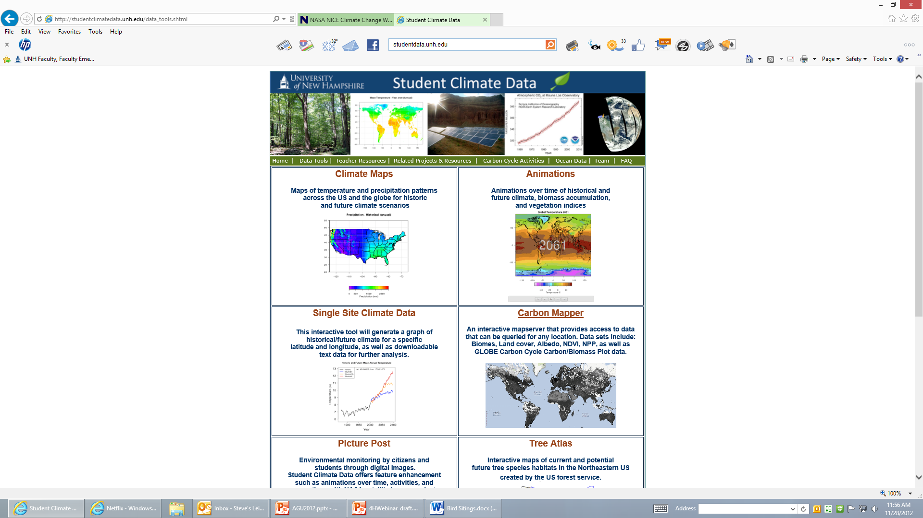
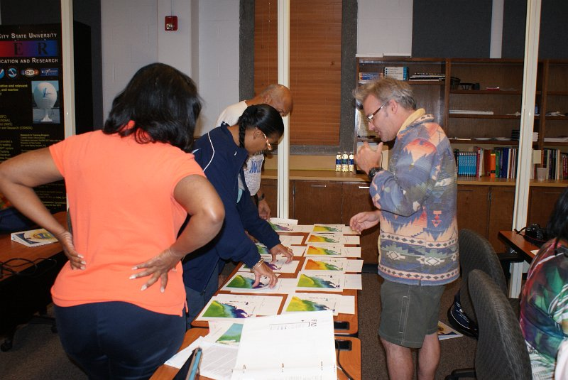
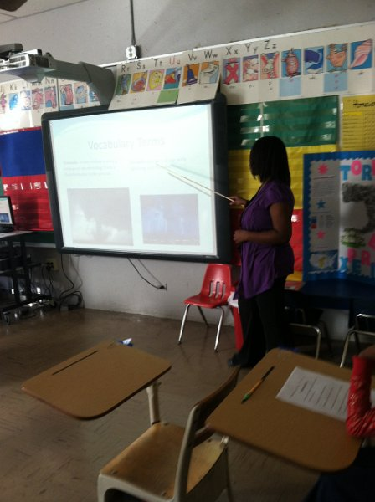
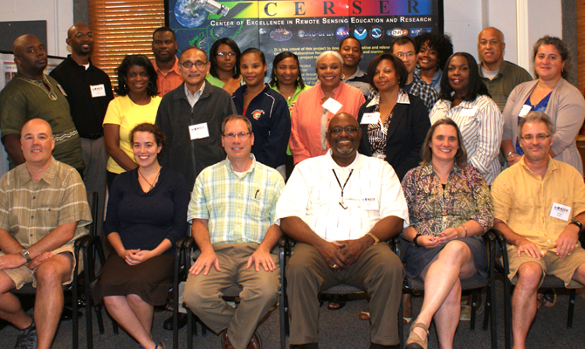



Engaging Minority University STEM Education Professors in the Science of Climate Change
Stephen R. Hale¹, Linda B. Hayden², Darnell Johnson², Erik Froburg¹, Mary Martin³, Timothy Moore⁴, Haley Wicklein³
Joan and James Leitzel Center, University of New Hampshire, Durham, NH.
Mathematics and Computer Science, Elizabeth City State University, Elizabeth City, NC.
3. Earth Systems Research Center, University of New Hampshire, Durham, NH.
4. Ocean Processes Analysis Laboratory, University of New Hampshire, Durham, NH.
Abstract
Program Design
Using NASA Tools
Elizabeth City State University (ECSU) and the University of New Hampshire (UNH) partnered to develop a program to enhance climate education for faculty from participating Minority Serving Institutions (MSI). This effort leverages the ongoing partnership between ECSU and UNH to increase the quality of climate education offered to under-represented pre-service teachers within STEM subjects. The program included a one-week workshop for STEM MSI faculty who teach STEM pre-service teachers. The workshop components focused on terrestrial and ocean climate education and relied on NASA datasets and web-based tools. Specifically, participants were introduced to methods for estimating carbon storage in forests and estimating primary production using ocean color remote sensing. The online data visualization tool GIOVANNI was utilized by participants so they can retrieve and utilize data within their own geographic contexts at their home institutions. After the workshop, participants revised their courses to include workshop components appropriate for pre-service teachers at their college or university. Two ECSU graduate students continue to provide technical Help Desk support for troubleshooting challenges for faculty to fully utilize the datasets and online tools. The ECSU and UNH faculty also continue to provide another layer of support for the MSI as they adapted their syllabi and lesson plans to include workshop materials and activities. Sixteen faculty drawn from 11 MSI in 7 states participated in the 2012-13 program.
Initial background in the Earth’s climate system
GIOVANNI
Terrestrial C sources and sinks
Estimating biomass and C in vegetation from DBH measurements
Ocean C sources and sinks
http://studentclimatedata.unh.edu/
Program Expectations
Audience
Understanding ocean color, sea surface temperature, and acidification.
MSI faculty will incorporate climate education and NASA data and visualization tools into their courses for pre-service teachers.
MSI faculty serving pre-service teachers in courses with climate education.
Back Row - Ronald White, Norfolk State Univ.; Josiah Sampson, Elizabeth City State Univ.; Ervin Howard, Elizabeth City State Univ.; Krista Hines, Hampton Univ.; Vanessa Figgers, Johnson C. Smith Univ.; Justin Deloach, Elizabeth City State Univ.; Chunlei Fan, Morgan State Univ.; Candace Carter-Stevens, Mississippi Valley State Univ.; Arthur Bowman, Norfolk State Univ.
Middle Row – Trina Spencer, Virginia State Univ.; Remata Reddy, Jackson State Univ.; Leslie Whiteman, Virginia State Univ.; Loretta Jaggers, Grambling State Univ.; Yvonne Coston, St. Augustine Univ.; Waneene Dorsey, Grambling State Univ.; Gulnibal Ozbay, Delaware State Univ.
Front Row – Erik Froburg, Univ. of New Hampshire; Haley Wicklein, Univ. of New Hampshire; Stephen Hale, Univ. of New Hampshire; Darnell Johnson, Elizabeth City State Univ.; Mary Martin, Univ. of New Hampshire; Timothy Moore, Univ. of New Hampshire
Not Appearing– Guana Dixon, Elizabeth City State Univ.; Linda Hayden, Elizabeth City State Univ.; Patrina Bly, Elizabeth City State Univ.

