Slide 1

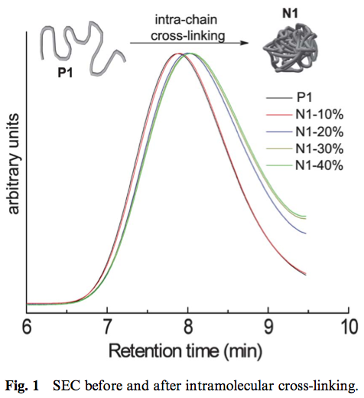
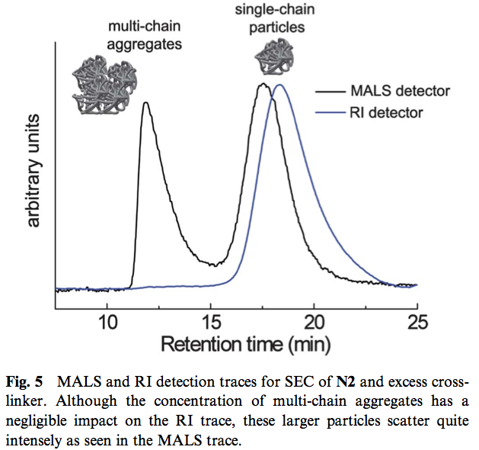
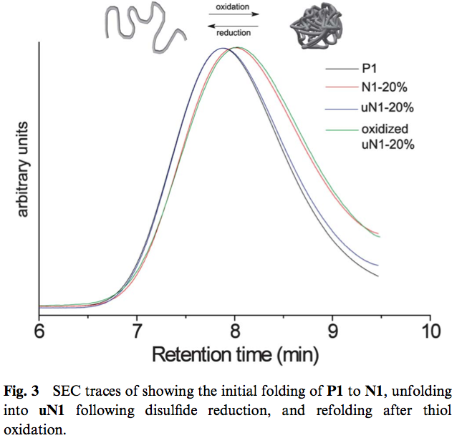
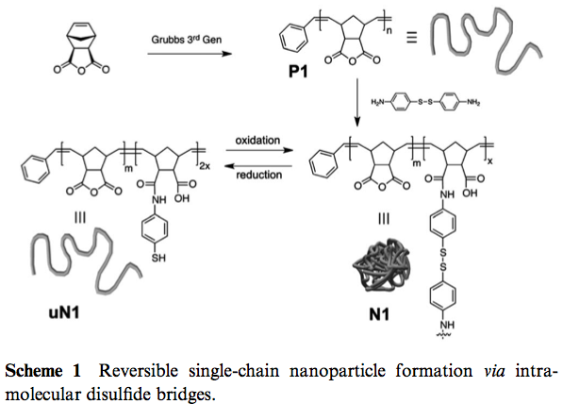
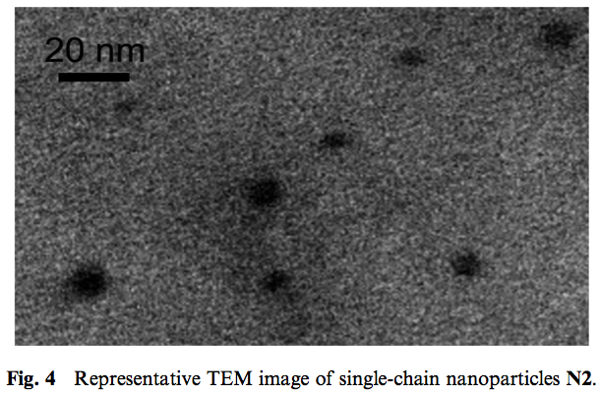
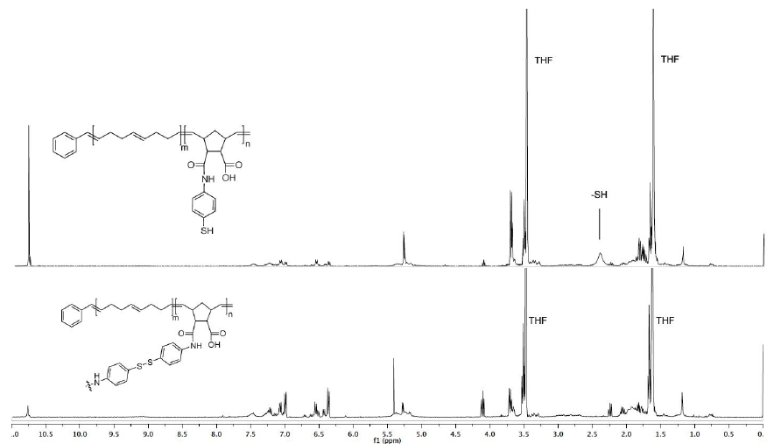
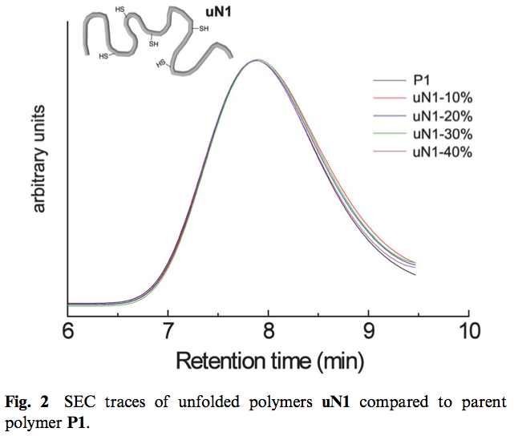
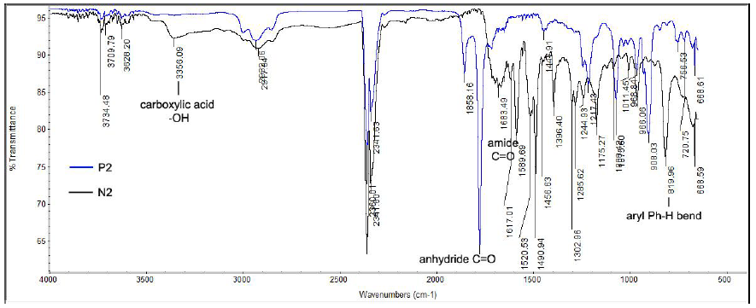


Single-chain polymer nanoparticles via reversible disulfide bridges
Bryan T. Tuten, Danming Chao, Christopher K. Lyon, Erik B. Berda
Introduction:
In analogy to nature, the fabrication of functional nanodevices from well-defined discrete macromelecules remains an important yet elusive research objective. Single-chain polymer nanoparticles (SCNPs) represent a significant step towards these ends. This technique is predicated on the concept that in sufficiently dilute polymer solutions (concentrations below the overlap concentration, c*), inter-chain interactions are minimized because the dimenstions of individual chains are smaller than the average distance between the chains. Thus, triggering a cross-linking reaction under these conditions will result in intrachain, rather than interchain coupling, facilitating a change in conformation from an expanded coil to a collapsed globule or particle.
After cross-linking, the various SCNPs were exposed to dithiothreitol (DTT) to reduce the disulfide bond, thereby expanding the collapsed particles back into a solvated globule.
The SEC plots in figure 3 demonstrates a full cycle of cross-linking, uncross-linking, and finally recross-linking again.
Upon recross-linking, MALS showed the beginnings of self-assembled, reversibly cross-linked SCNPs.
The anhydride based polymer was then exposed to different stoichiometric amounts of diamine (4-aminophenyl disulfide) cross-linker in order to see how compact the coils could be collapsed. Interestingly, it seems that 30% cross-linking is the limiting amount of cross-linker. This is most likely due to the fact that the polymer has become too compact to access the remaining internal anhydride moieties.
A representative sample of SCNPs was analyzed via TEM which agreed with the hydrodynamic radius value reported by viscometry.
At this point catalytic amounts of FeCl₃ was used as an oxidizing reagent to re-cross-link polymers back into SCNPs
Representative 1H NMR and FT-IR spectra showing the successful incorporation of the external, reversible cross-linker.
References:
E. Harth, B. V. Horn, V. Y. Lee, D. S. Germack, C. P. Gonzales,R. D. Miller and C. J. Hawker, J. Am. Chem. Soc., 2002, 124,8653–8660.
O. Altintas and C. Barner-Kowollik, Macromol. Rapid Commun.,2012, 33, 958–971.
J.-H. Ryu, S. Jiwpanich, R. Chacko, S. Bickerton and S. Thayumanavan, J. Am. Chem. Soc., 2010, 132, 8246–8247.
O. Altintas, E. Lejeune, P. Gerstel and C. Barner-Kowollik, Polym. Chem., 2012, 3, 640.
T. Mes, R. van der Weegen, A. R. A. Palmans and E. W. Meijer, Angew. Chem., 2011, 123, 5191–5195.
E. J. Foster, E. B. Berda and E. W. Meijer, J. Polym. Sci., Part A: Polym. Chem., 2011, 49, 118–126.
E. B. Berda, E. J. Foster and E. W. Meijer, Macromolecules, 2010, 43,1430–1437.

