Slide 1


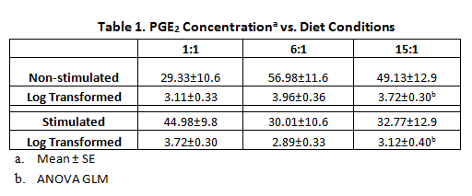
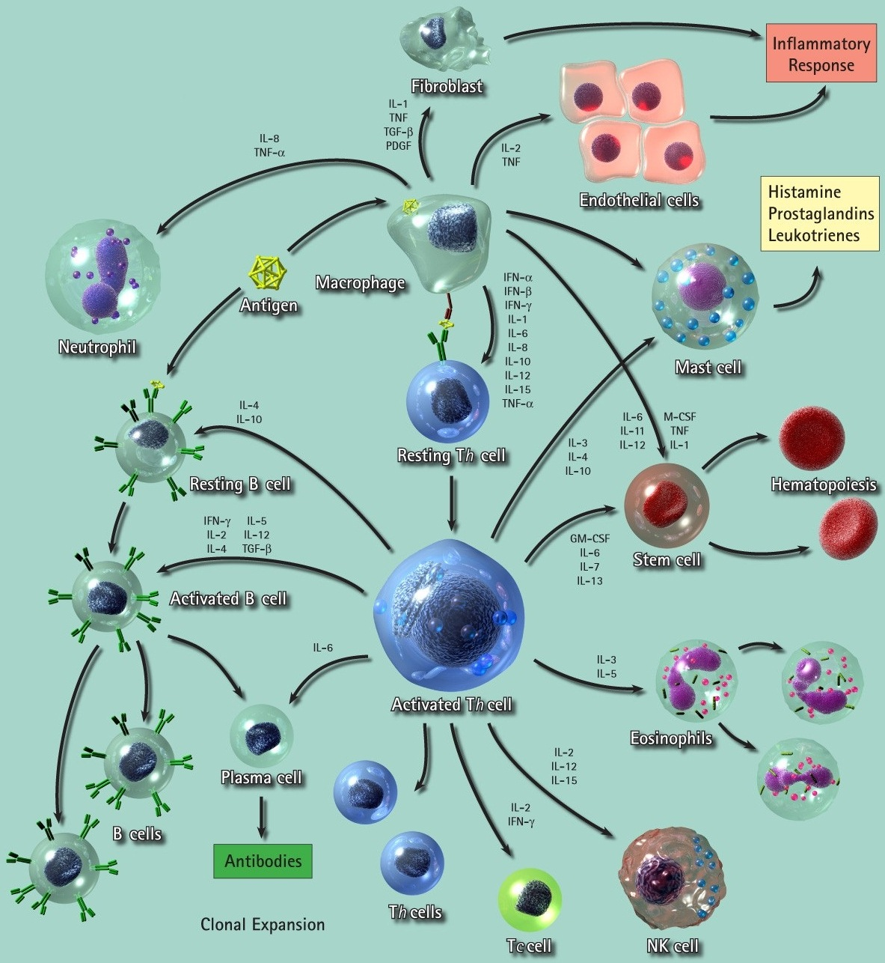


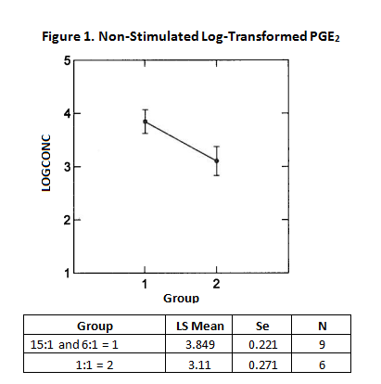
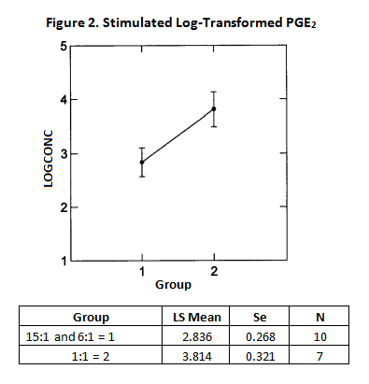
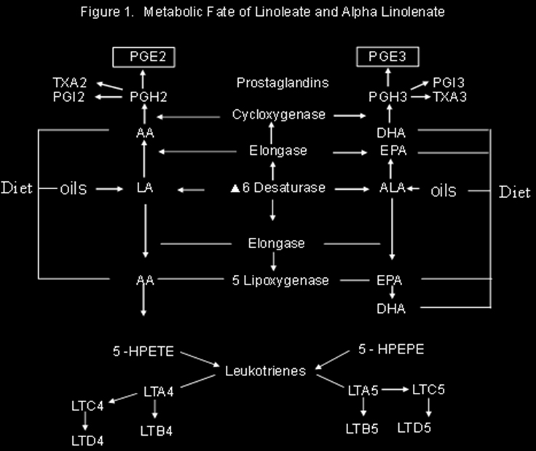
Jenny Jing
Department of Molecular, Cellular
and Biomedical Sciences
University of New Hampshire
Evaluating The Modulatory Effects of Dietary Fatty Acids on PGE₂
Dr. Anthony R. Tagliaferro
Anne Ronan
Department of Molecular, Cellular
and Biomedical Sciences
University of New Hampshire
Background and Significance
Respiratory allergy and related airway diseases, including asthma, have increased dramatically in the last thirty years in the U.S. suggesting that the environment may have a causal role. The typical American diet highly consists of processed food and grain-fed animal products and has been found to be imbalanced in the proportion of omega 6 and omega 3 fatty acids that can range from 10 to 20:1. The fatty acid ratio considered optimum for health is < 4:1 omega 6:omega 3 fatty acids. There is a growing body of experimental evidence that suggests the alveolar macrophage is an important innate immune cell that not only serves as a first line of immune defense against foreign agents in respiration but also can functions as an antigen-presenting cell of allergens to T-helper lymphocytes, that in turn, activate an elaborate immune response involving other T and B-lymphocytes toward development of allergy.
Hypothesis
Alveolar macrophage of mice that consume a diet that is high in omega 6 relative to omega 3 fatty acid will produce more PGE2
Results – Table Summary
PGE2 concentration of control and stimulated cells before and after log transformation is presented in Table 1
Methods
• C57BL/6 male 28-day-old mice were assigned randomly to one of three respective milk fat diet conditions where the ratios between n-6:n-3 are: 1) Low [1:1], 2) Medium [6:1], 3) High [15:1].
• The animals were fed for 16 weeks. On weeks 12 and 13, the mice were sensitized to OVA (20 ug) adsorbed to 100 ul of Alum Imject [an aqueous solution of aluminum hydroxide (40mg/ml) and magnesium hydroxide (40 mg/ml)], by intraperitoneal injection.
• At the end of week 16, animals from each diet group were euthanized by CO2 asphyxiation and alveolar macrophages were taken by bronchoalveolar lavage (BAL).
• Cells were counted and seeded at three quarters of a million cells, incubated in growth media RPMI-1640 + FBS for 2 hours for adhesion. They were then stimulated with either LPS (1 ug/ml) or LPS + IC : IgG /OVA (4.8mg/mL:1ug) over 23 hours in 6 well plates.
• After 23 hours, cells were centrifuged and supernatant frozen at -80 C for later assay of PGE₂. Cells were scraped for RNA extraction (QIAGEN RNeasy Microkit) and stored at -80o C for later microarray analysis.
• PGE₂ assay done using a commercial kit (R&D Systems, Inc).
• Statistical analysis of diet treatment effects on PGE₂ was analyzed using ANOVA GLM. Since there was considerable variability in PGE₂ within the treatment groups, data was log transformed for statistical analysis.
Results
PGE₂ production was significantly higher from macrophages of animals fed the 15:1 and 6:1 diets when combined as one group in comparison to the 1:1 treatment. P = 0.05
In response to IC stimulation, PGE₂ production of macrophages from mice fed 1:1 diet increased in comparison to macrophages of animals fed 6:1 and 15:1 when combined as 1 group. P = 0.03
Conclusions and Next Steps
Alveolar macrophages of the animals that have been sensitized to OVA and fed the 6:1 or 15:1 diets were found to produce more PGE₂ in comparison to the 1:1 diet. The response to IC stimulation was unexpected, but we speculate that the macrophages exposed to the 1:1, produced more PGE₂ that may cause an up-regulation of IL-10, a cytokine that can neutralize inflammatory responses.
Current findings support further the hypothesis that PGE₂ is an important signal for lymphocytes to modify them towards an antibody-related and away from inflammatory acquired immunity
.
The next step is to investigate key regulatory genes associated with allergy and their association to PGE₂ using PCR microarray.
Prostaglandin E₂
The eicosanoid, prostaglandin E2 (PGE₂), is a chemical product of the macrophage = suspected to be an important signal of transduction for activating a T-lymphocyte response toward allergy development and related airway disease such as asthma. Production of PGE₂ by macrophages requires omega 6 fatty acids, particularly arachidonate, for its synthesis, but more importantly, correlated to the level of omega 6 relative to omega 3 fatty acids in the diet. It has been generally assumed that all AA-derived eicosanoids are pro-inflammatory; however, it has been shown that prostaglandin E2 (PGE₂), a biosynthetic product of AA, has been shown in vitro to modify T-helper and B-lymphocytes to phenotypes associated with allergy development. Like n-6, n-3 fatty acids, eicosapentaenoic acid (EPA) and docosahexaenoic acid (DHA), also are incorporated into inflammatory cell phospholipids in a time- and dose-dependent manner.
References
Simopoulos AP. The importance of the ratio of omega-6/omega-3 essential fatty acids. Biomed Pharmacother 2002;56:326-79.
Snijdewint FGM, Kalinski P, Wierenga EA, Bos JD, Kapsenherg ML. Prostaglandin E2 differentially modulates cytokine secretion profiles of human T-helper lymphocytes. J Of Immunology 1993; 150:5321-5329.
Mito N, Kitada C, Hosoda T, Sato K. Effect of diet-induced obesity on ovalbumin-specific immune response in a murine asthma model. Metabolism 2002; 51(10):1241-1246.
Tantisira KG, Weiss ST. Complex interactions in complex traits: Obesity and asthma. Thorax 2001; 56 (Supp 11): 1164-74.
CDC self-reported asthma prevalence among adults-United States 2000. MMWR, 2001;50:682-686.
Kerver J, Yang JE, Bianchi L, Sung WO. Dietary patterns associated with risk factors for cardiovascular disease in healthy adults. Am J Clin Nutr 2003;78:1103-10.
Acknowledgements
Funded by the The New Hampshire Agricultural Experiment Station. Additional funding provided by UNH: The Hamel Center for Undergraduate Research, The Office of Faculty Development and Inclusive Excellence Initiatives and the University Honors Program.

