Slide 1

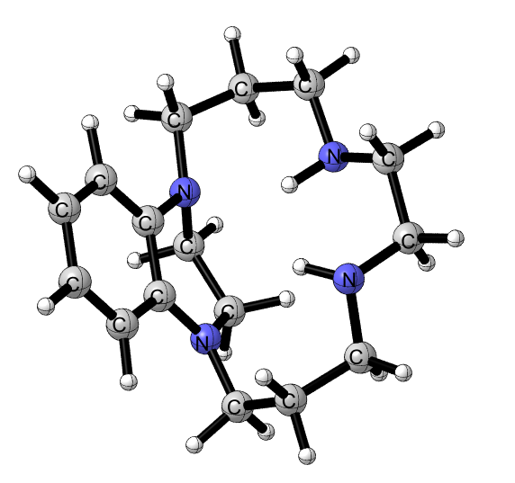
Synthesis of Adjacent-Bridged Benzo-Annelated Cyclam and Attempted Synthesis of
Cross-Bridged Benzo-Annelated Cyclam
Amanuel B. Ghidey*, Edward H. Wong and Gary R. Weisman
University of New Hampshire, Department of Chemistry, Durham, NH 03824
abi43@unh.edu
Introduction
Results and Discussion
Synthesis of Cross-Bridged Benzocyclam
Further Attempts Towards the Synthesis of Benzo-Annelated Cross-Bridged Cyclam
Cyclam is a 14-membered cyclic tetraamine ligand that has the ability to strongly bind metal cations (1 and 2, Figure 1). Structural modifications were made by Weisman and coworkers¹ to the parent polyazamacrocycles “cyclam” and “cyclen” ligands to form the “cross-bridged” tetraazamacrocycles, which have nonadjacent nitrogens bridged with an ethylene unit, first reported in 1990¹ (3 and 4, Figure 1).
One of our research goals was to build the benzo-annelated cross-bridged cyclam 8 (R = Me). An alternative synthetic route was designed under kinetic conditions employing a strong alkylating agent, methyl trifluoromethanesulfonate (magic methyl). Following Reed’s procedure, the bisaminal 14 was prepared. We were able to achieve the alkylation though it was not selective. Unfortunately the subsequent reduction gave mixture of products.
Figure 1. Structures of cyclam (1) and cyclen (2) and their cross-bridged analogues (3) & (4) including a low-energy, diamond-lattice-type conformation (5) and metal-coordinated low energy conformation (6).
Scheme 2. Methylation of 14 under kinetic conditions.
Synthesis of Adjacent-Bridged Benzo-Annelated Cyclam (21)
Our approach towards the synthesis of adjacent-bridged benzocyclam 21 involves alkylation using allylbromide and reductive ring expansion by a mild reducing agent, NaBH₄. Finally, deallylation gave the desired product 21. Compound 21 was characterized by ¹H and ¹³C{¹H} NMR, 2-D NMR, ESI+ HRMS, IR and melting point. Isomerization of 18 to 19 from (87:13) ratio to (40:60) was also observed following 54 hours of heating, suggesting 18 is the kinetic product and 19 is the thermodynamically stable product. This isomerization is explained by an endo anomeric effect which is hypothesized to be the dominant stabilizing interaction with axial substituents having anti-periplanar orientation to the anilino nitrogen lone pair.
A clamshell-shaped cavity or cleft is created as a result of this bridging. These free ligands are flexible, but when coordinated to metal cations “they adopt a low energy conformation having all four nitrogen lone pairs convergent upon a cleft for complexation of small metal ions and encapsulation of protons”.² As a result of the convergent conformation, these ligands exhibit high metal ion complexing ability and strong basicity. The strong basicity can hamper their use in metal ion complexing applications. In order to decrease the strong basic nature, conjugating the amine lone pairs to a π-system was proposed. Some of the proposed structures are depicted in Figure 2.
Target
Figure 3. Global minima of 21 (MMFF calculation).
Figure 2. Proposed structures to decrease the basicity of cross-bridged cyclam.
Initial Attempt Towards the Synthesis of Cross-Bridged Benzo-Annelated Cyclam
and Actual Synthesis of an Adjacent-Bridged Benzo-Annelated Cyclam
Scheme 3. Synthesis of novel ligand 21.
Scheme 4. Isomerization of 18 and 19.
Reed has synthesized benzocyclam 13 which is the main precursor to get to the target material and proposed a possible route to synthesize cross-bridged benzocyclam (8, R= Me).³ Condon following Reed’s methodology has synthesized the adjacent-bridged benzocyclam 16.⁴
¹H NMR of 21, C₆D₆, 500 MHz
¹³C{¹H} NMR of 21, C₆D₆, 125 MHz
¹H NMR, d₄-Methanol, 500 MHz
²¹
Transition metal complexation was investigated with Cu(II) and Zn(II). Zinc coordination was successful according to its NMR spectroscopy, though further purification is needed. Unfortunately we were unable to achieve the Cu(II) complexation due to oxidative decomposition.
Scheme 1. First synthesis of benzocyclam 13 and compound 16 .
²²
References
1) Weisman, G. R.; Rogers, M. E.; Wong, E. H.; Jasinski, J. P.; Paight, E. S. J. Am. Chem. Soc. 1990, 112,
8604.
2) Wong, E. H.; Weisman, G. R.; Hill, D. C.; Reed, D. P.; Rogers, M. E.; Condon, J. S.; Fagan, M. A.;
Calabrese, J. C.; Lam, K. C.; Guzei, I. A.; Rheingold, A. L. J. Am. Chem. Soc. 2000, 122, 10561.
3) Reed, D. P. Ph.D. Dissertation, University of New Hampshire, 1998.
4) Condon, J. S. M.S. Thesis, University of New Hampshire, 2002.
Scheme 5. Transition metal complexation attempts.
Acknowledgements
The Department of Chemistry of the University of New Hampshire is acknowledged for financial support and all W-W group members.

