Slide 1

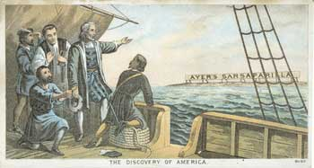
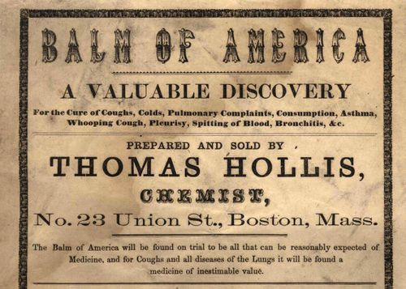
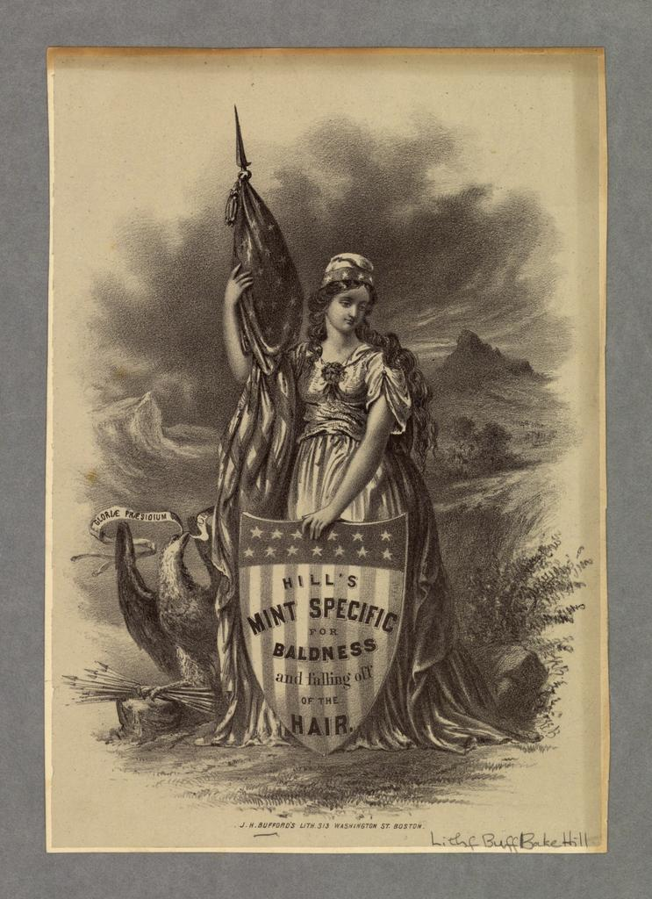
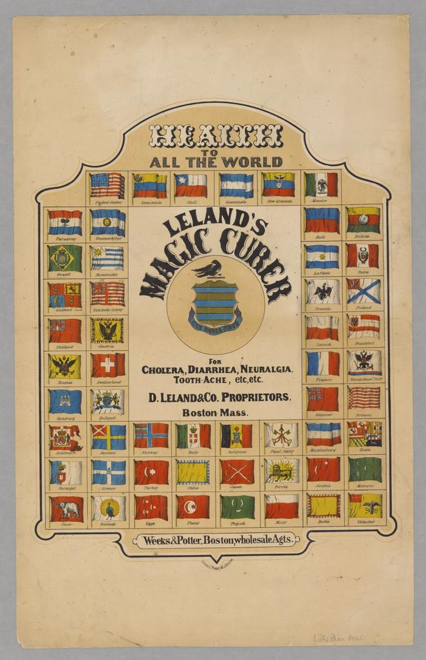
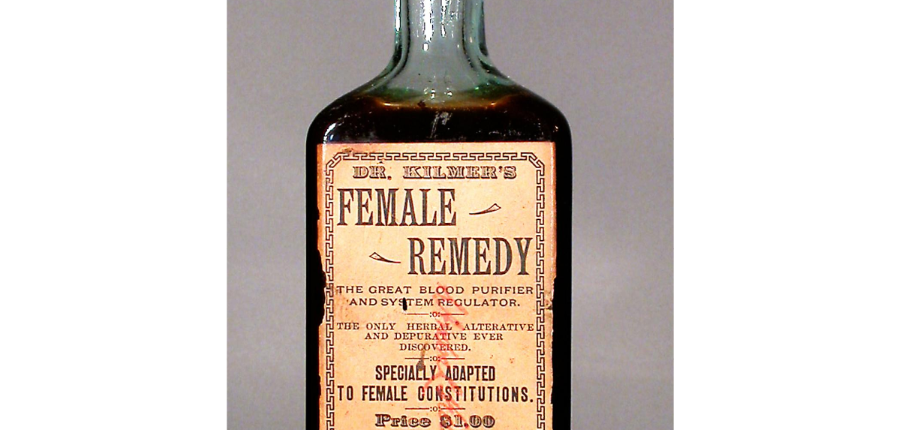
‘ Balm of America’: Nationalism, Advertising, and
Proprietary Medicines in Nineteenth-Century America
K.A. Woytonik
PhD Candidate
Department of History
University of New Hampshire
Abstract:
Proprietary medicines flourished in the nineteenth century. As Americans struggled to make sense of the new nation, savvy businesspeople and owners of patent formulas drew on new forms and methods of advertising to increase distribution and profits of such items as cure-alls, elixirs, fever powders, salves and medical devices. With little government regulation or resistance from the very-young professional medical community until the late 1800s, proprietary medicines found a niche in lay usage across the United States due to advertising campaigns that stressed uniqueness, scarcity, efficacy, and a distinctly American quality of the product. This poster visually demonstrates how advertisers linked health to nationalism to legitimate and sell products that, within a century, came to be termed "quackery" and "snake-oil".
Why did people seek ‘cure-alls’?
Nineteenth-century ideas about medicine were informed by early modern beliefs in the “alkahest”, better known now as “the philosopher’s stone” or “Elixir of Life”. Seventeenth-century chemists believed the alkahest, as a universal solvent, had medicinal properties that made it a cure-all. As chemical and medical science developed, beliefs about human systems enforced the notion of a cure-all with the adoption of Humorism. This theory posited that the human body contained four fluids, or humors, and internal imbalance explained illness; many patent medicines promised to balance the humors, thereby “curing all”. People did not need to be actively ill to be drawn to cure-alls: below, Dr. Kilmer’s “Female Remedy” is marketed as a sex-specific “system regulator” based on “female constitutions” and advised daily use.
How were proprietary medicines advertised and sold?
Peddlers of patent medicines were savvy and advertised their products in almanacs, magazines and newspapers. Companies often chose a nationalistic theme, which had renewed significance after the Civil War. Ayer’s Sarsaparilla claimed to be “without doubt the discovery of America” and depicted the first ship arriving to the continent, marked by the product. Thomas Hollis’s “Balm of America” also used language of discovery and the product being unique to the United States.
The symbols of the nation featured prominently in ads such as Hill’s Mint Specific for Baldness. Lady Liberty, bedecked in American flag garb, poses with an eagle and a shield bearing the products name. Other advertisements extended the nationalistic representation to argue for America’s domination of the medicine market. Leland’s Magic Curer out of Boston, Mass. displayed 54 nations’ flags, indicating a global consumer base, and alleging that the company dispensed “health to all the world.” Ads had in common this exaggerated imagery, and made extraordinary claim in terms of both health benefits and market.
Why were proprietary medicines so popular in the nineteenth century?
Several nineteenth-century societal conditions explain the boom in patent medicines between 1800 and 1900.
1. Professional medical fields were only just developing in America in this era, and hospitals and physicians were most frequently found in urban areas and in the North. By 1900, professional organizations and medicine manufacturers challenged patent-holders and claimed their products were “snake oil”.
2. Americans maintained a long history of home care involving folk remedies and notions of preventative medicine. Patent medicines, which could be easily purchased or ordered, fit into nineteenth-century home health practices. These medicines were also consumed by populations wary of new medical science.
3. With no medical or legal oversight and patents readily available, companies were able to create and sell medicines without regulation and without having to disclose ingredients. By 1906 proprietors were under pressure from legislators who demanded governmental public health oversight.
Sources:
All advertisements from the manuscript collections of the following archives:
Hagley Library
American Antiquarian Society
Natural Museum of American History at the Smithsonian Institute

