Slide 1

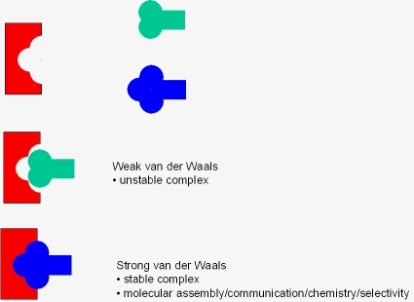
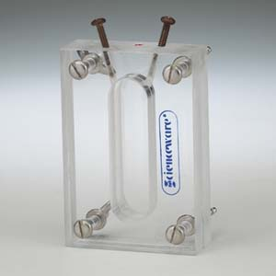
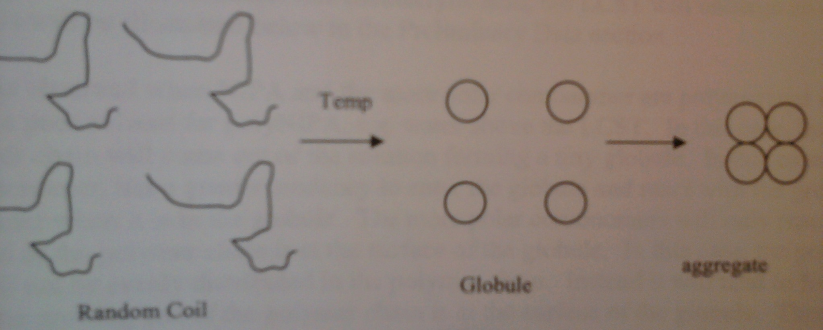
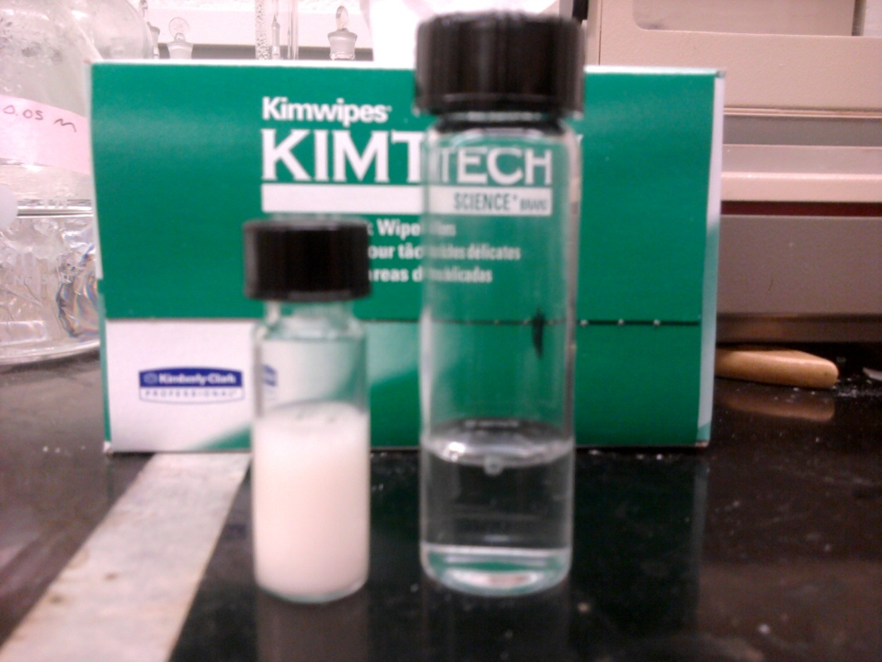
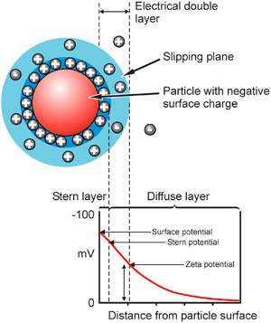
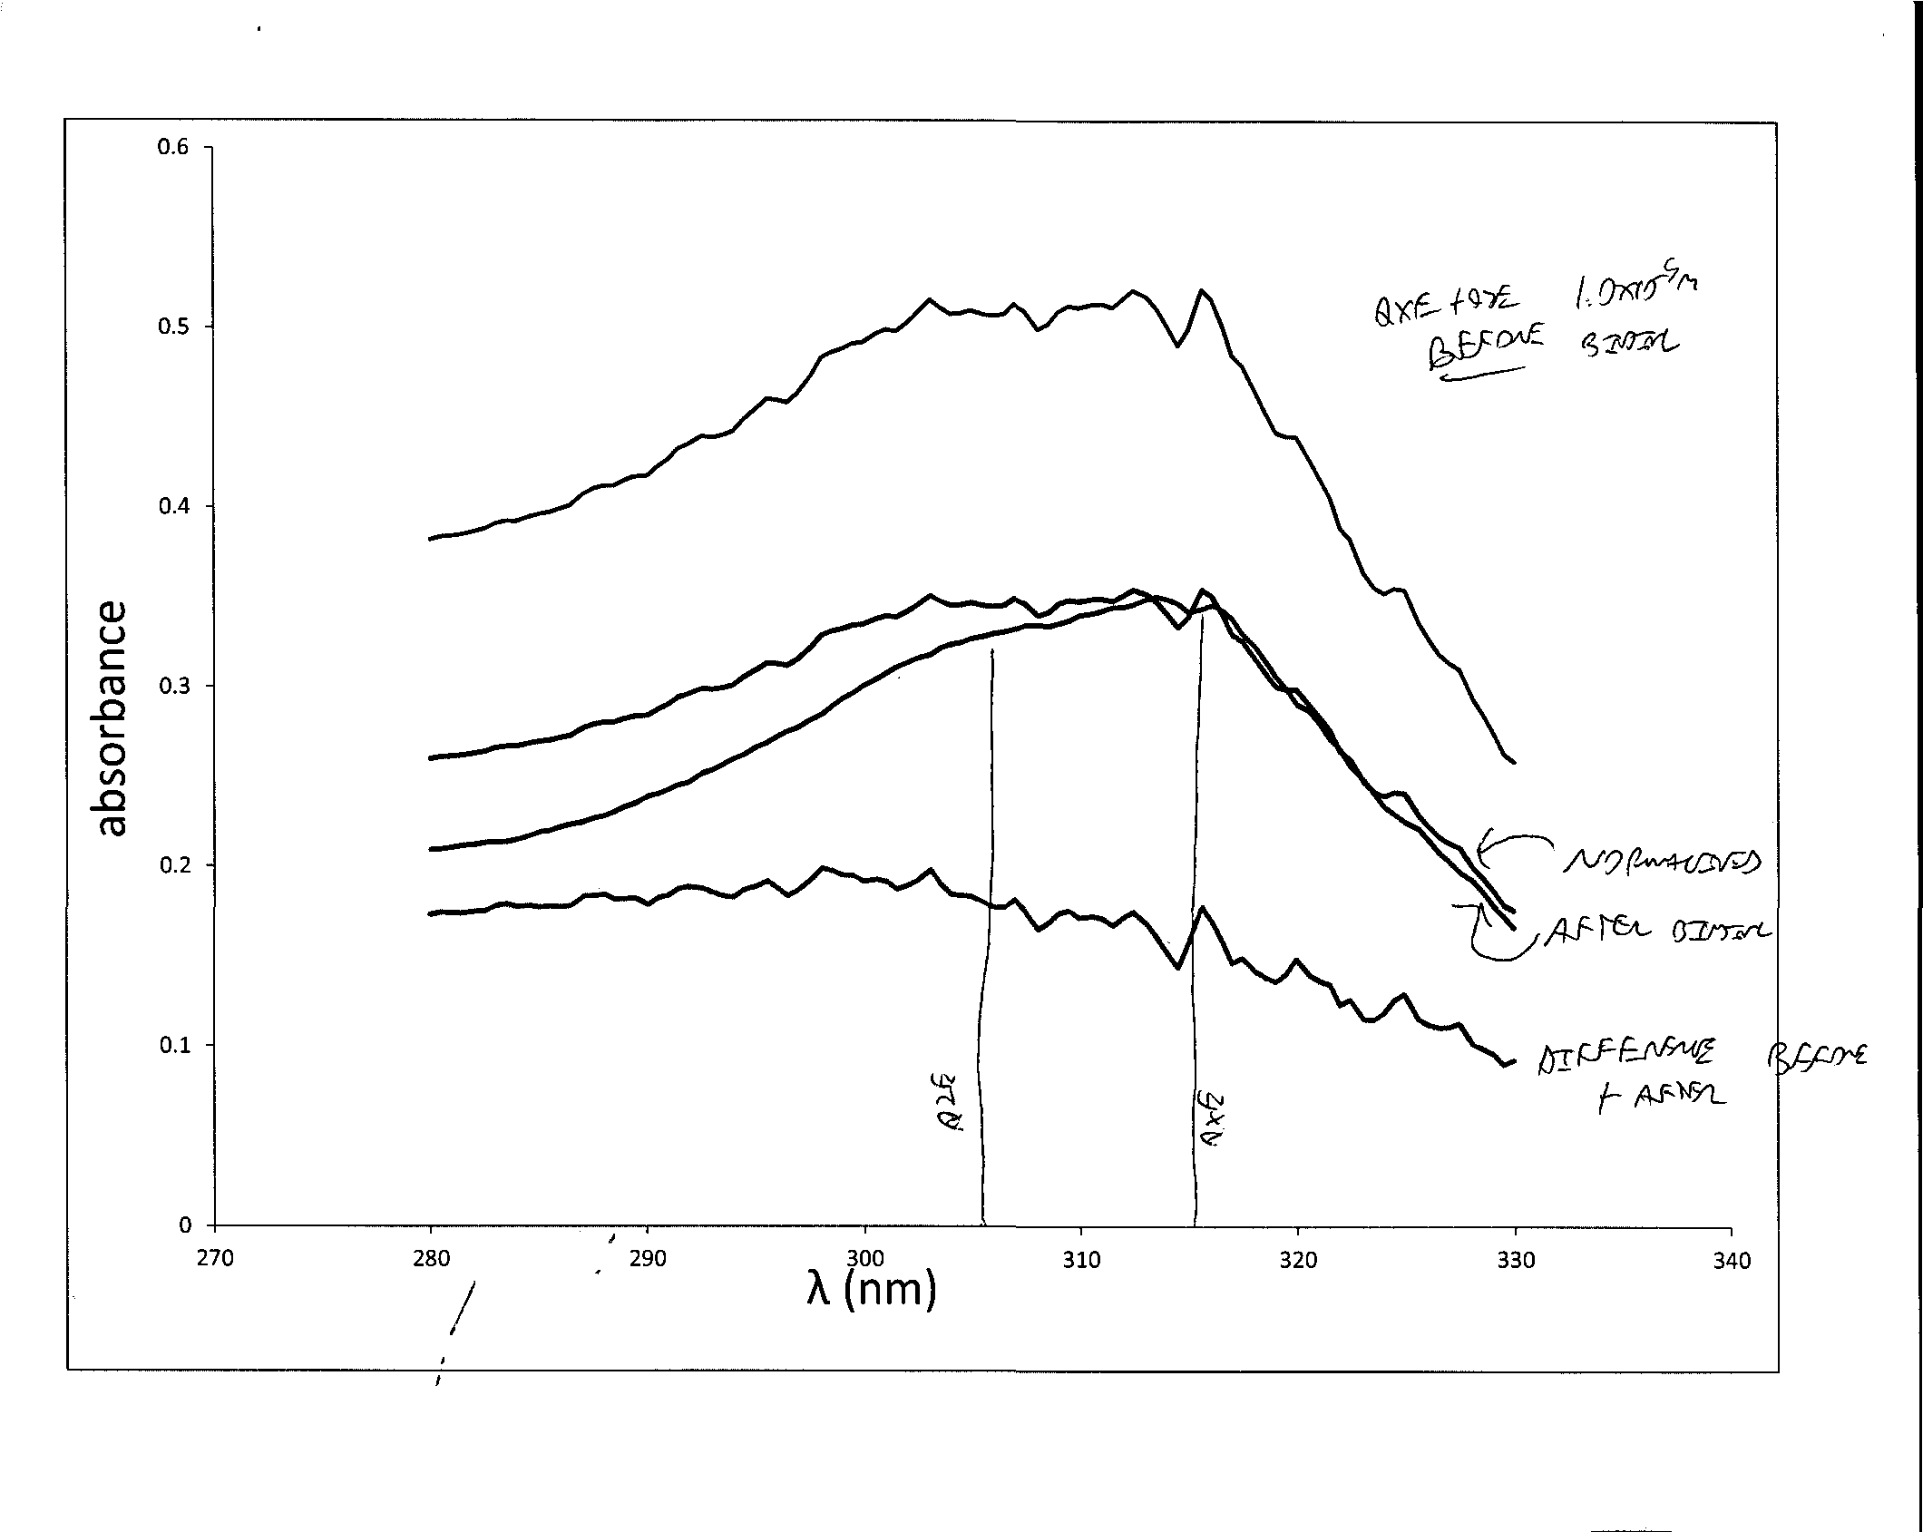
Molecular Recognition Using Uncrosslinked Polymers of N-isopropylacrylamide
Alex Papantones
Background
Molecular Recognition
Results
The term “molecular recognition” describes specific interactions between two or more molecules that involve non-covalent bonding including hydrogen bonds, metal coordination, hydrophobic interactions, Van Der Walls interactions, π-π interactions, and electrostatic effects¹.
Molecular recognition is extremely common among biomolecules¹. Biological receptors are highly selective to their complimentary substrates and are often stereoselective , but are very complex molecules that are difficult to synthesize. In addition each receptor is only useful for binding to unique substrates.
A solution to this problem pursued in this project is a form of molecular imprinting using Uncrosslinked polymers of N-isopropylacrylamide and methacrylic acid to selectively bind analytes.
How Partitioning Works
- Synthesize imprinted polymer @ pH7
- Remove template molecule by dialysis
- Time frame several hours to days
- Experiments at 20, 45, and 65°C
Dialysis Solvent
pH 7 buffer
70% MeOH/25% H₂O/5% HOAc
pH 2 HCl
The molecules involved bind as “host” and “guest” molecules. The two molecules are complementary, and can form a coordination complex between each other that the host molecule cannot form with any other molecule. A good analogy is a keyhole and a key. The guest will easily bond to the host but any other guest molecule will not be able to bind to the host molecule at all.
Polymerization details
Polymers purified by dialysis
- For this project concentrations of MAA were 0, 10, or 20 mol%
- Reaction reaches completion in minutes
- Free Radical synthesis, can use water or acetonitrile as solvent
Imprinted polymer in Dialysis Tubing
λ_{abs} = 310.1 nm
λ_{abs} = 314.9 nm
λ_{abs} = 306.5 nm
Properties of polyNIPA
Equilibrium Dialysis method:
1.00 mL Imprinted polymer on one side, 1.00 mL template solution (0.0001 M) on other side.
PolyNIPA has a Lower Critical Solution Temperature (LCST) of 32°C. It is soluble in water below this temperature and will aggregate out of solution at higher temperatures. This process is reversible⁴.
Experiments lasted 24 h and were conducted at 28° and 45°C.
Concentrations of template monitored by absorbance spectroscopy.
Dialysis Cell
Better Binding and selectivity at 45°C.
Polymer (analyte) | T = 28°C | T = 45°C
2 BDSR QXE (QXE) | ∆A₃₀₆ none ∆A₃₁₅ 0.043 | ∆A₃₀₆ none ∆A₃₁₅ 0.070
10 BDSR QXE (QXE) | ∆A₃₀₆ none ∆A₃₁₅ 0.026 | ∆A₃₀₆ none ∆A₃₁₅ 0.049
2 BDSR QXE (QZE,QZE) | ∆A₃₀₆ none ∆A₃₁₅ none | ∆A₃₀₆ 0.035 ∆A₃₁₅0.053
10 BDSR QXE (QXE,QZE) | ∆A₃₀₆ none ∆A₃₁₅ none | ∆A₃₀₆ 0.026 ∆A₃₁₅ 0.037
When the polymerization is carried out at high temperature in the presence of a template molecule, the molecules are surrounded by aggregated polymer imprinting that molecule into the polymer structure. Allowing the polymer to relax to the random coil state releases the template molecules during dialysis⁵.
Vials of 40 mg/mL polyNIPA 20% MAA in pH 7 HBES buffer at 65°C (left) and 20°C (right)
0.0001 M QXE + 0.0001 M QZE
-There is a charge on the outer surfaces of polymer interacting with the solution
-High zeta potential can tell us precisely at what temp LCST occurs
Can often give us clues as to the structure of a polymer aggregate
-Measured by Zetasizer Nano instrument using Laser
Doppler Velicometry³
Normalized QXE + QZE
Solution after Equilibrium with 4 BDSR QZE imprinted polymer at 45°C
∆Absorbance during binding
QZE response
QXE response
Zeta Potential is the electrical potential between the dispersion medium and the stationary area of fluid attached to a dispersed particle. It can also be described as electrical potential in the interfacial double layer (DL) at the location of the slipping plane versus a point in the bulk fluid away from the interface. A value of 30 mV (+ or -) would be considered to be a highly charged, stable²
Conclusions and Future Experiments
-Early experiments showed that the uncrosslinked template polymers are capable of re-binding target molecules.
-Equilibrium dialysis experiments have shown selectivity for both QXE (10:1, 2:1 bdsr ) and QZE (4:1 bdsr) imprinted uncrosslinked polymers using a 0.0001 M standard solution of mixed QXE and QZE.
-Selectivity was best for 4:1 bdsr polymers.
-Temperature during dialysis has a major effect on binding with the best binding observed at temperatures just above the LCST (45C) with less binding or even no binding (Figure 8) at lower temperatures (28C). It does not seem to make a difference if the temperature is raised above 45C
-.New Experiment using RAFT polymerization to synthesize polymer, Vinylpyradine as recognition monomer, and Nitrophenols as target molecules.
  Calculate relative selectivity ratios, or distribution ratios between the three polymers using equilibrium dialysis experiments and solutions of mixed analyte molecules.
  Replicate the selective binding results I got for the two uncrosslinked polymers using similar binding experiments with a wider variety of crosslinked polymers.
-Expand the molecular imprinting to amino acids and chiral molecules. It would be a major breakthrough to be able to selectively bind chiral molecules like in a real biochemical sensor.
-Further characterization of the selective polymers by GPC and light scattering to determine the polydispersity and molecular weight. These will need to be known for this work to be potentially published
Diagram of a 1,5-naphthyridine molecule being bound by polyNIPA/MAA
Effect of QXE on zeta for polyNIPA 20% MAA 1.00 g/L
Increase in stability @ LCST
LCST
LCST much less apparent
Lower zeta potential/stability
10 mV more stable than unimprinted polymer
Acknowledgements:
Dr. Rudolf Seitz and Research group
John Csoros and Dr. Sterling Tomellini
References: (1) Nelson, D.; Cox, M. Principles of Biochemistry 5th ed. New York. 2008. p. 88. (2) http://www.malvern.com/LabEng/technology/zeta_potential/zeta_potential_LDE.htm.
(3) Malvern Instruments. Zetasizer Nano User Manual. Worcestershire, England. 2004. (4) Piletsky, S., Turner, A., Molecular Imprinting of Polymers, Landes Bioscience 2006
(5) O. Oktar, P. Caglar, W. R. Seitz, Chemical modulation of thermosensitive poly(N-isopropylacrylamide) microsphere swelling: a new strategy for chemical sensing, Sensors and Actuators B: Chemical, Volume 104, Issue 2, 24 January 2005, Pages 179-185, ISSN 0925-4005, DOI: 10.1016/j.snb.2004.04.033.

