Slide 1
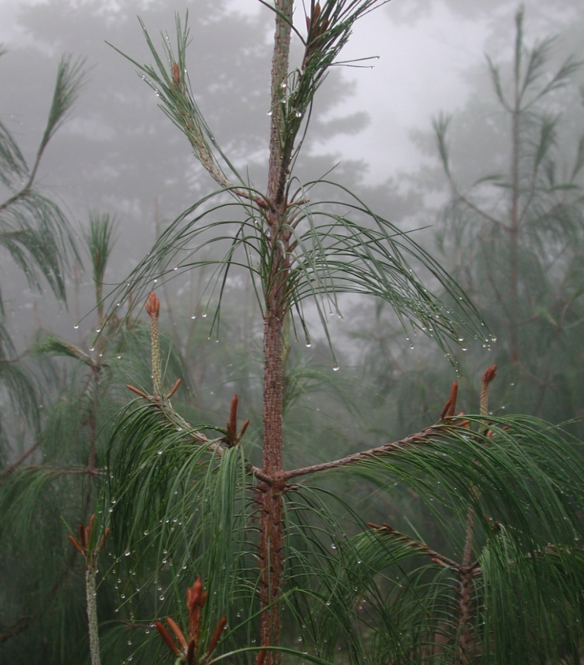
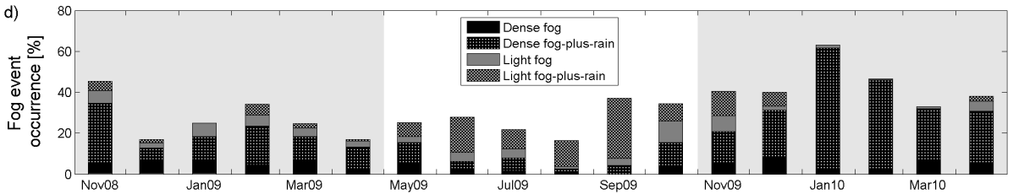
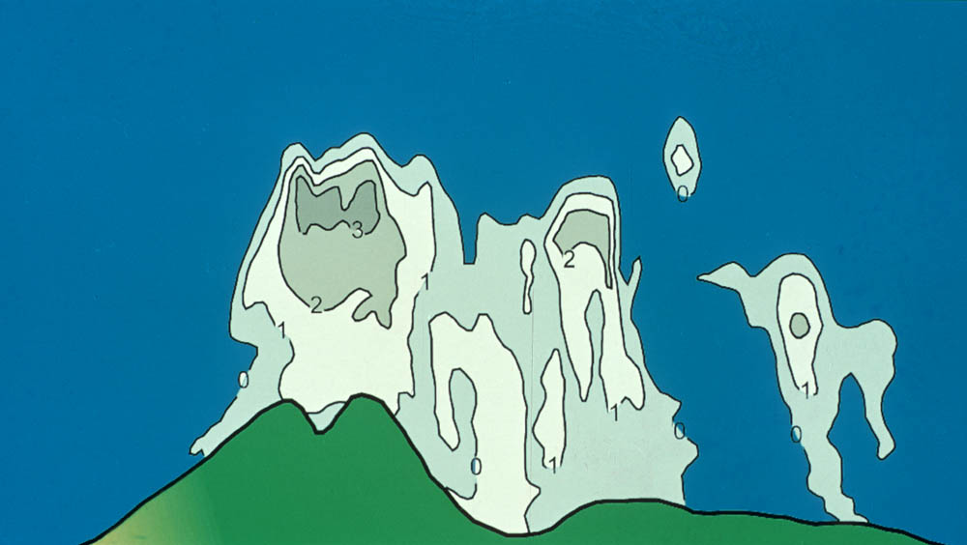
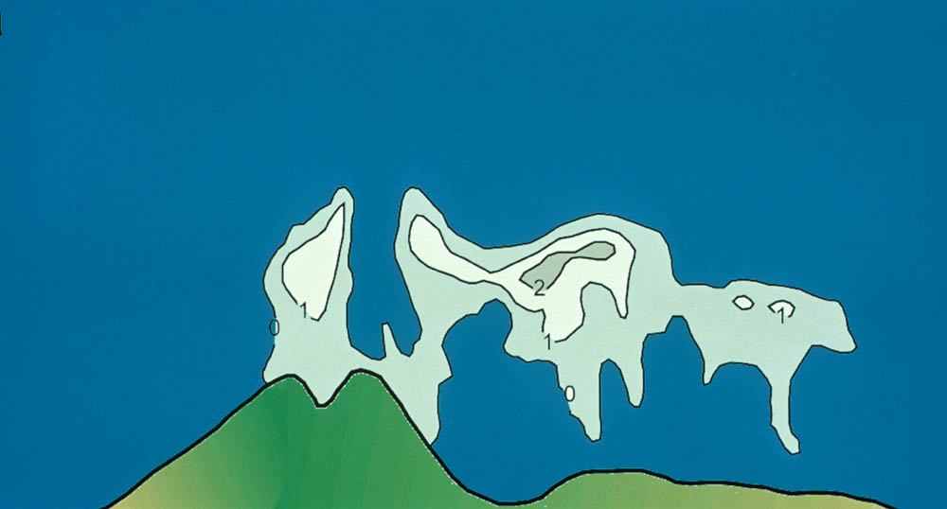
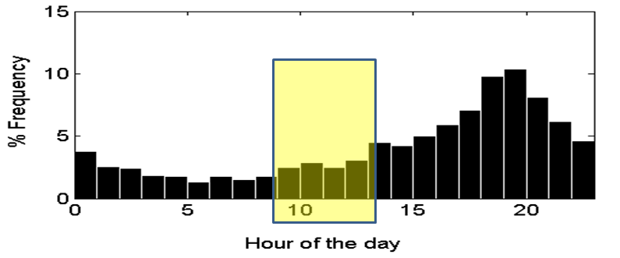
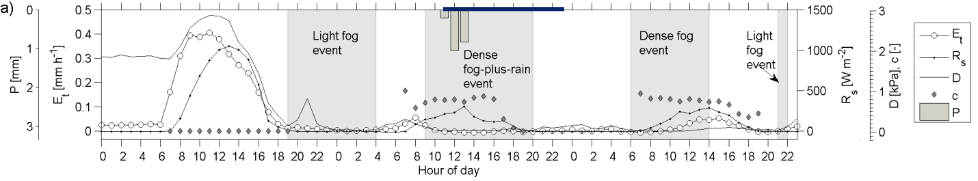
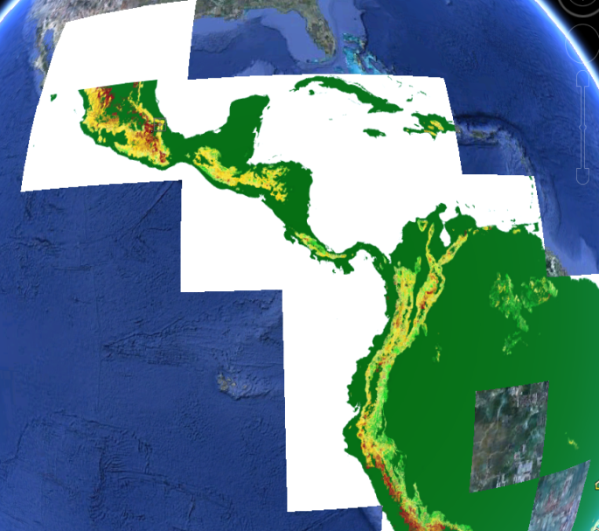
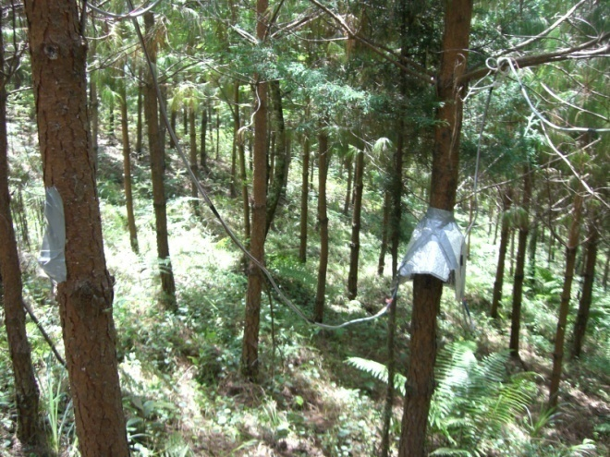
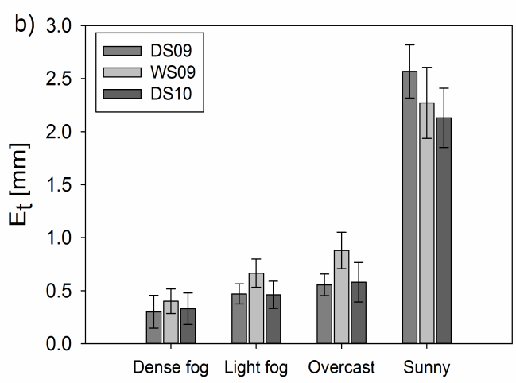
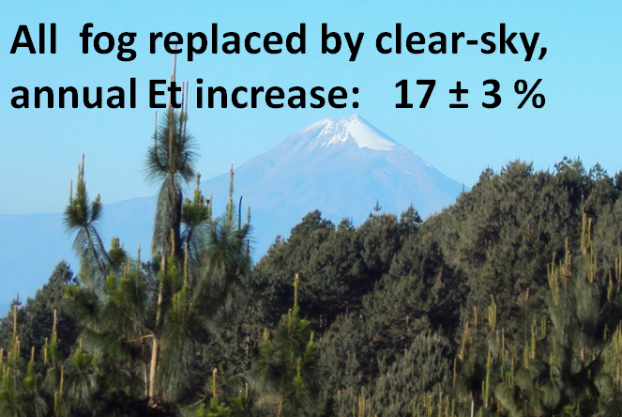
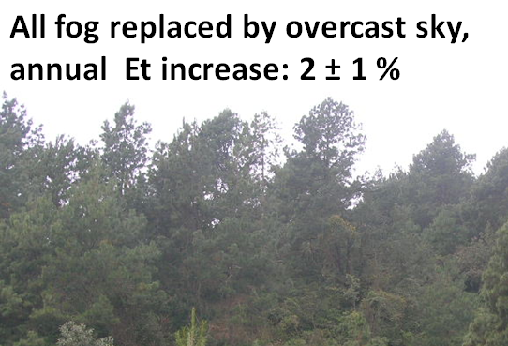
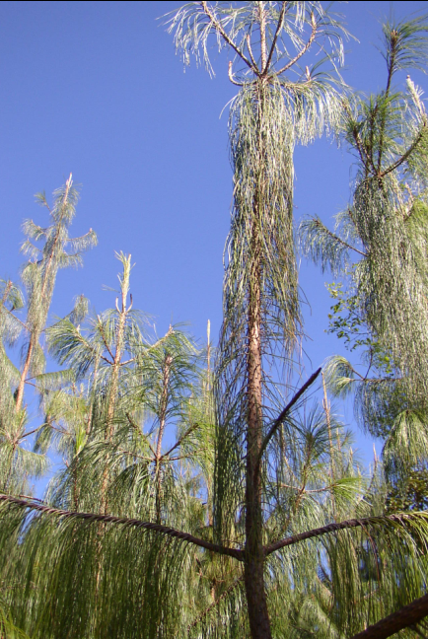

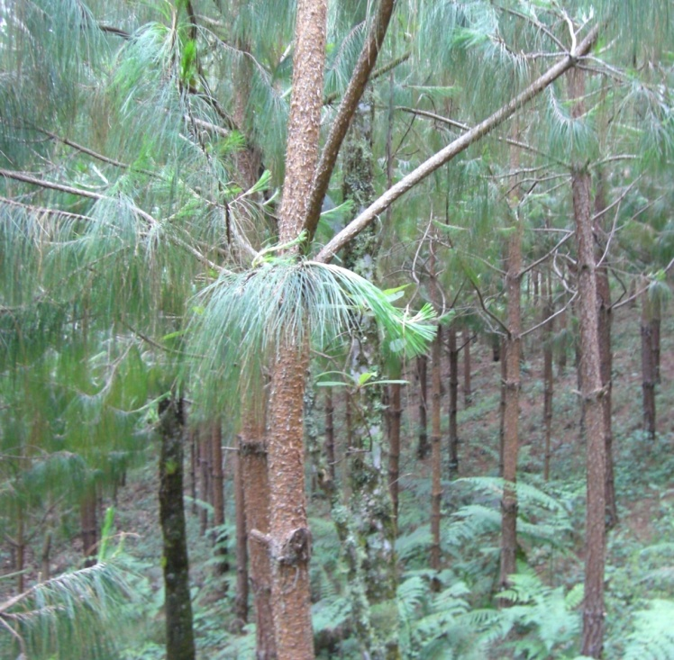
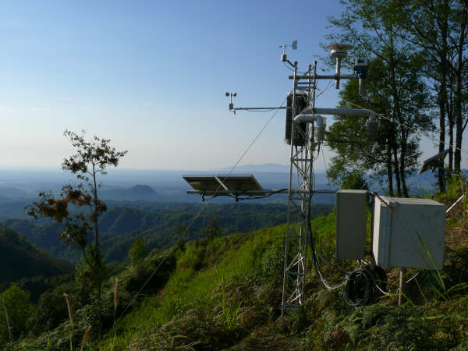
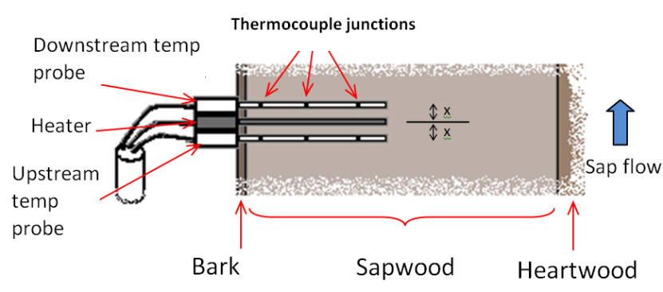
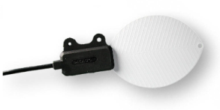
Suppression of pine transpiration due to fog:
Implications of climate change for a seasonally dry tropical montane cloud belt d d
M.S. Alvarado-Barrientos^{1,2}, F. Holwerda^{1,2}, H. Asbjornsen¹, T.E. Dawson³, L.A. Bruijnzeel⁴
¹ Dept. of Natural Resources and the Environment, University of New Hampshire, USA; ² Atmospheric Sciences Center (CCA), Universidad Nacional Autónoma de México, México;
³ Dept. of Integrative Biology, UC Berkeley, USA; ⁴ Critical Zone Hydrology Group, VU University, Amsterdam, The Netherlands.
Motivation:
Climate change-related alterations in the average height of the cloud belt of tropical mountains may drastically reduce fog occurrence.
Frequent immersion in fog contributes to maintain high water yield from watersheds within montane cloud belts because of additional water inputs (fog, drizzle) and the suppression of plant transpiration.
Tree plantations are an increasing land cover worldwide, and their potential higher water use compared to other land covers sparks concerns about reduced water yield.
Given the projected rise of the cloud belt,
how much more transpiration expected from Mexican weeping pine reforestations?
Key Findings and Conclusions:
Fog occurred 32% of the time with seasonal variation.
Rainfall accompanied fog 75% of this time.
At time of maximum transpiration, low fog occurrence.
Canopy was wet for 1/3 of the time, but most was due to rainfall . Transpiration is suppressed mainly by reductions in solar radiation and increasing air humidity during fog-only occurrence.
Relative to sunny conditions, transpiration (Et) was suppressed
by: 90 ± 7 % under dense fog, 83 ± 7 % under light fog, and
78 ± 10 % under overcast conditions.
Linking fog climatology to suppression of Et relative to sunny
and overcast conditions, two scenarios of diminishing fog
occurrence were evaluated:
Dry 2008/09: 26%
Wet:
26%
Dry 2009/10: 42%
Deforestation of
lowland forests
Changing sea surface
temperature
Barradas et al. (2010; Karmalkar et al. (2011); Lawton et al. (2001); Richardson et al. (2003); Van der Molen et al. (2006); Williams et al. (2007)
Figure from: Lawton et al. (2001)
Time series of transpiration dynamics and concurrent weather conditions. P = rainfall; Et = transpiration; Rs = incoming solar radiation; D = vapor pressure deficit;
c = cloudiness factor (clear sky = 0; overcast = 1). Fog events shown as gray areas. Leaf wetness duration shown with a blue bar on top x-axis.
Study area and Methods:
Cofre de Perote
(4200 m asl)
10-year-old
Mexican weeping pine
(Pinus patula) reforestation
Distribution of potential montane cloud forest zones
(Mulligan & Burke, 2005)
Study area
2100 m a.s.l.
80% of rainfall May - Oct
Gulf of
Mexico
Hourly sapflow-derived stand level transpiration rates under different weather conditions:
Characterization of fog climatology and
leaf wetness duration:
Climate change-related
reduced dry-season precipitation,
more than diminishing fog alone, may reduce soil water reserves.
Heat Ratio Sapflow Method
(Burgess et al. 2001)
Sunny
Foggy
Overcast
Weather station with
visibility sensor
Leaf wetness sensors at two heights within the canopy.
Cloud base may rise few hundred
meters, thus this is a more likely
scenario
Fog = horizontal visibility < 1000 m

