Slide 1
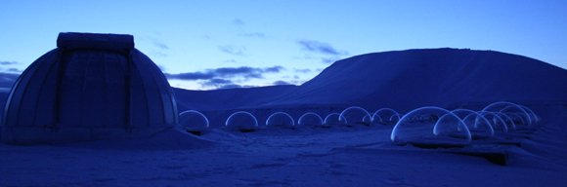

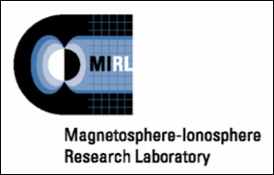




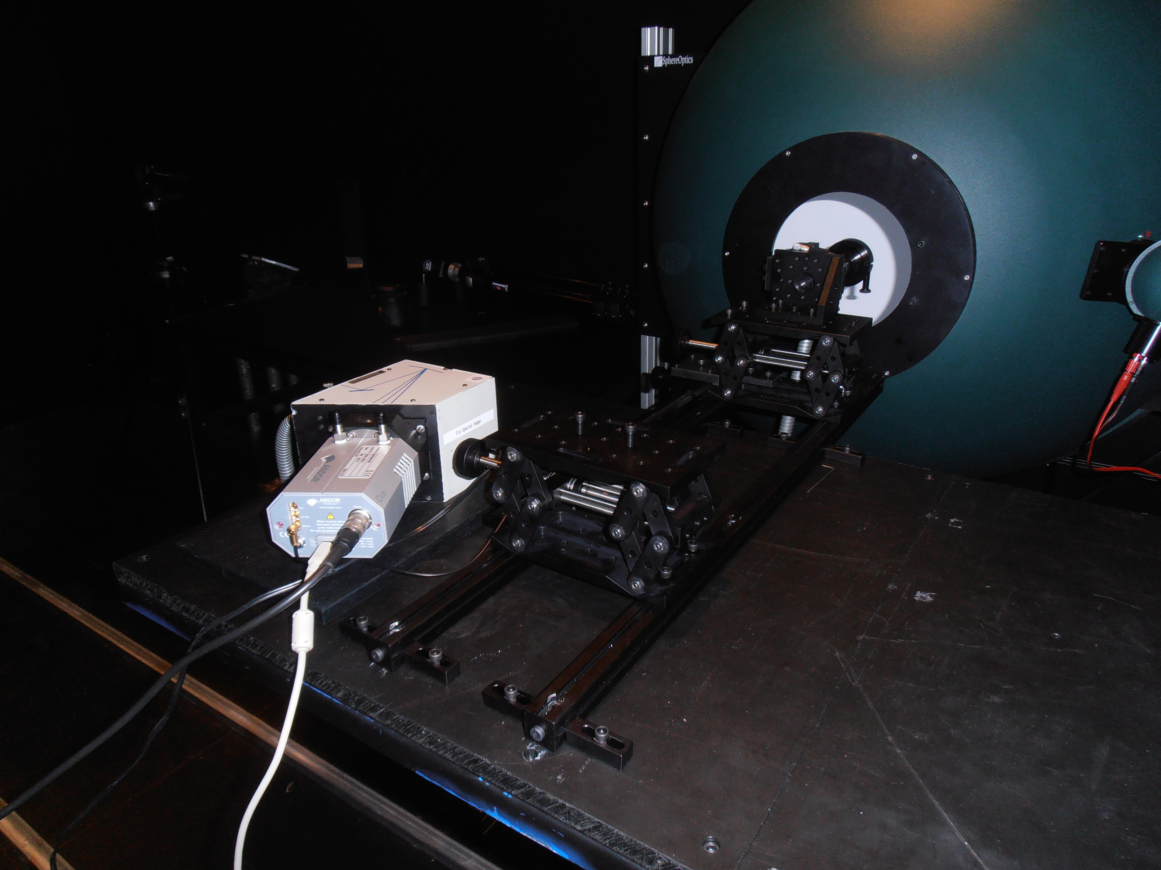
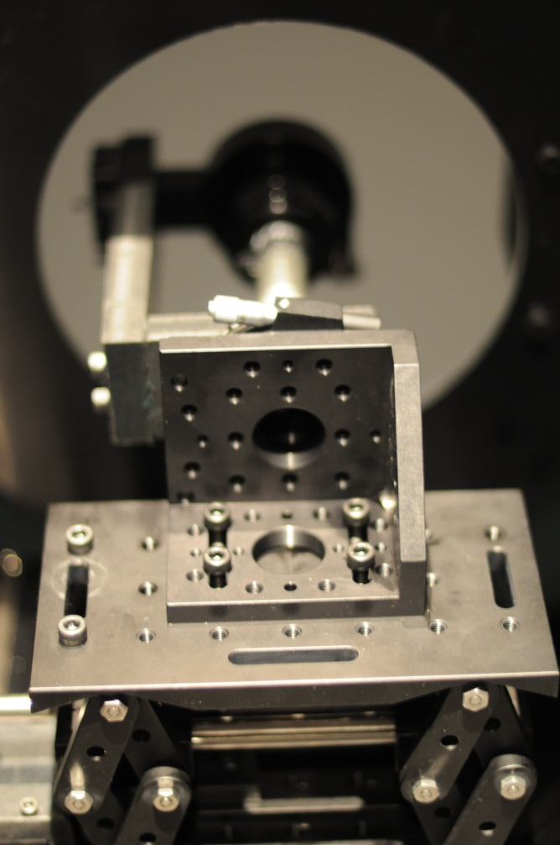
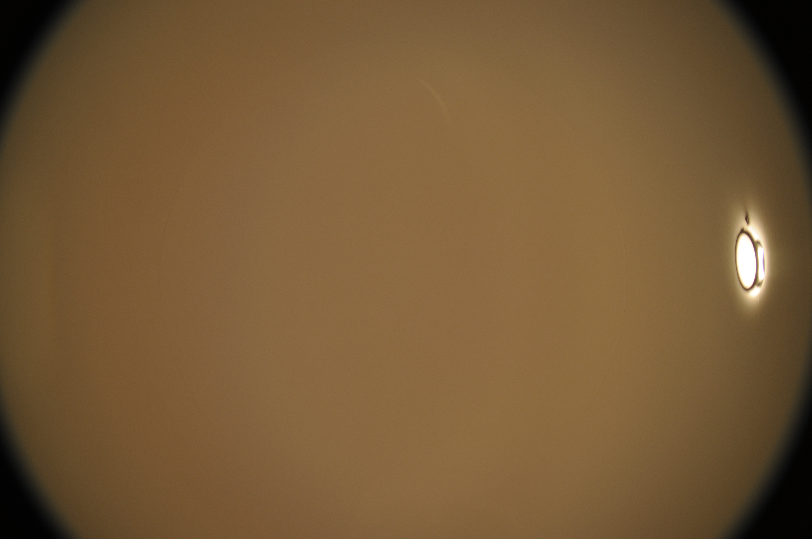
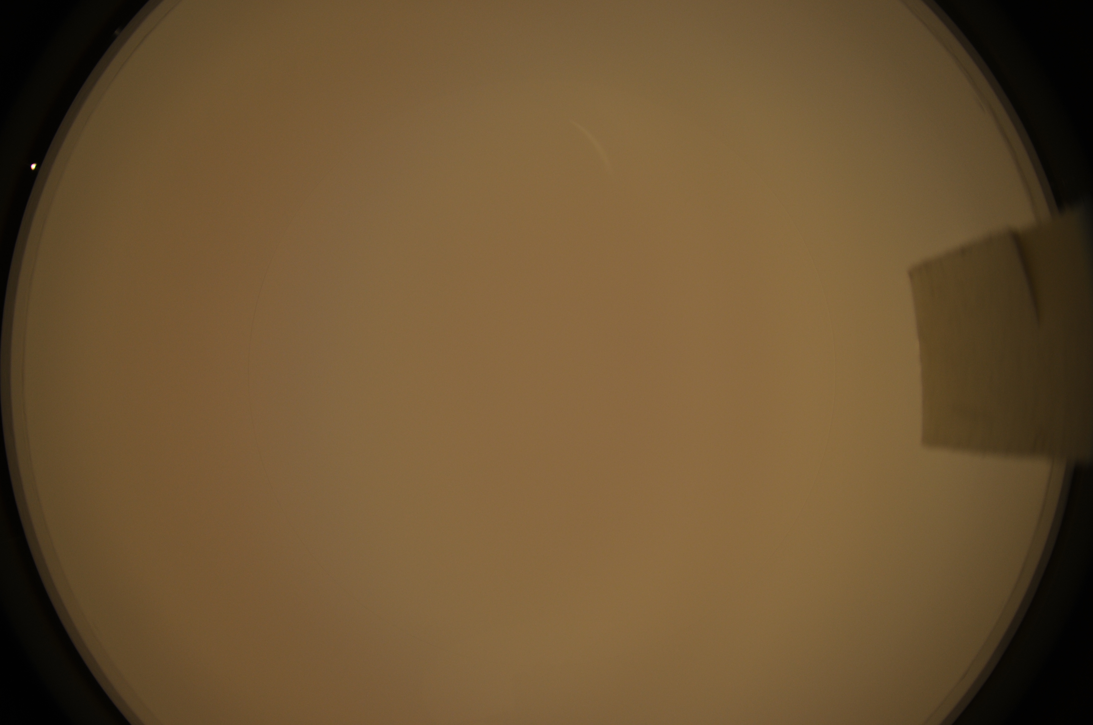
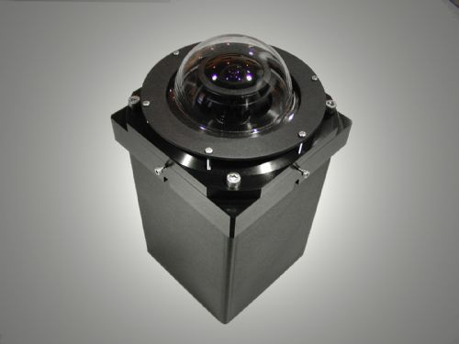
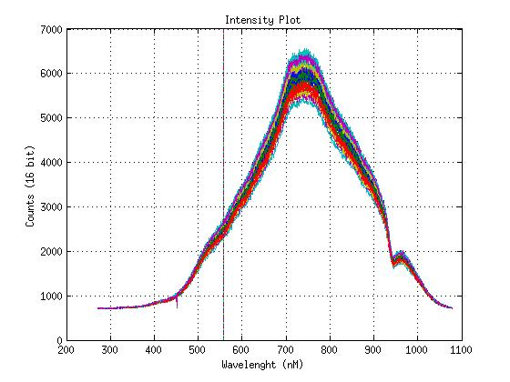
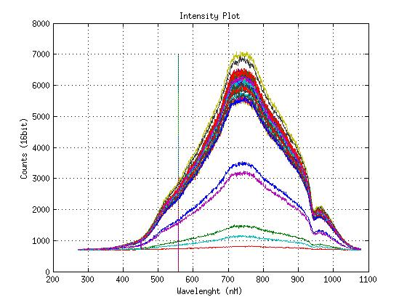
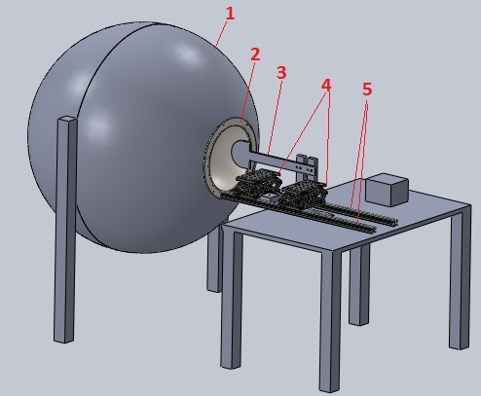
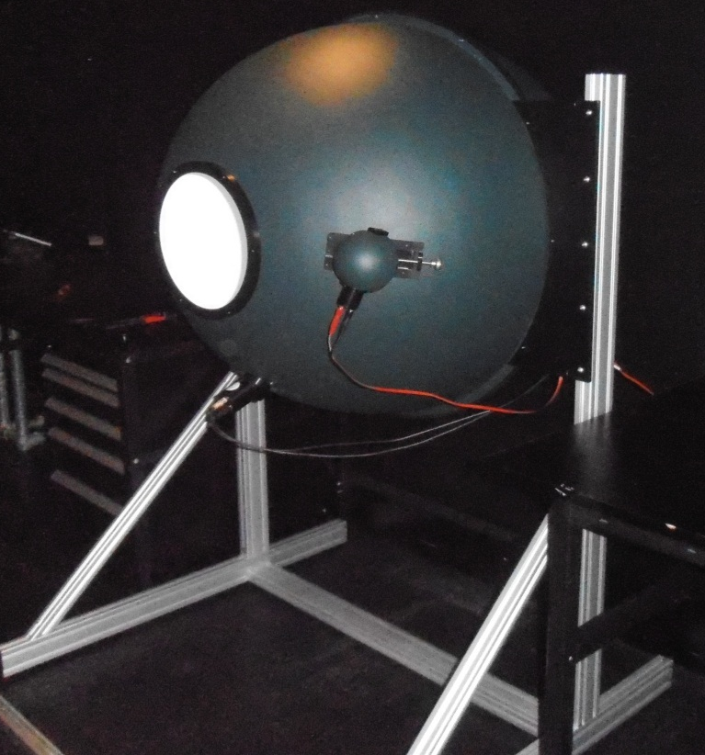
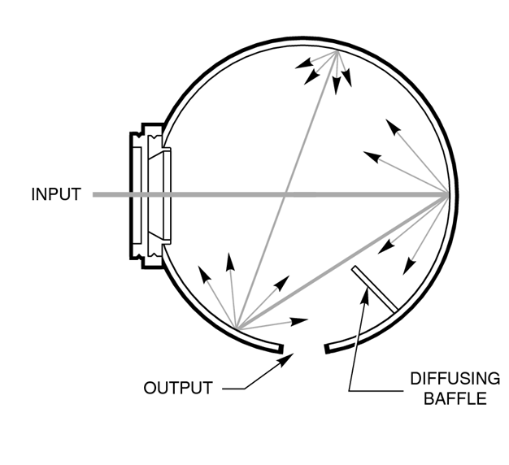
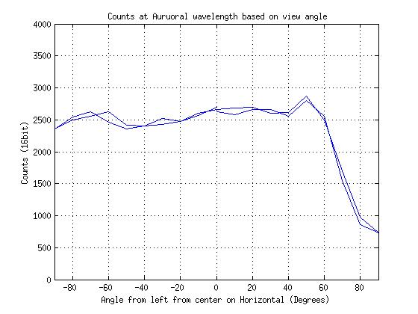
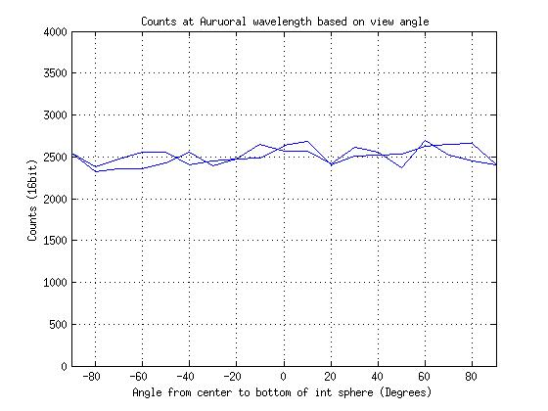
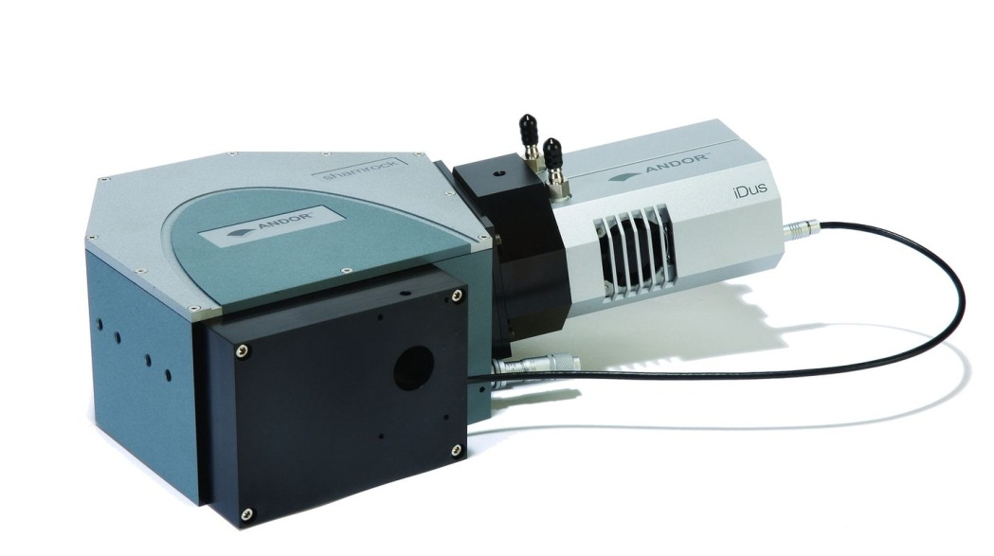
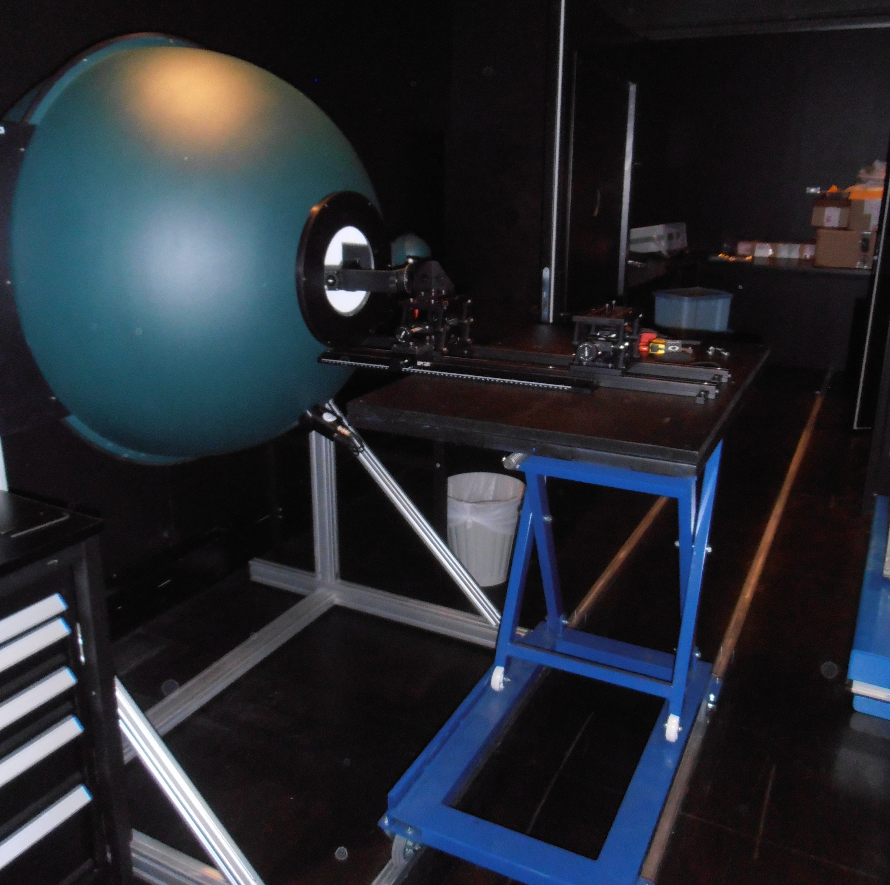
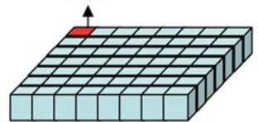
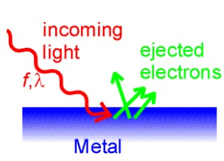
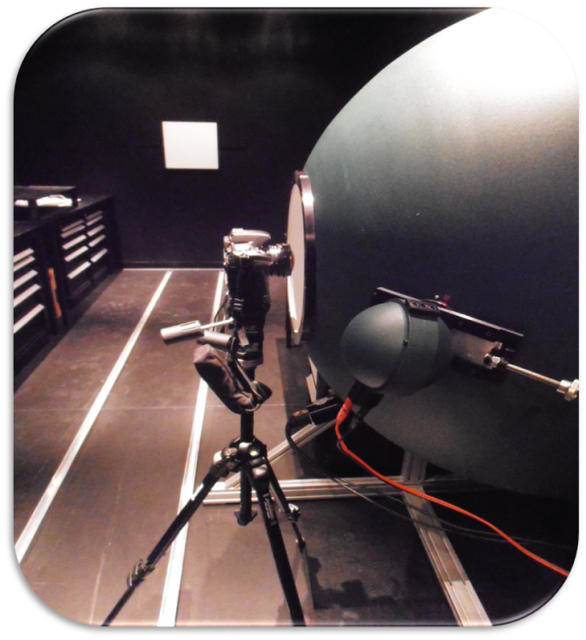
Development of an Optical Calibration Facility at an Auroral Research Station
Drummond Biles, Fred Sigernes, Marc Lessard
University Centre in Svalbard, University of New Hampshire
Author Contact: dep42@unh.edu
Introduction
Testing
Design
Test Setup
Longyearbyen, Svalbard is located at approximately the 80 degree north latitude line and is home to an advanced research facility called the Kjell Henrickson Observatory (KHO). The KHO houses many advanced optical instruments which study the upper levels of the atmosphere and the phenomenon know as the Aurora Borealis. One of these instruments is known as an all-sky camera. The name is derived from the “fish eye” style lens that it uses, making it possible to view up to 180 degrees of the night sky. The following project details a method of calibration for these cameras.
Initial Testing
Without Moon Blocker
With Moon Blocker
Image From:
http://anniekatec.blogspot.com/2011/02/arctic-current-warmer-than-for-2000.html
-Test setup to describe light field within integration sphere from which an all sky camera would be calibrated
-Nikon D300 Camera with a MC Peleng 3, 5/8 Fisheye lens
Test Results
Vertical Light Field
Horizontal Light Field
Camera Calibration
Initial design
Spectrometer
Instruments
Integration Sphere
1. Integration Sphere
2. Dome Cover
3. Moon-Blocker
4. Lab Jacks (height control)
5. Tracks (depth Control)
-Each line represents the spectrum at a different angle along the particular axis
-Calibrate Imager at 557.7 nm
Built Setup
Conclusion
From the test results it can be seen that the light field within the integration sphere can be described across the x and y axis from +90 degrees to -90 degrees. These results can be obtained for any wavelength within the visible spectrum. Therefore, an all sky camera can be accurately calibrated improving the accuracy of any data taken with the all-sky camera.
Pixel Variation
Calibration Procedure
Camera Setup
Special THANKS to
The Class of 52
Mr. Frank and Ms. Patricia Noonan
UNIS
For Funding this Research
-Constructed calibration setup within optical lab

