Slide 1

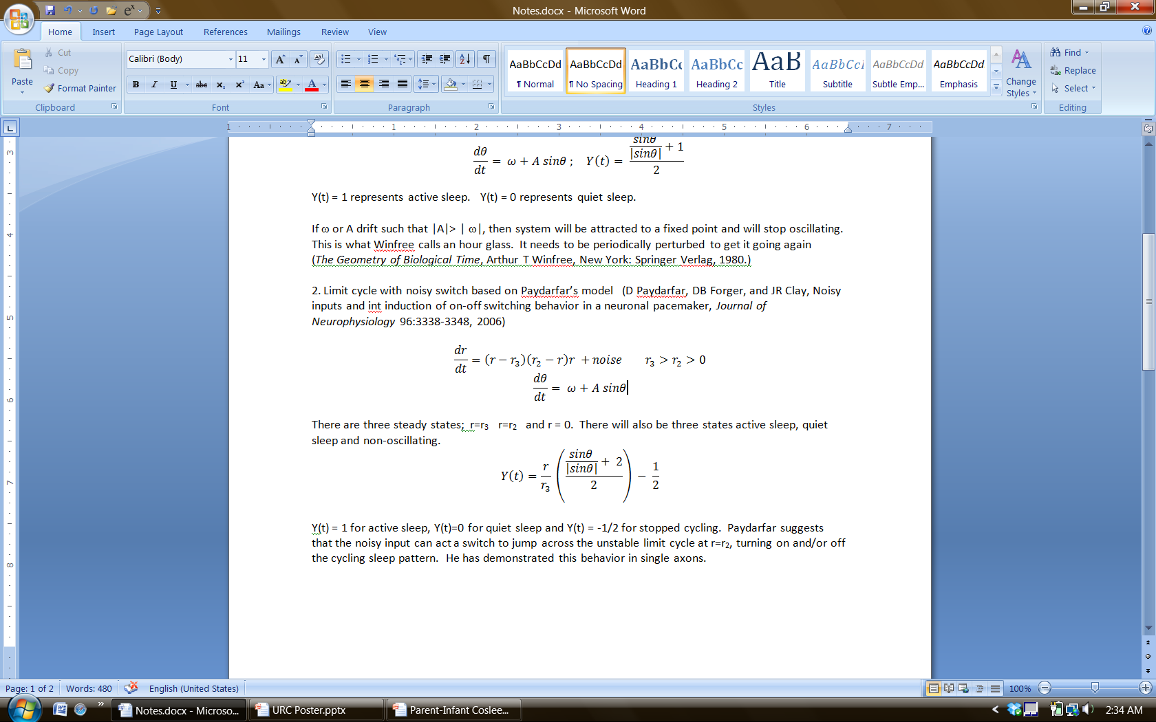
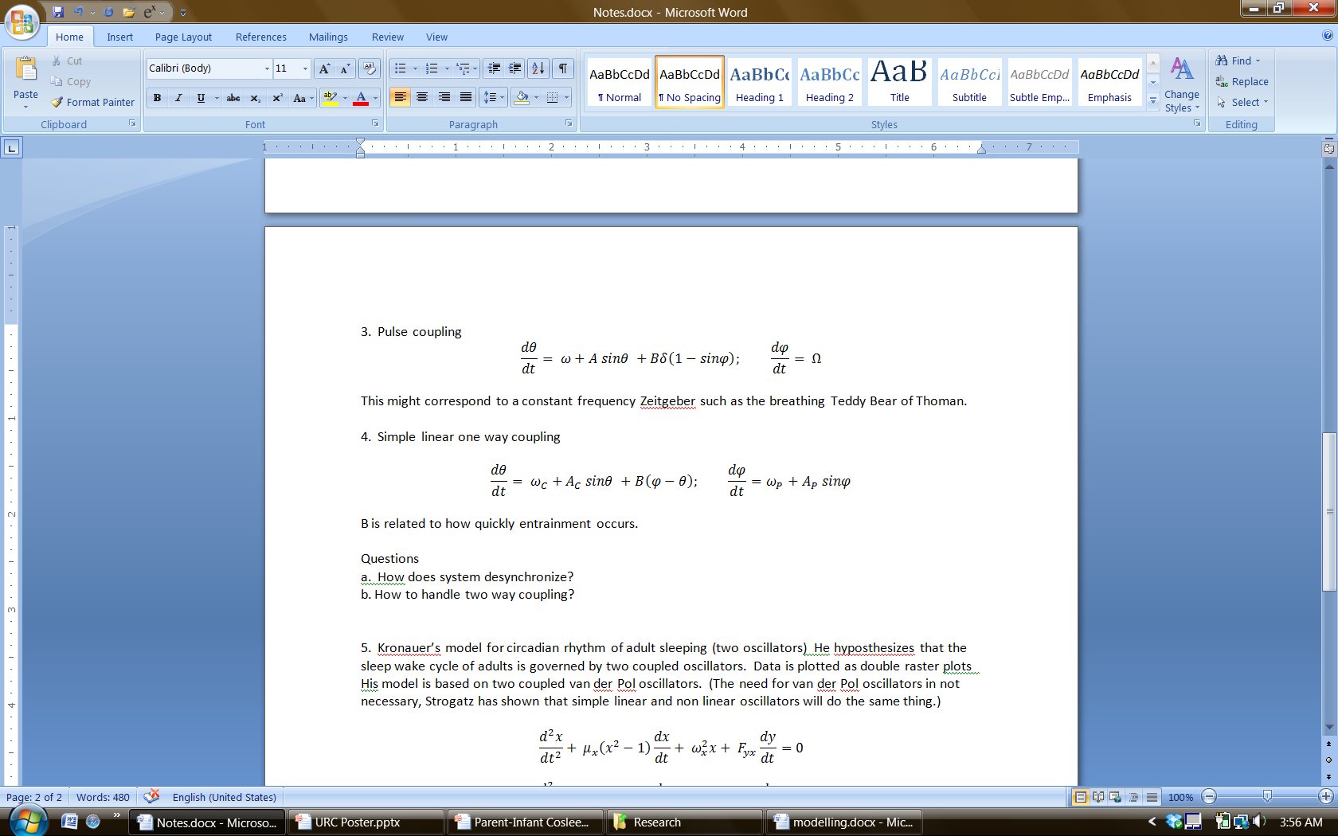
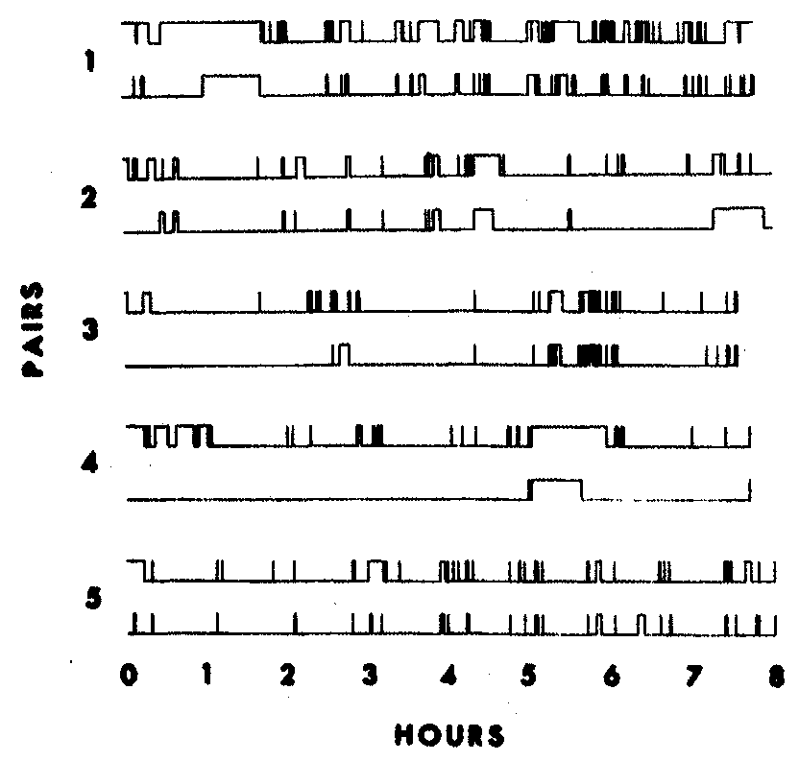
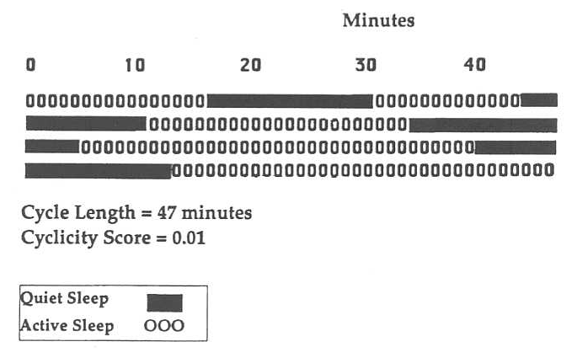
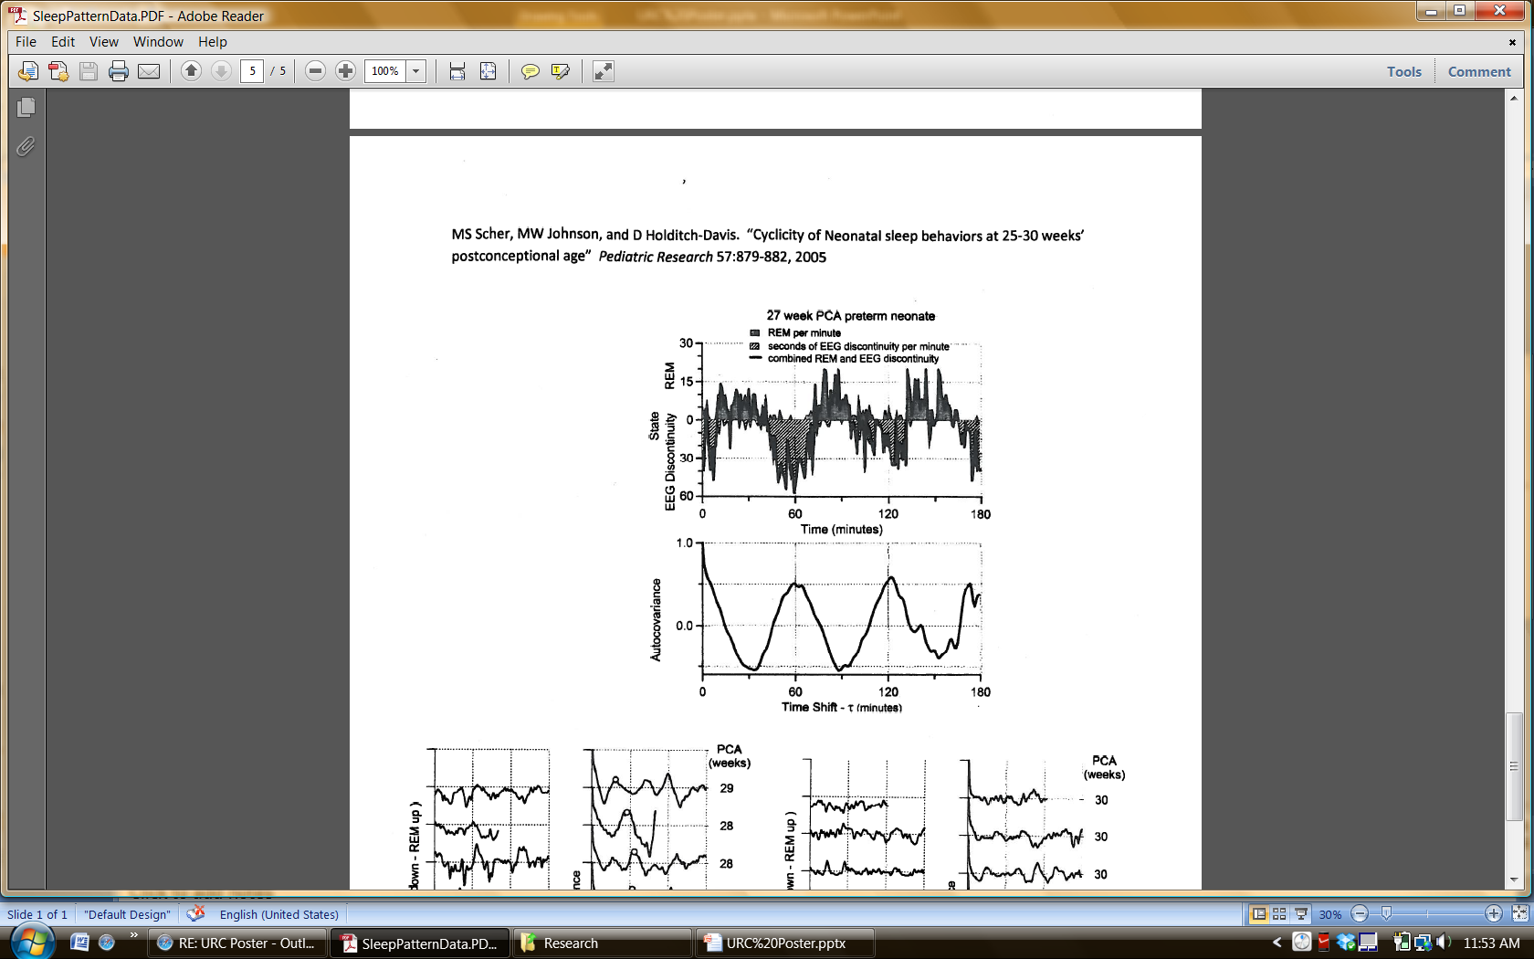
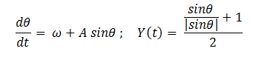
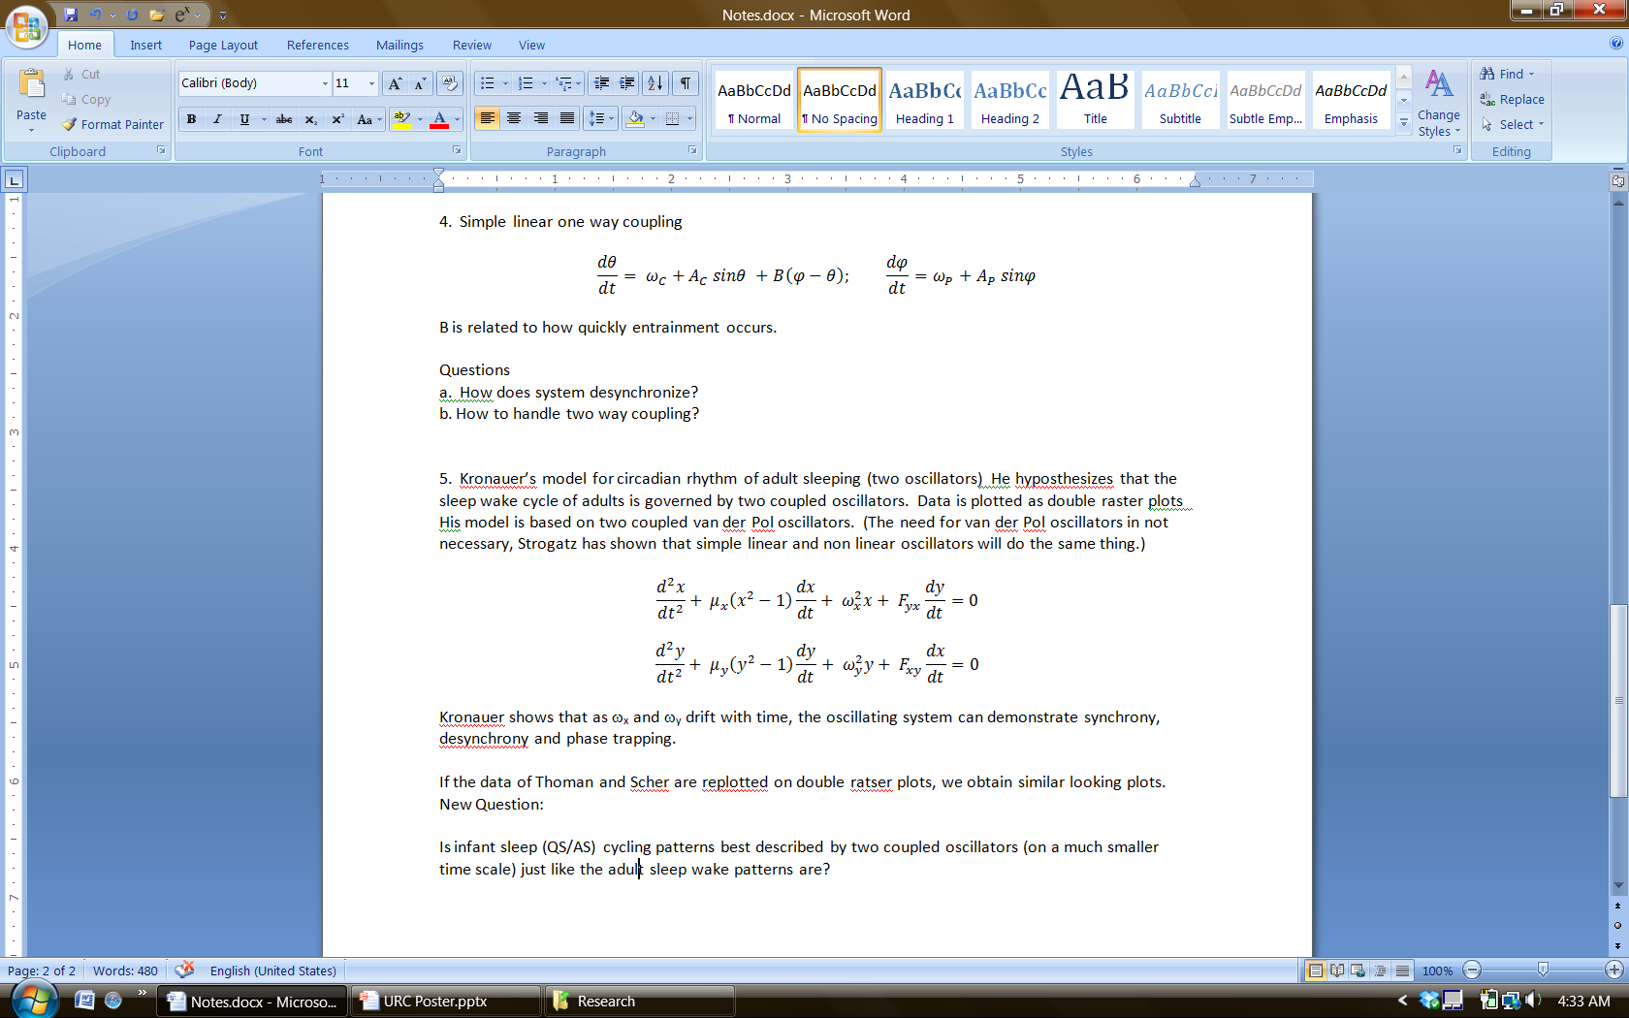
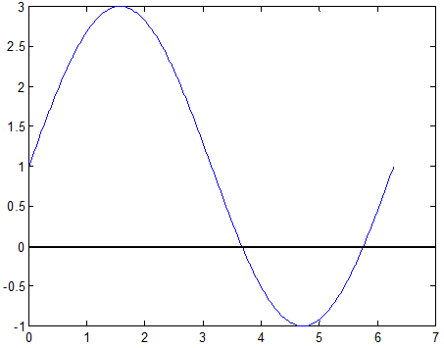
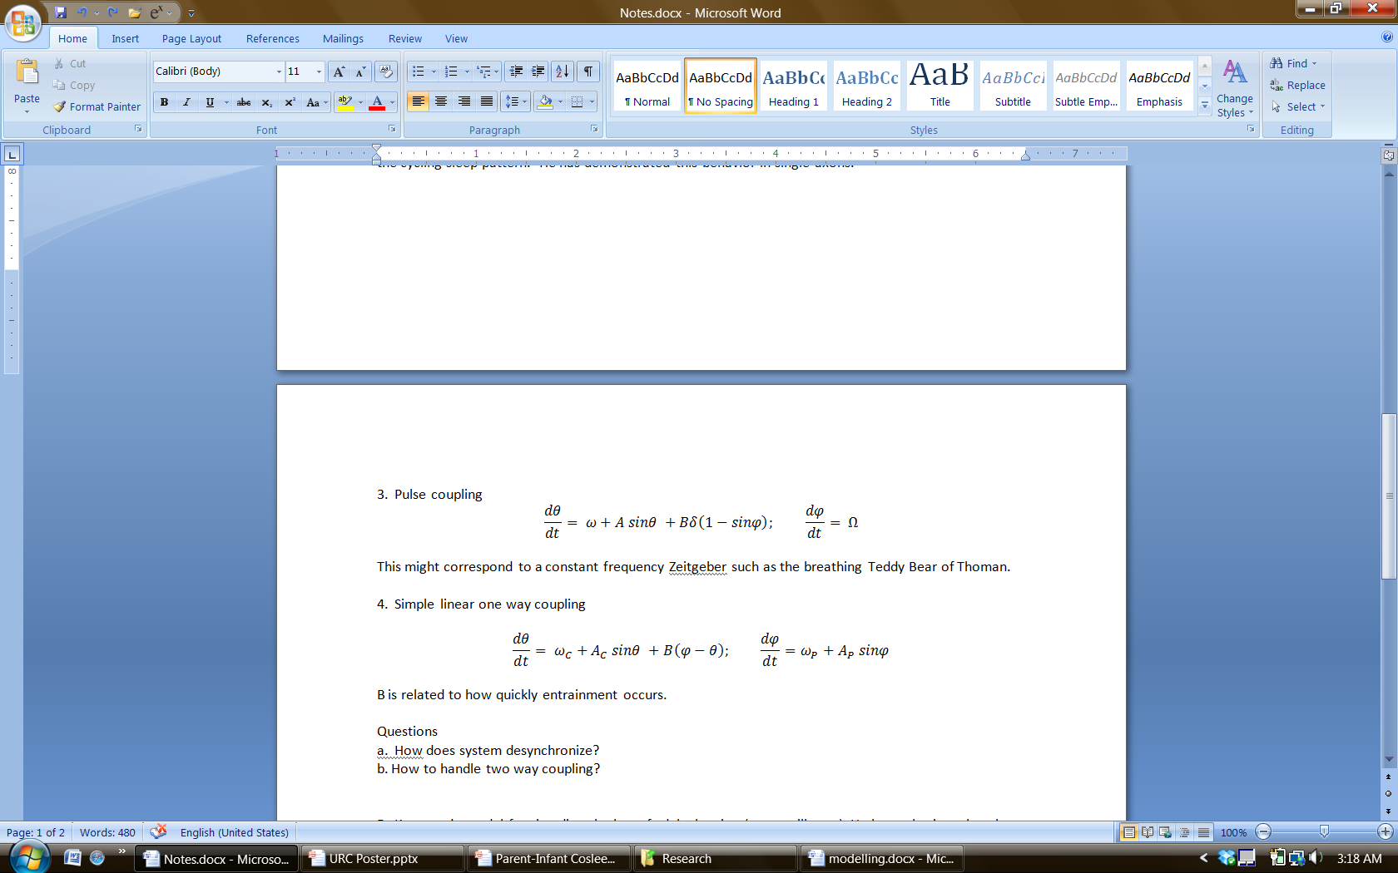
Cosleeping Mothers and Babies and Sudden Infant Death Syndrome
Sachi Nagada and Russell T. Carr
Chemical Engineering, University of New Hampshire
Introduction
Sudden Infant Death Syndrome (SIDS) is a phenomenon where an infant under the age of one dies due to unknown reasons. There are speculations that the reasons might include respiratory problems or circulatory problems but doctors have not been able to pinpoint the cause of death yet. One theory in the field is by Dr. McKenna, whose hypothesis is that signaling occurs between mothers and babies when they are cosleeping (sleeping next to each other or are in the same room). This signaling may assist to reset the breathing patterns or the arousal rhythm of sleep which would help some babies who might be susceptible to SIDS. The objective of the study was to test this hypothesis of mothers and babies cosleeping by looking at mathematical equations and relating them to different states of sleep: active and quiet sleep. This was done by modeling sleep in several different ways and by using sleep data from Dr. Thoman^{[1]}, Dr. McKenna^{[2]}, and Dr. Scher ^{[3]}as shown below.
Limit Cycle with Noisy Switch
This type of modeling was based off of Dr. Paydarfar’s work with neurons^{[5]} in which he introduced an on and off switch. Using the switch, Dr. Paydarfar was able to make the axons jump from one stable limit cycle across an unstable limit cycle to another stable limit cycle and make them start oscillating again using the method. In this model, there are three steady states and the equations used were
When r=r₃, it is considered to be active sleep. When r=0, the infant is in quiet sleep. And when r=r2, the infant is not oscillating which is a problem stage that needs to be avoided. By adding a switch, the infant’s cycle would go from the non-oscillating (unstable) stage to oscillating stage (stable) in order to cross the danger zone and would switch to either quiet or active sleep again.
Y(t) =1 represents active sleep
Y(t) = 0 represents quiet sleep
Y(t)=1/2 represents the unstable limit cycle in between.
Matlab Results
Simple Linear One Way Coupling
This way of coupling only accounts for the mother’s signal given to the infant and it does not take into account the mother’s response to the infant’s signal back. The equations were
The model assumes that the mother’s signaling to the infant is periodic as represented by φ. The B represents how fast the two equations will reach entrainment, which is when two systems lock and get a common period.
Matlab Results
Conclusions
The original hypothesis by Dr. McKenna about two way signaling between mother and infants cosleeping could not completely be modeled because of problems that were introduced with two way coupling. It was discovered that one way coupling from mother to child can be modeled and it can affect the baby’s cycle considerably to the point that both systems were entrained.
One way to model the problem with two way coupling is to use Kronauer’s method of using coupled Van der Pols equations and plotting sleep data on raster plots. He discovered that adult circadian rhythm is regulated by two coupled oscillators. So there is a possibility of applying similar theory to infants but the raster plots would be at a much smaller scale since infants sleep at a much shorter period than adults. So research can be continued but different techniques of plotting two way coupling equations would have to be explored along with raster plots to see if infants can be modeled with the same equations but with different periods. Kronauer’s method has the appeal of describing both rhythmic and acyclic sleep patterns.
Mother’s signaling
Baby’s cycle
Entrainment
New Questions
Some new questions were introduced when dealing with the systems:
How does the system of baby and mother desynchronize after phase-locking?
How to handle two way coupling (baby to mother and mother to baby) ?
Is infant sleep cycle similar to the adult sleep/wake cycle but just on a smaller time scale and is the best way to describe them by two way coupling?
The figures above are data from Dr. McKenna^{[2]} and Dr. Thoman^{[1]} respectively. The figure to the left is from Dr. Scher’s data^{[3]}. All of these measure the periods of active and quiet sleep.
The switch would be similar to a mother rubbing the infant’s back or patting the baby. Any movement that wakes up the baby is considered to be a switch.
The graph highlights how the mother’s signaling helps the infant’s cycle get regulated
Kronauer’s Model
Dr. Kronauer states that adult circadian rhythm is administered by two coupled oscillators. His model is plotted on raster plots and the equations are based on coupled Van der Pols equations.
When plotted on raster plots, ω_{x} and ω_{y} can be seen to synchronize, desynchronize and be phase-locked as seen in the graph below.
Literature Cited
¹ Borghese, IF, KL Minard, and EB Thoman, "Sleep Rhythmicity in Premature Infants: Implications for Developmental Status" Sleep vol 18, no 7, pp 523-530, 1995. Minard, KL, K Freudigman, EB Thoman. "Sleep rythmicity in infants: index of stress or maturation" Behavioural Processes vol 47, pp 189-203, 1999.
² McKenna, JJ, S Mosko,C Dungy,and J McAninch, " Sleep and arousal patterns of co-sleeping human mother infant pairs: A preliminary physiological study with implications of the study of sudden infant death syndrome(SIDS)", American Journal of Physical Anthropology Vol 83, 331-347,1990.
³ Scher, MS, MW Johnson, and D Holdith-Davis, "Cyclicity of Neonatal sleep behaviors at 25-30 weeks' postconceptional age", Pediatric Research vol 57, pp. 879-882, 2005.
⁴ Winfree AT, The Geometry of Biological Time, New York:Springer Verlag 1980.
⁵ Paydarfar, D, DB Forger, and JR Clay, "Noisy Inputs and the Induction of On-Off Switching in a Neuronal Pacemaker" Journal of Neurophysiology vol 96 pp. 3338-3348, 2006.
⁶ Kronauer, RE, CA Czeisler, SF Pilato, MC Moore-Ede, and ED Weitzman, "Mathematical model of the human circadian system with two interacting oscillators", American Journal of Physiology vol 242 pp. R3-R17, 1982. Gander, PH, RE Kronauer, CA Czeisler and MC Moore-Ede, "Simulation the action ozeitgebers on a coupled tow oscillator model of the human circadian system", American Journal of Physiology, vol 247 pp. R418-R426, 1984. Gander, PH, RE Kronauer, CA Czeisler, and MC Moore-Ede, "Modeling the action of zeitgebers on the human circadian system:comparisons of simulations and data", American Journal of Physiology vol 247 pp.R427-R444, 1984.
Nonlinear Oscillator
This way of modeling is also known as the hourglass model by Dr. Winfree in his text^{[4]} because the system needs to be perturbed every once in a while for it to continue oscillating. The equation used to model was:
Y(t) = 1 represents active sleep Y(t) = 0 represents quiet sleep
When |A| > |ω| , the system will get stuck in
its oscillations . It is at this point that the baby
needs the stimulus to restart its cycle.
Attractive fixed point
O Repelling fixed point
Matlab Results
Pulse Coupling
This type of modeling was inspired by Dr. Thoman’s data and her experiment in which she had a breathing teddy bear. A pump was inserted into the teddy bear which made the teddy bear expand and contract and send one way pulse like signals to the infants. Any one way signaling is known as a zeitgeber. The equation used to model this was:
The φ represents the one way signaling from the teddy bear while the θ represents the infant’s sleep cycle.
Matlab Results
Acknowledgments
I would like to thank the Hamel Center for undergraduate research for funding the research and especially Mr. Hamel for his contribution.
I would also like to thank Dr. Carr for letting me be a part of this research and for teaching me so much about mathematics and programming with Matlab.
Lastly, I would like to acknowledge the University of New Hampshire for giving me this opportunity to conduct research and present the findings.
This is similar to apnea episodes for babies.
The graph shows how the signal from the zeitgeber helps baby’s cycle start oscillating again.
The graph is plotted in a way so that the data between 24-48 hours is replotted in the second line for 0-24 hours.

