Slide 1

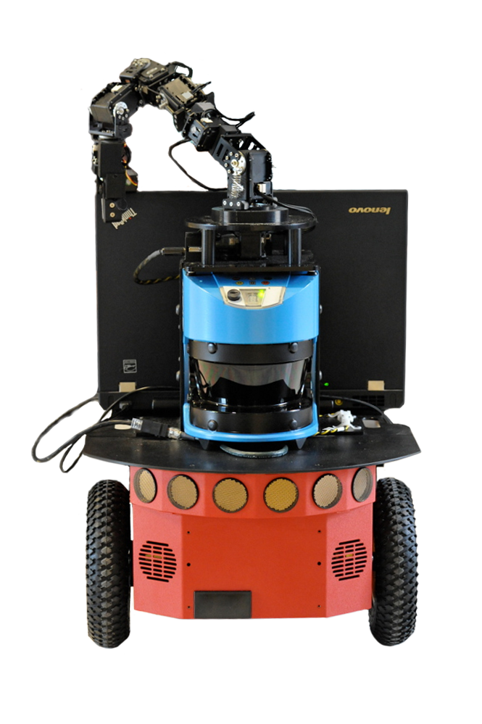
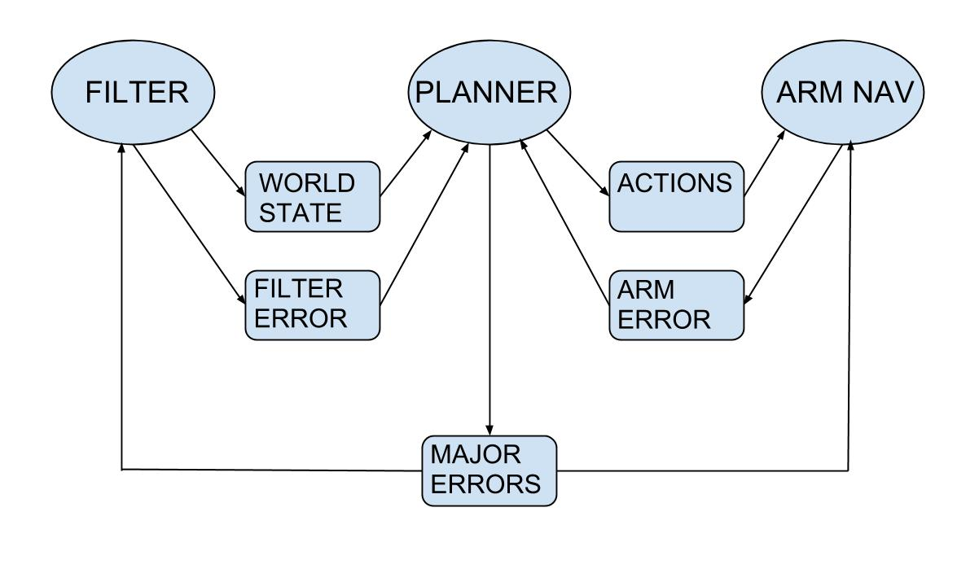
Robot Block Sorting
Alex Schwartz, Tyler Janowski, William Breen
Objective
Design
Implementation
To develop code for a robot to semi-autonomously perform common number sorting algorithms on blocks that are assigned values by using a robotic arm and LIDAR.
Develop a 3 node ROS application that analyzes the world state, plans arm movements, and executes those movements to perform the desired sorting algorithm on the blocks. ROS is primarily being used for message passing between the nodes and for general structure.
Filter: The service takes in LIDAR laserscan data and returns a list of all the moveable objects. It achieves this by filtering through the data and grouping together points in a 2D map which are close together within the range of the arm.
Movement Planner: Observes the world state from the filter, performs a virtual sort on the blocks and makes a queue of goal states for the arm. These are sent until an expected change in the world state occurs, then new filter data is observed. If an error occurs in either node or if the virtual state of the blocks does not match the actual state appropriate actions are taken.
Arm: The driver features movement to a safe state for the arm, the ability to open and close the gripper, the ability to move to an XYZ coordinate, and basic orientation control. It sends an error if a goal is unable to be accomplished.
The Nodes
World State Analyzer: Use the LIDAR to observe the current world state, analyze where blocks are located, and pass relevant information onto the planner.
Movement Planner: Defines a series of actions that the arm will need to make in order to complete the sort. Handles errors and discrepancies between all nodes and attempts recovery if possible.
We were tasked to complete this project using the Robot Operating System (ROS) on a P3-DX robot equipped with a Cyton Gamma 300 arm and a SICK LMS-500 LIDAR
Arm Drivers: Uses ActinSE libraries from Robai to navigate the arm to goals received from Movement Planner node.
Results
ROS
Each node has been unit tested and can complete its intended objective.
Integration has been implemented, but not tested thoroughly enough to create a fully working product.
ROS (Robot Operating System) provides libraries and tools to help software developers create robot applications. It provides hardware abstraction, device drivers, libraries, visualizers, message-passing, package management, and more
-ROS.org
Advised by: Wheeler Ruml and Scott Kiesel

