Slide 1


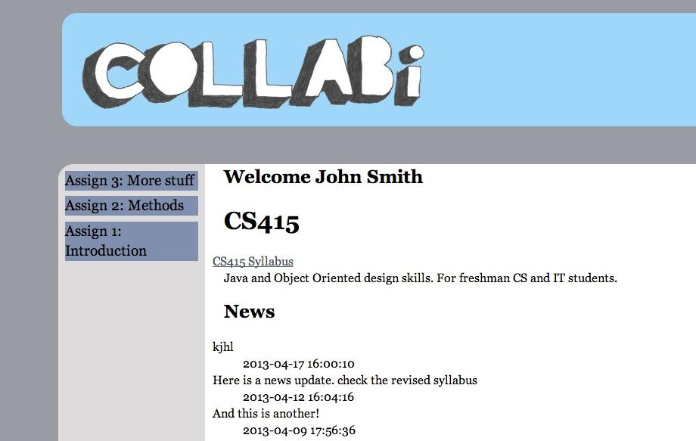
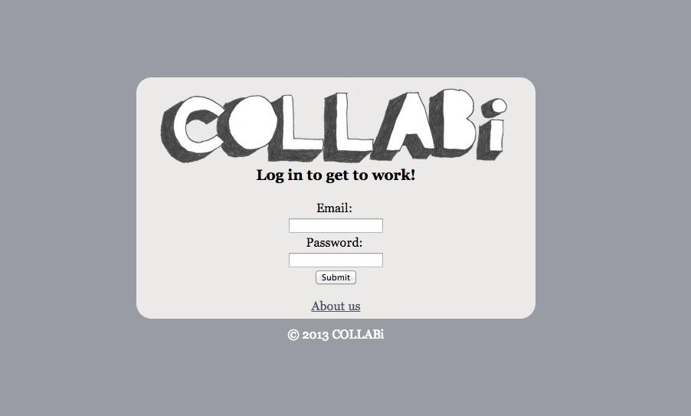
A Web Based Collaborative Educational Forum
Caroline Espaillat, Jared Hooper
and Nate Rubin
Introduction
Technical Details
Karen Jin first approached us with the intent of developing a learning website that would supplement teaching with an open, engaging and interactive aid. When we sat down with Karen, we spent a long time working out what current Learning Management Systems (LMS) did right, and what was still lacking in each one. We found that certain sites approached this by providing a means to push content from instructor to student. Others provided a forum for students to comfortably engage with the instructor. However, none provided an environment that was oriented around the student. It was decided that our goal would be to combine the approaches we had discovered in other LMS and combine it with a student oriented approach. A big part of what differentiates this approach from a LMS like Blackboard is that while instructers have the ability to push content to the students, students are able to push, or more accurately, share content that they find in their own pursuits with their fellow classmates. Based on the model of collaboration, we began work on COLLABi...
Feature Implementation
Feature | Blackboard | Piazza | COLLABi
Assignment organized discussion | Basic, dropped in forums. Equivalent to any basic internet forum software. | Core service. Well organized with a robust tag system. | Will expand on the Piazza model by implementing a "reputation" model to encourage participation.
Storage for class and assignment related materials | Provides a method for instructors to share with students, but not students with other students. | Allows attachments for posts, but organizational options are limited. | Allows for Blackboard-like lists of materials and links, but also provides a section for students to share with their respective classes.
Organization based on classes and assignments | Class based organization, can organize assignments with folders. | Organization is strictly tag based. | Everything is based on a hierarchy of classes and then assignments
CodeIgniter 2.1.3
  php-ActiveRecord
MySQL 5.5.23
Apache 2.2.22
MVC frameworks such as CodeIgniter make building data driven sites with relatively complex database schemas more straightforward. Also, as we will be passing this code off to future developers, the standardized structure will aid them in picking up where we left off. The code is structured in such a way that anyone with a knowledge of related web frameworks (e.g. Ruby on Rails, Django, CakePHP) would be able to quickly understand and immerse themselves in the environment. It is also relatively straightforward to migrate the site from server to server, as all it requires is a basic Apache setup with PHP implementation, with portable configuration settings.
How the site works…
COLLABi is structured as a question and answer based forum, organized by class. Each student registered for the site is associated with one or more classes, with each class being moderated by one or more instructors. Class pages have a section with updates and announcements, similar to how Blackboard is used. From here, students browse to the class assignment they wish to discuss, and are able to browse others' questions and answers, as well as visit links to websites or files that students and instructors have found relevant to the assignment. Students from here can also post their own question, answer, or resource. Currently, everything is ordered simply by the date it was posted, but once a voting system is in place, there will be a system in place to order items according to a mixture of the popularity of the item, as well as the "reputation" of the user who posted it.
Future Goals
The future for Collabi will require the following maintenance and feature enhancements in order to be ready for deployment:
Implement voting system
further user interface improvements
  AJAX implementation
  Mobile interface
  General polishing up of what we have
  Allowing student discussion for posted resources
Tighten security
Usability testing

