Slide 1
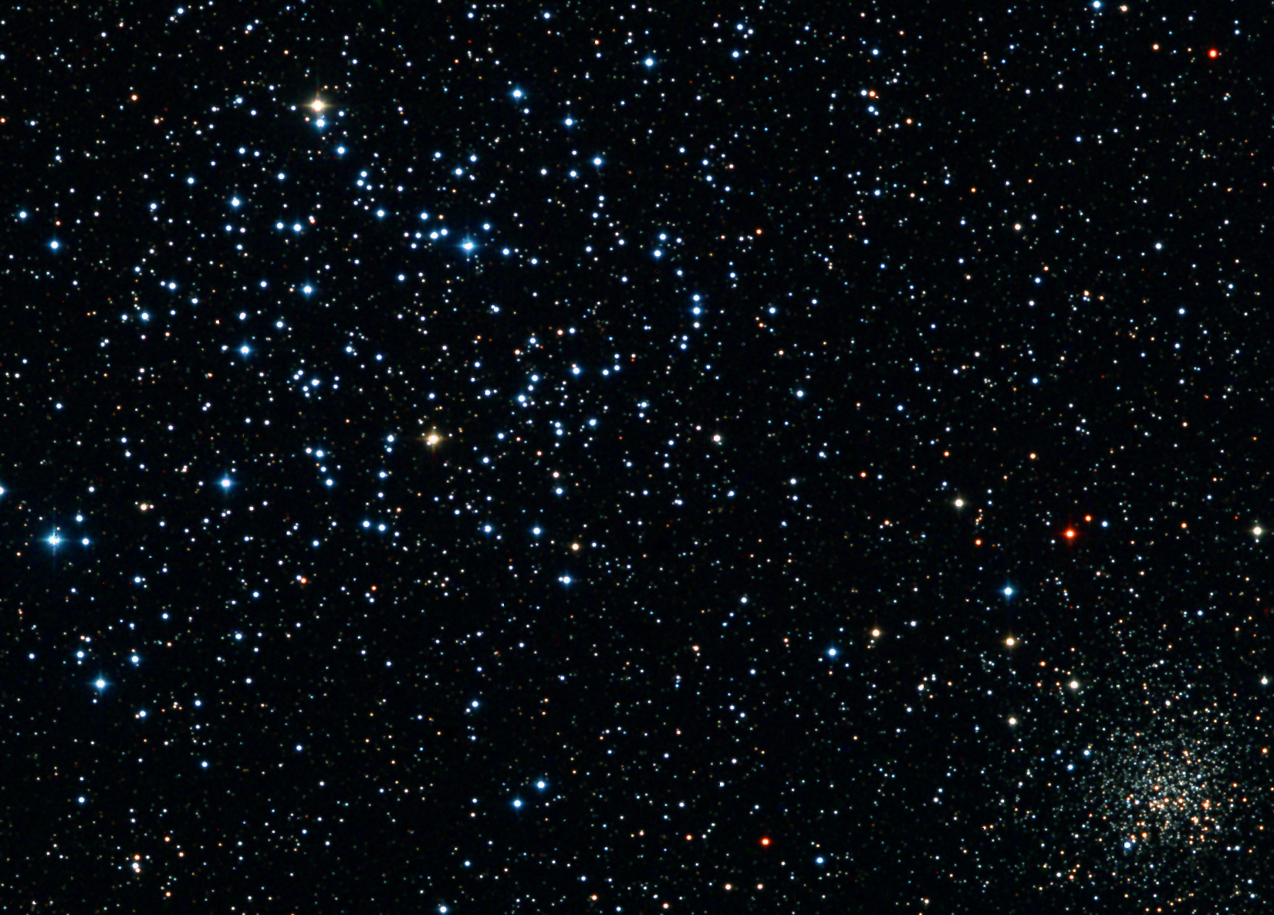


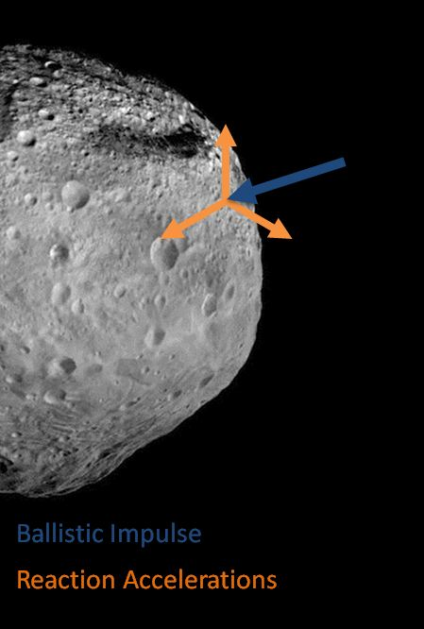
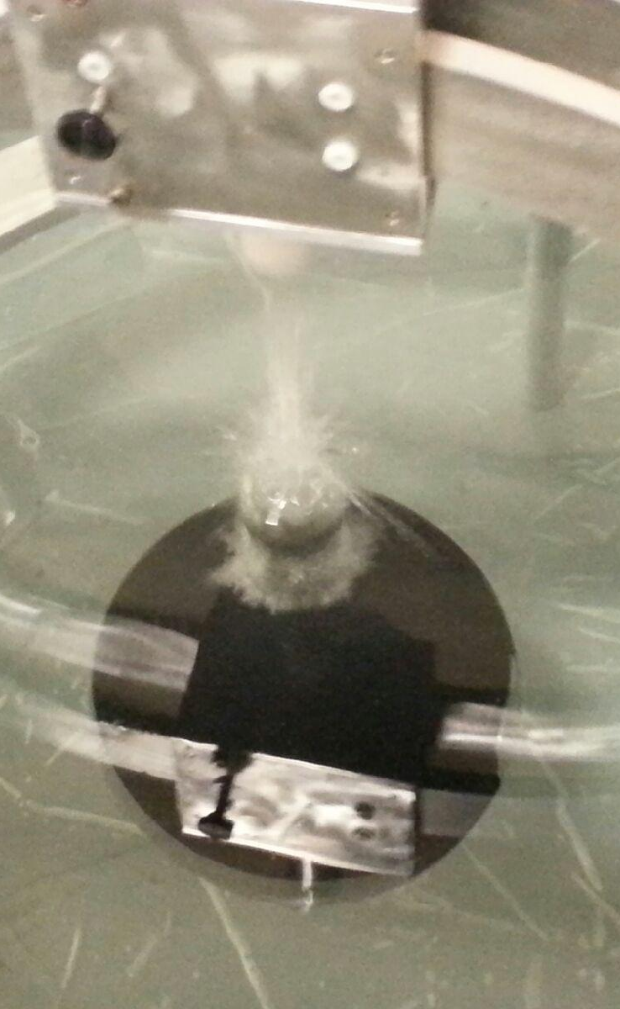
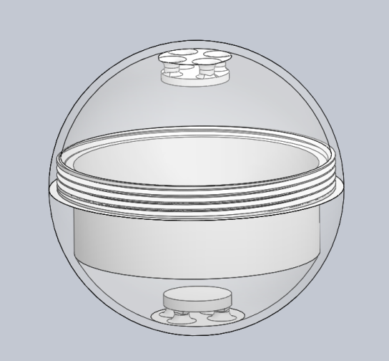
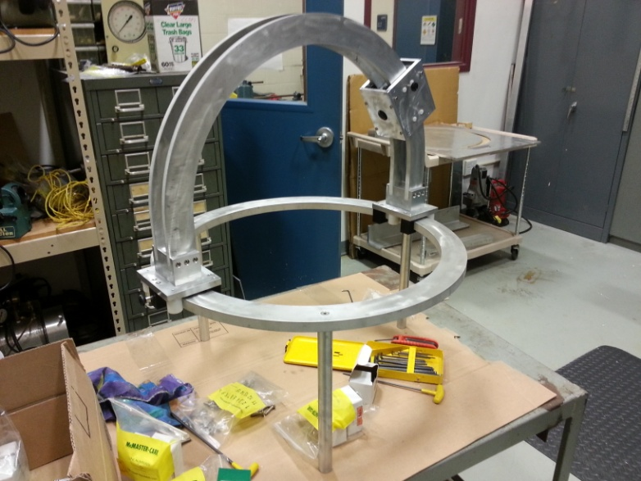
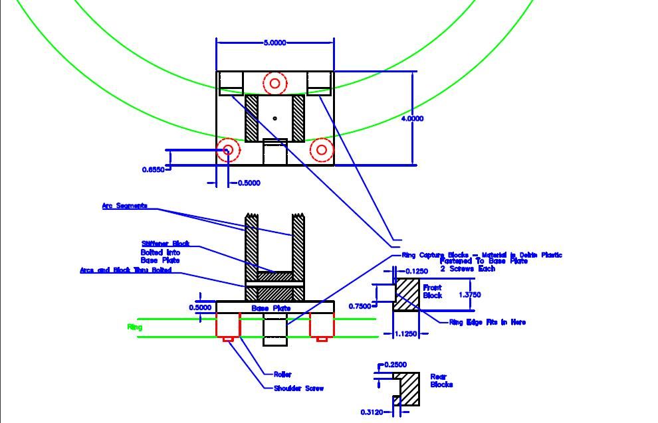
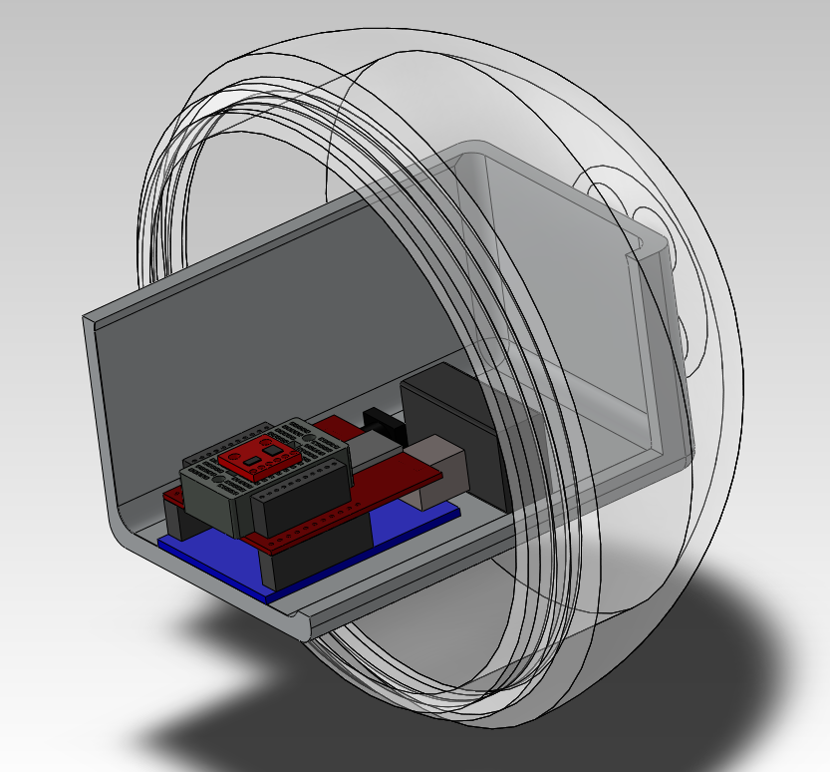
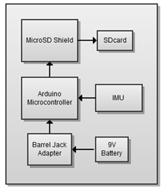
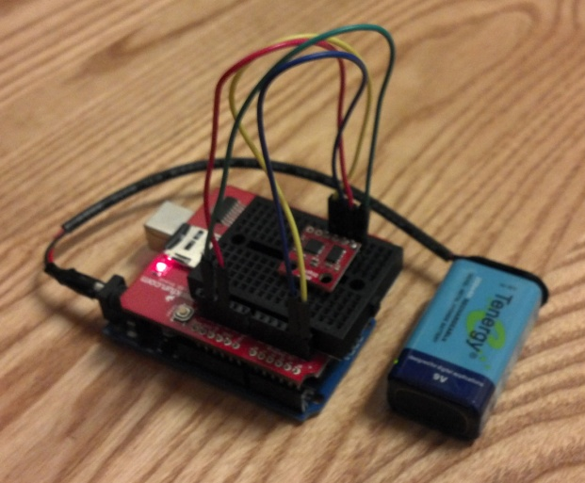
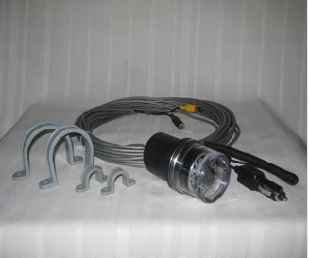
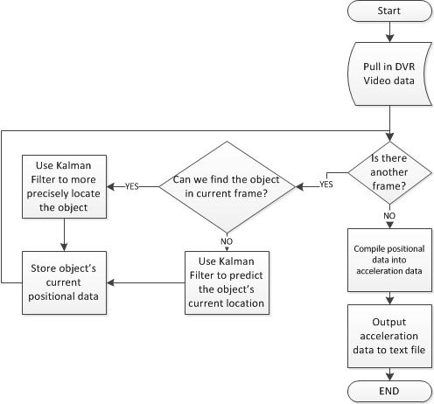
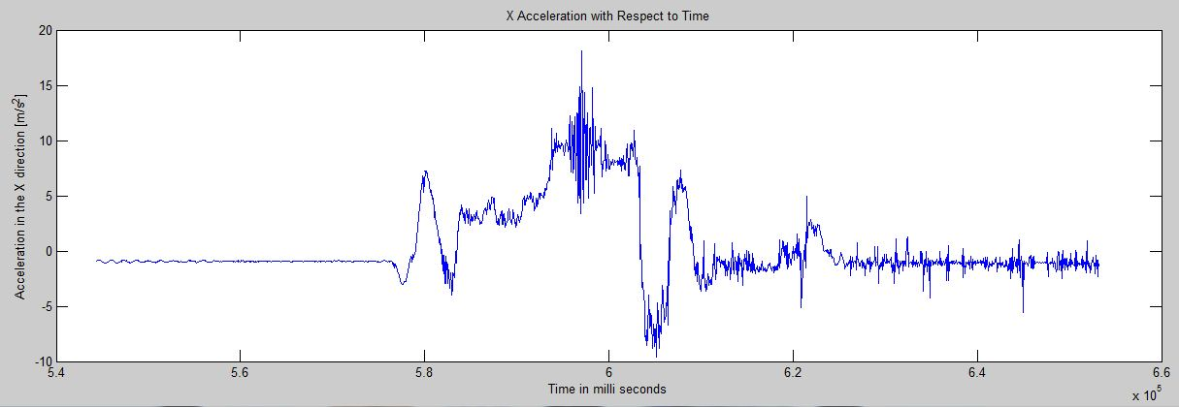
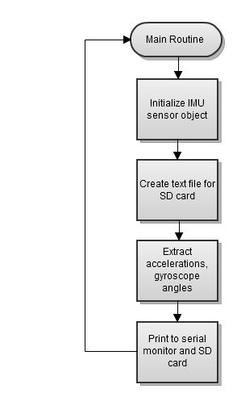
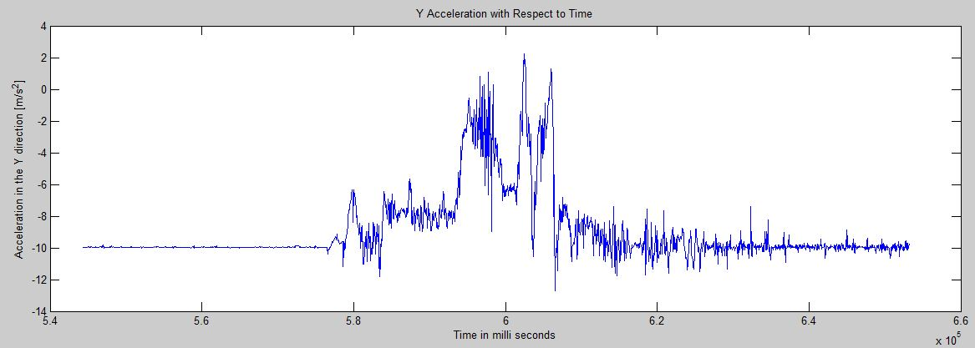
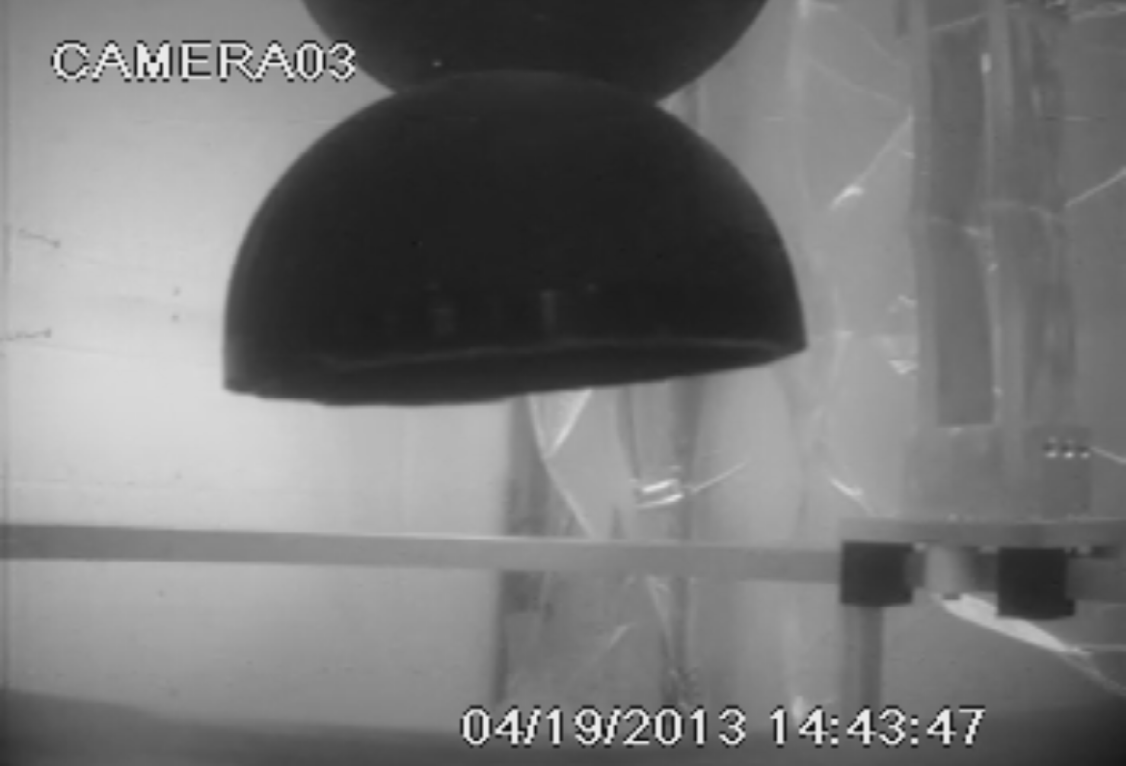
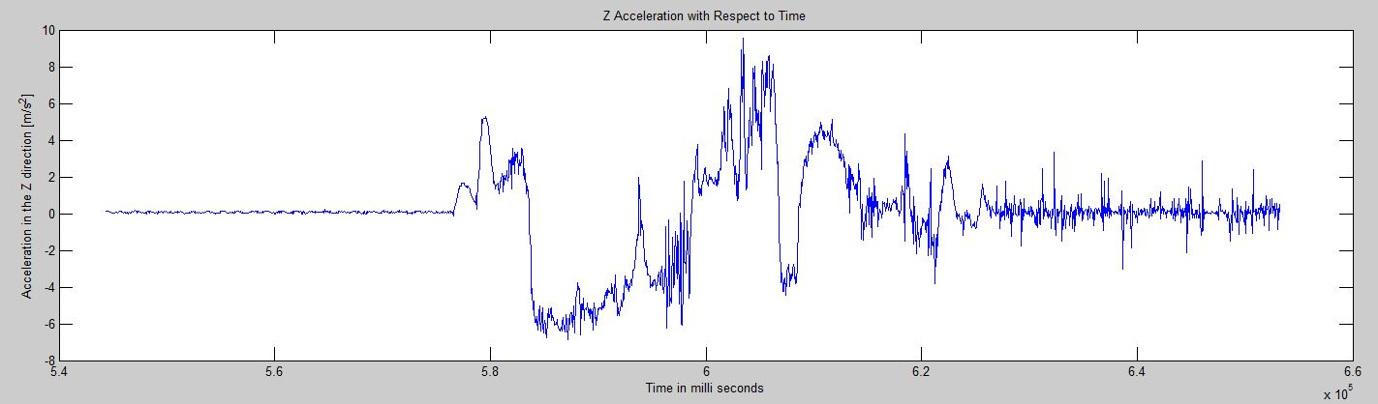
Asteroid Modeling and Prediction
Underwater Asteroid Ballistic Test Platform
Team Members: Kimberly Worcester, Luigi Pasto, Zachery Levesque, Jacob Therrien, Justin Remillard, Jon Nappi, Jeff Puzzo Advisor: Professor May-Win Thein
Background & Objective
Mechanical Design & Analysis
As of today, April 2013, there are approximately 10,000 discovered Near Earth Objects (NEOs).
About 860 of these are asteroids with a diameter of one kilometer or larger. Any asteroid that has a diameter of two kilometers or larger will cause a global catastrophe if it impacts Earth.
As of this year, we have only mapped about 10% of near Earth asteroids, and Earth is long overdue for an asteroid impact.
One method of asteroid mitigation is impacting the asteroid with a ballistic to perturb its orbit.
This project is an attempt to determine the feasibility of modeling an asteroid collision with an underwater ballistic to mimic a zero gravity environment. An underwater test bed was designed to model an asteroid collision. The goal of this test was to analyze the precise moment of impact, in addition to immediately before and after the collision. In order to conduct this test, a model asteroid was designed, and mechanisms were created for the ballistic and launching mechanism. The data was acquired through a microprocessor and an inertial measuring unit (IMU). This data will be confirmed visually through video and object tracking software as well as through analytical modeling predictions.
The asteroid housing was modeled according to the waterproof box size and machining restrictions. ABS plastic was chosen for buoyancy purposes, due to the fact that ABS plastic is slightly more dense than water. The waterproof box is less dense than water, and combined with the ABS plastic, will create a neutrally buoyant asteroid.
The rig is designed to fit in our test tank of 3’x3’x5’. The material is 6061 aluminum (so it will not rust underwater). The base ring can move 360 degrees and the launcher can travel 180 degrees around the top arches. This will allow us to launch at any point on the top hemisphere of the asteroid. The launching mechanism includes a compression spring which is held in place by a pin which will produce various predetermined stages of compression.
Electronics Design & Implementation
Object Tracking & Analysis
The flow chart below describes the arduino code that logs the data collected from the IMU. The datalogger accounts for the x, y, and z components of acceleration and angular velocity (gyroscope). All data is time stamped via milliseconds.
3 SeaView cameras are positioned around the rig, one per axis, to record asteroid collision. Video from the cameras is saved on a 4 channel DVR to be retrieved later and processed using Object Tracking Software (OTS)
Block diagram of electronics design. The components involved are listed below along with some specifications:
Arduino Uno Microcontroller
32k Flash Memory
16 Mhz Clock Speed
6 Degrees of Freedom IMU
  ADXL345 accelerometer
  ITG-3200 gyro
  MicroSD Shield
  Powered via 9V battery
This setup secures within a waterproof box, which will then be encapsulated by the model asteroid housing. Powered by a 9v battery, the design is untethered.
Video is removed from the DVR and converted to the AVI format for the Object Tracking Software (OST) to process it. Stepping through the video frame by frame, the OTS uses the Kalman Filter to analyze the video and gather positional data, which is then converted to accelerational data.
Sample data of IMU accelerations as a result of device being placed on a shaky surface. Each spike corresponds to each jolt of the IMU.
A special thanks to our generous sponsors: NH Sea Grant and Professor May-Win Thein
and project assistance from Paul Lavoie, Donya Frank, and Custom Welding

