Slide 1


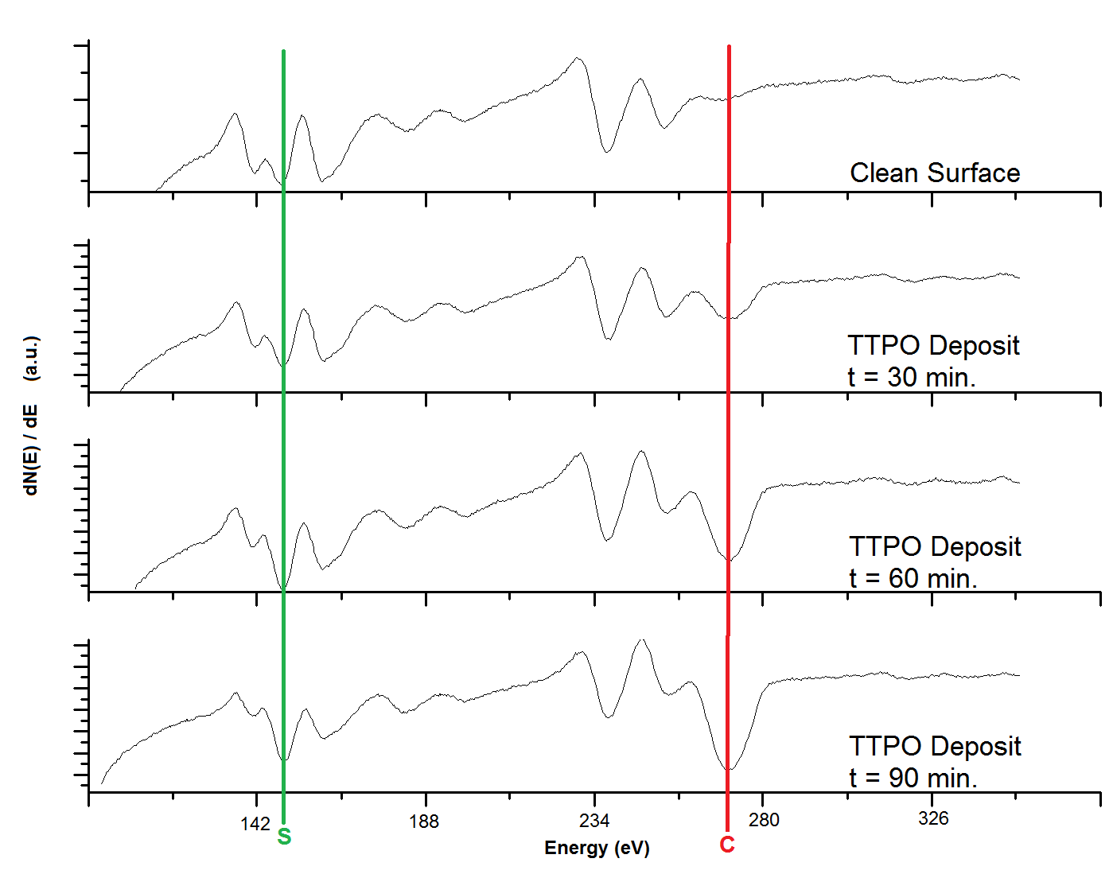
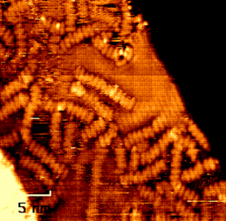
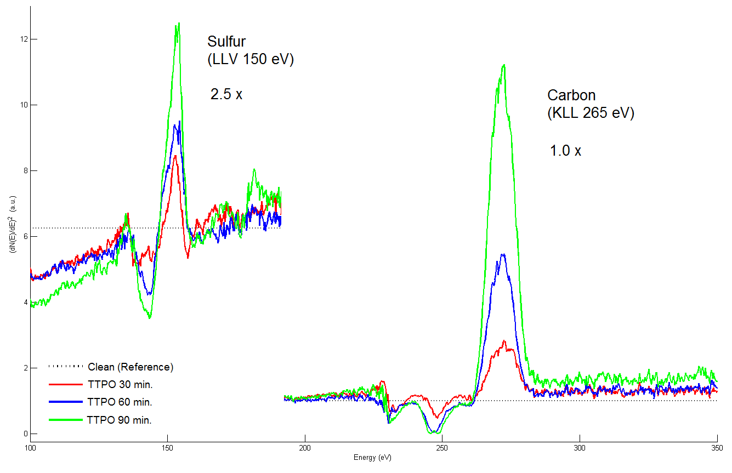
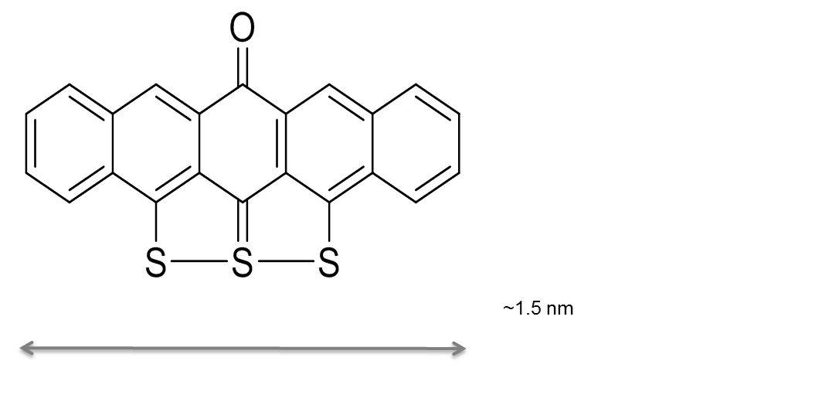
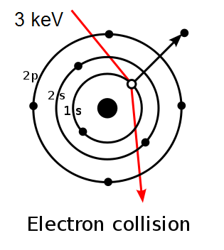
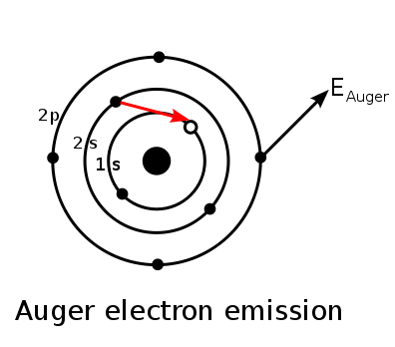
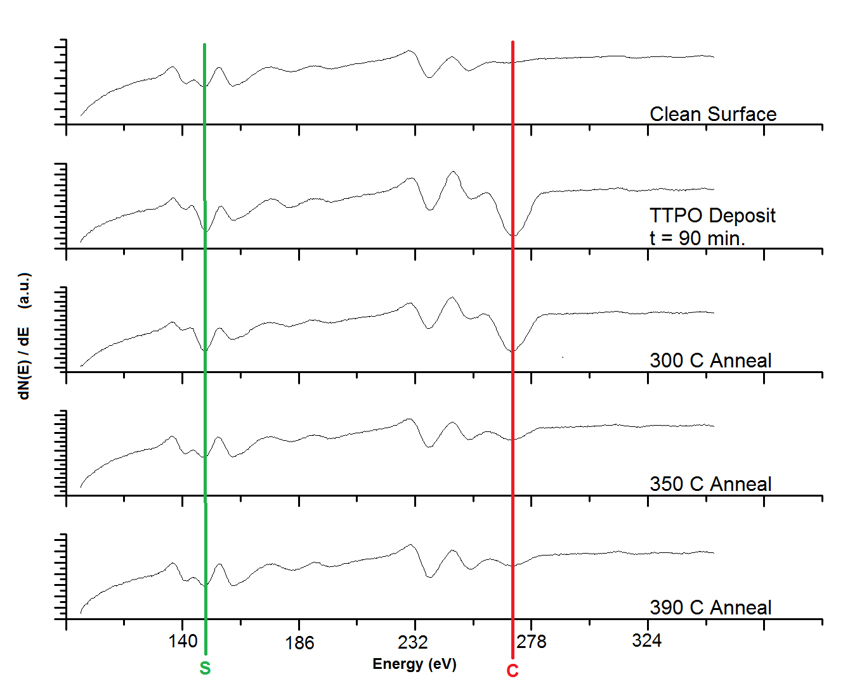
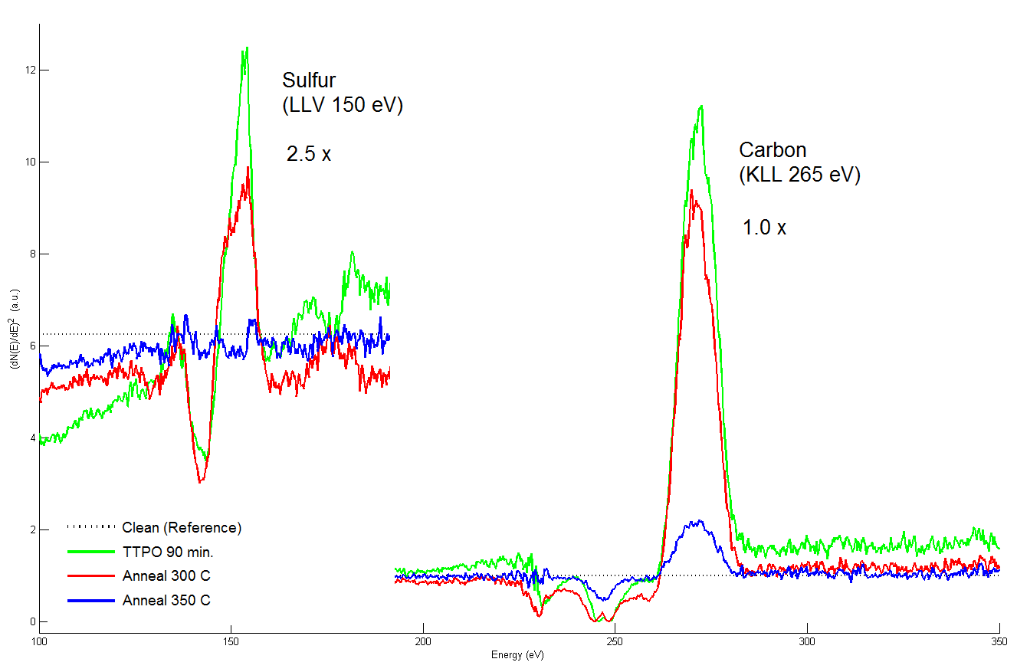
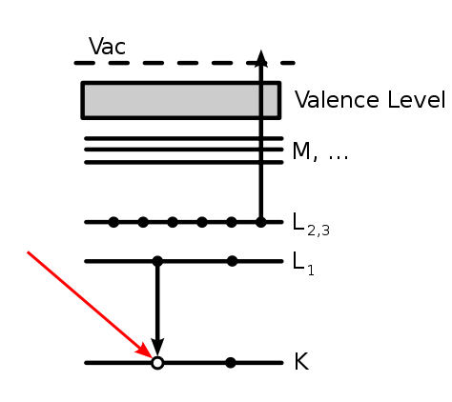
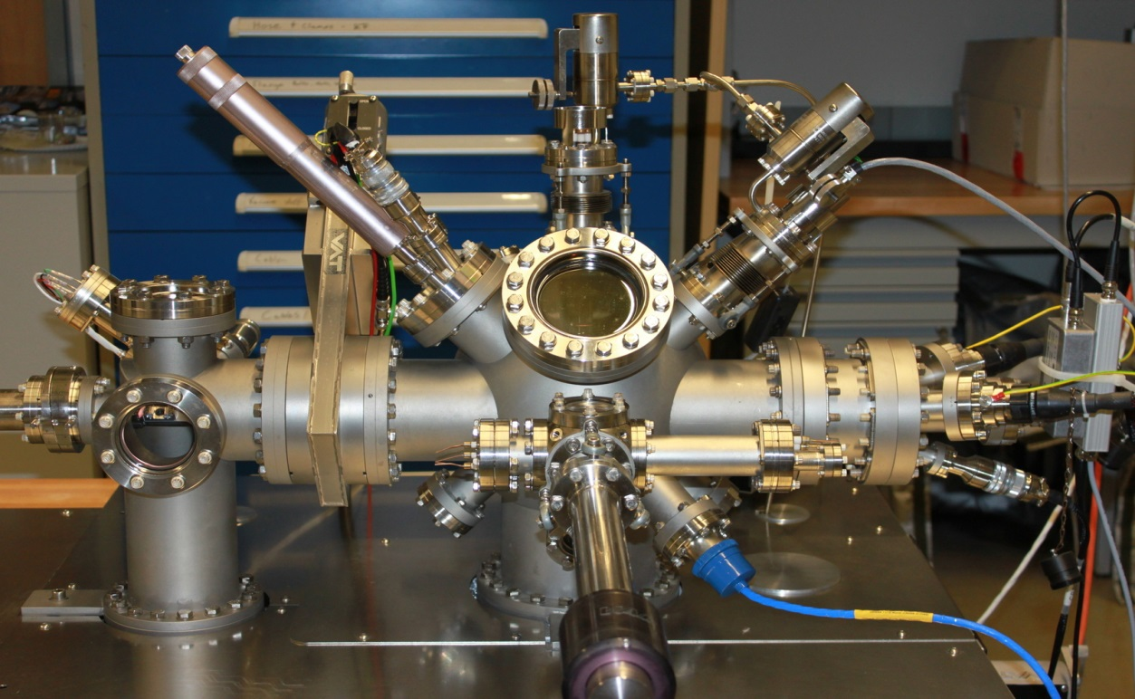
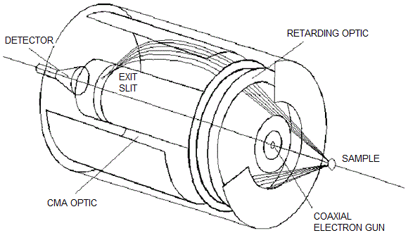
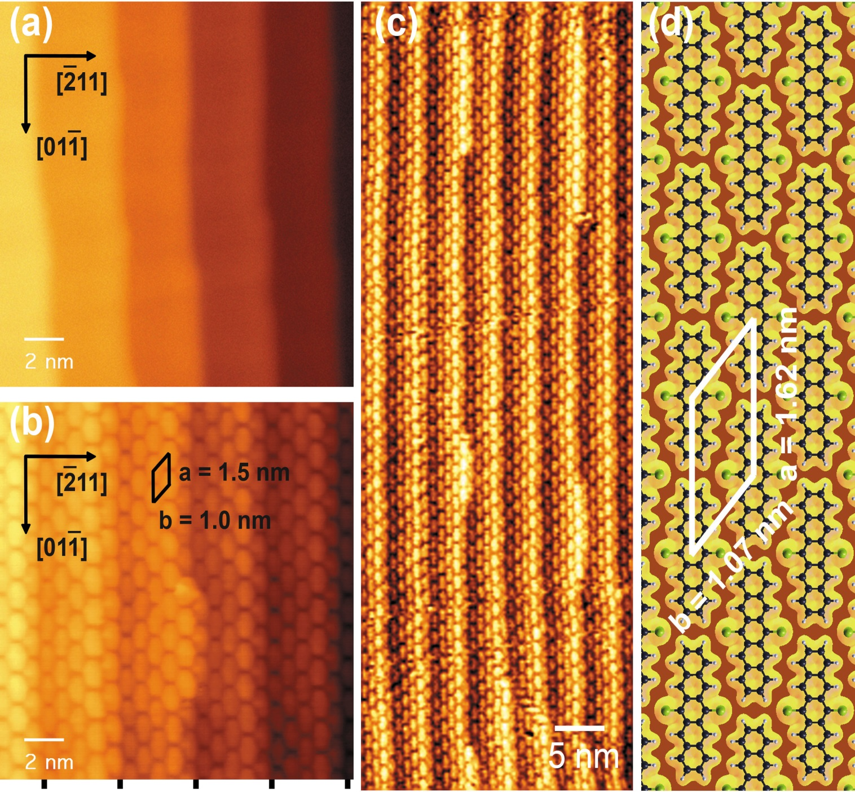
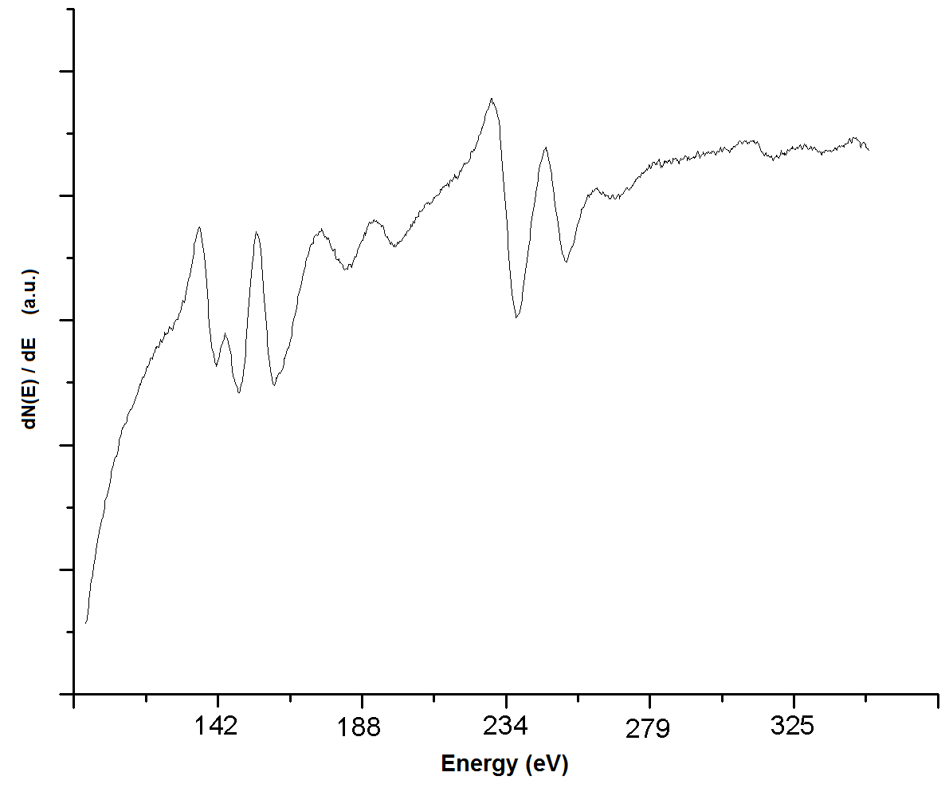


Investigation of Trithiapentaceneone on Au(788) by Auger Electron Spectroscopy
Jeremiah van Baren¹, Amanda Larson¹, Jun Wang¹, Jeremy Kintigh², Glen P. Miller², and Karsten Pohl¹
¹Department of Physics, ²Department of Chemistry University of New Hampshire;
NSF Center for High-rate Nanomanufacturing
Abstract
TTPO Auger Spectrum, Indicators
  Self-assembly of organic molecules can facilitate the efficient production of highly-ordered architectures¹ on the molecular scale which have a wide range of applications in new materials and electronics.
  Thorough investigation of such surface assemblies requires microscopic methods, which are time-consuming and highly dependent upon pristine operating conditions.
  Auger electron spectroscopy (AES) provides rapid, surface-sensitive chemical analysis that greatly increases the efficiency of surface studies, including those of molecular assemblies.
  5,6,7-trithiapentacene-13-one (TTPO), a novel pentacene derivative synthesized by UNH Miller Group, is examined on vicinal Au(788) by AES to compliment scanning tunneling microscopy study.
Primary TTPO constituents are candidates for Auger “fingerprint”
Carbon: common surface contaminant; high concentration
Sulfur: low natural presence; high relative Auger sensitivity
TTPO deposited in 30 minute increments by PVD
STM image suggests sub-monolayer coverage after deposition time, t = 30 min.
Carbon and sulfur Auger peaks scale with varied TTPO deposition
Auger spectrum; cumulative TTPO deposition
(green) S (LLV, 150 eV), (red) C (KLL, 265 eV)
STM image; TTPO (ellipsoids in chains)
on vicinal Au(788); sub-monolayer coverage indicated;
deposition time, t = 30 min.
Auger spectrum; cumulative TTPO deposition;
normalized to substrate, Au, spectrum (black)
cumulative depositions pictured as red, blue, and green, respectively
Materials and Methods
Auger Electron Spectroscopy
Temperature Dependent Desorption
Novel pentacene derivative (TTPO), synthesized at UNH, on Au(788) substrate
Instrumentation contained in ultra-high vacuum chamber (~10⁻¹⁰ mbar)
Deposition and AES analysis performed in situ
TTPO deposited by physical vapour deposition (PVD)
Primary surface analysis and TTPO coverage determination by scanning tunneling microscopy (STM)
Benzene Rings (Carbon)
The Auger Effect
Inner-shell vacancy is created by el high-energy (3-5 keV) electrons
Higher-shell electron transitions to fill vacancy (core hole)
Emission of Auger electron with energy, E_{auger}, characteristic of electronic structure.
Auger transition defined by participating electron orbitals (e.g., KLL)
Adsorbed species will desorb at some critical temperature when energy exceeds surface bonding
Indicator peaks dramatically decrease at T = 340º C
Comparatively small peak change for T < 300º C
5,6,7-trithiapentacene-13-one
3 keV
Cylindrical Mirror Analyzer
UHV Chamber
Auger electrons pass between outer and inner shell
Shell bias determines energy of electrons incident upon detector
Auger spectrum; cumulative thermal annealing
(green) S (LLV, 150 eV), (red)C (KLL, 265 eV)
Auger spectrum; cumulative thermal annealing;
normalized to substrate, Au, spectrum (black)
(green) TTPO 90 min., (red) 330º C anneal, (blue) 350º C anneal
Molecular Self-Assembly
Conclusions
Governed by molecule-molecule and molecule-substrate interactions
Allows efficient production of molecular-scale architectures
S (LLV, 150 eV) and C (KLL, 265 eV) Auger peaks scale with varied TTPO coverage
C peak loses significance in prolonged study as it is present following thermal annealing beyond TTPO decomposition temperature ( T > 390º C) due to natural occurrence of carbon in UHV environment
S (LLV) is an excellent indicator peak of TTPO coverage as sulfur is unlikely to originate from other sources
Slow decrease of indicator peaks following thermal anneal, 250º C < T < 330º C, suggests desorption of molecules in surface layers above immediate substrate interface
Disappearance of S peak at T = 350º C likely indicates complete desorption of remaining TTPO monolayer
Thermal annealing for optimal TTPO SAM assembly safe for T < 300º C, but lower temperatures preferable
Additional TTPO (beyond monolayer coverage) may be removed through thermal annealing
Auger Spectra
Signal intensity is extremely low; output differentiated to maximize peak sensitivity.
Surface composition determined by observed intensity of characteristic Auger peaks
Quantitative analysis difficult due to complexity of interaction
STM image of Au(788)
(b,c) STM images of 6,13-dichloropentacene (DCP) SAM ¹
(d) DFT model of free- standing DCP SAM ¹
Auger spectrum of gold (Au)
Nanoscale Science and Engineering
Center for High-rate Nanomanufacturing
EEC-0832785
References
[1] Wang, J., Kaur, I., Diaconescu, B., Tang, J.M., Miller, G.P., and Pohl, K. ACS Nano 2011 5 (3), 1792-1797
[2] Thompson, B., Tyson, C. Auger Electron Spectroscopy. In Chemical Analysis, vol. 74.; Wiley, 1985; pp 19-53.

