Slide 1

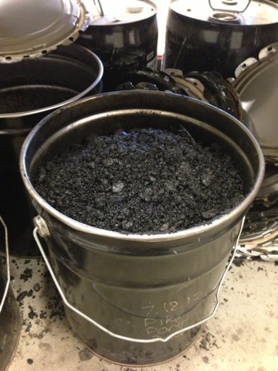





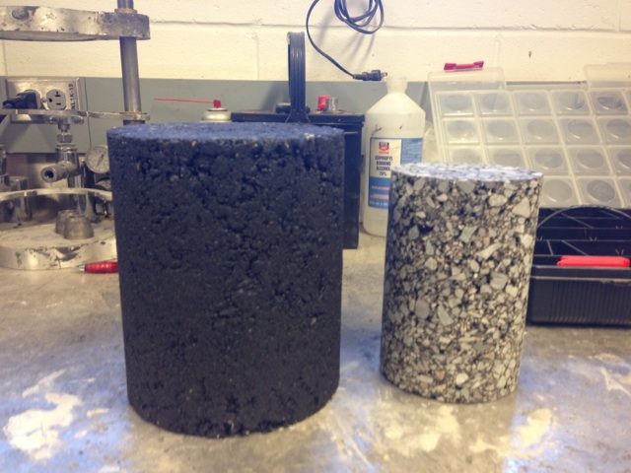
Asphalt Conditioning:
Inundation and Force-Saturation Effects on Asphalt Pavement Performance
Christopher Jacques & Michael Figueroa
Dr. Jo Sias Daniel, Faculty Mentor
Department of Civil Engineering, University of New Hampshire, Durham, NH
Introduction
Materials and Methods
Current Testing
The widespread use of asphalt concrete as a roadway surface is due to its safe and efficient performance under traffic loads. What if it’s not as safe as we all think though? The short and long-term effects of inundation and force-saturation on asphalt pavement performance are not well known. An increase in the frequency and duration of inundated roads is expected in the future due to sea levels rising, climate changes, and an increase of disastrous storms such as Hurricane Sandy or Katrina. The effects of inundation and force-saturation must be evaluated so that safer roads can be built, roads last longer, and time and money is saved for road maintenance.
Multiple steps involved to test the specimens:
Fabricating specimens:
  Heating, compaction, coring
Measuring air void content
Controlling temperature of specimens
Testing
Procedures completed include: fabricating specimens, determining air void content, changing specimen temperatures, and testing.
Control data set is needed to compare inundation and force-saturation results to existing pavement performance
AMPT testing at 3 different temperatures, 6 different load frequencies
Data satisfies what is expected
Compaction
Asphalt placed in oven at 142° C
Heated asphalt placed into cylindrical mold
Mold placed into gyratory compactor
Specimen dimensions: 150 mm x 180 mm
Coring
Compacted specimens cored with boring drill
Specimens cut with industrial saw
Specimen dimensions: 100 mm x 150 mm
Measuring Air Void Content
Specimens weighed while dry, wet, and submerged
Weights used to determine air content
Target air content: 6 ± 0.5%
Inundation- when roads are flooded, asphalt is left under water for days
Force-saturation- the impact of tires from traffic forces the water further into the asphalt
Approach
This research is part of an Undergraduate Research Experience (INCO 590) to be completed by June 2013.
Serves as pilot studies that will be used to develop research proposals for more extensive projects.
Research Question: How does asphalt pavement performance change after inundation and/or force-saturation?
6 specimens evaluated: 3 are soaked in water (simulate inundation), 3 are vacuum-saturated and soaked (simulate force-saturation) and compared to stiffness when not soaked
Results of testing will focus on dynamic modulus and phase angle
Asphalt behaves differently under varying frequency of loads and temperatures
Dynamic modulus- measure of material’s stiffness; tested at different frequencies and temperatures using a machine called AMPT
Phase angle- the delay between the applied stress and the resulting strain; also tested using AMPT
Applying Brackets
Brackets need to be applied to specimen so LVDTs from AMPT can attach
Bonding epoxy created
6 metal brackets glued to side of specimen
Brackets removed after control set testing
Future Testing
Procedures to be completed include: conditioning specimens, testing, and comparing results
Conditioning
3 specimens are normally inundated
3 specimens are vacuum-sealed in CoreLok equipment
Vacuum-sealed specimens opened underwater to induce force-saturation
All specimens placed in freezer for 16 hours then placed in a 60°C water bath for 24 hours (freeze/thaw cycle)
AMPT Testing
Asphalt Mixture Performance Tester
Specimens placed into environmental chamber at: 2.4° C, 20.6° C, and 37.8° C
Dynamic modulus and phase angle tested at: 4.4° C, 21.1° C, and 37.8° C
Load applied at different frequencies:
25, 10, 5, 1, 0.5, 0.1 Hz
Vibratory, sinusoidal loading (stress) applied to specimen
LVDTs measure deformation of asphalt (strain)
Continued Testing
After conditioning, all specimens will be tested in AMPT again following same procedure as used previously
Expected Results
Dynamic modulus is expected to decrease and phase angle is expected to increase under inundation and force-saturation conditions.
Acknowledgments
Dr. Jo Sias Daniel, David Mensching, Ashton Congalton, Rob Chase
References
Patsy Lynch. Flooded road in Texas. 28 July 2008. Photograph. Wikimedia Commons. Accessed 15 April 2013.< http://commons.wikimedia.org/wiki/File:FEMA_-_37361_-_Flooded_road_in_Texas.jpg> (Left Picture)
Wikimedia Commons. Road flooded sign Gidley Road. 11 March 2011. Photograph. Wikimedia Commons. Accessed 15 April 2013.
< http://commons.wikimedia.org/wiki/File:Road_flooded_sign_Gidly_Road.JPG> (Upper Right Picture)
Asphalt specimens are compacted (left) and cut (right) to be conditioned and tested in the AMPT.

