Slide 1

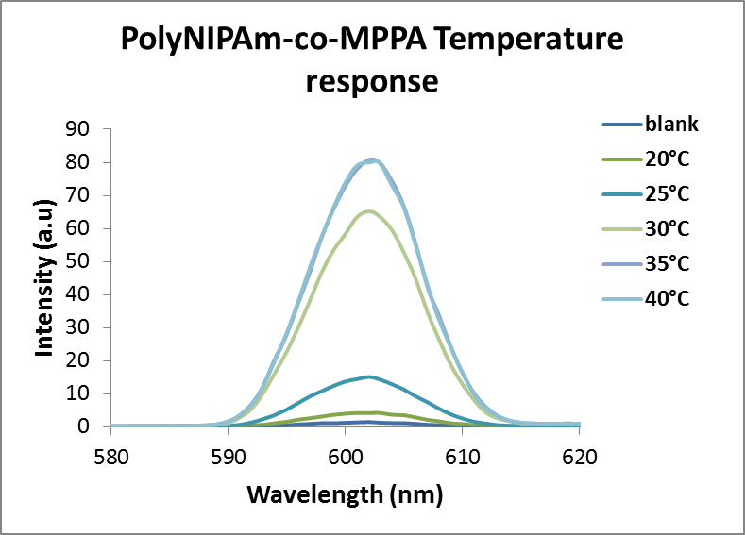
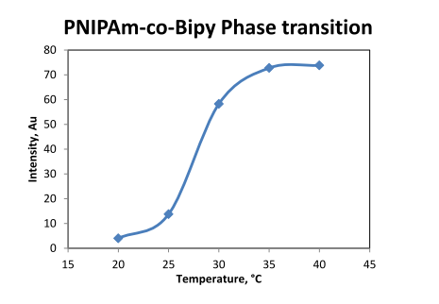
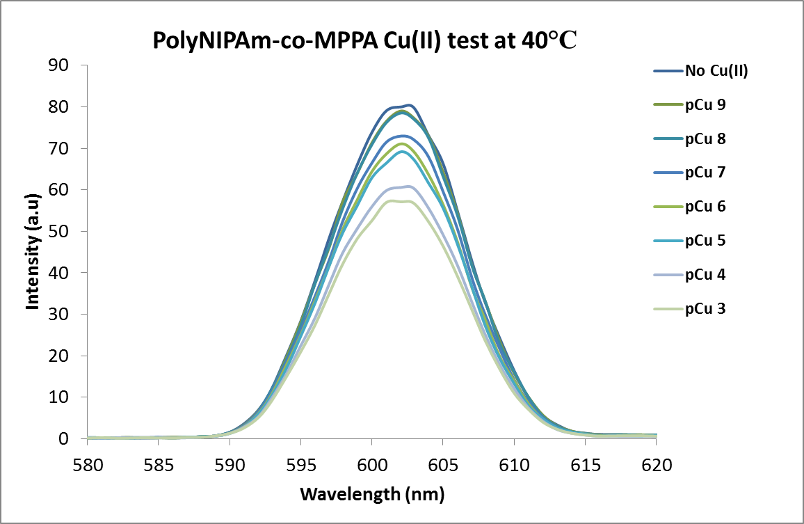
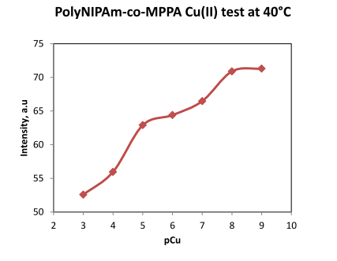
Effect of Cu(II) on the Aggregation of PolyNIPAM-co-Bypiridine
Modified-Silica Nanoparticles
Jean Remy Mutumwa* and William R. Seitz
Department of Chemistry, University of New Hampshire, 23 Academic way, Durham, NH 03824-2602 jkf32@unh.edu
Undergraduate Research Conference, April 2013
Introduction
A new free Cu(II) ion sensor is being prepared based on poly N-isopropylacrylamide-co-N-(4'-methyl-2,2'-bipyridin-4-yl)-N-propylacrylamide (PNIPAm-co-MPPA) copolymer coated with silica particles. The second order scattering measurement showed the sensor that responded sensitively to trace amount of Cu(II) ion. The detection limit can be as low as 10⁻⁸ M Cu(II). Thermal phase transition properties of poly N-Isopropylacrylamide and the stability of the silica nanoparticles rendered organic functionalization, such as polymerization, possible for designing versatile metal ion sensors.
Results
Behavior of polyNIPAm copolymers-coated silica particles
Scheme 3. Schematic illustration for thermal phase transition and Cu(II) test on SiO₂-PNIPAm-co-MPPA
PolyNIPAm scattering data
Second order scattering was utilized to monitor the conformational change of copolymer-coated silica particles.
Figure 1. (a) Second order scattering intensity at different temperatures, (b) Phase transition curve for PolyNIPAm-co-MPPA.
Figure 2. (a) Second order scattering intensity at different concentrations of Cu(II) at 40°C, (b) calibration curve with Cu(II) for PolyNIPAm-co-MPPA.
Future works
Synthesis of aminated silica nanoparticles
Aerosil 200 silica particles 1 were aminated with APTES (3-aminopropyltriethoxysilane) in toluene under room temperature for 24 hours.
Scheme 1. Amination of SiO₂ particles
Preparation of polyNIPAm-co-MPPA copolymer
PolyNIPAM-co-MPPA was prepared via RAFT or Reversible Addition-Fragmentation chain Transfer, a type of living radical polymerization which, with appropriate chain transfer agent usually containing thiocarbonylthio group, allows the synthesis of macromolecules with complex architectures and predetermined weight¹. For this purpose, polyNIPAm-co-MPPA was designed with 100 monomers of NIPAm vs. 2 monomers of MPPA.
Scheme 2. Synthesis of polyNIPAm-co-MPPA via RAFT polymerization
We are currently in process of coating a previously synthesized polyNIPAm-co-MPPA to the surface of the Aerosil 200 silica particles (scheme 4). Alternative synthesis will directly utilize RAFT polymerization (scheme 5).
Scheme 4. Coating the silica particles with polyNIPAm-co-MPPA.
Scheme 5. Synthesis of SiO₂- polyNIPAM-co-MPPA via RAFT polymerization
PolyNIPAm-co-MPPA Temperature
Respons
PolyNIPAm-co-MPPA Phase Transition
PolyNIPAm-co-MPPA Phase Transition
PolyNIPAm-co-MPPA Phase Transition
a
PolyNIPAm-co-MPPA Phase Transition
a
b
a
b
Conclusion
A Cu(II) sensor based on polyNIPAm-co-MPAA coated silica particles is being developed. The intensity of second order scattering could be measured to determine trace amount of Cu(II) in water samples. The polymer itself showed that the detection limit could be as low as 10-8M. Coating polymer on silica particles is currently under process.
a
PolyNIPAm-co-MPPA Cu(II) test at 40°C
b
PolyNIPAm-co-MPPA Cu(II) test at 40°C
b
Acknowledgements
We acknowledge the Department of Chemistry for financial support and all Seitz and Planalp groups members.
Reference
1. Yao, S.; Jones, A.M.; Du, J.; Jackson, R.K.; Massing, J.O; Kennedy, D.P.; Bencivenga, N.E.; Planalp, R.P.; Burdette, S.C.; Seitz, W.R. Analyst. 2012, 137, 4734 – 4741

