Slide 1


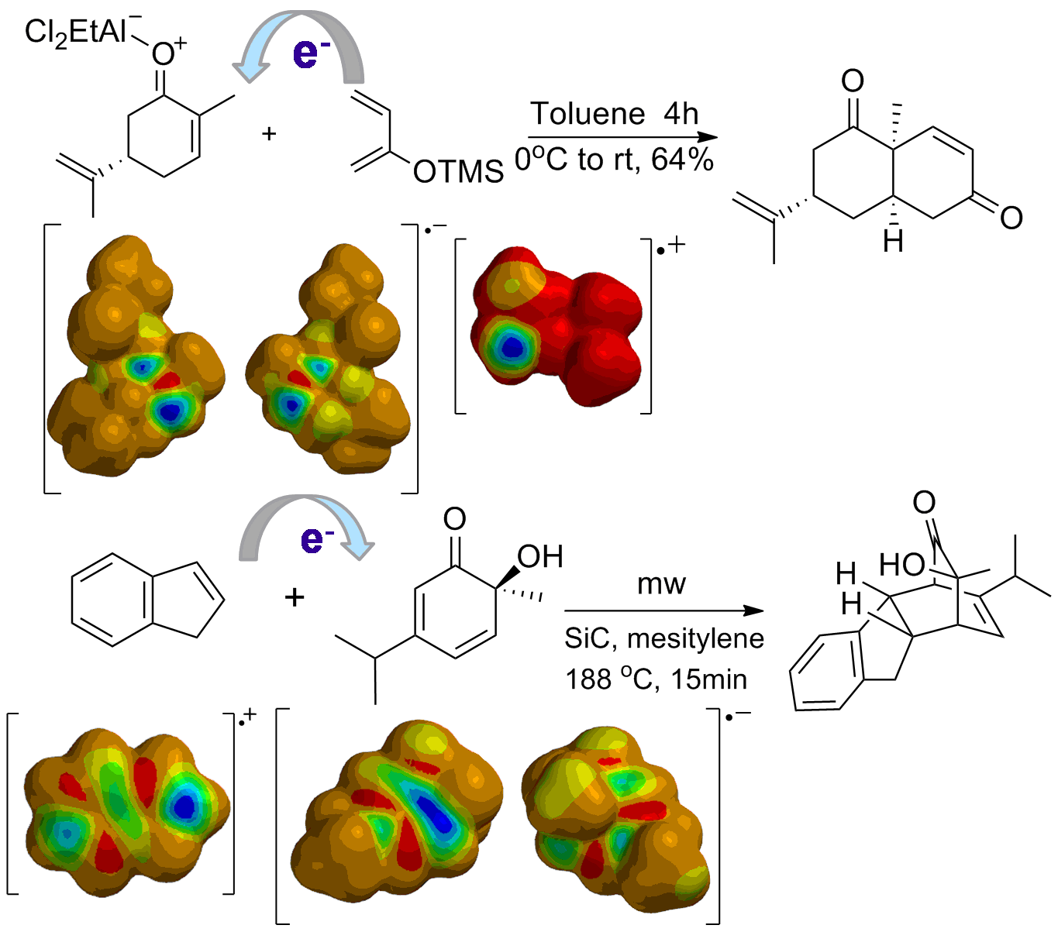
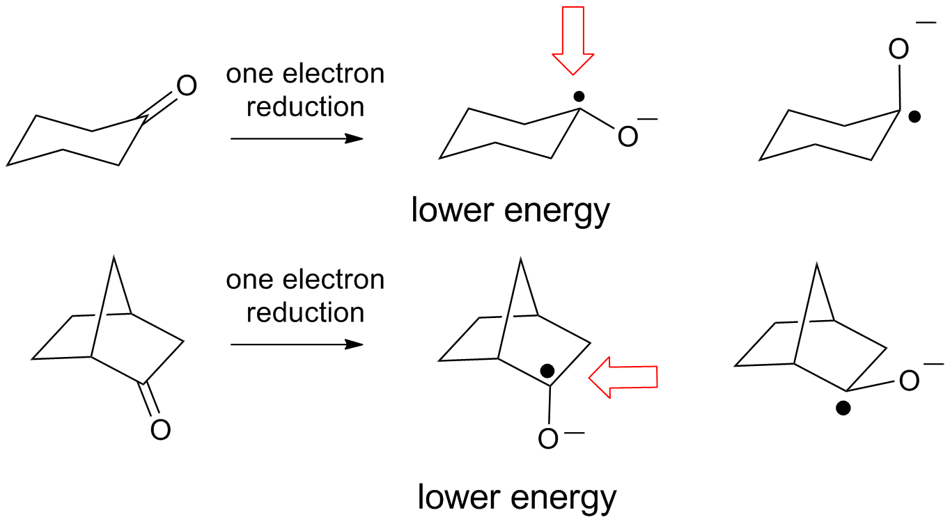
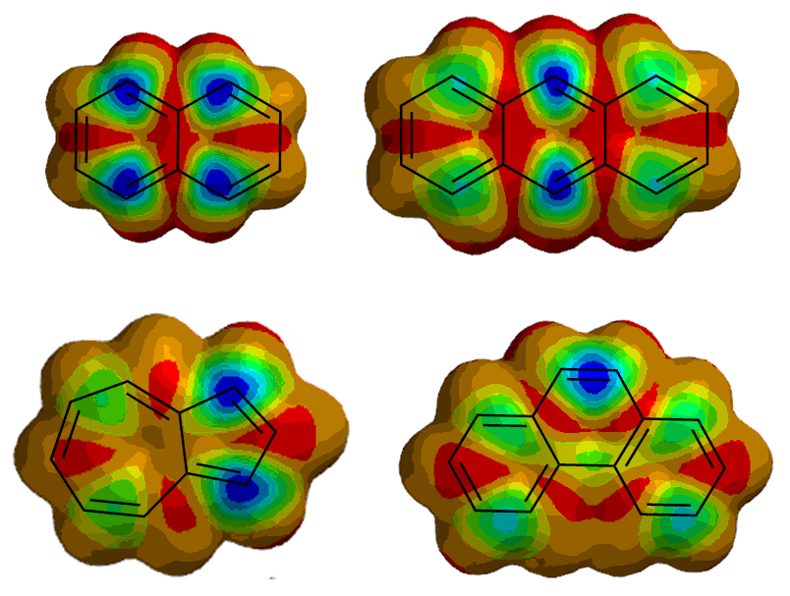
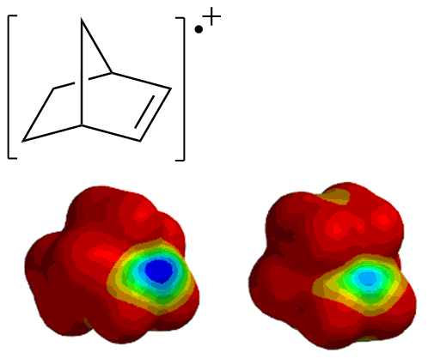
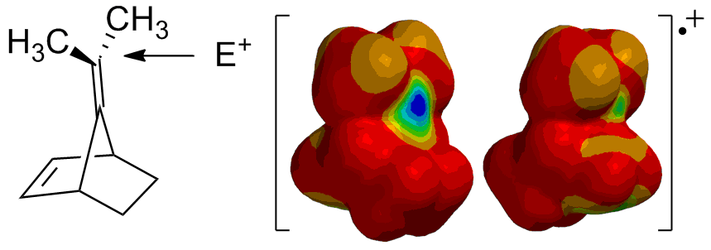
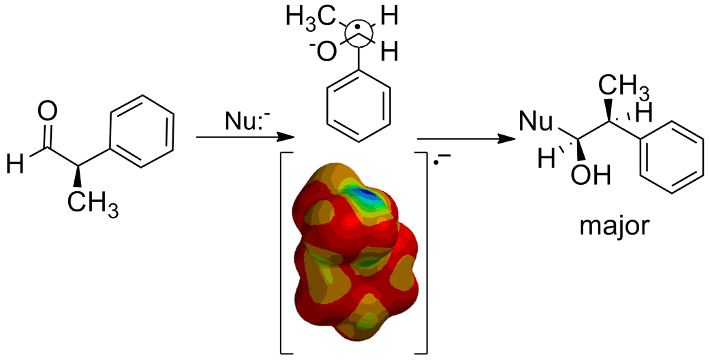
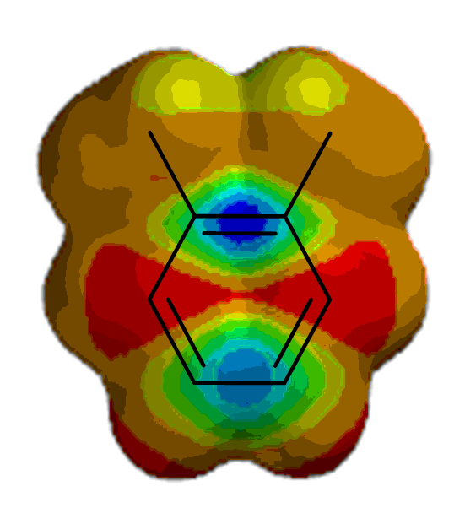
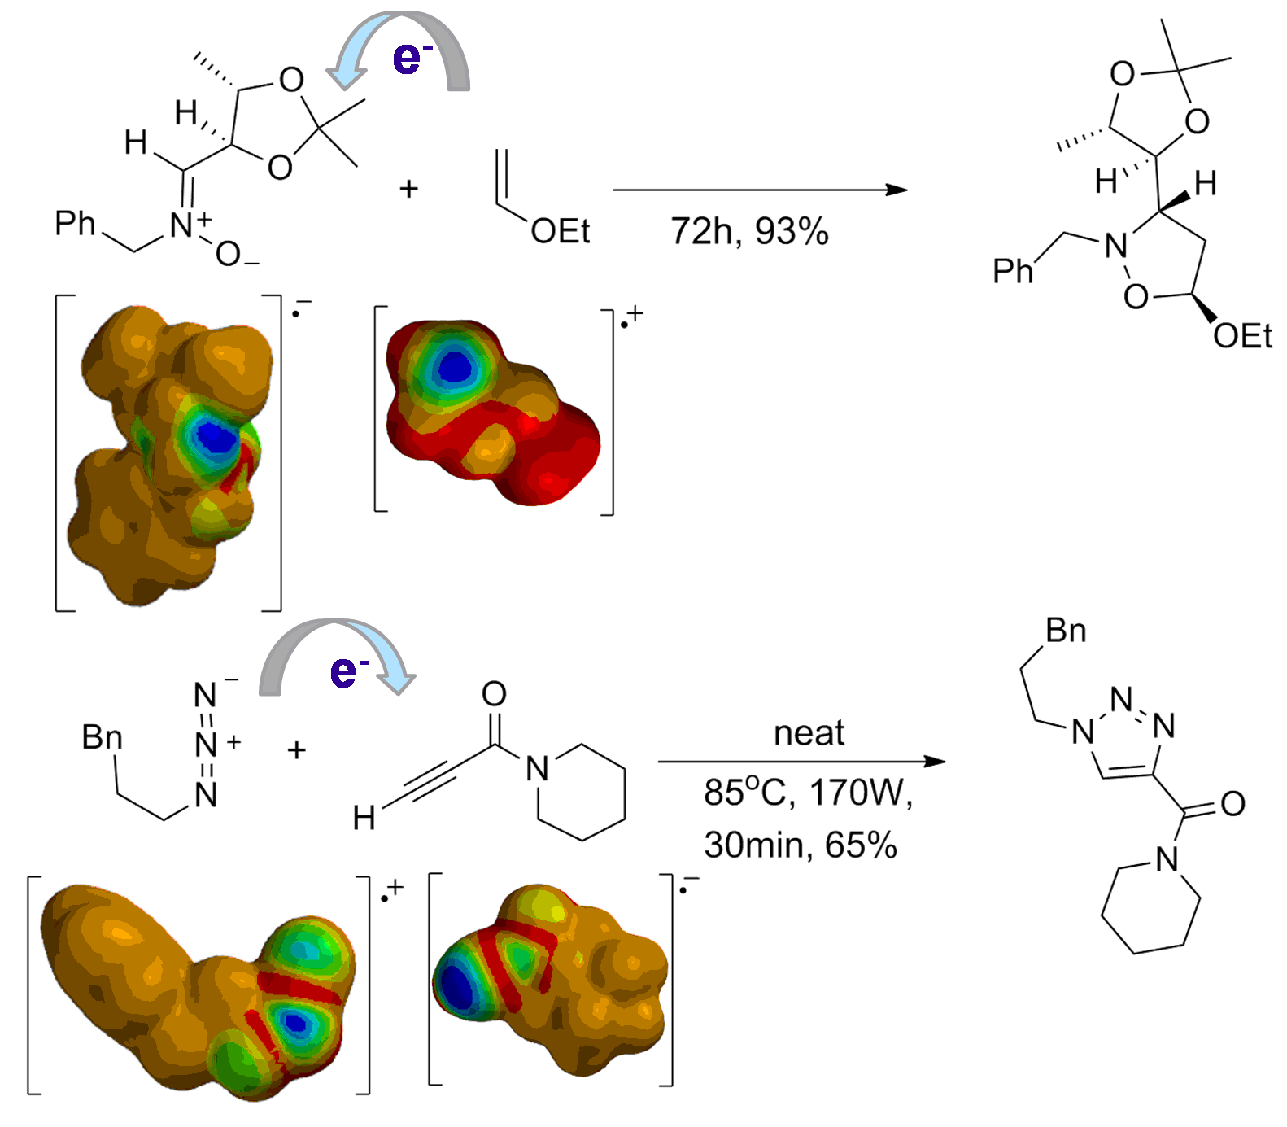
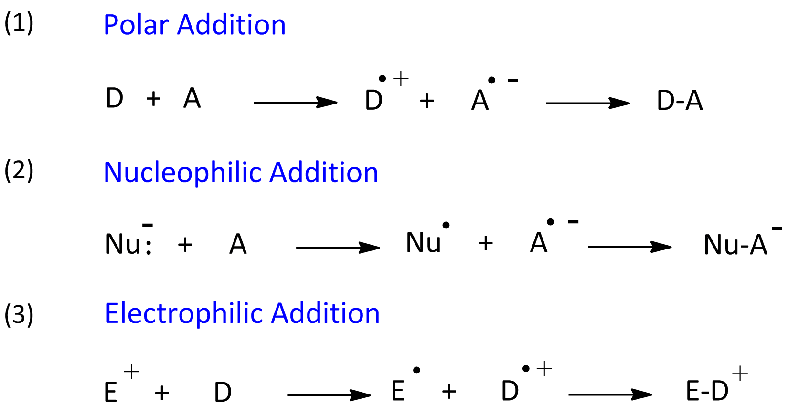
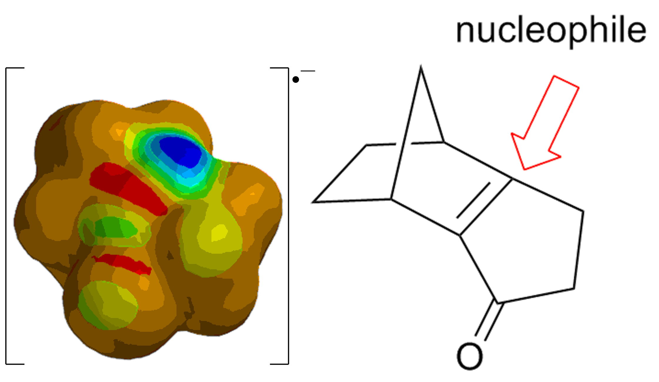
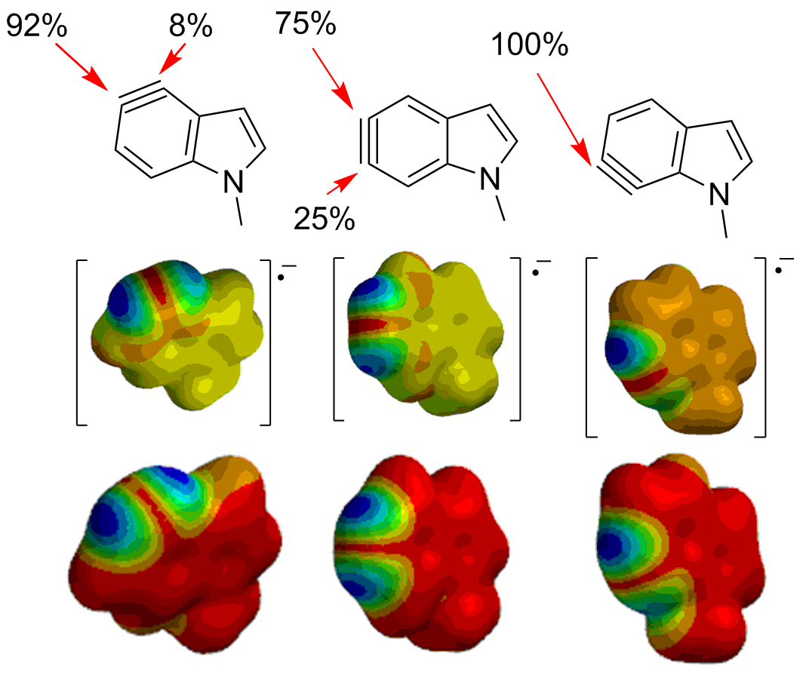
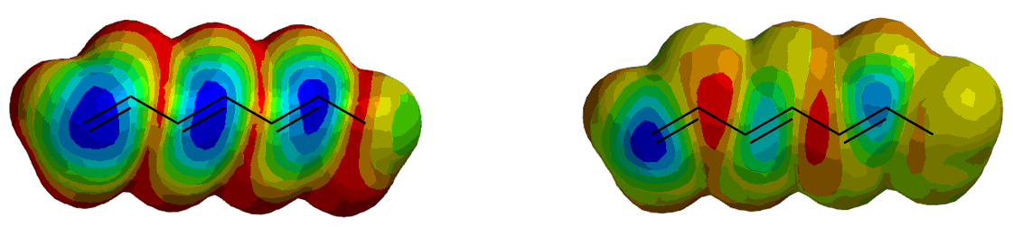

Beyond FMO Theory: An Electron Transfer Model
(ETM) for Predicting Regioselectivity in Bimolecular Reactions
Katharine J. Cahill* and Richard P. Johnson
University of New Hampshire, Department of Chemistry, Durham, New Hampshire, NH 03824
kjt49@unh.edu, rpj@cisunix.unh.edu
Introduction and History
Polar Cycloaddition Reactions
Nucleophilic Additions
Electrophilic Additions
Polar bimolecular reaction mechanisms define a continuum that ranges from concerted through single electron transfer (SET). In some cases, there is experimental evidence for radical ion intermediates.¹ Most reactions probably have some degree of electron transfer. This is implicit in the frontier molecular orbital (FMO) description of reactions, which examines HOMO-LUMO interactions.² Polar and SET reactions may follow similar reaction coordinates.³
For nucleophilic additions, visualization of the SDM for the substrate radical anion provides a clear prediction of reactive sites and stereochemistry. Pyramidalization can result in multiple conformers. For simple ketones, the lower energy conformer is consistent with observed diastereoselectivity.¹²
In electrophilic additions, ETM transfers an electron to make the electrophile radical and the substrate radical cation. In practice, visualization of the SDM for the reactant radical cation provides a clear prediction of reactive sites.
Exo addition to norbornene is clearly predicted.
ETM easily predicts both regio- and stereoselectivity. For an acyclic structure, the lowest energy radical ion conformer predicts stereoselectivity. This is in agreement with the Felkin-Ahn model.
Both regio and stereochemical selectivity are predicted for this bicyclic example.¹⁰
Many theories have been developed for the prediction of regio- and stereoselectivity in chemical reactions. Frontier molecular orbital (FMO) theory has held sway for the past four decades as one of the simplest approaches to predicting chemical reactivity and selectivity.² More recently, conceptual DFT and HSAB theories have also been described.⁴ Even slight differences in experimental bond lengths have been recognized as subtle augurs of reactivity.⁵ Unfortunately, as simple π electron wavefunctions were replaced by more advanced ab initio and DFT methods, the application of predictive models has become more complex.
Polar cycloadditions have been widely studied and it is usually easy to identify the expected direction of electron transfer. We find that the regiochemistry of both [2+4] and [3+2] cycloadditions is rationalized by optimizing the radical ion structures and visualizing the spin density map (SDM) for each radical ion.
For electron rich aromatics, ETM predicts addition at the para and ipso positions. This is consistent with experiment.¹¹
There is less pyramidalization in the radical anions of enones. In methylcyclohexenone, facial differences are clear without geometry changes.¹³ For bicyclic enones, ETM easily predicts both regio and stereoselectivity.¹⁴
Conclusions
We are exploring an Electron Transfer Model (ETM) for bimolecular reactions. In ETM, we systematically transfer an electron in the direction that is more likely based on reactant polarity. Projecting along the mechanistic coordinate to a radical ion is expected to exaggerate and thereby clarify effects of polarization. The basis for this model is the expected similarity of reaction coordinates for polar concerted and SET reactions.
Our results¹⁶ show that ETM correctly predicts regiochemistry and stereochemistry in a broad array of reactions, including Diels-Alder and dipolar cycloadditions, many types of nucleophilic addition, and electrophilic addition to aromatic rings and polyenes. Carbonyl radical anions are pyramidalized; the preferred mode of pyramidalization is a reliable augur of reaction stereochemistry. This simple but powerful method presumably works because exaggerating the degree of electron transfer clarifies polar effects. We are continuing to explore the applications and limitations of this method.
References
1 – Review: Lund, H.; Daasbjerg, K.; Lund, T.; Occhailini, D.; Pedersen, S.U. Acta. Chem. Scand. 1997, 51, 135.
2 – Fleming, I., Molecular Orbitals and Organic Chemical Reactions, John Wiley & Sons, Ltd., 2010.
3 – Pross, A. Acc. Chem. Res. 1985, 18, 212.
4 – (a) Hess, D.H.; Jones, G.O.; Houk, K.N.; Adv. Synth. Catal. 2006, 348, 2337. (b) Gayatri, G.; Sastri, G.N. J. Chem. Sci. 2005, 117, 573.
5 – Bürgi, H.B.; Dunitz, J.D. Acc. Chem. Res. 1983, 16, 153.
6 – Angeles, A. R.; Waters, S. P.; Danishefsky, S. J., J. Am. Chem. Soc. 2008, 130, 13765.
7 – Dong, S.; Cahill, K. J.; Kang, M.-I.; Colburn, N. H.; Henrich, C. J.; Wilson, J. A.; Beutler, J. A.; Johnson, R. P.; Porco, J. A., J. Org. Chem. 2011, 76, 8944.
8 – DeShong, P.; Dicken, C. M.; Leginus, J. M.; Whittle, R. R., J. Am. Chem. Soc. 1984, 106, 5598.
9 – Katritzky, A. R.; Singh, S. K., J. Org. Chem. 2002, 67, 9077.
10 – Paquette, L.A.; Hertel, L.W.; Gleiter, R.; Boehem, M.C.; Beno, M.A.; Christoph, G.G. J. Am. Chem. Soc. 1981, 103, 7106.
11 –Myhre, P.C. J. Amer. Chem. Soc. 1972, 94, 7921.
12 – (a) Mehta, G.; Chandrasekhar, J. Chem. Rev. 1999, 99, 1437. (b) Dannenberg, J.J. Chem. Rev. 1999, 99, 1225.
13 – Allinger, N. L.; Riew, C. K., Tetrahedron Lett. 1966, 1269-72.
14 – Klunder, A.J.H.; Volkers, A.A.; Zwanenburg, B. Tetrahedron 2009, 65, 2356.
15 – Im, G. Y. J.; Bronner, S. M.; Goetz, A. E.; Paton, R. S.; Cheong, P. H. Y.; Houk, K. N.; Garg, N. K., J. Am. Chem. Soc. 2010, 132, 17933.
16 – Cahill, K.J.; Johnson, R.P., J. Org. Chem. 2013, 78, 1864.
The observed percent reactivity of each site for nucleophilic addition of aniline correlates well with spin density in the radical anions of various indolynes.¹⁵ The regioselectivity is not as well predicted by the LUMO of the neutral structures.
ETM vs. FMO – The effect of polarization
Visualization of the HOMO of hexatriene does not clearly show where an electrophile will add. ETM is clearer because it shows the effects of polarization at the transition state.
ETM Computational Details
For a polar bimolecular reaction, we choose the expected direction of electron transfer and optimize structures for the relevant radicals or radical ions using density functional methods (usually M052X) which are known to give an excellent account of radical ions. Sites of higher reactivity are then revealed by mapping spin density (odd electron character) on the electron density surface, assuming that a new two electron bond would occur at sites of highest spin density. Spartan 10 and Gaussian 03/09 were used for all calculations.
Radical
Anion
HOMO
Radical Cation
Acknowledgements
LUMO
We are grateful for generous support from the National Science Foundation (CHE-0910826).

