Slide 1
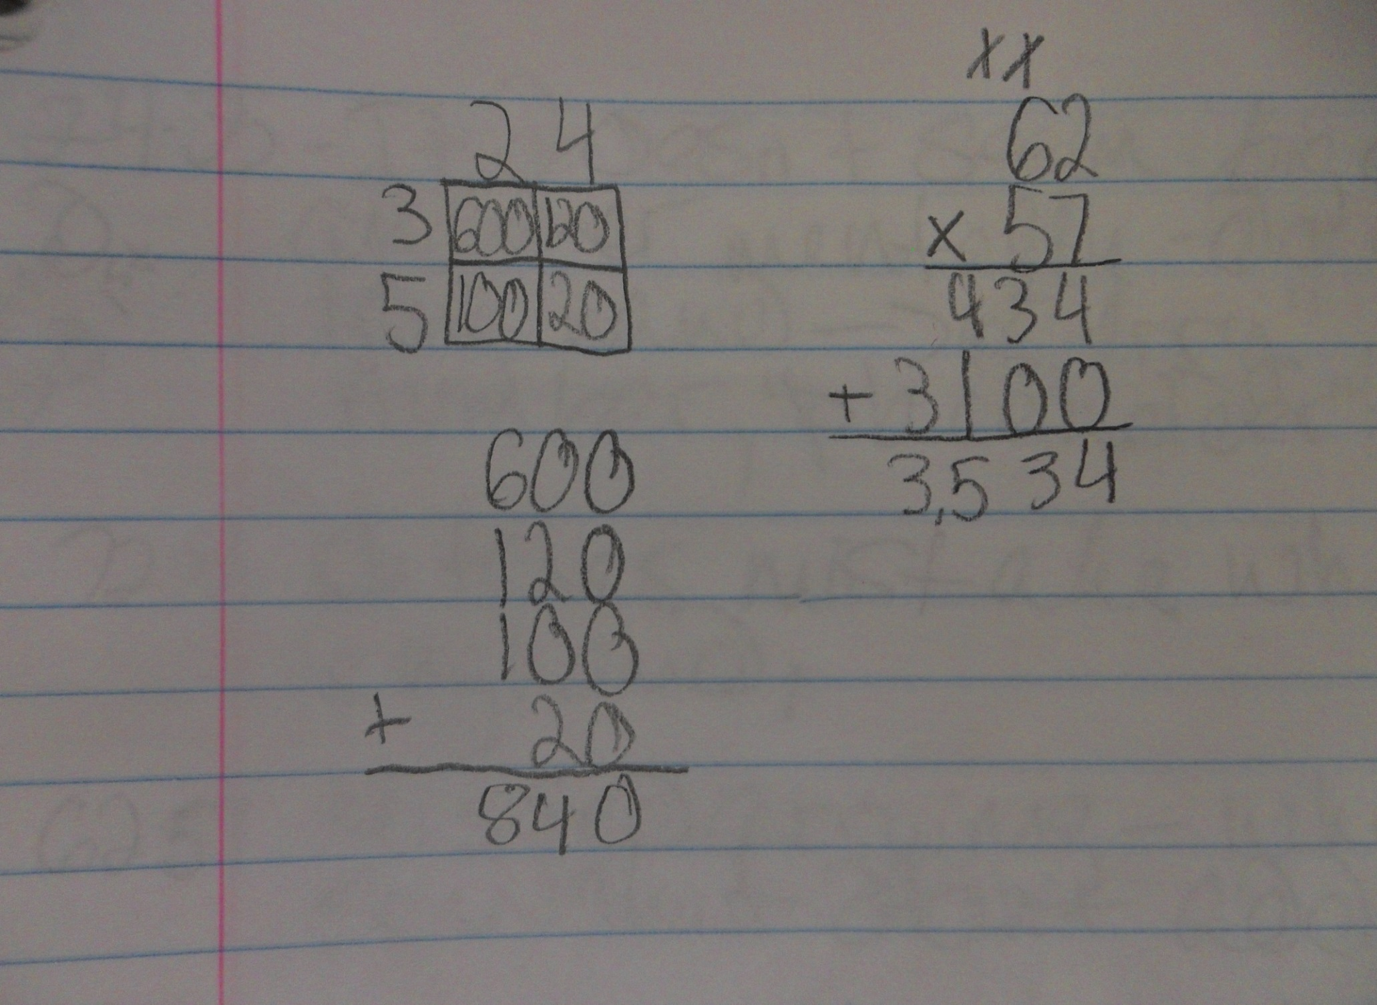
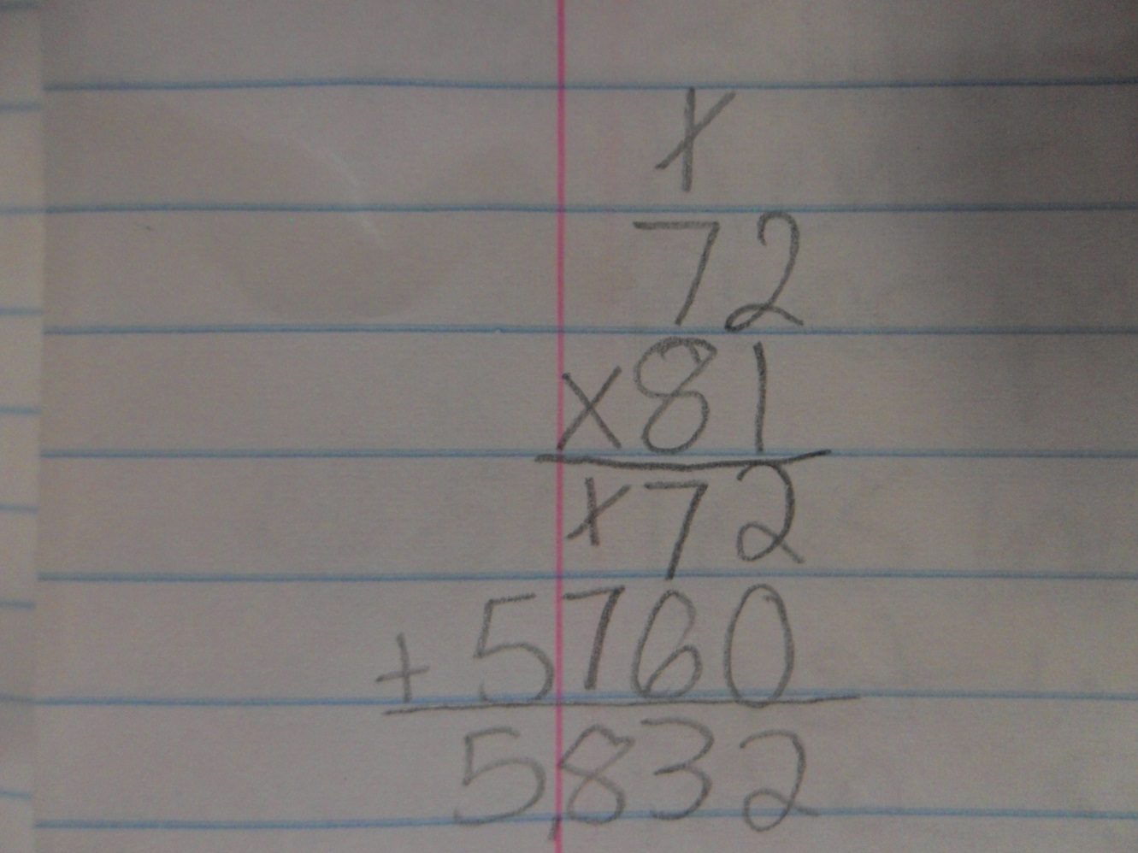
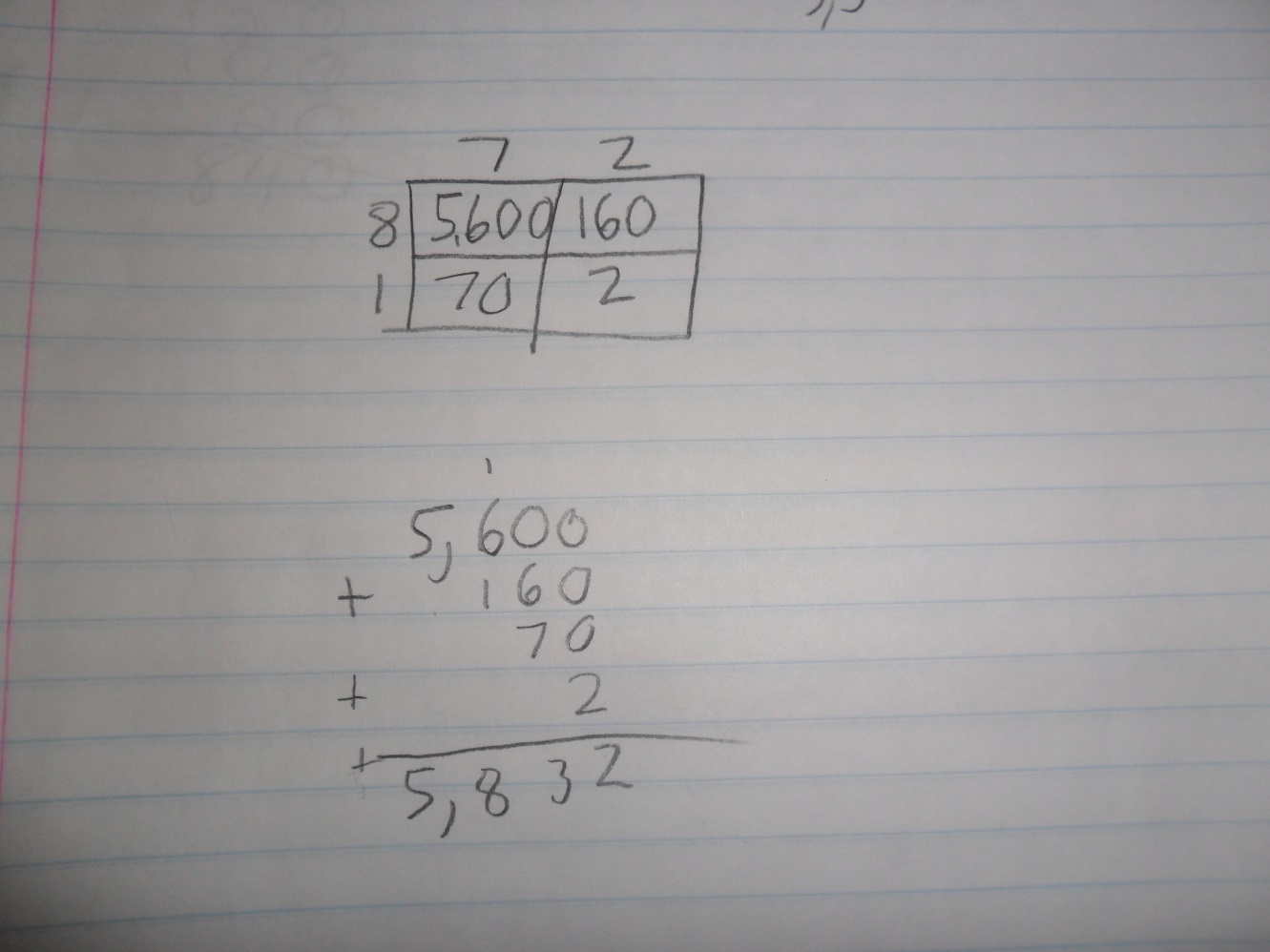
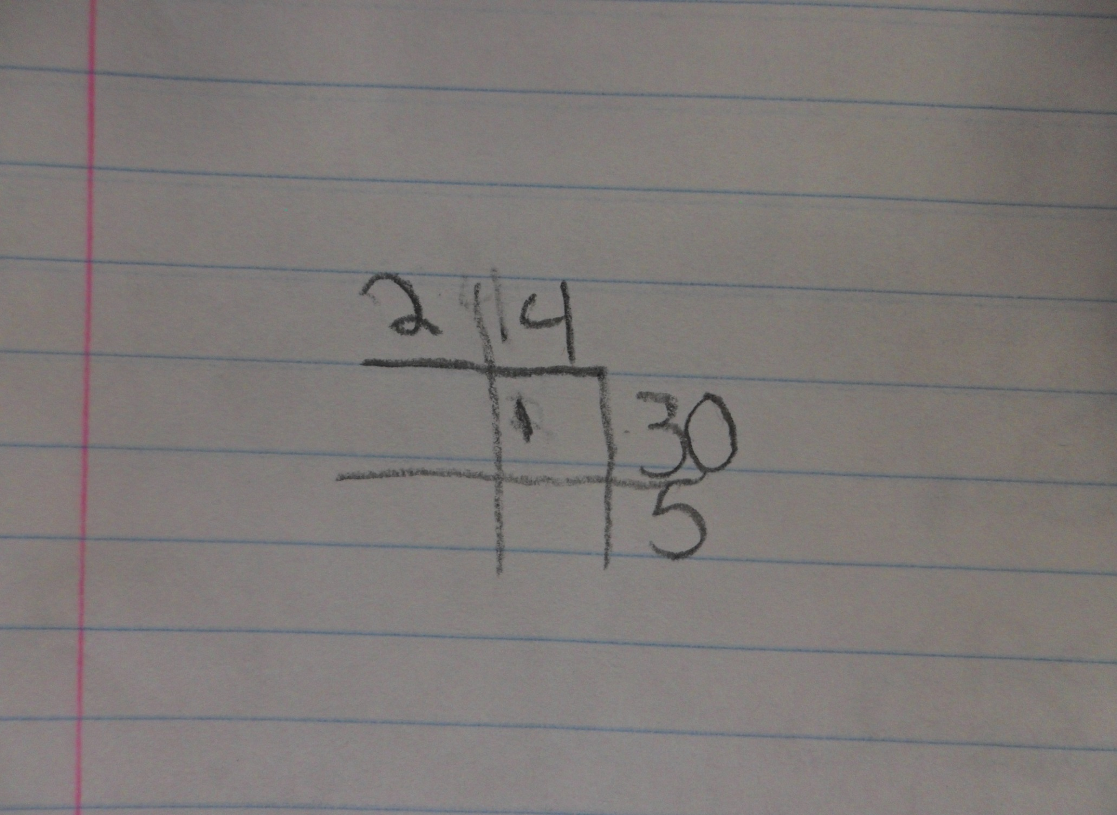
Chosen Multiplication Methods and the Ability to Learn New Methods
Research Questions
Catherine Tarushka
Department of Mathematics and Statistics
Faculty Advisor: Sharon McCrone
Is there a correlation between a specific multiplication algorithm which is a student’s primary method and the ability to efficiently learn and use other multiplication algorithms?
In what ways does a student’s chosen mental algorithm for multiplication differ from the pencil and paper algorithm, and are the students aware of these differences?
Introduction
  I intended to explore how students thought about the multiplication algorithms that they use, both on paper and mentally since “Algorithms are one means by which we can look into one another’s minds” (Morrow).
This research was to
  Identify their favored multiplication algorithms, both mental and pencil and paper methods.
  Compare and contrast those metal and written algorithms.
  Teach the Box Method, which was a completely new algorithm for all of the students involved.
  Return for an exit interview to observe any students’ change in favored method.
  Asses competency when using the Box Method.
This work is important because multiplication is a requirement for higher levels of math.
Multiplication methods are numerous . If particular algorithms are the most conducive to future learning, then these methods should be a focus.
According to research there are many (at least 7 found) multiplication algorithms commonly documented. Among these are the Box Method, and Long Multiplication, also known as the traditional algorithm
This research will determine if a student’s ability to learn new methods is affected at all by how they currently perform multiplication.
If students understand the connections between mental arithmetic and pencil and paper methods, they may be able to develop flexible strategies between future math concepts.
Findings
All five students used the Long Method of multiplication with pencil and paper, because it is what they claimed to have always used.
Students who demonstrated flexibility in using algorithms mentally were able to learn the Box Method the best, in that in the exit interview they were able to perform it successfully.
  4 out of 5 students used at least 2 methods of mental multiplication (in all cases, students used knowledge of place value as one of these methods) in the exit interview.
  These same 4 out of 5 students were able to successfully perform the Box Method in the exit interview.
  Only James was able to successfully perform the Box Method without any prompting in the exit interview. He used three different mental arithmetic methods successfully.
  2 students used Long Method mentally primarily and neither could perform the Box Method without prompting if at all in the exit interview.
Students were in general only aware of mental and pencil and paper similarities if they were identical.
  Summer and Jessica were completely in tune with their methods. They both used the Long Method for all calculations in both interviews.
  D.V. Saw similarities initially but later said his methods were completely different.
  James initially failed to see similarities, but later saw them.
  Ronald saw no similarities and referred to multiplication in his head as “splitting” while his pencil and paper algorithm was just “multiplication”, indicating, as several others did that Long Method is the only way to multiply during both interviews.
Above: James was able to perform Both and Long methods interchangeably, as shown.
(Exit Interview)
Long Method of Multiplication (James, Initial Interview )
Box Method
(Ronald, Initial Interview)
Methodology
5 fifth grade students participated: “Summer”, “James”, “D.V.”, “Jessica”, and “Ronald”: These students were chosen by their teacher to represent a variety of mathematical competency levels.
  The algorithm for multiplication most prevalent in the classroom was the Long Method.
  Data was collected over the course of two interviews: an initial interview and an exit interview. (Each interview was 10-15 minutes in length).
  The focus of each interview was students’ explanations of their reasons and methods.
Initial Interview
  Students were asked to solve double digit multiplication questions using a pencil and paper with no specific method suggested.
  Then students were asked to solve double digit multiplication questions mentally and were asked to think out loud.
  Finally, students were taught the Box Method and given the opportunity to practice one problem.
Exit Interview
  Students were asked identical questions to those in the initial interview.
  Students were asked to use the Box Method and their competency was evaluated.
Place Value Discoveries
Though not one of my original questions, the importance of place value in students’ understanding of multiplication quickly became prevalent.
This suggests a strong connection between place value and the ability to successfully use multiplication algorithms.
  I found that students who were able to discuss place value during the interview process were more likely to be able to use more than one method when performing mental arithmetic (2 out of 3).
  All 4 students who used placeholders for the question of 22*11 found the answer.
  The 1 student who did not use place value was the only one not able to perform the box method at the exit interview.
Below: Jessica was unable to perform the Box Method at all, even with prompting.
(Exit Interview)
Conclusion
It appears that it is not the primary method that affects if students are capable of learning new multiplication, but the multitude of methods that students use to multiply which affects their aptitude when learning a new algorithm.
Because there are so many methods used in mental arithmetic, there appears to be fewer conscious connections between mental arithmetic and standard pencil and paper algorithms.
This disconnect may affect number sense in higher mathematics, since students do not see that the multiplication in their heads and on paper is the same.
References:
Morrow, Lorna J., and Margaret J. Kenney. The Teaching and Learning of Algorithms in School Mathematics. Reston, VA: National Council of Teachers of Mathematics, 1998. Print.

