Slide 1
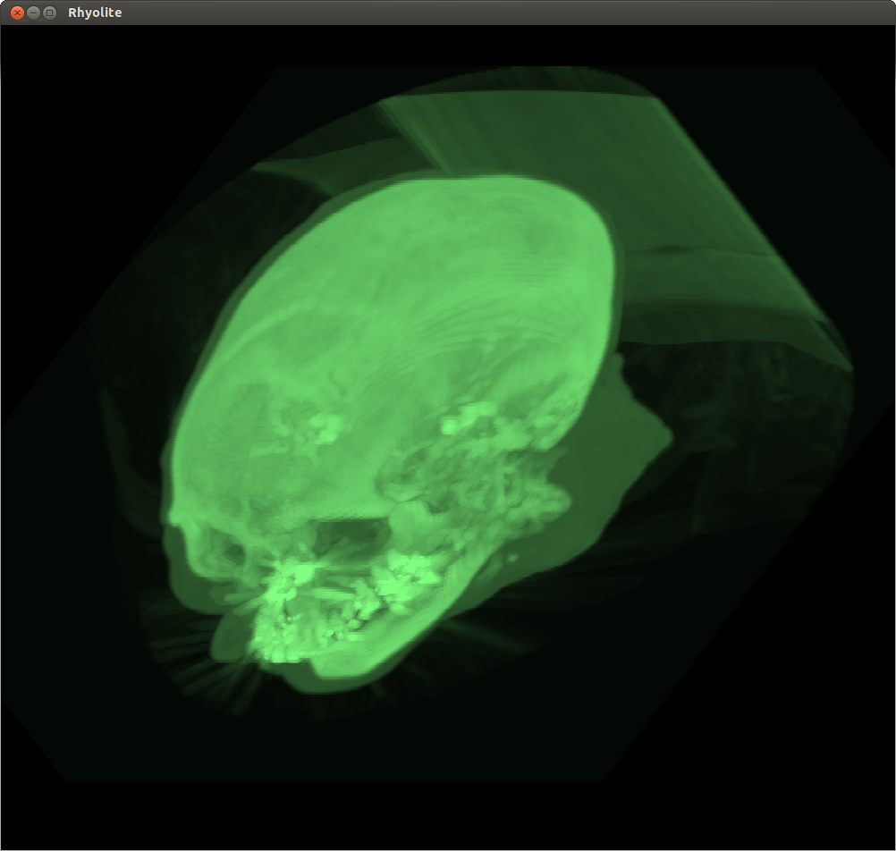
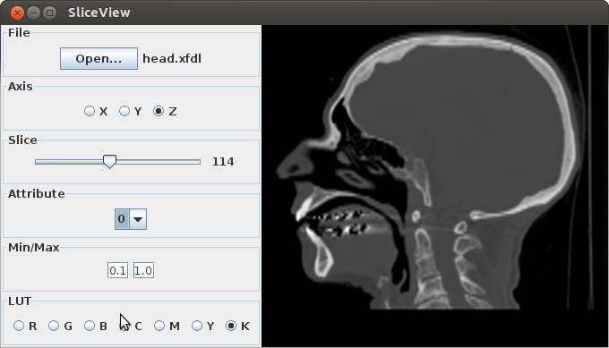
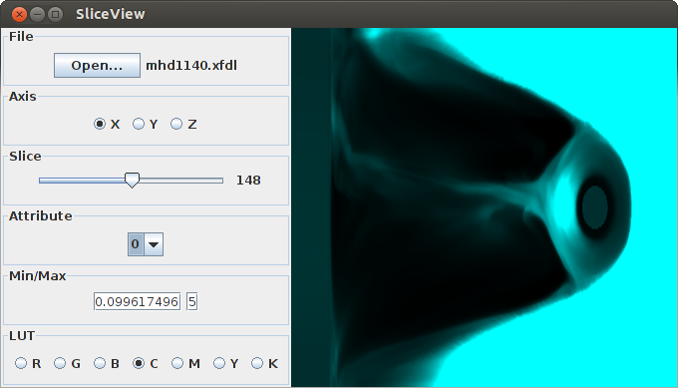
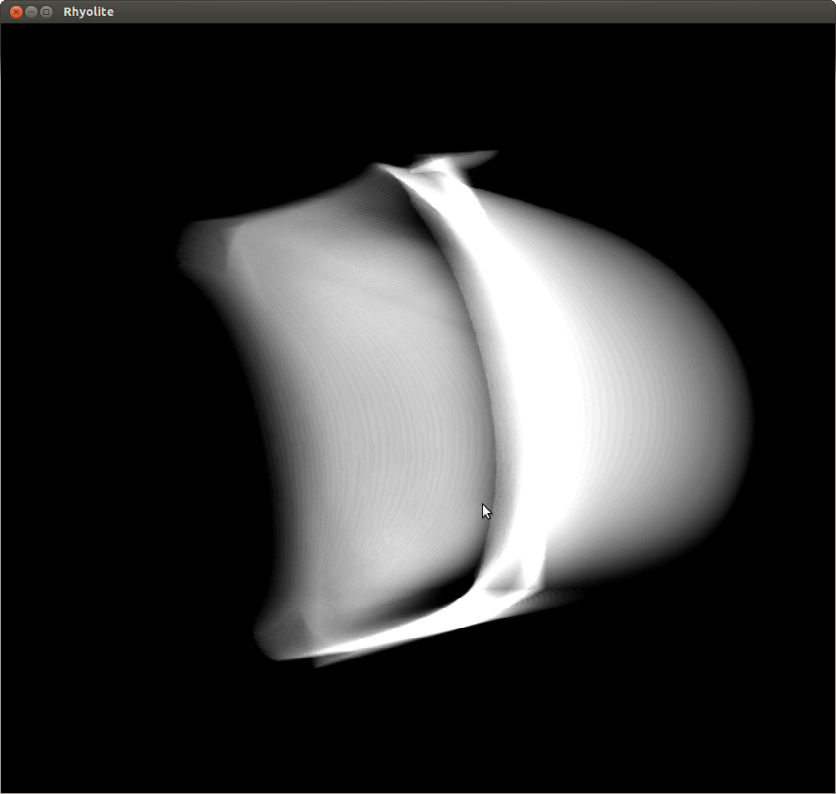
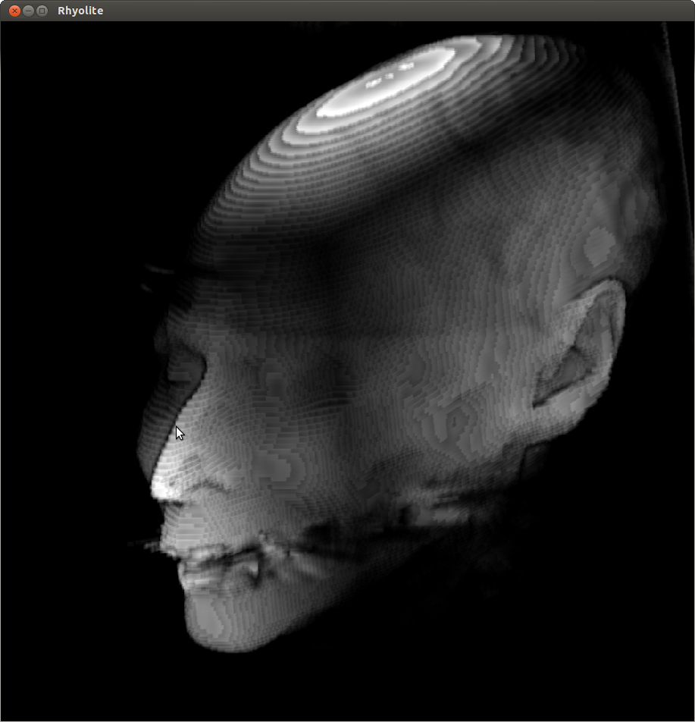
Rendering Adaptive Resolution Data Models
Daniel Bolan
Abstract
For the past several years, a model for large datasets has been developed and extended to create a new space-efficient alternative for use in visualization. These models use an adaptive resolution that can deliver both the high level detail necessary for effectively visualizing small details while maintaining a smaller size by partially eliminating redundant information in uniform regions.
Before we started, there existed no renderers ready for use with these adaptive resolution data representations. The models had to be converted to more uniform grids before being displayed, which could have a serious impact on the rendering performance. We set out to create two tools to work with these models in order to help expedite the development of an implementation of adaptive resolution model. Two applications were ultimately developed, SliceView and Rhyolite, which each render this implementation directly using two different methods.
Volume Rendering
Volume rendering is another way to visualize these large datasets. It works by considering the data as a cloud of translucent gas with its opacity defined by a transfer function. Imaginary rays of light are cast through the data, and the information about the light that gets reflected back or absorbed gets recorded and used as a pixel in the final image. After repeating this process for every pixel in the image, you end up with a rendering that reflects all three dimensions of the data in a single image.
Rhyolite
Rhyolite is a direct volume renderer the relies on ray casting. Developers can create their own transfer functions (two of which are demonstrated below), modify LUTs, and arbitrarily rotate the camera around the dataset using the mouse. There is a significant performance issue with Rhyolite, however, with a medium-sized image taking between one and five minutes to render (depending on the direction of the camera and the transfer function being used). Future development could get better performance by using multithreading or even using a GPU directly in order to perform the necessary calculations.
Adaptive Resolution Data Models
When working with very large sets of data, it is often prohibitively slow to display every point in the set. In order to get around this fact, certain points are often excluded from the rendering. The viewer may display the full dataset at a lower resolution, which can give a good overview of the data while introducing an acceptable amount of error. Alternatively, one could choose to see a small subset of the data with much higher accuracy. This typically occurs when a viewer “zooms in” on the data to explore in more detail a small section of the current scene. This is common in data visualization and requires different resolutions of the same data.
Currently the most common method for incorporating these different views is simply to store the data at multiple resolutions, and load the different datasets individually as a higher or lower level of detail is required. This causes several problems, however. These multiresolution datasets are very redundant and require the a lot of space to store. They also create a fair amount of error in the more detailed regions of the data, forcing the viewer to change resolutions often and, in turn, load another version of the dataset. Reading in the new resolution from a disk is a slow operation and creates a significant delay.
Granite Scientific Data Management System
Over the past several years, computer science researchers have been developing a variety of approaches for combining the different resolutions. These “adaptive resolution” data models provide a more space-efficient solution that can minimize error, even when viewing the entire dataset. Areas where there exist a high level of detail have a higher resolution, while relatively uniform portions of the original data have their resolutions lowered. This results in a hybrid that not only manages to show the details of the more intricate regions of the data but also does not waste space storing as much redundant information.
Professor Bergeron and his student have been doing research in multiresolution and adaptive resolution data models for over ten years. During that time they have developed an extensive software environment for facilitating this research called the Granite scientific data management system. The principal goals of the Granite system are to facilitate interactive visual exploration of data sets that are much too large to fit into main memory.
Adaptive resolution data models contain significant data on the error introduced to them, and can use that information to guide its own creation, guaranteeing that supplied constraints on the introduced error are satisfied. This feature allows great flexibility in both the compressing of the data and the quality of representation.
Slice Rendering
Slice renders are the most common way to render a dataset. This is not necessarily because they are the most effective method, but because they are often the easiest to implement and require the least amount of training to understand. They essentially function as a cross section of the data, taking all points near a given plane and using those to generate an image. Because scientific data is often rectilinear (i.e., they line up with the coordinate grid), it is typically easiest to “slice” along the major axes. Creating slice renders from different angles requires either interpolating between points to find what the values of the plane would be or rotating the entire dataset and realigning it to a rectilinear grid.
SliceView
We began development
with the slice renderer
because it didn’t require as
much math and served as
an introduction to the
Granite API. SliceView
allows the user to open a
dataset and then select the
axis and position in the data as well as modify the image by allowing the use of custom lookup tables (LUTs) for colors and specifying the range of values that he or she would like to view. This application is
completely interactive and works in real time, though there is a minor delay when slicing along the z-axis due to what we believe are caching issues. This can be fixed by rotating the dataset whenever the user picks a new axis in order to align the points in such a way that all of the data needed for a specific slice are more likely to be in memory at the same time.
Acknowledgement
This research was funded by the UNH Hamel Center for Undergraduate Research. Many thanks to Mr. Dana Hamel for his generosity in particular, as well as Professor Bergeron of the UNH Computer Science Department for his invaluable guidance and support.

