Slide 1
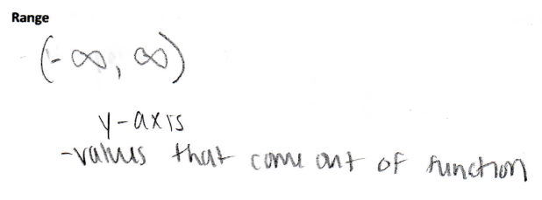
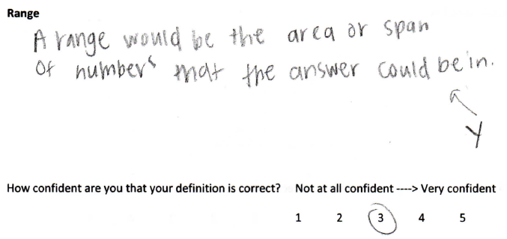
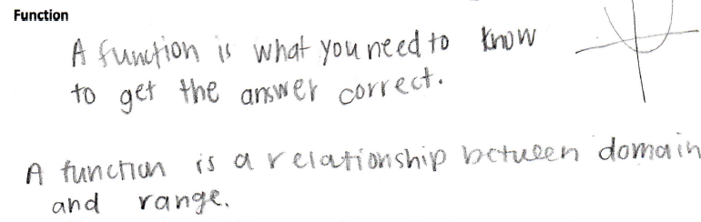
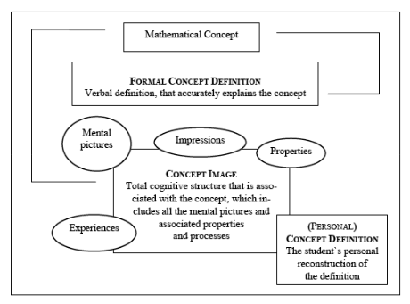

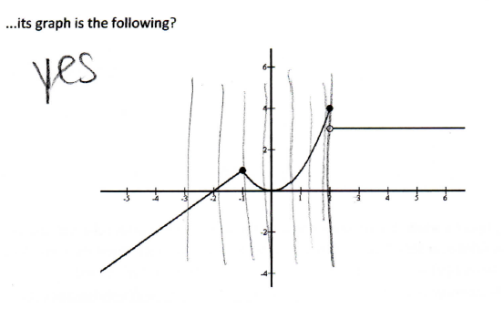
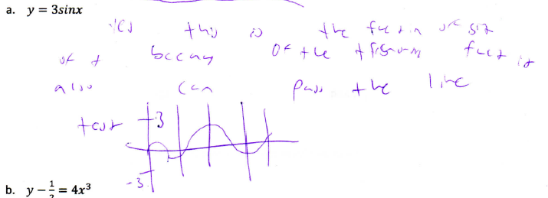
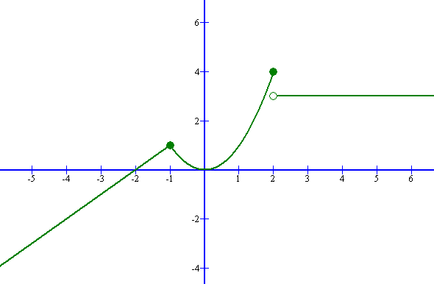
Definitions in Mathematics: What do High School Students Know?
Julianne Sacco Dr. Sharon McCrone, Faculty Advisor
Department of Mathematics & Statistics
Background
Questions
Are students able to write their own precise definitions for various mathematical terms in a high school pre-calculus class?
Does the ability to write precise definitions translate to students being able to successfully do mathematics? Related, does the inability to write precise definitions translate to students being unable to successfully do mathematics?
Findings
Descriptions Misconceptions Incomplete Definitions
Vertical Line Test: If the graph of an equation passes the VLT, then the equation is a function.
Composition of functions: Initially, two students guessed, while the third student argued that neither represented the commission because both f(g(x)) and g(f(x)) would be negative. This suggests that the student did not understand that the domain of the composite function would be x>5000. After clearing up this misconception, the students correctly reasoned together that f(g(x)) represented the commission.
Definitions are essential to doing math.
Robert E. Jamison: only “once students understand HOW things are said, they can better understand WHAT is being said, and only then do they have a chance to know WHY it is said.”¹
Definitions are not used when doing math.
Shlomo Vinner: neither students nor mathematicians use definitions in order to do mathematics; instead they access their evolving concept image – a visual representation or collection of experiences related to the given term. ²
Student definition of “range”
Student definition of “range”
Student definition of “function”
…to each element x in the set A exactly one element y…
Methodology
Participants:
3 students in CP Pre-calculus
Individual and small group work
Tasks:
  Definitions: domain, range, function
Describe the following terms using words, pictures, examples, or any other way you can think of. Then define the terms in complete sentences.
Domain
How confident are you that your definition is correct? Not at all confident ----> Very confident
1 2 3 4 5
Range
How confident are you that your definition is correct? Not at all confident ----> Very confident
1 2 3 4 5
Function
How confident are you that your definition is correct? Not at all confident ----> Very confident
1 2 3 4 5
*At this point, the students and I reviewed their definitions and the textbook definitions. Together, they wrote definitions in their own words based on the textbook definitions to use in answering the following questions. They were given copies of the textbook definitions to aid them in answering the questions as well.
Existence: Is there a function such that…?
  …each positive number corresponds to 1, each negative number corresponds to -1 and 0 corresponds to 0?
  ... f(0) = 1, f(1) = 1, f(n+1) = f(n) + f(n-1) for n≥1?
  ...its graph is the following?
Identification: Is the following a function? Explain. State the domain and range.
Which of the following are functions? Explain why or why not. State the domain and range of each.
  y = 3sinx
  y - ½ = 4x³
Application: function composition
You work forty hours a week at a furniture store. You receive a $220 weekly salary, plus a 3% commission on sales over $5000. Assume that you sell enough this week to get the commission. Given the functions f(x)=0.03x and g(x)=x-5000, which of f(g(x)) and g(f(x)) represents your commission?
Instead of grammatically correct complete sentences giving the definition of the term, students shared a description – their concept image.
Some math terms have common English meanings or multiple mathematical meanings that can be confused.
Together, the students came up with a general description for the term ‘function’; however, their description lacked the specific information that distinguishes a function from any other relation.
Concept image and concept definition map
Rationale
Much of math is very procedural and can be learned by rote memorization. However, just because students can do the mathematics does not mean that they can understand it. Understanding why the math works gives students the ability to apply the math in new contexts; it allows students to use the math as a tool for problem-solving.
Additionally, mathematics has its own vocabulary. Students need to recognize that the same word in common English may have a very specific mathematical definition (or even multiple mathematical definitions).
A student graphed the equation and used the VLT to show that it is a function.
A student used the VLT to determine if this is the graph of a function.
What should students know?
According to state standards, high school students should be able to…
CCSS for Mathematical Content:
F-IF-1: Understand that a function from one set (called the domain) to another set (called the range) assigns to each element of the domain exactly one element of the range. If f is a function and x is an element of its domain, then f(x) denotes the output of f corresponding to the input of x. The graph of f is the graph of the equation y=f(x).
F-IF-3: Recognize that sequences are functions, sometimes defined recursively, whose domain is a subset of the integers. For example, the Fibonacci sequence is defined recursively by f(0) = f(1) = 1, f(n+1) = f(n) + f(n-1) for n≥1.
F-BF-1c: Write a function that describes a relationship between two quantities.
(+) Compose functions. For example, if T(y) is the temperature in the atmosphere as a function of height and h(t) is the height of a weather balloon as a function of time, then T(h(x)) is the temperature at the location of the weather balloon as a function of time.
NCTM Algebra Standards:
Understand relations and functions and select, convert flexibly among, and use various representations for them.
Use a variety of symbolic representations, including recursive and parametric equations, for functions and relations.
NCTM Communication Standard:
Use the language of mathematics to express mathematical ideas precisely.
Conclusions
Students could not write complete definitions of mathematical terms
  Lack of practice?
  Lack of understanding?
  Fear of writing something false?
  Students did not use the given textbook definition when solving problems
  Students did not recognize functions that are defined recursively
  Students know how to test if a given equation is a function in a specific situation
  Given a graph and using the VLT
Bibliography
¹Robert E. Jamison, “Learning the Language of Mathematics”, 2000, 1.
²Shlomo Vinner, “The Role of Definitions in the Teaching and Learning of Mathematics”, 1990, 4.

