Slide 1



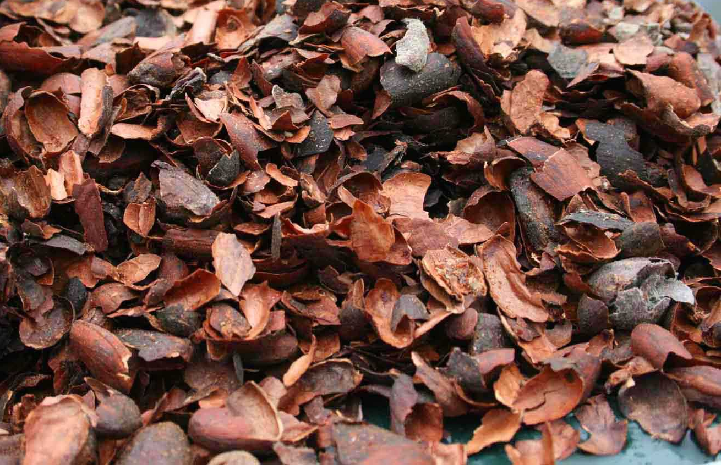
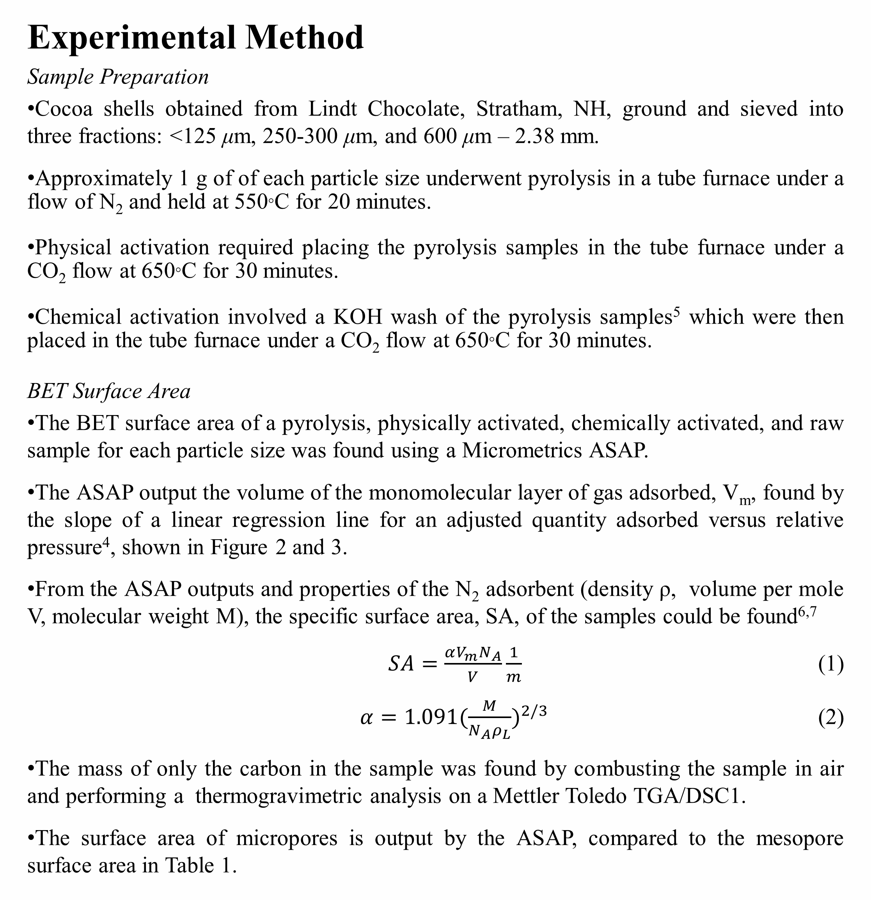
Adsorptive Properties of Activated Cocoa Shells for Use in Wastewater Treatment
Lauren Pappas, Jillian L. Goldfarb, Ph.D.
University of New Hampshire, Hamel Center, Department of Chemical Engineering, Durham, NH 03824
Background
The purpose of this research is to
explore cocoa shells as a source of
activated carbon and a resource for
wastewater treatment facilities.
Pharmaceuticals and personal care
products are often discarded into the
water streams due to improper disposal
and human waste, contaminating the
nearby ecosystems and drinking water supply¹.
Antibiotics enter the water streams, increasing the number of antibiotic resistant bacteria and possible allergic reactions.
Many antibiotics enter the water stream through the excretion of the average consumer. The River Taff in the UK was sampled in several places, before and after wastewater treatment plants, WWTP, and large towns². It was seen that the pharmaceutical pollutants increased significantly around the domestic regions, having concentrations ranging from a few ng/L to 1 μg//L.
Activated carbon is often used to adsorb pollutants in WWTPs. Though activated carbon is not expensive, regenerating it is and therefore cheaper sources of biomass are being looked at instead of commercial activated carbon³.
Cocoa shells have been obtained from the nearby Lindt chocolate manufacturing facility in Stratham, NH. By converting the left over cocoa shells into activated carbon, the waste from the Lindt facility would be reduced and the environment made cleaner if used as a source of sorbent material with wastewater.
Pyrolysis
Biomass is a carbonaceous fuel that will undergo a series of steps from pyrolysis to oxidation.
The compounds contained in biomass, cellulose, lignin, and hemicellulose, thermally decompose when heated in the absence of oxygen. Carbonization of the biomass (cocoa shells) occurs, converting the organic material into carbon and gases.
The carbon, also containing ash, is recovered to be used as the starting material in creating activated carbon.
The surface area after pyrolysis was looked at in this study, comparing it to the surface area of raw biomass and activated carbon. It was theorized that after pyrolysis the surface area would increase, but would be significantly less than when activated.
Activation
Activation increases the number of pores present in the material, thereby increasing the surface area of the material, by introducing it to oxygen.
There are two methods of activation, physical activation and chemical activation. Pyrolysis is the first step to both methods, removing all the organic materials.
Physical Activation
Carbon left over from pyrolysis is activated using carbon dioxide as the activating compound.
The carbon from the pyrolysis step is heated under of flow of carbon dioxide, requiring only one step.
Chemical Activation
Chemical activation produces a higher yield than physical activation, reducing the percentage of tar produced⁴ and increasing the percentage of carbon.
Potassium hydroxide is used to activate the carbon from the pyrolysis step.
An additional step including an HCl wash is required, increasing the number of steps and amount of chemicals used in chemical activation compared to physical activation.
Figure 4. Specific surface area for each particle size of cocoa shell for the raw samples and the samples that underwent pyrolysis. The specific surface area increases with decrease in particle size and increases for the samples that underwent pyrolysis compared to raw.
Figure 5. Specific surface area for each particle size of cocoa shells that were physically and chemically activated. The specific surface area increases with decrease in particle size and increases for the samples that underwent chemical activation compared to physical activation.
Table 1. Specific surface areas found for each particle size of raw, pyrolyzed, chemically activated, and physically activated cocoa shells. The mesopore surface area is shown in the left of the column and the micropore surface area is shown in the right of the column. The raw samples are only mesoporous.
Figure 1. Stages of biomass combustion
Cocoa Shell Size | Specific Surface Area (m²/g)
 | Raw | Pyrolysis |  | Physical Activation |  | Chemical Activation
<125 μm | 1.08 | 2.09 | 3.13 | 109.42 | 127.22 | 774.58 | 841.28
250-300 μm | 0.35 | 3.99 | 3.15 | 89.37 | 113.25 | 597.43 | 807.22
600 μm – 2.38 mm | 0.27 | 1.75 | 1.75 | 37.31 | 43.23 | 224.89 | 288.78
Discussion
It was theorized that as the cocoa shells became smaller there would be more surface area exposed per volume. It was also theorized that chemical activation would yield the highest surface area and physical activation would yield the second highest.
Table 1 shows the data collected from the Micrometrics ASAP, adjusted for only the carbon content in the sample since ash was present as well. The microporous surface areas are shown to the right of the mesoporous surface areas. It can be seen based on Table 1 and Figures 3 and 4 that the specific surface area (surface area of only the carbon) increased when the particle size decreased. This holds with the theorized outcome*.
Because of the relationship between surface area and volume, the volume increases much faster than the surface area. For this reason larger particles have a greater volume but their surface area is less because less of the mass is exposed on the surface. This is seen by the smaller cocoa shell particles having a higher specific surface area.
The second relationship seen in Table 1 and Figures 3 and 4 is between the methods performed. Pyrolysis yields a greater surface area because organic material is being removed, increasing the percentage of carbon in the sample. Physical activation yields a greater surface area than pyrolysis because the number of pores, and therefore the surface area of the particles, increases during activation. Chemical activation uses KOH, which creates a larger number of pores in the sample, as well as less tar (higher percent carbon), than physical activation and therefore has the highest specific surface area.
In conclusion, smaller particle sizes and chemical activation yields the largest specific surface area. This combination would adsorb the greatest amount of pollutants from the water. Because of the chemicals involved in chemical activation and the possible higher cost, physical activation may be desired as the chosen process as it yields a relatively high specific surface area.
*The 250 – 300 μm sample that underwent pyrolysis does not follow either trend. The raw, physical activation, and chemical activation 250 – 300 μm samples do follow both trends, indicating that there was an error in the preparation of this sample. Further analysis will be performed to confirm.
Experimental Method
Sample Preparation
Cocoa shells obtained from Lindt Chocolate, Stratham, NH, ground and sieved into three fractions: <125 μm, 250-300 μm, and 600 μm – 2.38 mm.
Approximately 1 g of of each particle size underwent pyrolysis in a tube furnace under a flow of N₂ and held at 550°C for 20 minutes.
Physical activation required placing the pyrolysis samples in the tube furnace under a CO₂ flow at 650°C for 30 minutes.
Chemical activation involved a KOH wash of the pyrolysis samples⁵ which were then placed in the tube furnace under a CO₂ flow at 650°C for 30 minutes.
BET Surface Area
The BET surface area of a pyrolysis, physically activated, chemically activated, and raw sample for each particle size was found using a Micrometrics ASAP.
The ASAP output the volume of the monomolecular layer of gas adsorbed, V_{m}, found by the slope of a linear regression line for an adjusted quantity adsorbed versus relative pressure⁴, shown in Figure 2 and 3.
From the ASAP outputs and properties of the N₂ adsorbent (density ρ, volume per mole V, molecular weight M), the specific surface area, SA, of the samples could be found^{6,7}
$SA=\frac{αV_{m}N_{A}}{V}\frac{1}{m}$ (1)
$α=1.091{(\frac{M}{N_{A}ρ_{L}})}^{2/3}$ (2)
The mass of only the carbon in the sample was found by combusting the sample in air and performing a thermogravimetric analysis on a Mettler Toledo TGA/DSC1.
The surface area of micropores is output by the ASAP, compared to the mesopore surface area in Table 1.
Figure 2. BET isotherm data output from the Micrometrics ASAP. Quantity of nitrogen gas adsorbed to the sample versus relative pressure for the raw and pyrolysis <125 μm samples.
Figure 3. BET isotherm data output from the Micrometrics ASAP. Quantity of nitrogen gas adsorbed to the sample versus relative pressure for the chemical activation and physical activation <125 μm samples.
References
Theivarasu, C. Mylsamy, S., Sivakumar, N. “Cocoa Shell as Adsorbent for the Removal of Methylene Blue from Aqueous Solution: Kinetic and Equilibrium Study.” University Journal of Environmental Research and Technology. 1 70-78. 2011.
Kasprzyk-Hordern, B., Dinsdale, R.M., Guwy, A.J. “Multi-residue method for the determination of basic/neutral pharmaceuticals and illicit drugs in surface water by solid-phase extraction and ultra performance liquid chromatrography-positive electrospray ionisation tandem mass spectrometry.” Journal of Chromatography A. 1161, 1-2. 17 Aug 2007. 132-145.
Theivarasu, C. Mylsamy, S., Sivakumar, N. “Cocoa Shell as Adsorbent for the removal of Methylene Blue from Aqueous Solution: Kinetic and Equilibrium Strudy.” Universal Journal of Environmental Research and Technology. 1. 2011. 70-78.
Ahmadpour, A. Do, D. D. “The preparation of active carbons from coal by chemical and physical activation.” Elsevier Science Ltd. 34, 4. 1996. 471-479.
Tseng, R., Tseng, S. “Characterizatoin and use of hight surface area activated carbons prepared from cane pith for liquid-phase adsorption.” Journal of Hazardous Materials. B136. 2006. 671-680.
Webb, P. Orr, C. “Analytical Methods in Fine Particle Technology.” Micrometrics Instrument Corporation. 1997.
Lowell, S. Shields, J. “Powder Surface Area and Porosity.” Chapman and Hall. 1984.
Acknowledgments
The author thanks Lindt Chocolates for providing the cocoa shells , the National Science Foundation (Grant No. NSF CBET-1127774 ), the UNH Hamel Center for Undergraduate Research, and Dana Hamel for funding the research.
Notes:
Second point under background – “dumped” is a bit colloquial for science, and also not really encapsulating the point. They end up in water supply because of human waste as well as disposal (your body does not adsorb all pharmaceuticals, and ends up in your, well, you know what.) Maybe just take out this point?
3 references is a little slim for all of this work. Esp the water idea (since we’re not “water” people – I would bulk up cites there a bit!
You have the full isotherm, but what about doing one for the zoomed in linear section for BET measurements? Maybe could put a series (raw/py/act) on a graph?

