Slide 1
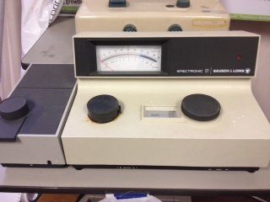
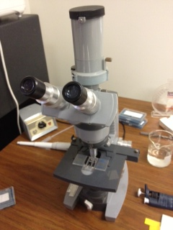
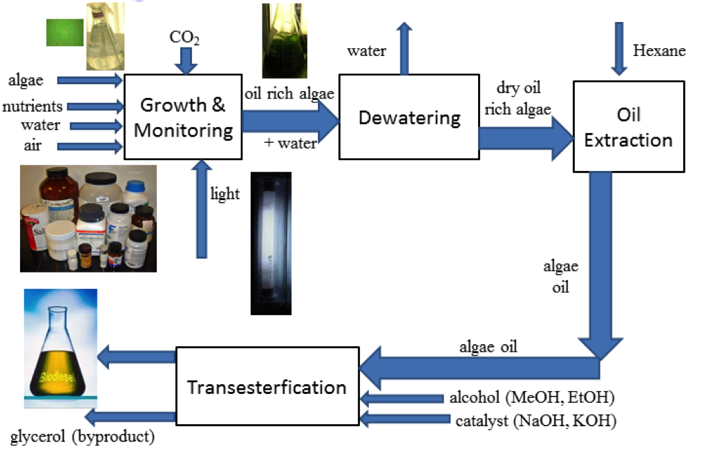
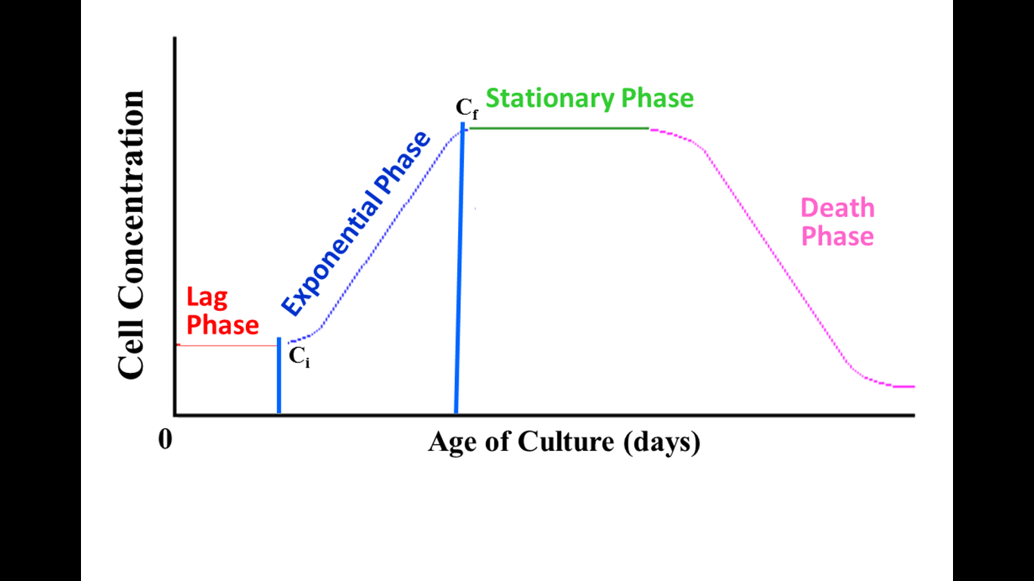

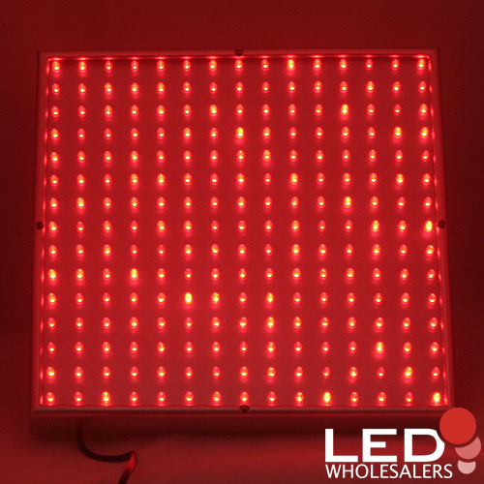
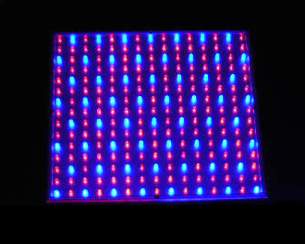
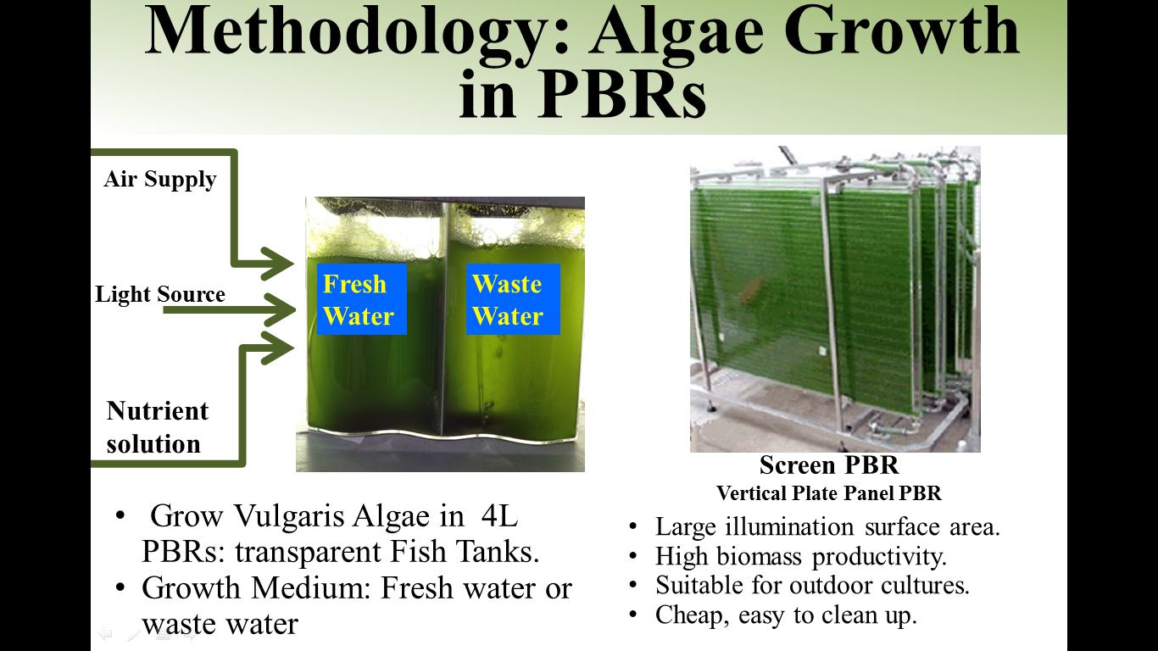
Energy and Water Resource Efficient Production of Microalgae Lipids
Kelsey Price, Chemical Engineering Dept., University of New Hampshire, Durham, NH 03824
Background
Process
Results
Algae require nutrients, light, CO₂ & a water medium to grow in a photobioreactor (PBR) and produce lipids
Lipids are hexane solvent-extracted from algae
Lipids (algae oil) are feedstock to renewable biodiesel
Monitor algae growth with spectrophotometer turbidity readings and microscope cell counts
Scale Up: Effect of Water Source on Chlorella C2 Productivity and Lipid/oil Concentration in 80L PBR, 8000 LUX Fluorescent Light
Algae Growth Stages:
Measured Turbidity:
Algae Pros & Cons
Results
Waste water produces more algae, and comparable lipids
Advantages | Disadvantages
No food vs. fuel concerns Reduce land requirements Consume CO₂ while growing | Fresh water consumption Energy Intensive Unfavorable economics
Effect of light and water source on lipid production
(Chlorella C2 Algae Lipid Production, mg lipids/L Solution-day)
Conclusions
LEDs produce more lipids than fluorescent lighting, while saving energy
A greater light intensity increases lipid production
Waste water is a viable option for growing algae and conserving fresh water
Goal/Objectives
Goal: Determine energy and fresh water efficient conditions to grow algae rich in lipids/oil
Objectives: To study:
Replacement of Fluorescent light with LEDs
Oil production in waste water vs. fresh water
Light intensity effect on lipid/oil production
Future Investigations
LEDs influence the production of more lipids, and waste water lipid results are comparable if not better
In-situ production of Biodiesel (integrated lipid extraction and transesterification)
Reduced and effective nutrient solution specific to algae growth in waste water
Replace hazardous hexane lipid extraction solvent
  Less hazardous alternative
  Inexpensive alternative
Methodology/Techniques
Effect of light intensity on lipid production
(Chlorella C2 Algae Lipid Production, mg lipids/L Solution-day)
Fluorescent
Red LEDs
Acknowledgments
PBR
PBR
Hamel Center for Undergraduate Research
Dr. Ihab Farag (Mentor)
Marian Elmoraghy
Dr. Nancy Whitehouse
Daniel Eltringham
Kristen Blackwell
John Newell
Dover Wastewater Treatment Facility
Grow algae in PBR using Fluorescent light and Red and Red-Blue LEDs (48% less energy)
Measure light intensity in LUX
Monitor algae growth
Harvest/dry algae, get algae production rate
Extract oil and determine algae oil content
8000 LUX
5500 LUX
m
2000 LUX
2000 LUX
A higher light intensity influences a greater lipid production.

