Slide 1
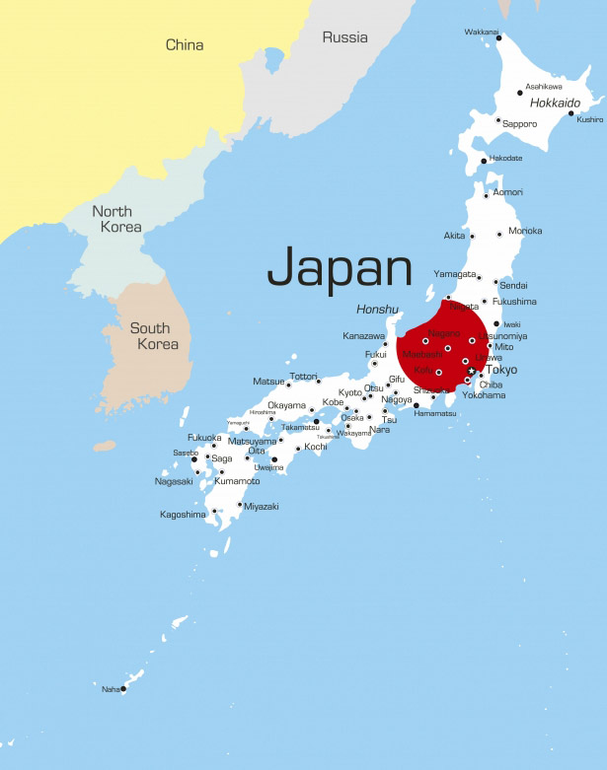
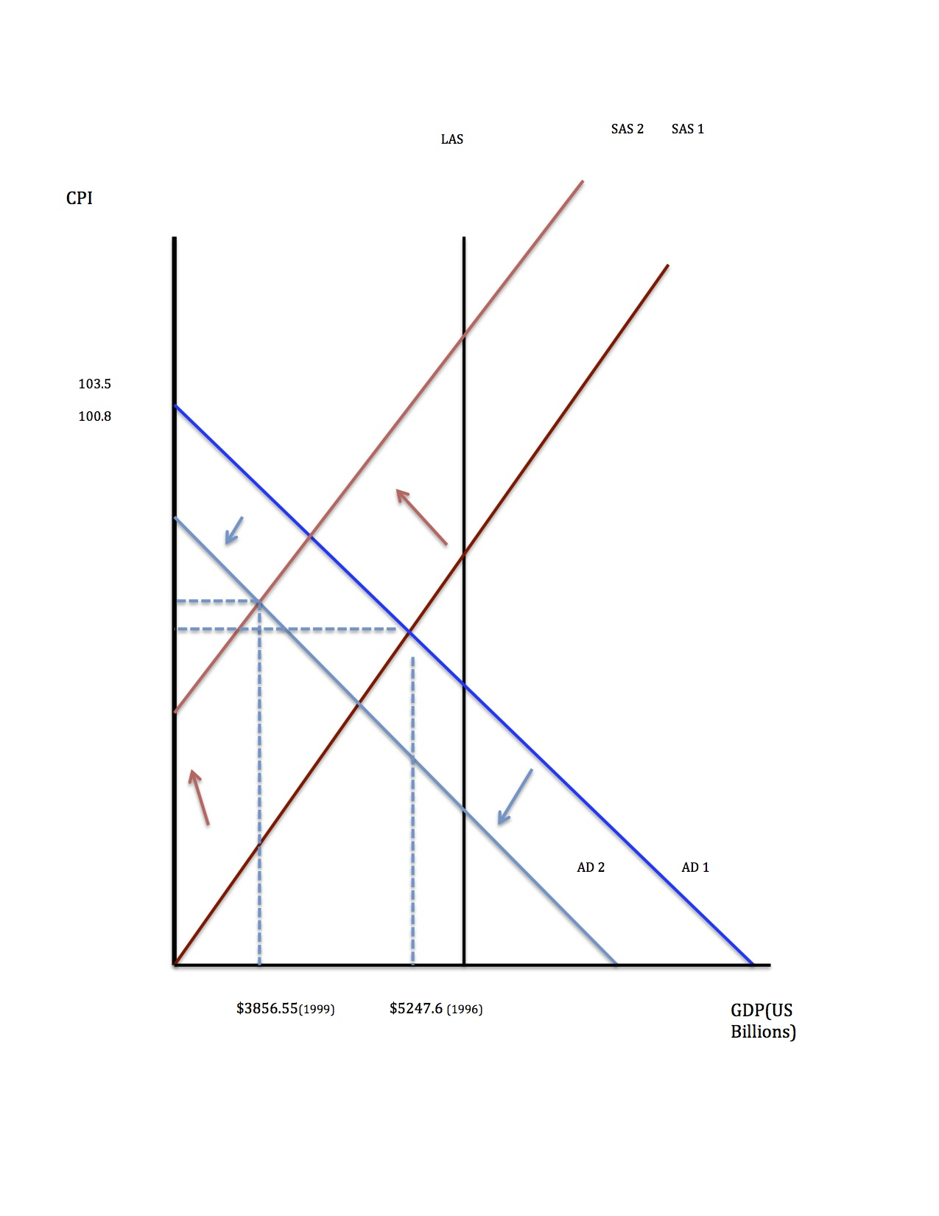
Economic Survey Of Japan
By Daniel Coste
Japan
Population of 128,057,352
Third Largest economy in the world
GDP per capita of $34,739
Developed country
Economy driven by manufacturing and exports after WWII
Economic Developments After WWII
WWII devastated Japan’s infrastructure and economy
The US lends Japan 2 billion dollars to rebuild the nation
Japan invests the loan into industry and education
Better manufacturing technology and exceptional education creates a powerful manufacturing and exporting sector
Industries such as auto manufacturing and commercial fishing experience great success
Japan sees high growth from 1950 to 1980 because of their favorable balance of trade
1986: Inflation
Booming export sector and high trade surplus through the 1950’s and 1980’s would cause the yen to appreciate in the mid 80’s
Appreciation led to less aggregate demand for Japanese exports
Government tries to devalue yen by cutting interest rates to increase money supply
Policy does increase aggregate demand but results in inflation
Bubble created in the stock and real estate markets
The 1990’s: Japan’s Decline
In response to hyper inflation the government tightens it’s monetary policy
Increased interest rates pop the bubble in the stock and real estate markets
Companies, individuals and banks lose an enormous amount of their assets that were in the bubble
Demand shrinks and economy slows
Japan hits a recession
Unemployment rises from 2.0% to 4.7%
1990 Recession AS/AD Model
Japan’s Current Recession
Japan is currently in its 3rd recession in 5 years
Japanese manufacturing and exports have been struggling because of the appreciating of the yen
A substantial amount of investment was lost after 1990’s
Global financial crisis has reduced demand for Japanese exports
China and South Korea have caught up to Japanese manufacturing
Government hopes to once again expand economy by using monetary policy and stimulus packages
2012 AS/AD Model
Aging Population
Japan’s aging demographic could cause further economic problems in the future
Low birth rate and low fatality rate
Population over 60 years old is growing while the population of young adults and children shrinks
Workforce will continue to shrink which will hurt Japan’s production
More and more resources will be needed to support elderly , most importantly a strong workforce
Japanese government refuses to grow it’s workforce through immigration

