Slide 1
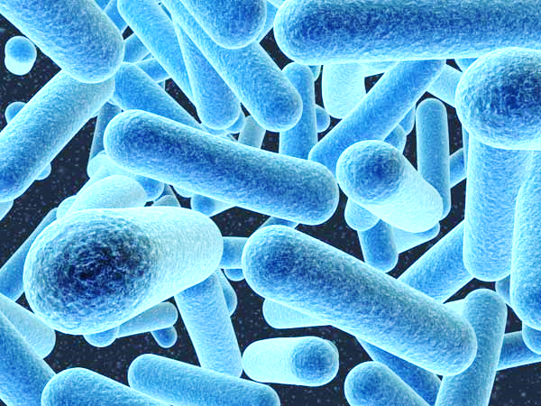

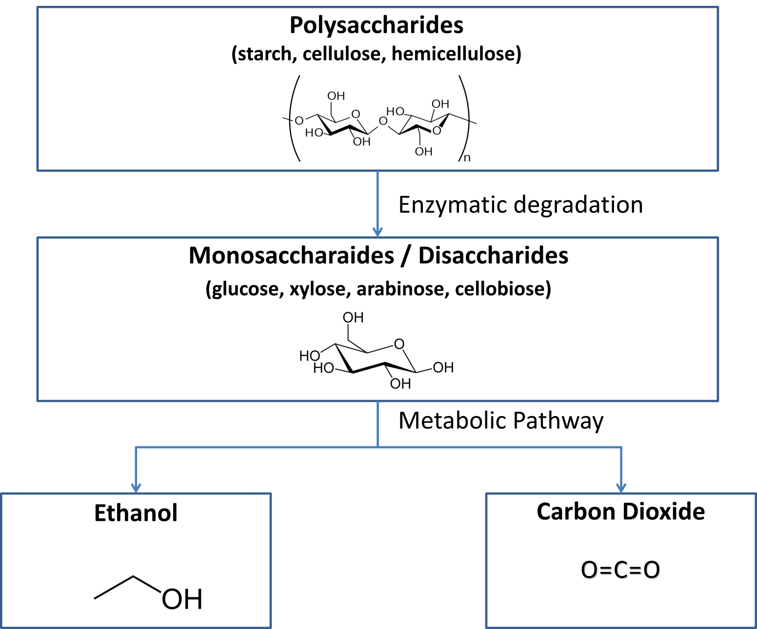
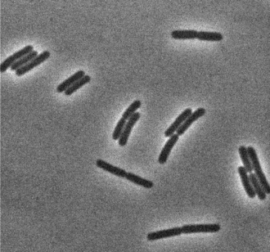
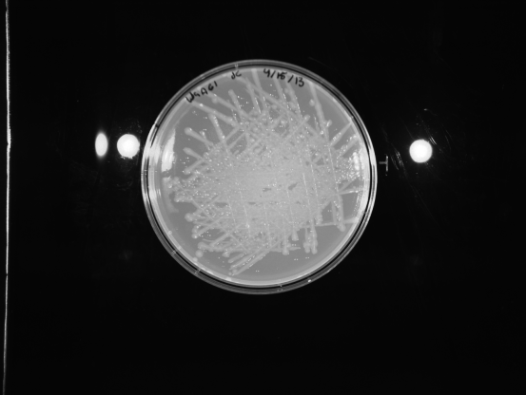
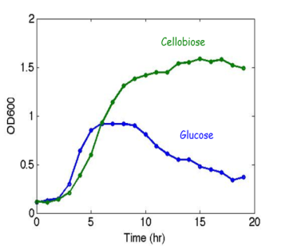
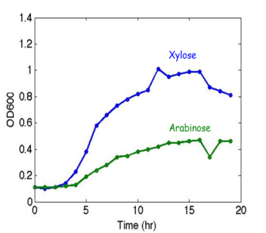
Screening of Geobacillus Strains for Sugar Metabolism Justin Cullity
Adviser: Dr. Kang Wu
Chemical Engineering
University of New Hampshire
Durham, NH
Introduction
Geobacillus are a genus of rod-shaped Gram-positive thermophilic bacteria, many of which have been shown to have unique features for industrial applications or bioremediation. The aim of this project is to screen the collection of 170 Geobacillus strains in our lab for their ability to grow on different sugars, including hexose and pentose sugars, cellobiose, and polysaccharides, such as cellulose, hemicellulose, and starch. Combined with genomics analysis, these results will reveal novel pathways or genes responsible for sugar metabolism. These pathways or genes will be engineered to enhance the efficiency of sugar utilization and reduce the cost.
Test for Amylase
Currently, tests for amylase are being performed on the Geobacillus strains. Various strains were cultured and stabbed onto Tryptose Blood Agar Base (TBAB) + 2% starch plates. The plates were then incubated for 15 hours at 60⁰C. An iodine solution was used to test for the presences of starch on the cultured plates. The iodine test will result in a dark blue color, in the presence of starch, and a lack of color change in the absence of starch.
Positive Results: The iodine test yielded results indicating that there was an absence of starch surrounded the tested strain. This was illustrated by the lighter region surrounding the cultured strain. This indicated that the strain of Geobacillus had utilized amylase to process starch for growth. Amylase can be isolated from strains that yield positive results for starch consumption. The isolated enzyme can then be amplified through a PCR process. (W9A51 and W9A50)
Negative Results: The iodine test yielding results indicated that there was no utilization of starch in the growth of the Geobacillus. This is illustrated by a dark blue color encompassing the strain.
Enzyme Use In Industry
Enzymes allow industrial processes to utilize biofuels.
Amylase: degrades starch to glucose (C⁶)
Cellulase: degrades cellulose to glucose (C⁶)
Hemicellulase: degrades hemicellulose to C⁵, C⁶, and C¹² sugars
  Food Industry: Production of bread, high fructose containing syrup, ethanol, maltose, fruit juices.
Figure 1: Production of ethanol from polysaccharides (chemical structures indicate production from cellulose)
Left Hand Picture: Geobacillus thermoglucosidasius 95A1
Right Hand Picture: TBAB Plate streaking of W9A61
Future Work
Assays testing for the utilization of cellulose and hemicellulose will be performed.
Continued testing of the ability of Geobacillus to utilize simple sugars such as glucose, xylose, arabinose, and cellobiose.
Co-cultures of different sugars will be used to observe the consumption pattern, and rates of the various Geobacillus strains.
Consumption of Simple Sugars
Geobacillus are known to contain enzymes that have the capabilities to degrade simple sugars. By measuring the Optical Density (OD) at wavelength of 600nm a growth curve of Geobacillus (95A1) was generated for various sugars.
Metabolism of Sugars
Polysaccharides: enzymes such as amylase, cellulase, and hemicellulase, degrade the long chain structure of the polysaccharide into monomers, which can be metabolized by the bacteria. Different enzymatic assays will be developed to test the presence and activity of these enzymes.
Disaccharides and Monosaccharaides: a series of enzymes collaborate to metabolize simple sugars, including cellobiose, glucose, xylose, and arabinose. These pathways provide energy for cell growth as well as synthesizing byproducts (ethanol, CO₂) which can be utilized in industry. Utilization of these soluble sugars can be tested in liquid culture by measuring the optical density (OD) of the Geobacillus strain with the tested sugar as the sole carbon source.
References
http://www.academicjournals.org/ajb/pdf/Pdf2005/Spe%20Rev/Aiyer.pdf
http://lib.convdocs.org/pars_docs/refs/132/131624/131624_html_m3e204d5d.png
http://0.tqn.com/d/chemistry/1/0/y/w/Glucose-2D-skeletal.jpg
http://0.tqn.com/d/chemistry/1/0/J/G/1/ethanol.jpg
http://blogs.discovermagazine.com/discoblog/files/2008/04/bacteria.jpg
Growth was tested on Arabinose (pentose), Xylose (pentose), Glucose (hexose), and Cellobiose (12 Carbon Sugar).

