Slide 1

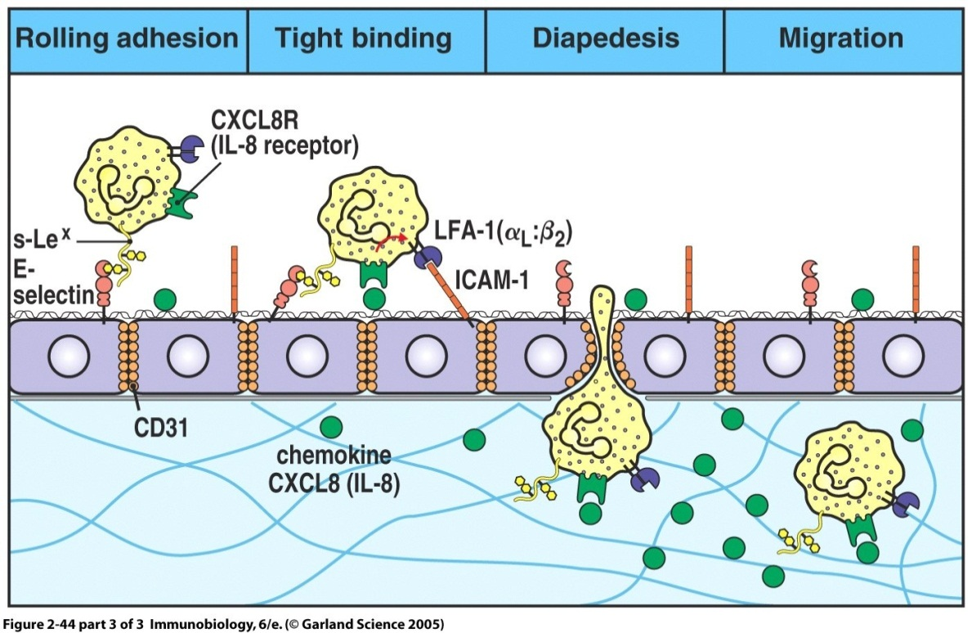
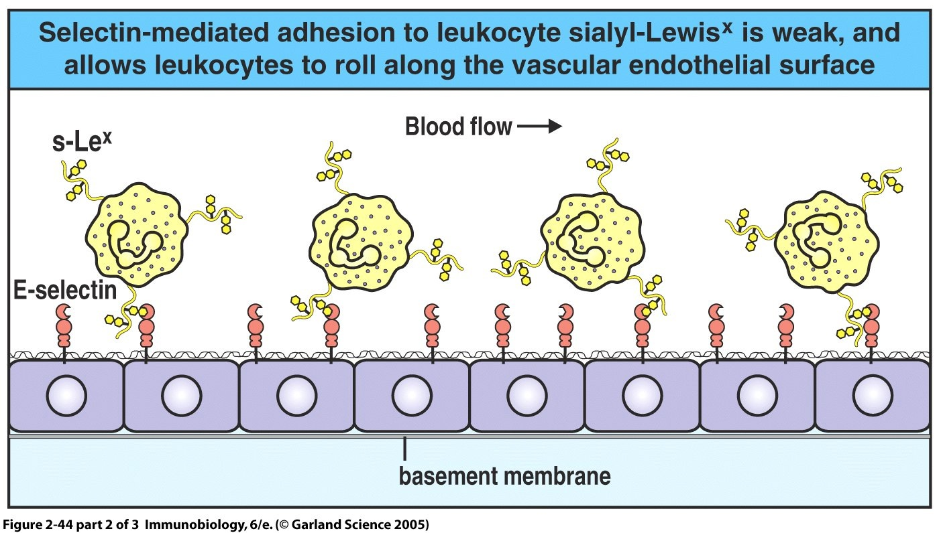
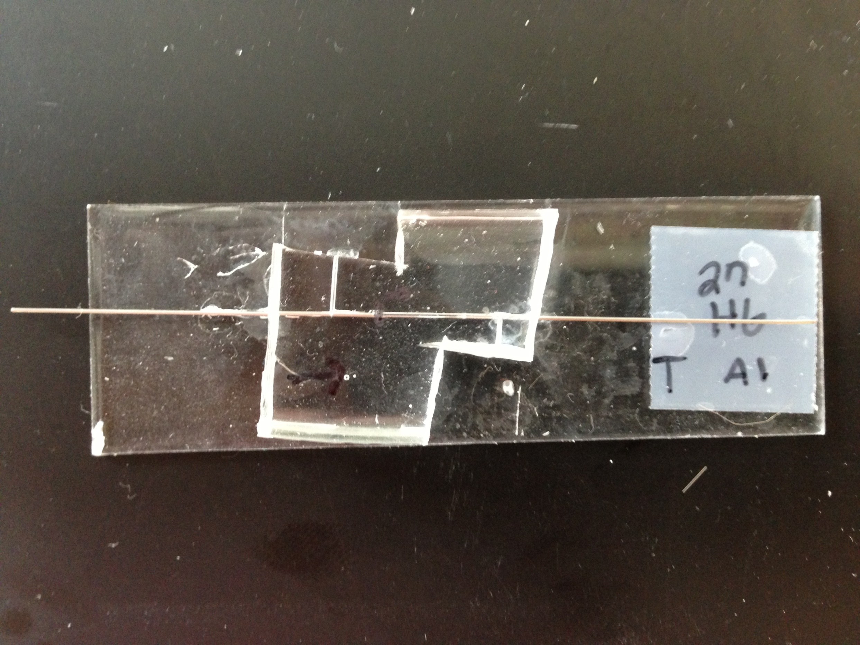
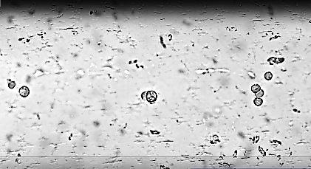
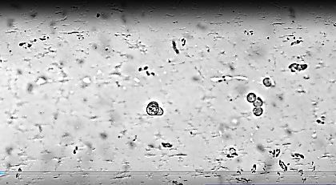
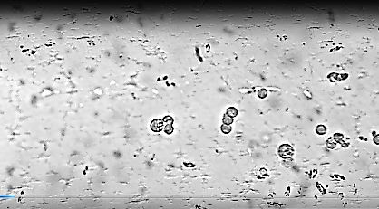
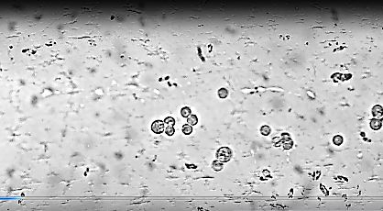
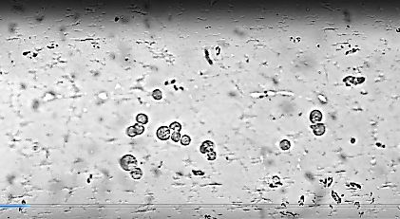
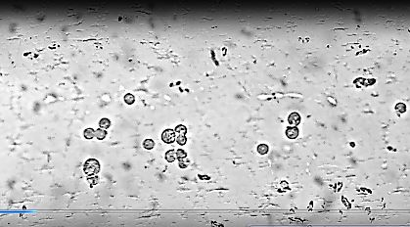
Adhesion of Rolling Cancer Cells to E-Selectin Along the Interior of a Microchannel
Brittany Artale, Michael Balch, and Alexandra Eicher
Department of Chemical Engineering
University of New Hampshire
Motivation & Goals
Introduction
Results & Discussion
Motivation:
Metastasis is of great concern when treating cancer patients
Localized radiation or surgical treatments will not destroy migrated or metastatic cancer cells
It may be possible to develop a microfluidic system that can selectively remove metastatic cancer cells from a blood steam, using a selective adhesion molecule E-selectin, to prevent further tumor establishment
Goals:
To successfully culture a strain of cancer cells
To fabricate a microfluidic system to study the flow of cancer cells
To coat a section of some of the microfluidic devices with E-selectin
To flow cancer cells through these treated channels
To observe the cancer cells’ adhesion properties to E-selectin
Cancer Cells:
Abnormal cells that no longer express the basic characteristics of healthy cells
Propagated from multiple mammalian cell mutations
A major property of cancer cells is their ability to metastasize
Metastasis is the ability of a cell to spread to other locations in the body
Metastasis is accomplished by circulating cancer cell adhesion to the wall of a blood vessel, its penetration through this wall, and its formation into a tumor in the surrounding tissue (See Figure 1)
E-selectin:
Prominent cell adhesion molecule found on the surface of endothelial cells
Carbohydrates on the surface of cells can easily adhere to E-selectin (See Figure 2)
Carbohydrates are increased on the surface of cancer cells
Cancer cells seem more suited than healthy cells to adhere to endothelial cells at metastatic sites
Based on the various methods to construct the microfluidic devices ,the use of household glue to create a straight-channel mold provided the cleanest cast. These are the optimum techniques that should be used when creating new casts.
Plasma cleaning was successful in adhering the cast to the PDMS coated and glass slides. The microfluidic devices were successfully fabricated to study the adhesion properties of E-selectin to cancer cells in solution. One of the microfluidic devices is shown in Figure 3.
The channels that were treated showed evidence of cell adhesion, while the control channels did not. Figure 4 shows one observation of a cell rolling and adhering to the surface in the treated channel. Figure 5 shows other cells that are still flowing through the device, providing evidence of adhesion. This adhesion to the channel walls was not observed in the untreated channel.
Methods
Figure 1: Depiction of Metastasis¹
Figure 2: Depiction of Cellular Adhesion to E-selectin¹
Conclusion
Cell Culturing:
Cell lines cultured:
  LS174T - human colon carcinoma
  MCF7 - human breast carcinoma
Cultured using standard cell culturing techniques:
  CO₂ independent medium (1X)
  10% Fetal Bovine Serum
  2 mM L-Glutamine
Device Mold Preparation:
Adhered 27 gauge needles to glass slides:
  Elmer’s glue
  House glue
Channel Preparation:
10:1 ratio of PolyDimethylsiloxane (PDMS) to curing agent
Adhered casts to slides:
  PDMS coated
  Glass
Control Channel Treatment:
Flowed milk solution through the entire channel system to prevent cells adhering to PDMS channel walls
Washed channels with PBS
Channel Treatment:
Inserted a slug of 1.11 µg/mL Protein G in PBS into each channel
Washed Channels with PBS
Inserted a slug of 2 µg/mL E-selectin in PBS over the treated area
Second wash with PBS
Flowed milk solution through the entire channel system, and let sit for 30 minutes
Washed channels with 0.1 M Ca+ Mg+ in PBS to activate E-selectin
Flow Tests:
Set flow rate between 5 µL/min and 10 µL/min of a PBS solution with a cell concentration of 10⁴ cells/mL to flow through the treated and control devices
Observed channels with an inverted microscope and camera for half an hour
Successfully fabricated channels
Determined optimum techniques for channel fabrication
  Glue type – household glue
  Geometry – straight-channel
Observed cellular adherence to the walls of treated channels
Future Work
Data
Quantify the differences between treated and untreated channels by recording the number of cells that became adhered to the respective microchannel walls
Determine bond strength of E-selectin by increasing the flow rate of the PBS solution until adhered cells and flushed away
Use the required flow rate to flush away adhered cells to calculate the shear stress and in turn force
Fabricate new molds and channel systems using the optimum techniques
Explore shelf life of E-selectin treatment
Figure 3: Photograph of one of our microfluidic devices. This one was made using house glue and a PDMS coated glass slide.
A
B
C
References
http://www.bio.davidson.edu/courses/immunology/students/spring2006/latting/home%20copy.html
Flow Direction
Flow Direction
Flow Direction
A: No flow.
B: Start of flow.
C: Clump of cells stop moving.
Figure 4: Depiction of a clump of cancer cells sticking to the wall of a treated microfluidic device.
Acknowledgments
A
B
C
D
We would like to thank Professor Adam St. Jean for mentoring us through this project, Professor Russell Carr for showing us the techniques needed to created the microfluidic devices, and Professor Nivedita Gupta for allowing us to use her laboratory resources.
Flow Direction
Flow Direction
Flow Direction
Flow Direction
Figure 5: Depiction of a clump of cancer cells stuck to the wall of a treated microfluidic device.

